Slide 1
Loan Approval Prediction using Fairness-Aware Machine Learning
-by P.Kanishka
2403A51231

Slide 2
Problem Statement:
Banks need to decide whether to approve or reject loan applications. Traditional decision-making can be biased or inefficient.
This project aims to:
Predict loan approval using ML models.
Ensure fair and unbiased decisions across different groups (like gender)

Slide 3
Explanation of the Project:
This project builds a machine learning system to predict loan approval based on applicant details.
Steps involved:
Data collection from loan dataset
Data preprocessing (handling missing values, encoding)
Training multiple ML models
Evaluating accuracy and fairness
The goal is to balance:
High accuracy
Low bias (fairness-aware system)

Slide 4
Description of Models Used
1. Logistic Regression
Simple and interpretable
Used as a baseline model
2. Decision Tree
Tree-based model
Easy to understand but may overfit
3. Random Forest
Ensemble of multiple trees
High accuracy and robustness
4. Support Vector Machine (SVM)
Finds optimal boundary between classes
Works well for complex data

Slide 5
Accuracy / Performance Metrics
SVM achieved the highest accuracy (~79.67%), making it the best-performing model.
Logistic Regression (~78.86%) also performed well and is more interpretable.
Random Forest (~78.05%) gave strong performance but slightly lower than SVM.
Decision Tree (~71.54%) had the lowest accuracy due to overfitting.

Slide 6
Model | Accuracy
Logistic Regression | 78.86%
Decision Tree | 71.54%
Random Forest | 78.05%
SVM | 79.67% ✅

Slide 7
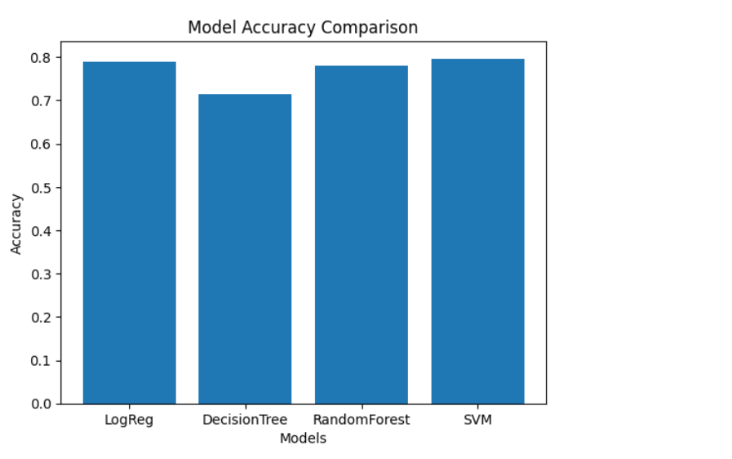
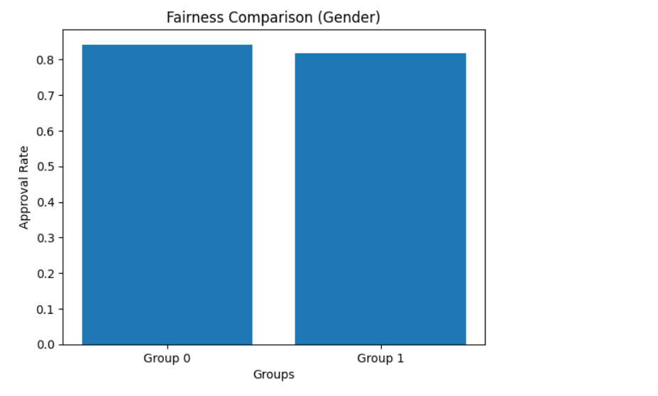

Slide 8
Conclusion
The SVM model performed best with the highest accuracy.
Logistic Regression provided good results with better interpretability.
Decision Tree showed lower performance due to overfitting.
Overall, combining accuracy + fairness, the system provides reliable predictions.

Slide 9
THANK YOU

