Slide 1
AI HACKATHON FOR BUILDERS 2026 · PROBLEM STATEMENT #5
QueryDoctor
Paste a slow SQL query. Get a faster one.
Kanishk Aman
Team LoneWolf · solo build

Slide 2
01 · THE PROBLEM
Slow queries are everywhere.
Nobody reads EXPLAIN plans.
$$$
⟳
¬
Wasted spend
Latent failure
Expertise gap
A single un-indexed query at production scale costs hundreds in cloud DB CPU every month.
Queries that pass review at 1k rows fall over at 1M. Most teams find out from a Slack alert.
DBAs are scarce. Junior engineers ship NOT IN anti-patterns and correlated subqueries by default.

Slide 3
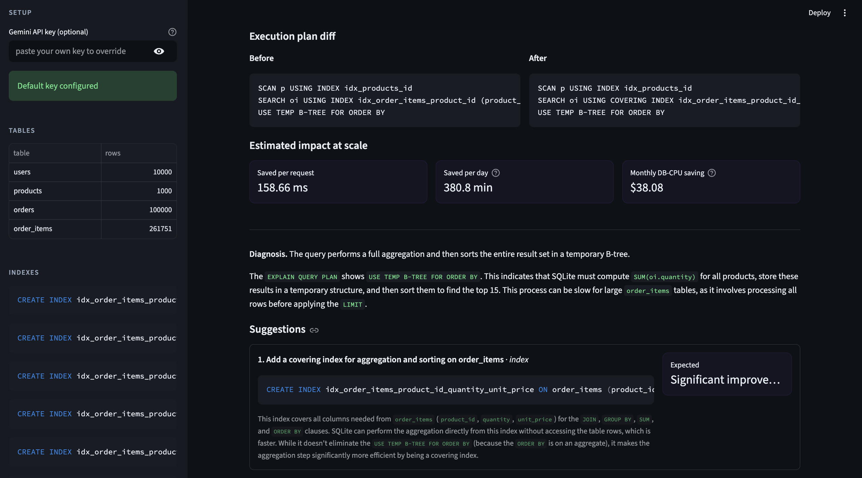
02 · THE SOLUTION
Benchmark. Diagnose. Apply. Re-benchmark.
Every recommendation is verified against the real database.
No vibes, no hand-waving — just measured milliseconds.
DEMO RUN
Best-selling products
aggregate over 260k rows
Baseline
179.92 ms
After fix
21.26 ms
8.5× faster
with one click

Slide 4
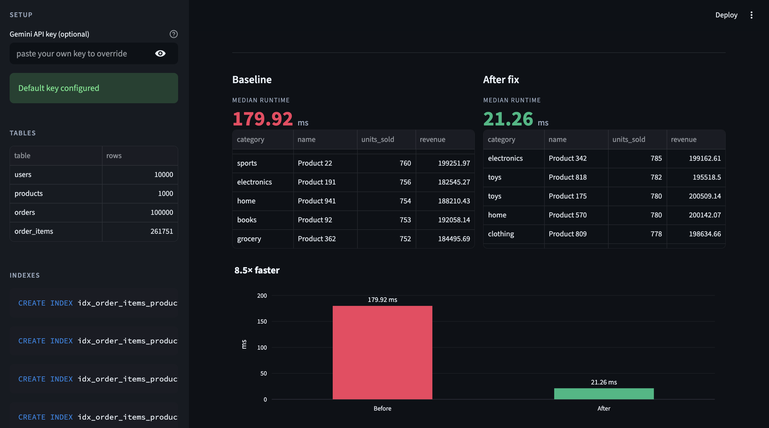
03 · HOW IT WORKS
Grounded suggestions, not generic SQL tips.
Query +
schema
EXPLAIN
plan
Gemini
2.5 Flash
Diagnosis +
fix SQL
Apply &
re-benchmark
Why this is different
Schema-aware
Gemini sees actual tables, existing indexes, and row counts — recommendations fit your database, not a textbook.
Plan-grounded
Suggestions are checked against the EXPLAIN plan: a fix is only proposed if it converts SCAN → SEARCH.
Anti-pattern aware
Catches NOT IN, correlated subqueries, and missing covering indexes. Rewrites SQL, not just adds indexes.
Verified, not guessed
Every fix is applied and re-run on the live database. The speedup number is measured, not promised.

Slide 5
04 · IMPACT & STACK
One click. Real dollars.
158.66 ms
380 min
$38.08
saved per request
DB-CPU saved / day
monthly cost saving
Modeled at 100 req/min on a single query. Multiply across a real codebase.
BUILT WITH
Python · Streamlit · SQLite · Plotly · Google Gemini 2.5 Flash
WHAT'S NEXT
Postgres + EXPLAIN ANALYZE · Pre-commit SQL lint · Fix history across the codebase
Kanishk Aman · Team LoneWolf
QueryDoctor

