Slide 1
HEIGHT & WEIGHT
PREDICTION
OF A
PERSON
EFFORTS BY:
KANISHKA MITTAL

Slide 2
PROBLEM STATEMENT
Height and weight are the most important parameters when it comes to monitoring phase of any person’s growth whether he/she is an infant or child or a teen or an adult or an old person.
Today with advancements in tech field everything is getting digitalized so does the evaluations because it is not possible to hold big data manually and it’s too difficult to analyze such data all at once.
Therefore this project is to predict the height and weight of a person on the basis of gender (predicted values are not 100% accurate as actual values but give a round about value).

Slide 3
ALGORITHM APPLIED
LINEAR REGRESSION
Linear means linear relationship between two or more variables,
In a two dimensional space or two variables bears a straight line that best fits the data points ie. y= mx + c
(where x and y are independent and dependent variable and m is slope and c is intercept)
- Gives the most optimal value for intercept & slope
- y & x variables remain the same, since they are data features & can’t be changed.
- Values controllable are the intercept and slope
- Multiple straight lines depending upon the values of intercept and slope are also possible(in that case,it fits multiple lines on the data points and returns the line that results in the least error.

Slide 4
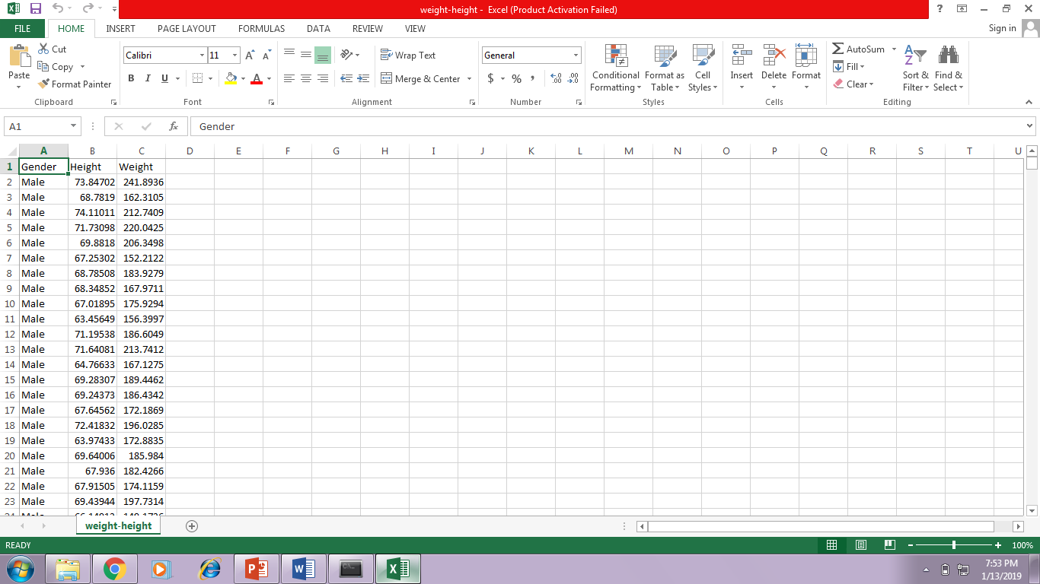
The following data set was provided having height weight and gender details

Slide 5
Data preparation
As per the algorithm,
Height & Weight are taken as dependent variables (labels)
Gender as independent variables(attributes)
(Assumption: value 0 for male & 1 for female)

Slide 6
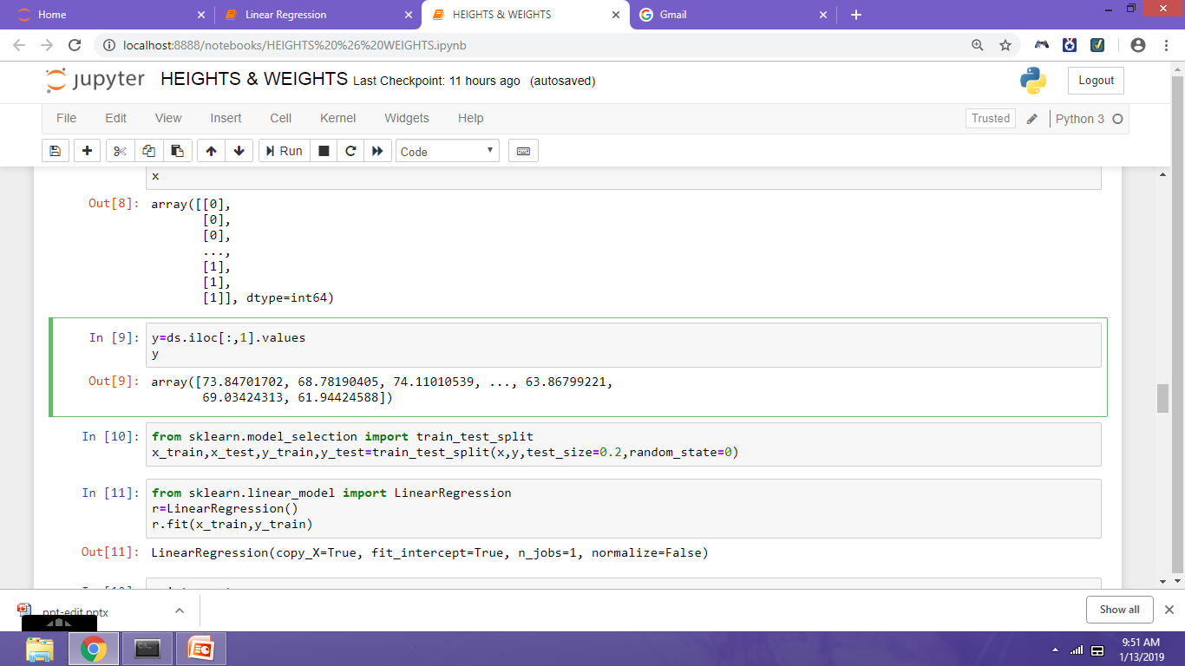
Now that we have our attributes and labels, the next step is to split this data into training and test sets. We'll do this by using Scikit-Learn's built-in train_test_split() method
The above script splits 80% of the data to training set while 20% of the data to test set. The test_size variable is where we actually specify the proportion of test set.

Slide 7
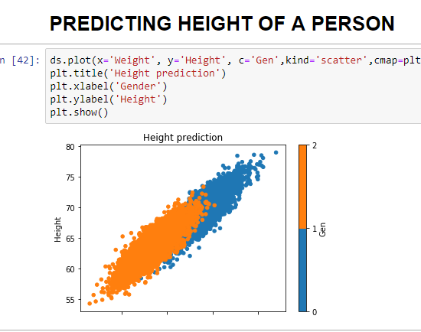
On plotting the graph we obtained the following,

Slide 8
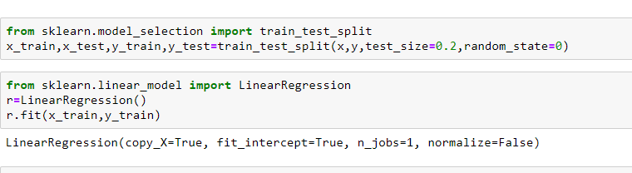
Data Training
Scikit-Learn is used to implement linear regression
models, done as follows:
import the LinearRegression class,
instantiate it,
call the fit() method along with our training data.

Slide 9
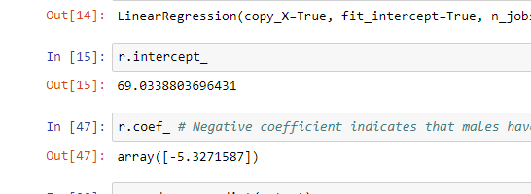
The coefficient comes out to be a negative value that clearly indicates that males have more height as compared to females.

Slide 10
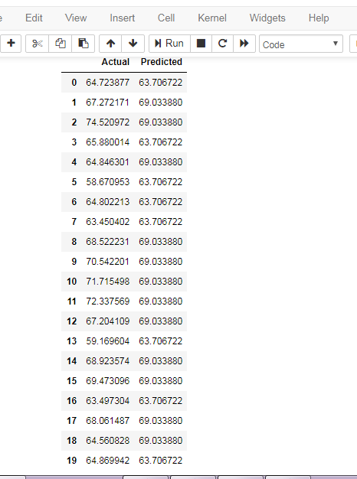
Predicted values are obtained by making predictions using test data which are not exact actual values but are near about that is useful in further analysis.

Slide 11
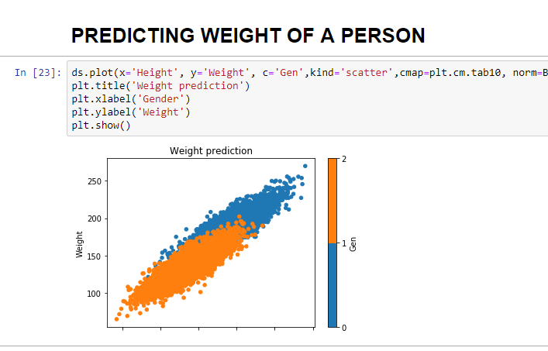
Similarly weight measure is taken ,

Slide 12
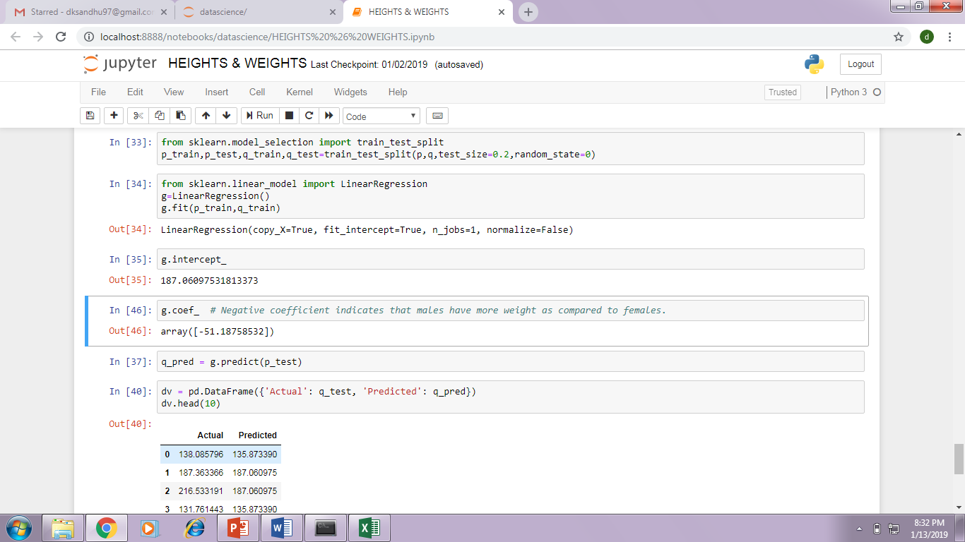
Negative coefficient indicates that males have more weight as compared to females.

Slide 13
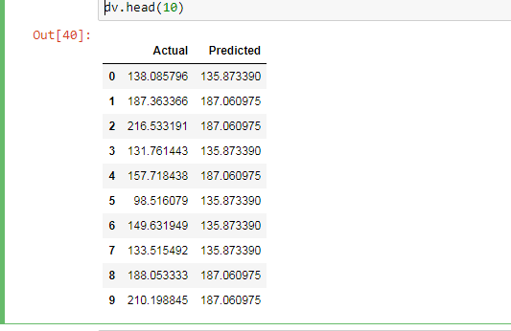
Following predicted data is obtained from the given data set,

Slide 14
Inference
Males have more height as compared to females.
Mean absolute error
2.20496081
Mean squared error
7.80553950
Root mean squared error
2.79383956
Males have more weight as compared to females.
Mean absolute error
15.54248527
Mean squared error
381.9850034
Root mean squared error
19.54443663

Slide 15
Thank you

