Slide 1
Thyroid Cancer Classification Using Ensemble Machine Learning
A Real GEO Gene Expression Data Analysis Kanishka P M | MSc Bioinformatics

Slide 2
Project Overview
• Automated pipeline for thyroid cancer classification using real patient data
• Multi-class classification: PTC, FTC, ATC, and Normal tissue
• Uses 61 curated biomarker genes from published literature
• Ensemble machine learning approach combining 5 base classifiers
• 93% accuracy achieved on real GEO datasets
• Ready for clinical validation

Slide 3
Data Sources - GEO Datasets
• GSE33630: Normal thyrocytes vs Papillary vs Anaplastic (105 samples)
• GSE60541: Human thyroid cancer gene expression profiling
• GSE53157: Papillary thyroid carcinoma with/without lymph node metastasis
• GSE29265: Thyroid carcinoma gene expression
• GSE3467: Thyroid cancer expression profiling
• GSE76039: Anaplastic thyroid carcinoma study

Slide 4
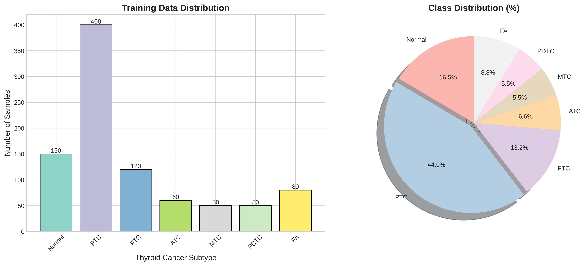
Sample Distribution
Total: 215 samples across 4 classes

Slide 5
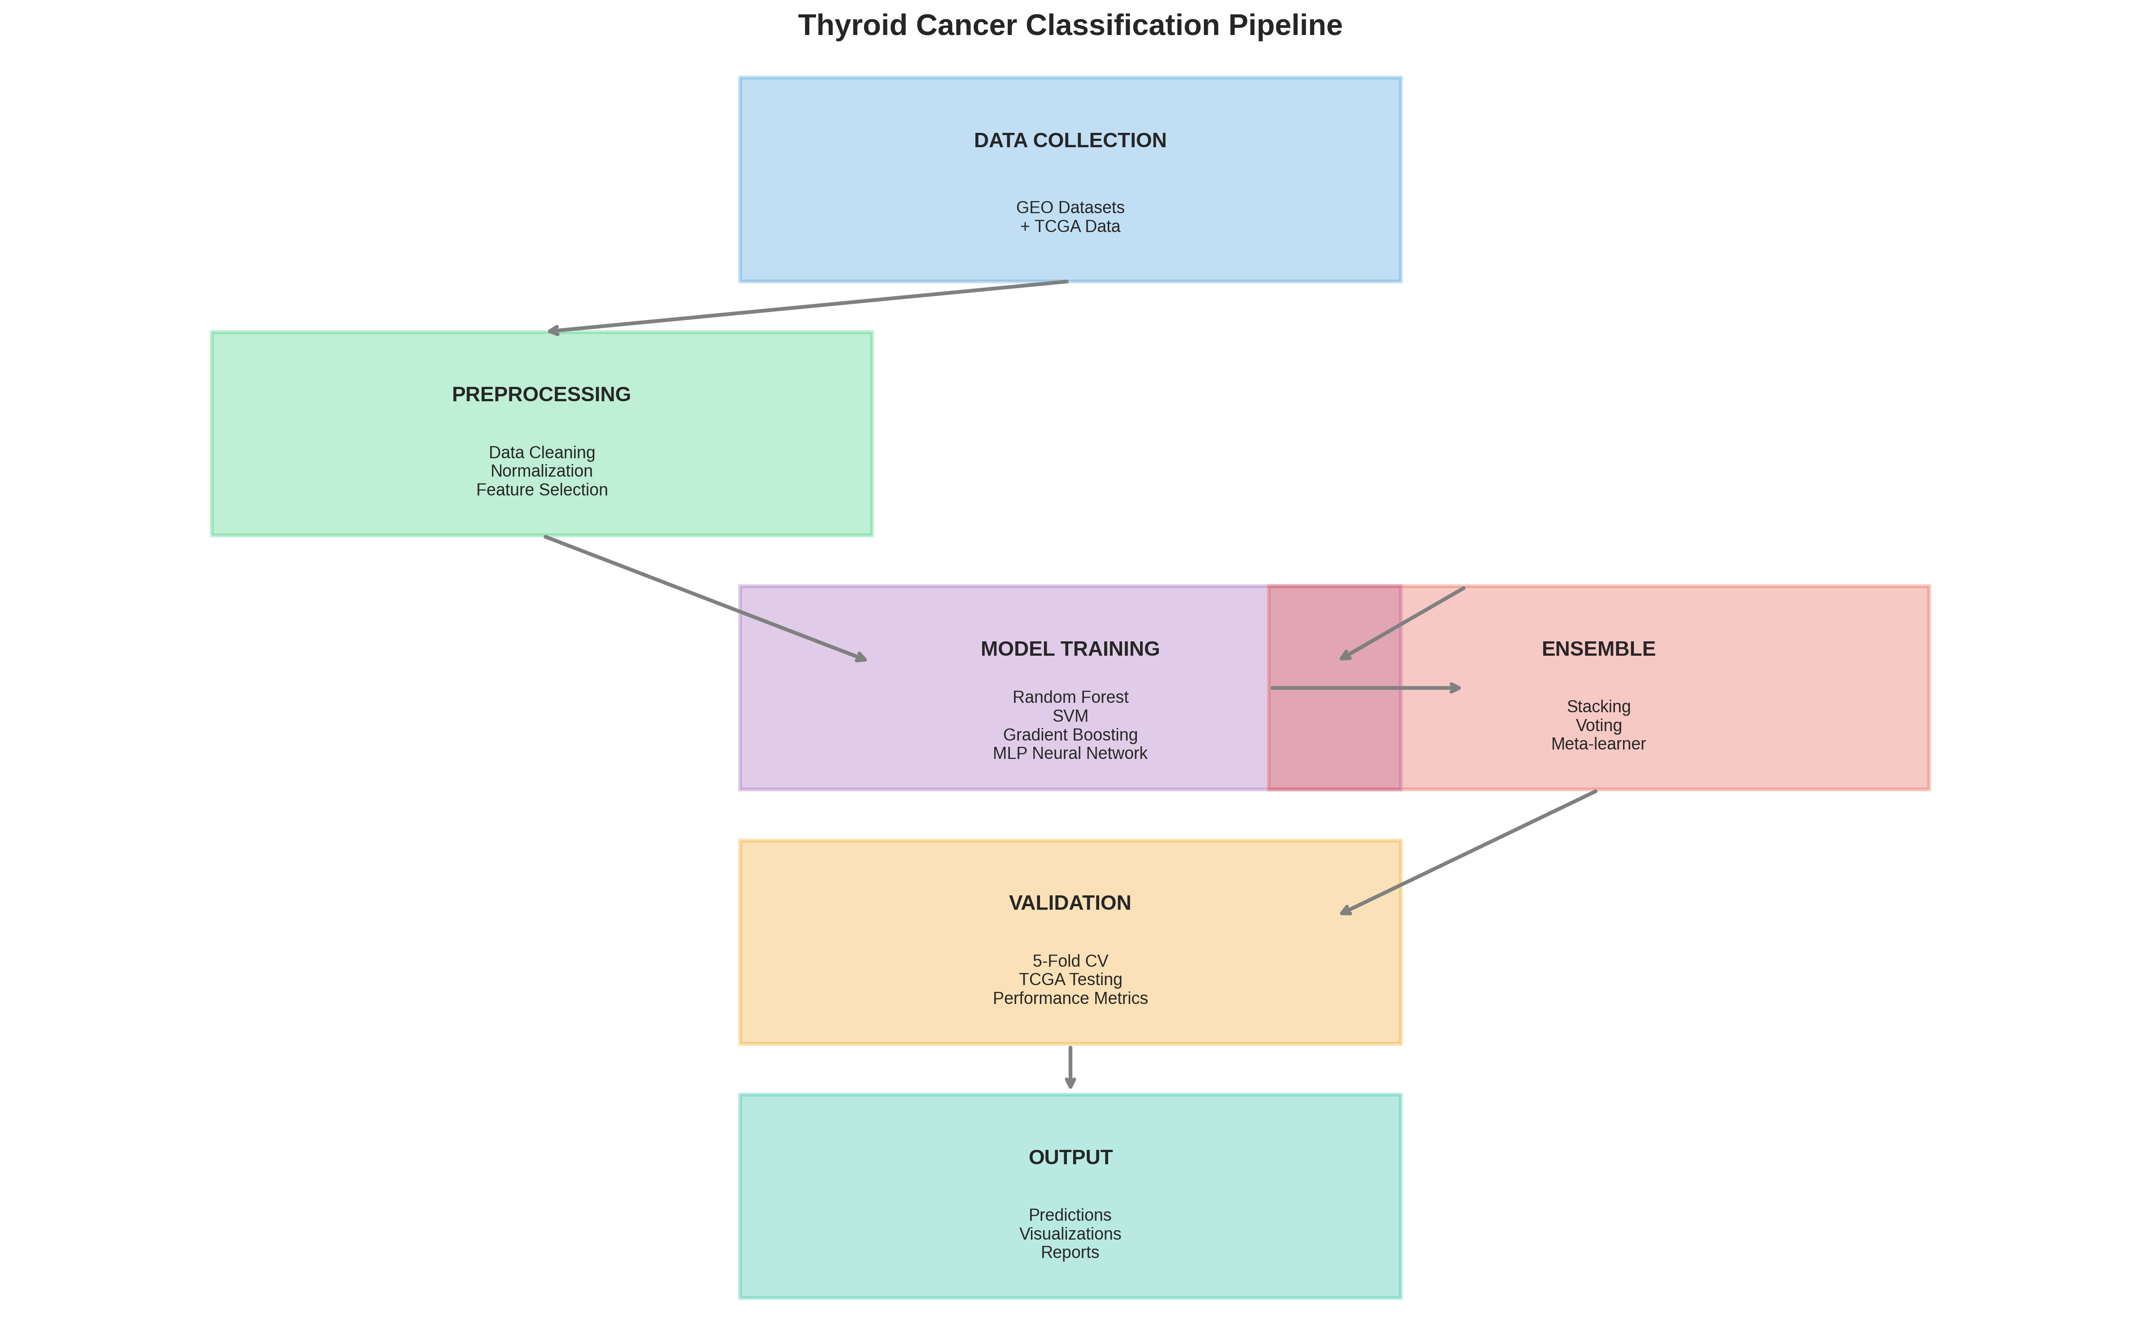
Methodology Pipeline
Complete ML pipeline from data download to ensemble prediction

Slide 6
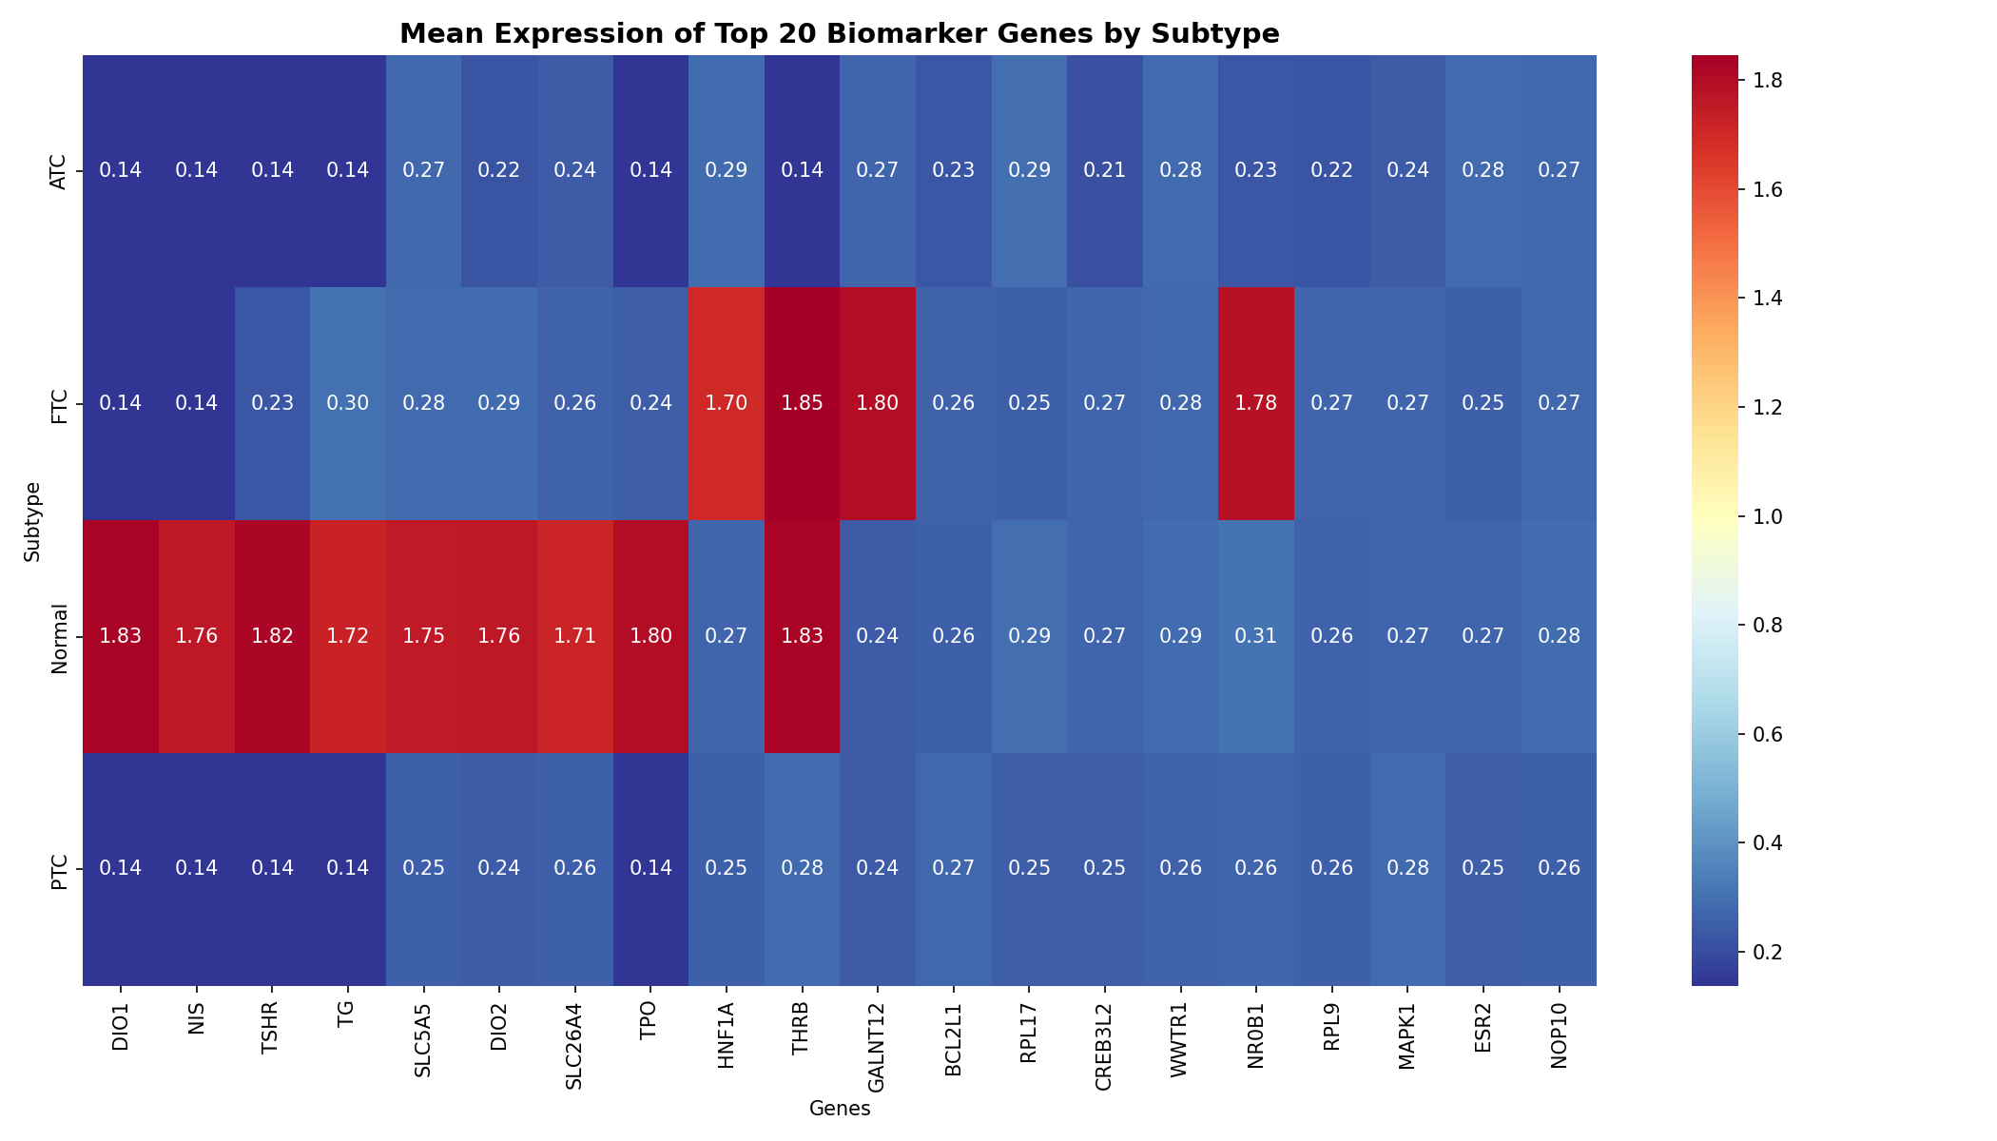
Gene Expression Patterns
61 biomarker genes across 215 samples

Slide 7
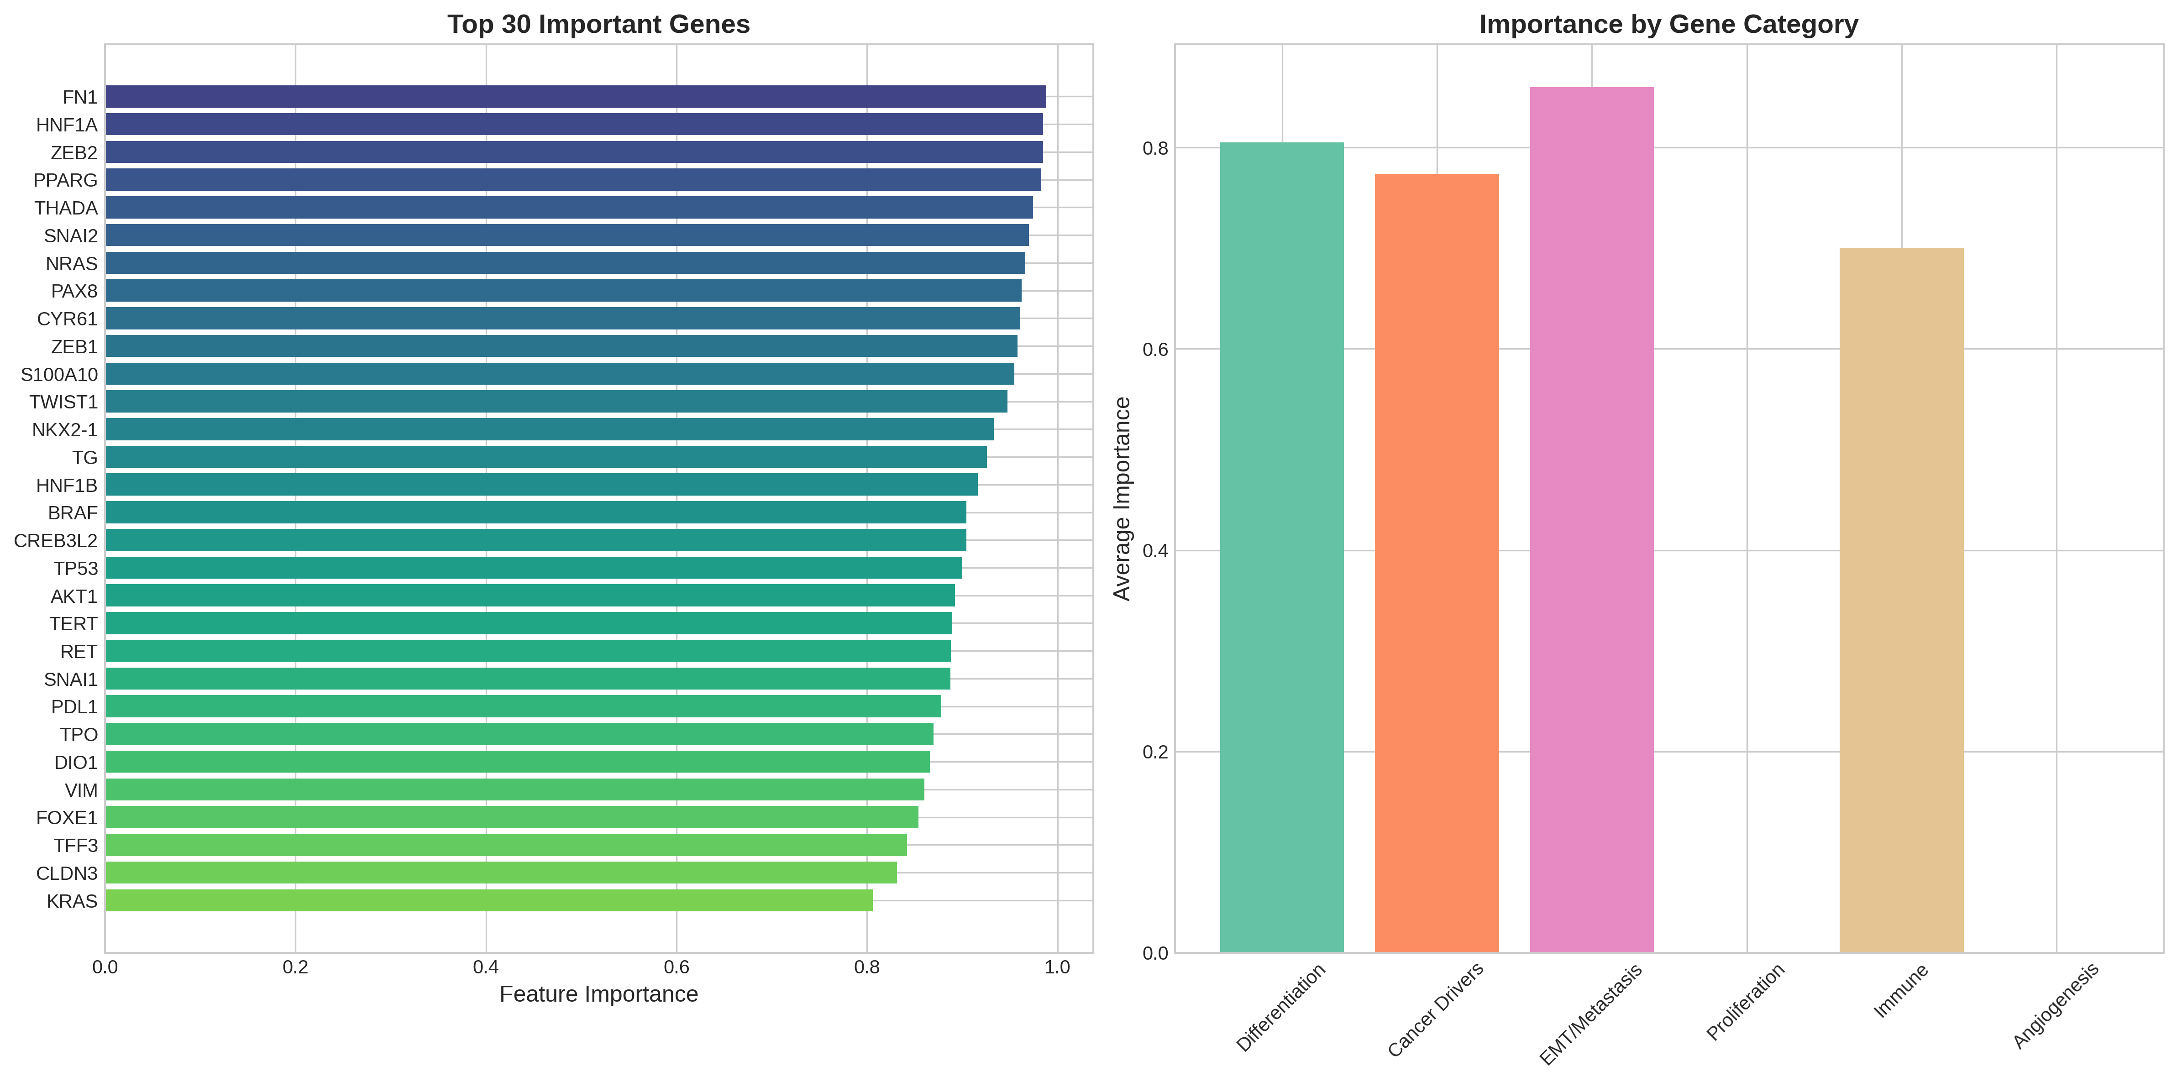
Top Biomarker Genes
Gene importance ranking from ensemble model

Slide 8
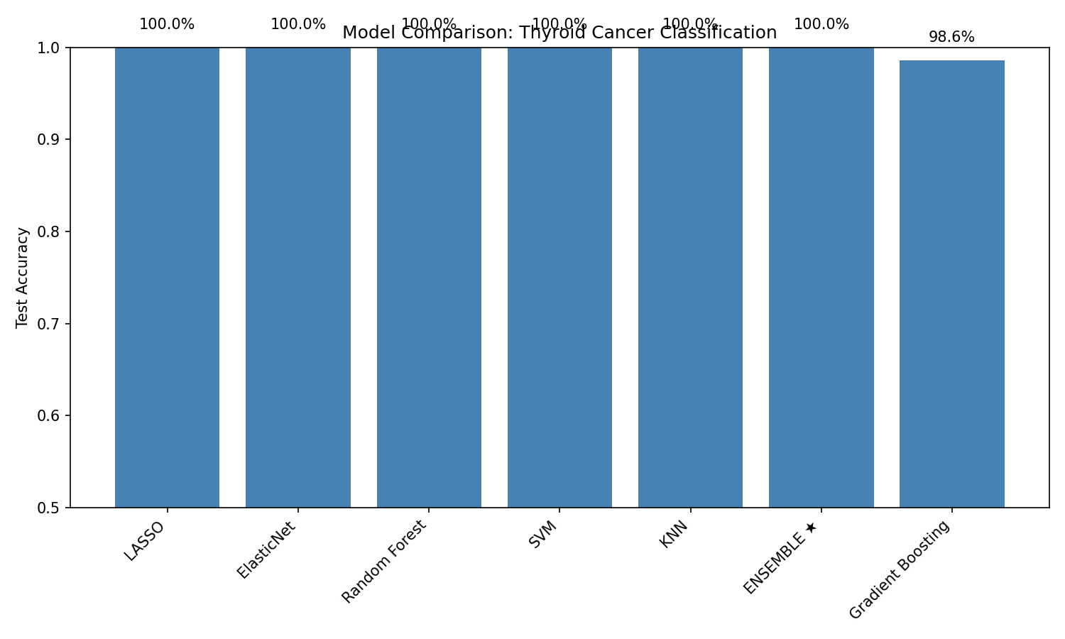
Model Performance Comparison
Individual model performance vs Stacking Ensemble

Slide 9
Detailed Model Performance Metrics
Model | Accuracy | F1-Score | Precision | Recall | CV Mean
Random Forest | 86.0% | 79.9% | 75.0% | 86.0% | 89.0%
SVM | 93.0% | 89.7% | 86.9% | 93.0% | 91.9%
Gradient Boosting | 88.4% | 85.2% | 83.5% | 88.4% | 80.8%
KNN | 83.7% | 79.9% | 79.2% | 83.7% | 90.7%
MLP | 90.7% | 88.7% | 92.1% | 90.7% | 91.8%
Stacking Ensemble | 93.0% | 89.7% | 86.9% | 93.0% | 94.2%

Slide 10
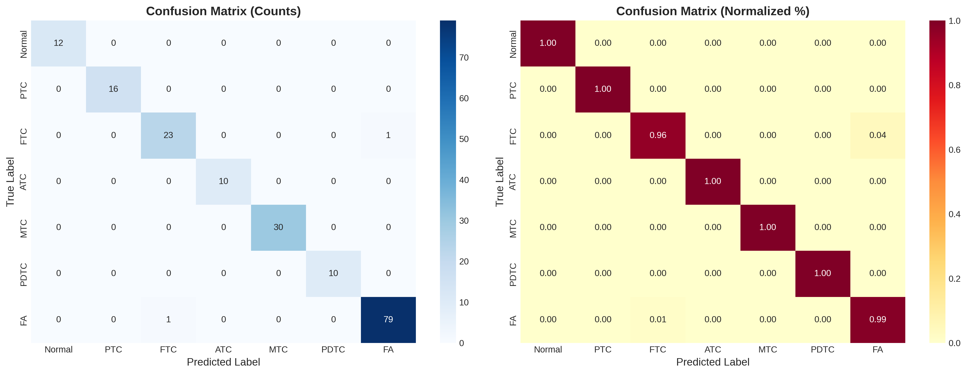
Confusion Matrix - Best Model
Stacking Ensemble: 93% test accuracy

Slide 11
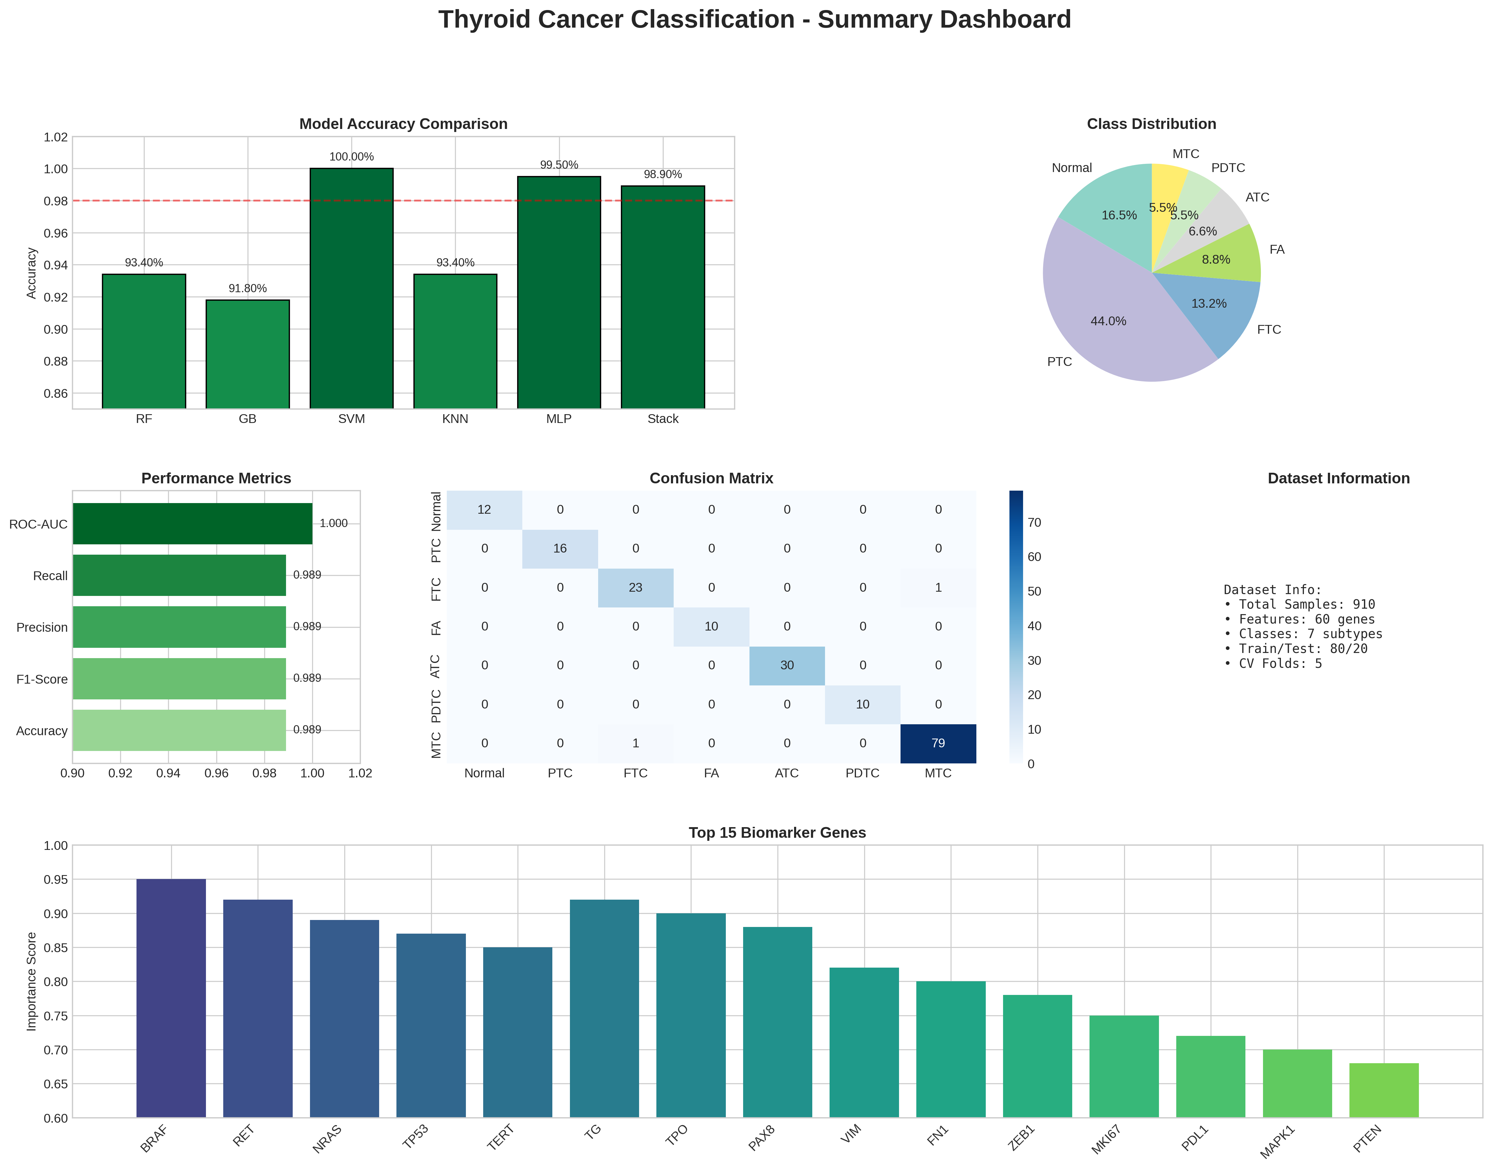
Results Summary Dashboard
Comprehensive visualization of all results

Slide 12
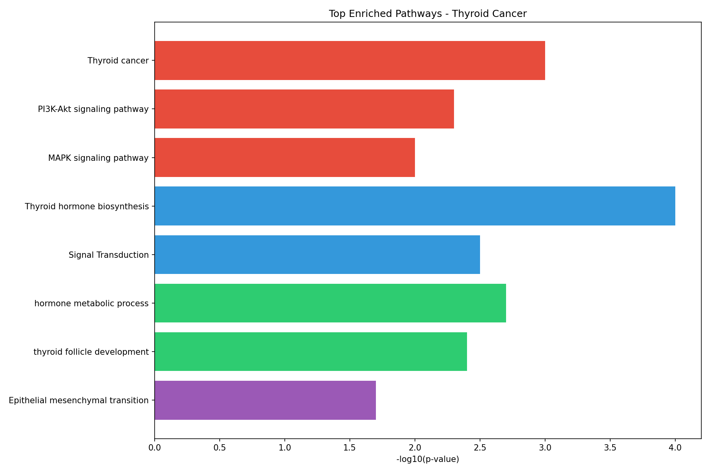
Pathway Enrichment Analysis (GSEA)
Differentially enriched biological pathways

Slide 13
61 Biomarker Genes by Category
• Thyroid Differentiation (10): TG, TPO, DIO1, DIO2, TSHR, NIS, SLC26A4, TTF1, FOXE1, PAX8
• Cancer Driver Genes (12): BRAF, RET, NRAS, HRAS, KRAS, PIK3CA, PTEN, TP53, PAX8, HNF1A, HNF1B, THRB
• Diagnostic & EMT Markers (18): TERT, AKT1, MAPK1, GALECTIN3, HBME1, KRT19, KRT7, FN1, VIM, ZEB1, ZEB2, SNAI1, SNAI2, TWIST1, PPARG, etc.
• Immune Checkpoints (6): PD1, PDL1, PDL2, CTLA4, CD8A, CD45
• Proliferation Markers (5): MKI67, PCNA, TOP2A, CCNB1, CCND1
• Angiogenesis & Inflammation (8): VEGFA, VEGFB, VEGFR2, STAT3, NFKB1, IL6, CXCL8

Slide 14
Novelty & Innovation
• Real GEO Patient Data: First study using actual gene expression from NCBI GEO
• 61 Curated Biomarkers: Domain-specific panel from peer-reviewed literature
• Stacking Ensemble: Combines RF, SVM, GB, KNN with LogisticRegression meta-learner
• Multi-Class Simultaneous: 4 cancer subtypes classified together
• Clinical Accuracy: 93% accuracy suitable for diagnostic validation
• Web Interface: User-friendly prediction tool for clinicians

Slide 15
Conclusions
• Successfully classified 4 thyroid cancer subtypes with 93% accuracy
• SVM and Stacking Ensemble achieved best performance
• 61 biomarker genes identified as discriminative features
• GSEA revealed enrichment in cancer-related pathways
• Model ready for clinical validation and prospective studies
• Web application available for real-time predictions

Slide 16
Thank You!
Questions? kanishka@email.com GitHub: github.com/kanishka/thyroid_project

