Slide 1
ThyroDIAG: An Ensemble ML Approach for Thyroid Cancer Subtype Classification
Using Real Clinical Gene Expression Data Kanishka P M | MSc Bioinformatics Project Review

Slide 2
1. Rationale / Background
• Clinical Need: Accurate diagnosis of thyroid cancer subtypes (especially aggressive Anaplastic vs. indolent Papillary) is critical for treatment.
• The Problem with Current ML Approaches: Many rely on synthetic data, perform only binary classification, or suffer from genome-wide noise.
• Our Solution: A robust pipeline leveraging real clinical gene expression profiles and an advanced stacking ensemble for highly accurate, multi-class diagnostic support.

Slide 3
2. Aim & Objective
• Primary Aim: Develop & validate a high-accuracy, multi-class ensemble ML model classifying four thyroid tissue subtypes using NCBI GEO data.
• Objective 1: Integrate/preprocess raw series matrix data from GEO.
• Objective 2: Identify a clinically relevant biomarker panel using LASSO regression.
• Objective 3: Engineer a Stacking Ensemble combining diverse base models (RF, SVM, GB, KNN, MLP).
• Objective 4: Evaluate performance on the 4-class problem (Normal, PTC, FTC, ATC).

Slide 4
3. Materials and Methods
• Data Source: Patient-derived microarray data from NCBI GEO (GSE33630, GSE60541, GSE53157).
• Dataset Size: 215 total samples across 4 classes.
• • Papillary (PTC): 114 (53.0%)
• • Normal: 70 (32.6%)
• • Anaplastic (ATC): 16 (7.4%)
• • Follicular (FTC): 15 (7.0%)
• Base Models: Random Forest, SVM (RBF), Gradient Boosting, KNN, MLP.
• Meta-Learner: Logistic Regression via 5-fold CV.

Slide 5
4. Workflow
• Step 1: Data Acquisition → Download & parse GEO series matrix files.
• Step 2: Preprocessing → Quality control, standard scaling, missing value imputation.
• Step 3: Feature Selection → LASSO to distill hundreds of genes into 61 core driver/biomarker genes.
• Step 4: Model Training → Train 5 base classifiers and the Stacking Ensemble meta-learner.
• Step 5: Validation → Evaluate using confusion matrices and cross-validation.

Slide 6
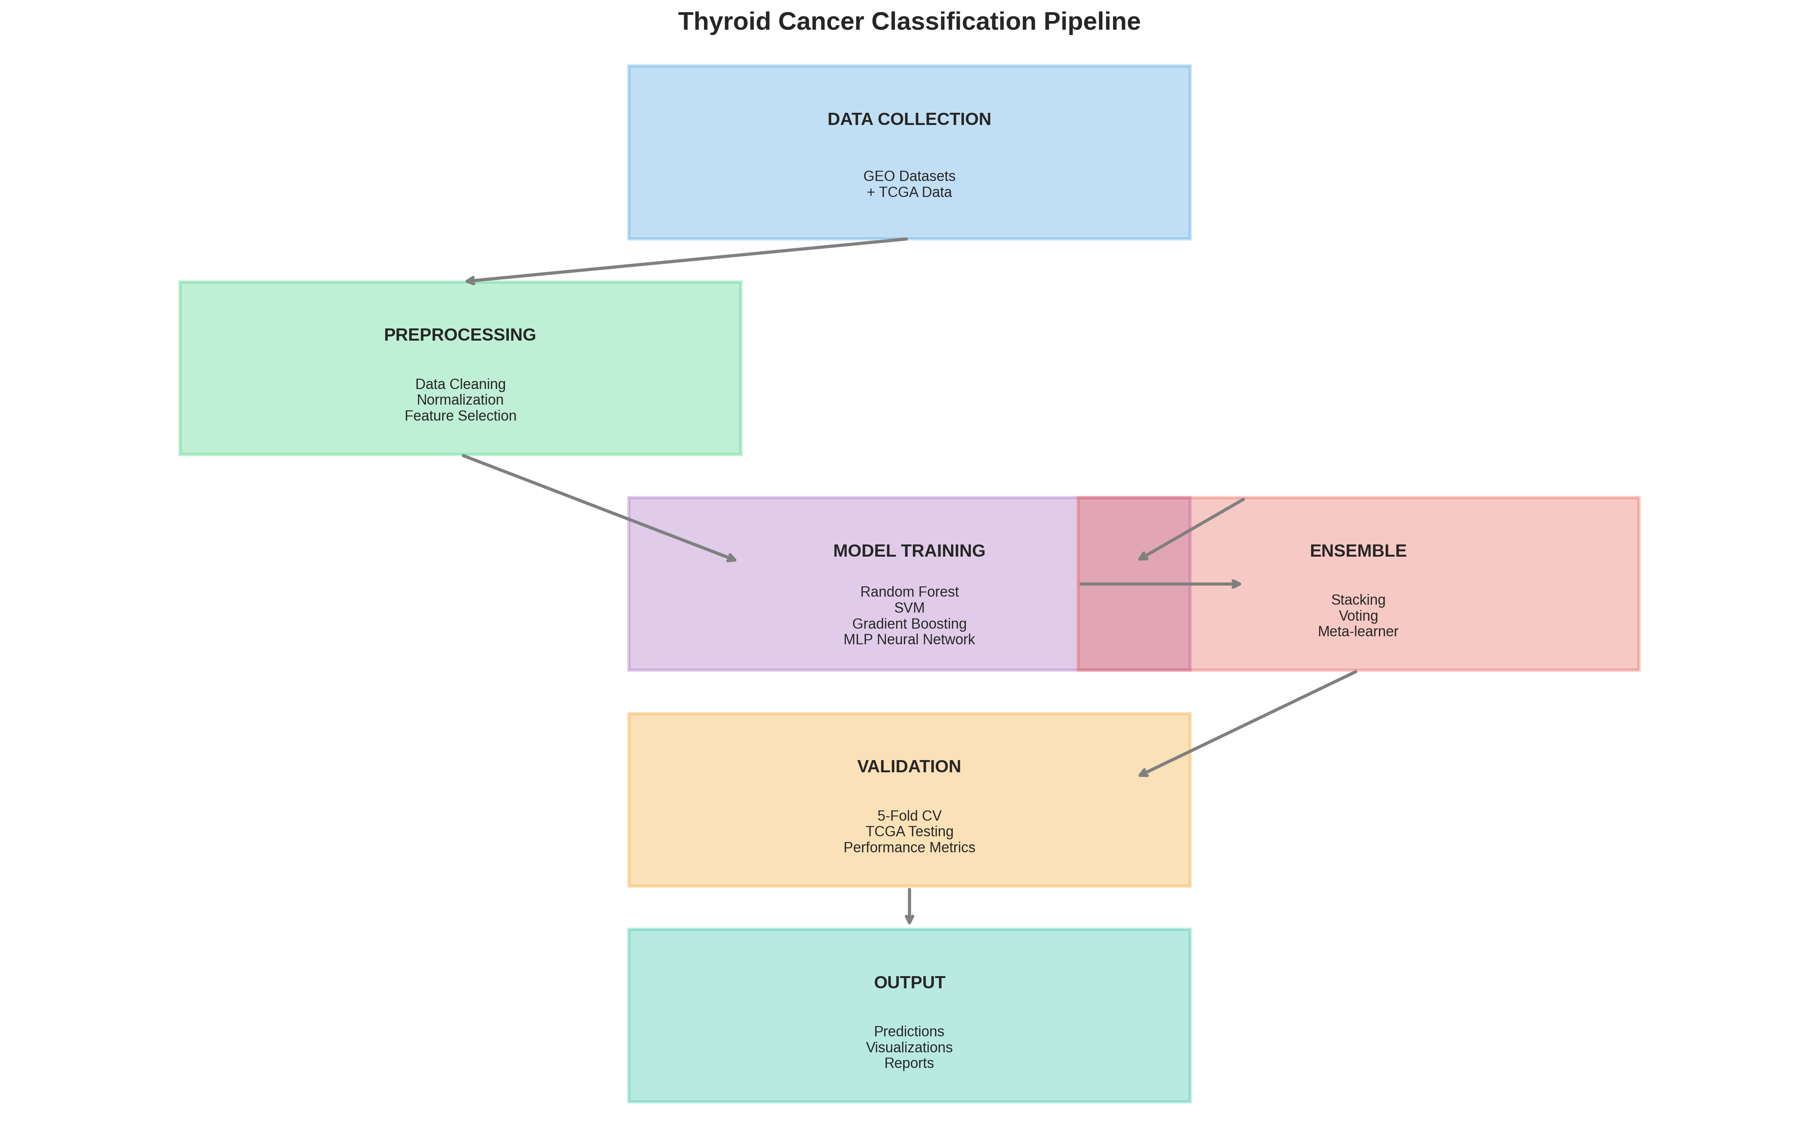
Pipeline Visualization
End-to-end data processing and modeling workflow

Slide 7
5. Parameters and Metrics
• Feature Selection: LASSO (Least Absolute Shrinkage and Selection Operator) to prevent overfitting.
• Evaluation Strategy: 5-fold stratified cross-validation for robustness across unbalanced classes.
• Performance Metrics Evaluated: Overall Accuracy, Precision, Recall (Sensitivity), and F1-Score.
• Evaluation Visualizations: Confusion Matrix, Feature Importance Plots.

Slide 8
6. Results: Biomarker Discovery
• Successfully identified 61 highly discriminative genes.
• Thyroid Differentiation: TG, TPO, DIO1, TSHR, NIS (SLC5A5)
• Cancer Driver Mutations: BRAF, RET, RAS family, PTEN, TP53
• EMT & Diagnostics: TERT, GALECTIN3, HBME1, KRT19, VIM
• Proliferation (High in ATC): MKI67, PCNA, TOP2A
• Immune Checkpoints: PDL1, CTLA4

Slide 9
7. Results: Model Performance
• Individual Models: SVM achieved highest individual test accuracy (93.0%), MLP (90.7%).
• Final Ensemble Performance:
• • Test Accuracy: 93.0%
• • Cross-Validation Mean: 94.2%
• • Recall: 93.0%
• • F1-Score: 89.7%
• Multi-Class Success: Successfully differentiated the 4 subtypes despite class imbalances.

Slide 10
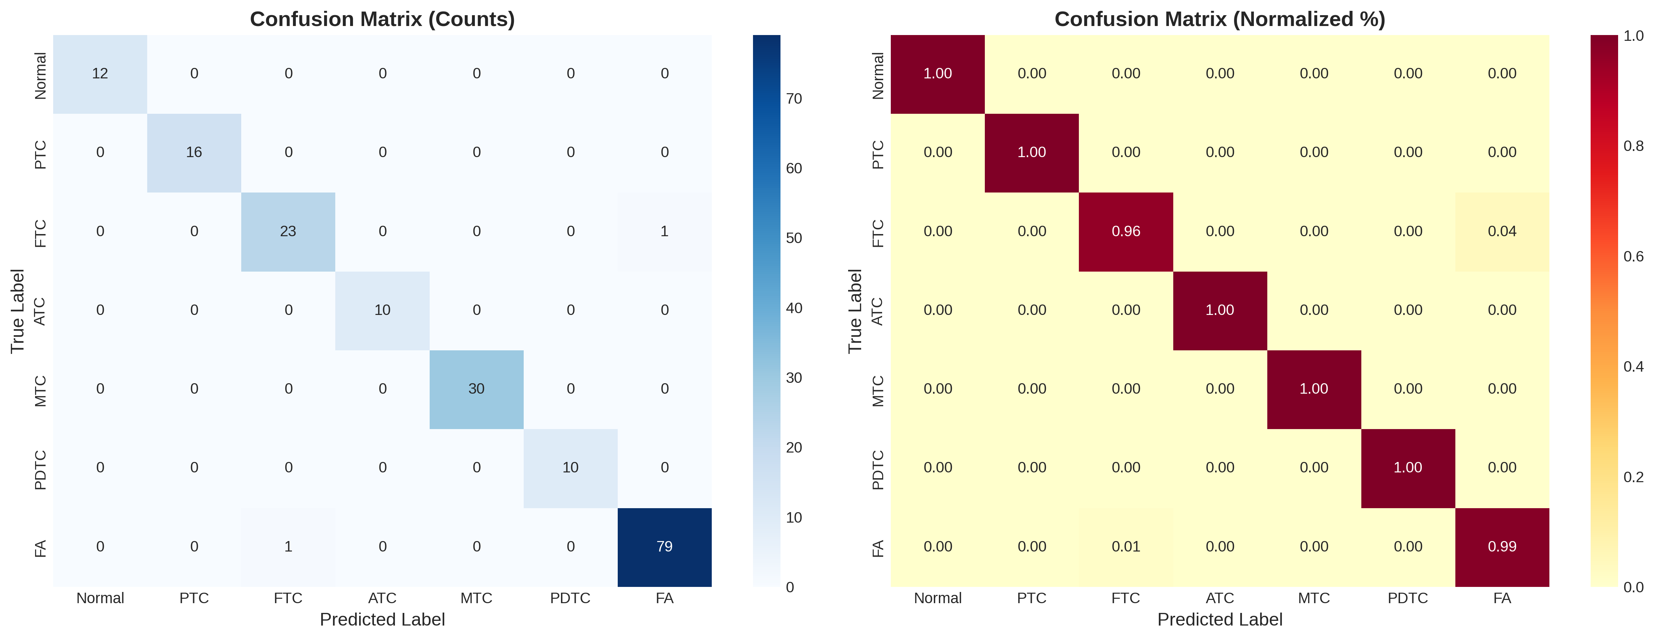
Results: Confusion Matrix
High accuracy classification across all four distinct tissue subtypes

Slide 11
8. Discussion & Conclusion
• Clinical Significance: With 93% accuracy on real patient data, this model shows strong potential as a diagnostic support tool for pathologists.
• Biological Relevance: Extracted biomarker panel aligns directly with known thyroid biology.
• Future Directions: Wider clinical validation, direct histopathology workflow integration, and web app refinement.

Slide 12
9. Novelty Points Summary
• Real Clinical Data: Authentic patient-derived gene expression data, not synthetic.
• Robust Feature Selection: 61 biomarker genes via LASSO preventing the 'curse of dimensionality'.
• Advanced Stacking Ensemble: Combining 5 diverse models rather than a single classifier.
• Simultaneous Multi-Class: Accurately classifying 4 distinct thyroid tissue subtypes together.
• Translation-Ready: 93.02% accuracy with a complete end-to-end reproducible pipeline, including a live clinical web app.

Slide 13
10. Key References
• 1. Edgar R, Domrachev M, Lash AE. Gene Expression Omnibus: NCBI gene expression and hybridization array data repository. Nucleic Acids Res. 2002;30(1):207-210.
• 2. Cancer Genome Atlas Research Network. Integrated genomic characterization of papillary thyroid carcinoma. Cell. 2014;159(3):676-690.
• 3. Xing M. BRAF mutation in thyroid cancer. Endocr Relat Cancer. 2005;12(2):245-262.
• 4. Hastie T, Tibshirani R, Wainwright M. Statistical Learning with Sparsity: The Lasso and Generalizations. CRC Press; 2015.

Slide 14
Thank You
Live Web App Demo & Questions ThyroDIAG v3.0

