Slide 1
IBM University Engagement Project Submission
“Adaptive Academic Integrity Platform powered by IBM Granite”

Slide 2

Project Tile – Academic Integrity Intelligence Platform (AIIP)
Domain of Project – Education Technology (EdTech)
Student Name | Recent Passport Photo | Email ID | Mobile number [WhatsApp]
Kanishka Tyagi |  | kanishkatyagi10@gmail.com | +91 9821053215

Slide 3
Problem Statement -
Problem Statement: AI-Driven Plagiarism Intelligence for Assignments
Academic institutions are facing growing challenges in detecting sophisticated plagiarism, especially when assignments are paraphrased or generated using AI tools. Traditional plagiarism detection systems primarily rely on text matching and often fail to identify contextual similarities, writing-style inconsistencies, and instructor-specific evaluation patterns.
As the use of Generative AI continues to increase, there is a need for an intelligent system that can adapt to historical student submissions, instructor feedback, and course-specific expectations to accurately identify potential academic misconduct while minimizing false positives.
Objective: Design and develop an AI-powered plagiarism intelligence platform using IBM Granite and IBM Cloud that performs semantic plagiarism detection, writing-style analysis, AI-generated content detection, and adaptive risk assessment to support academic integrity.

Slide 4
Proposed Solution -
Proposed Solution: Academic Integrity Intelligence Platform (AIIP)
The proposed solution is an AI-powered Academic Integrity Intelligence Platform (AIIP) built using IBM Cloud, IBM watsonx.ai Foundation Models, React, and FastAPI to help educational institutions evaluate assignment submissions efficiently.
The platform allows users to upload assignment PDFs through a web interface. The backend extracts text from the uploaded document and securely sends it to IBM watsonx.ai Foundation Models for intelligent analysis.
The AI model generates a comprehensive Academic Integrity Report containing an Assignment Summary, Academic Integrity Score (0–100), Possible Plagiarism Observations, AI-Generated Content Analysis, Citation Suggestions, and Recommendations for Improvement.
The system consists of three core modules:
Assignment Upload Module – Uploads and manages assignment PDF files.
Document Processing Module – Extracts and preprocesses text from uploaded assignments.
AI Analysis Module – Uses IBM watsonx.ai Foundation Models to analyze content and generate explainable academic integrity reports.
Overall, AIIP provides a scalable, AI-powered, and deployment-ready solution that assists educators in identifying potential plagiarism, understanding AI-generated content, and promoting fairness and transparency in academic evaluation.
credible to reviewers.

Slide 5
Technology Used
React + Vite + Tailwind CSS – Developed a responsive web interface for uploading assignment PDFs and displaying academic integrity reports.
FastAPI (Python) – Built REST APIs to process uploaded PDFs, extract text, and communicate with IBM watsonx.ai.
IBM watsonx.ai Foundation Models – Performs AI-powered assignment analysis, generating an Academic Integrity Score, plagiarism observations, AI-generated content analysis, citation suggestions, and recommendations.
IBM Cloud – Provides secure cloud infrastructure and authentication services for accessing IBM AI models.
PyPDF2 – Extracts text from uploaded PDF assignments for AI analysis.
IBM Identity & Access Management (IAM) – Authenticates secure API access to IBM watsonx.ai services.

Slide 6
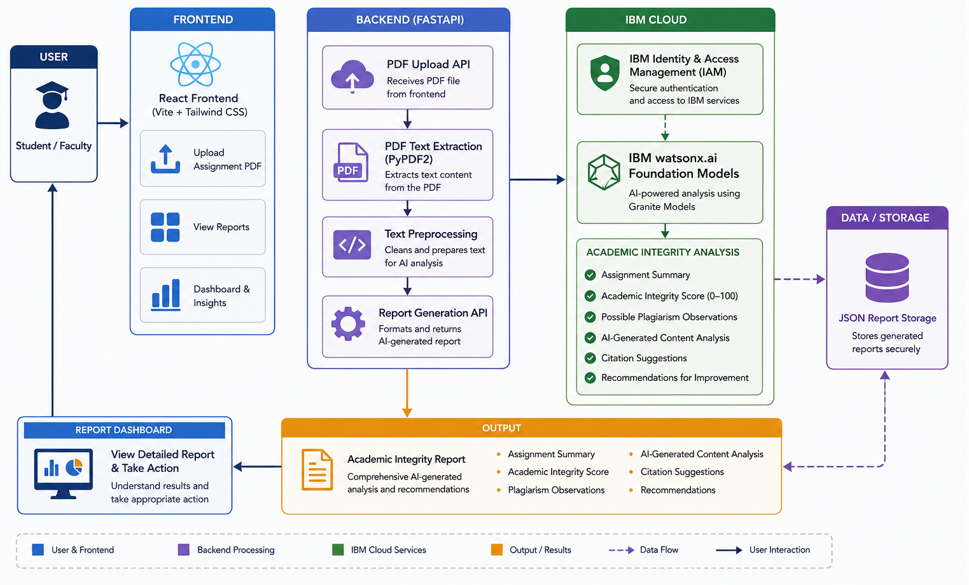
Architecture blueprint

Slide 7
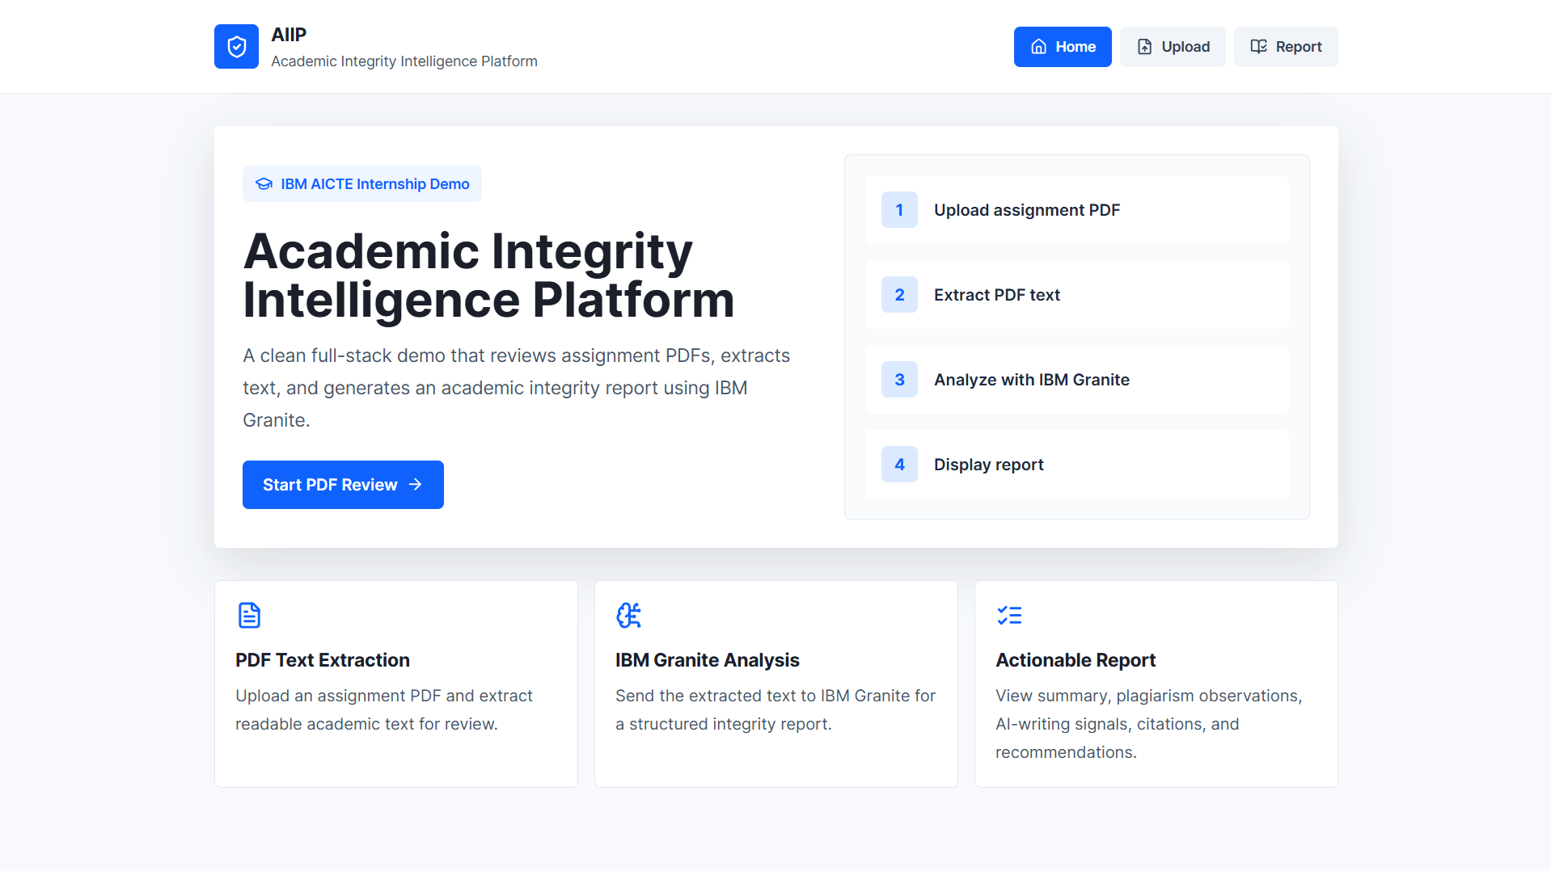
Home Page

Slide 8
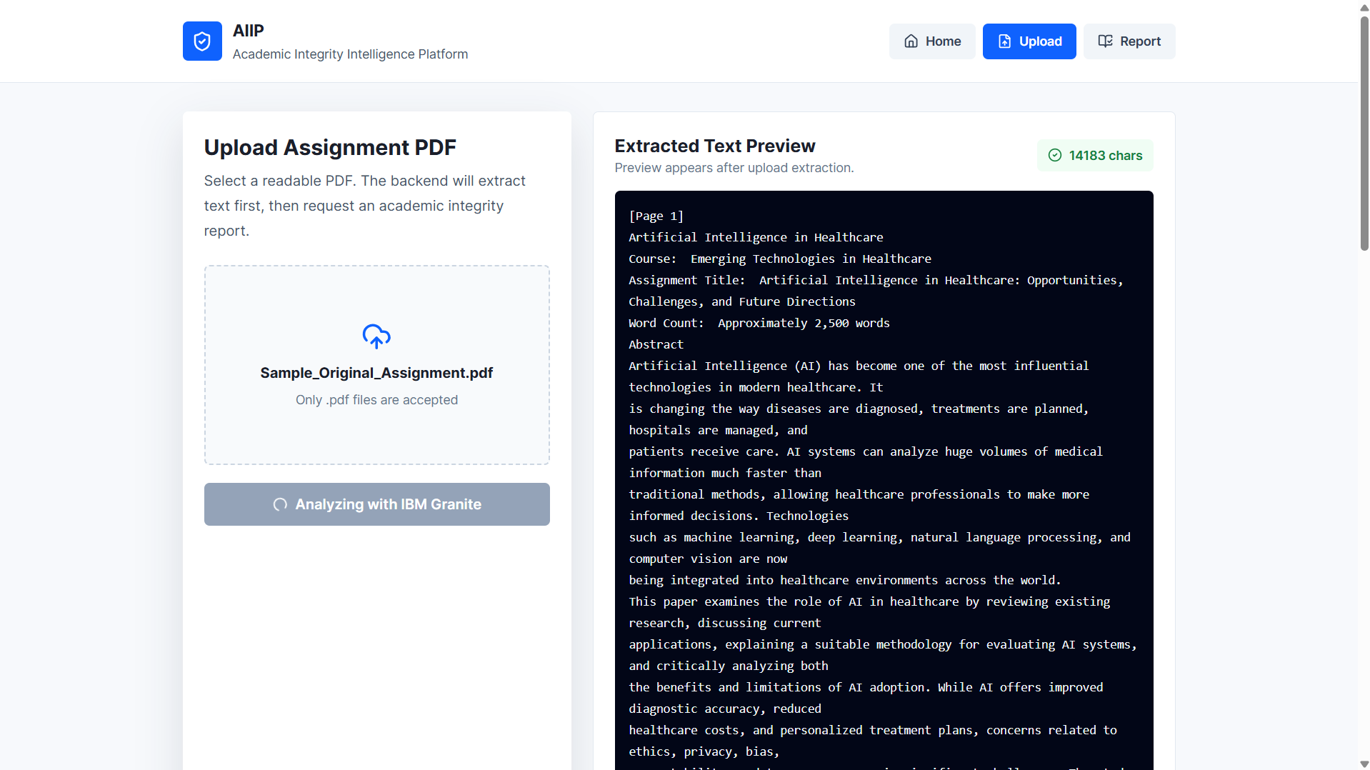
Upload Assignment Page

Slide 9
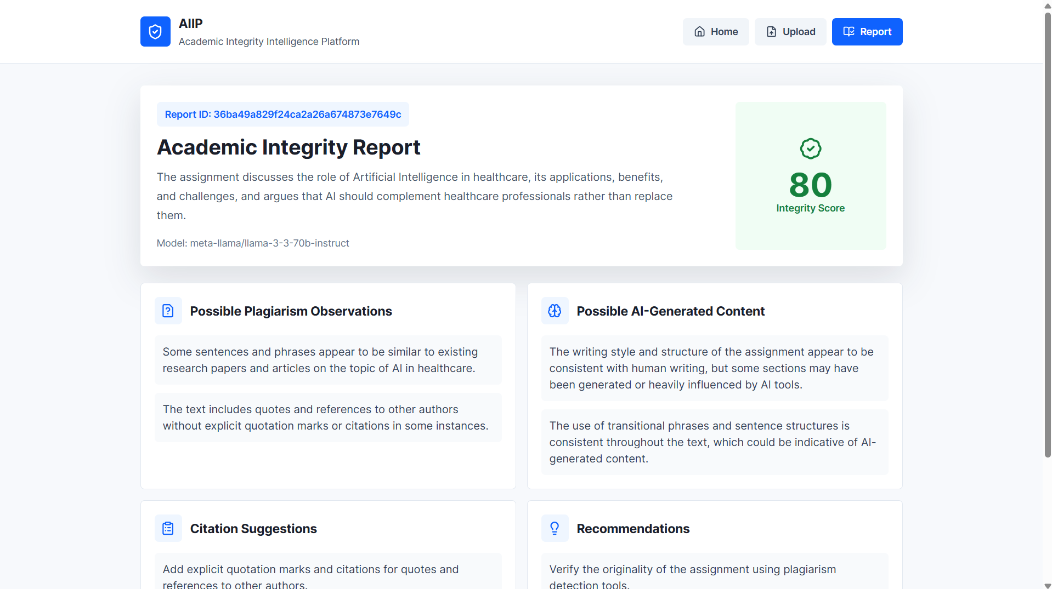
Academic Integrity Report

Slide 10
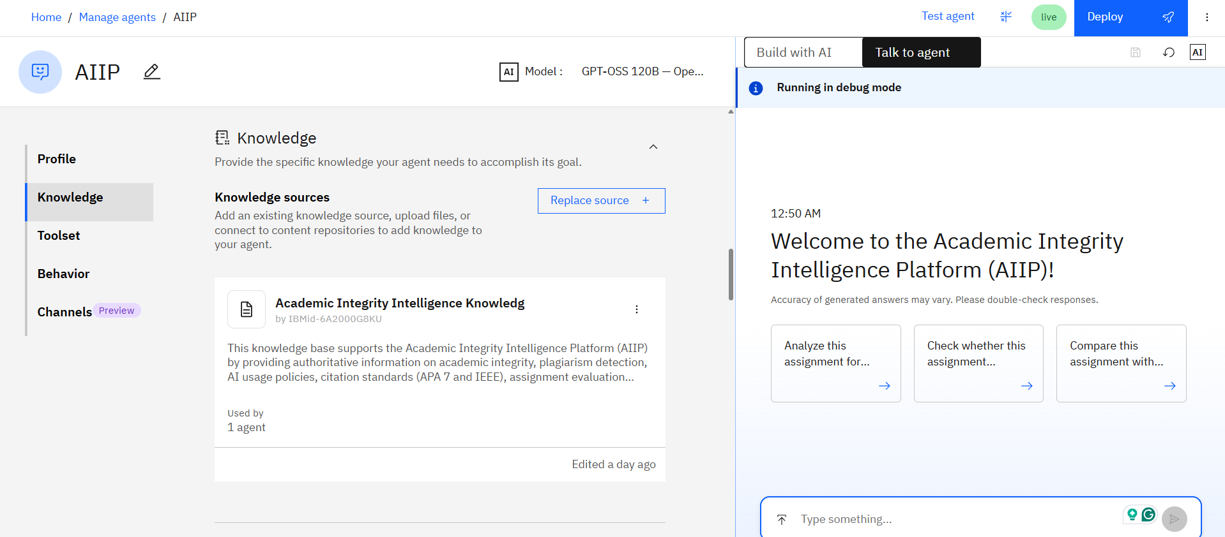
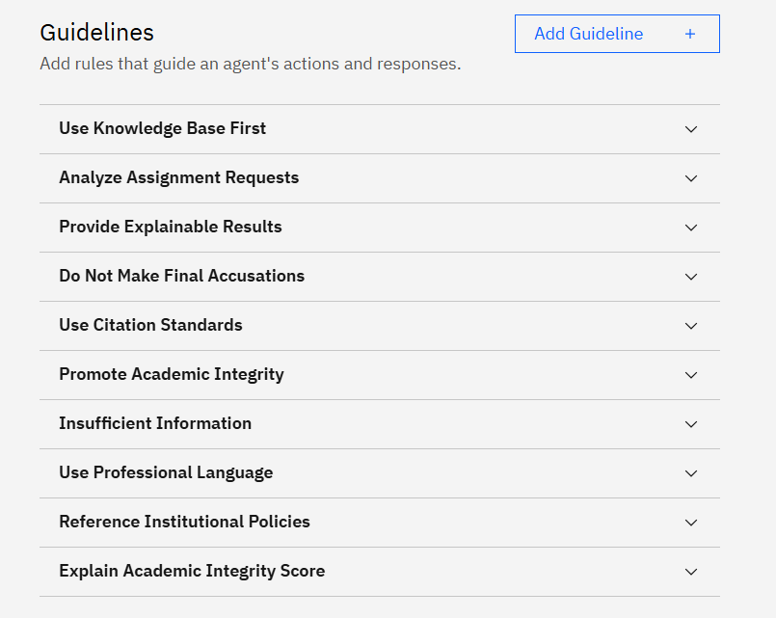
Future Enhancements
Future Integration with IBM watsonx Orchestrate
In the next phase of AIIP, we plan to integrate IBM watsonx Orchestrate as an intelligent academic assistant. The agent will help faculty and students interact with the platform using natural language by:
Answering questions about Academic Integrity Reports.
Explaining plagiarism observations and AI-generated content analysis.
Providing citation guidance and academic writing best practices.
Assisting faculty in interpreting AI-generated recommendations.
Supporting institutional academic integrity policies through conversational AI.
Status: Prototype agent created in IBM watsonx Orchestrate. Integration with the AIIP web application is planned for the next development phase.

Slide 11
Novelty and Uniqueness
AI-powered Academic Integrity Analysis automates the evaluation of assignment submissions, reducing manual review time for educators.
IBM watsonx.ai Foundation Models provide intelligent analysis by generating assignment summaries, academic integrity scores, plagiarism observations, and AI-generated content analysis.
Single Integrated Platform combines PDF upload, text extraction, AI analysis, and report generation into one easy-to-use web application.
Explainable AI Reports provide integrity scores along with plagiarism observations, citation suggestions, and recommendations, enabling transparent academic evaluation.
Scalable and Deployment-Ready Architecture built with React, FastAPI, and IBM Cloud, allowing future integration with Learning Management Systems (LMS), institutional databases, and conversational AI assistants.

Slide 12
Git Hub Link
kanishkatyagi1/Academic-Integrity-Intelligence-Platform

Slide 13
Future Scope
Learning Management System (LMS) Integration – Integrate AIIP with platforms like Moodle, Canvas, and Google Classroom for seamless assignment evaluation.
Advanced Semantic Plagiarism Detection – Incorporate vector databases and semantic similarity models to detect paraphrased and context-based plagiarism.
IBM watsonx Orchestrate Integration – Integrate the prototype AI assistant to help faculty and students understand reports, academic integrity policies, and citation best practices.
Multi-Language Support – Extend AI analysis to assignments written in multiple languages for broader educational adoption.
Institutional Dashboard & Analytics – Provide administrators with insights into submission trends, integrity scores, and academic performance through interactive dashboards.
Scalable Cloud Deployment – Deploy AIIP as a secure SaaS solution on IBM Cloud, enabling universities and educational institutions to use the platform at scale.

Slide 14
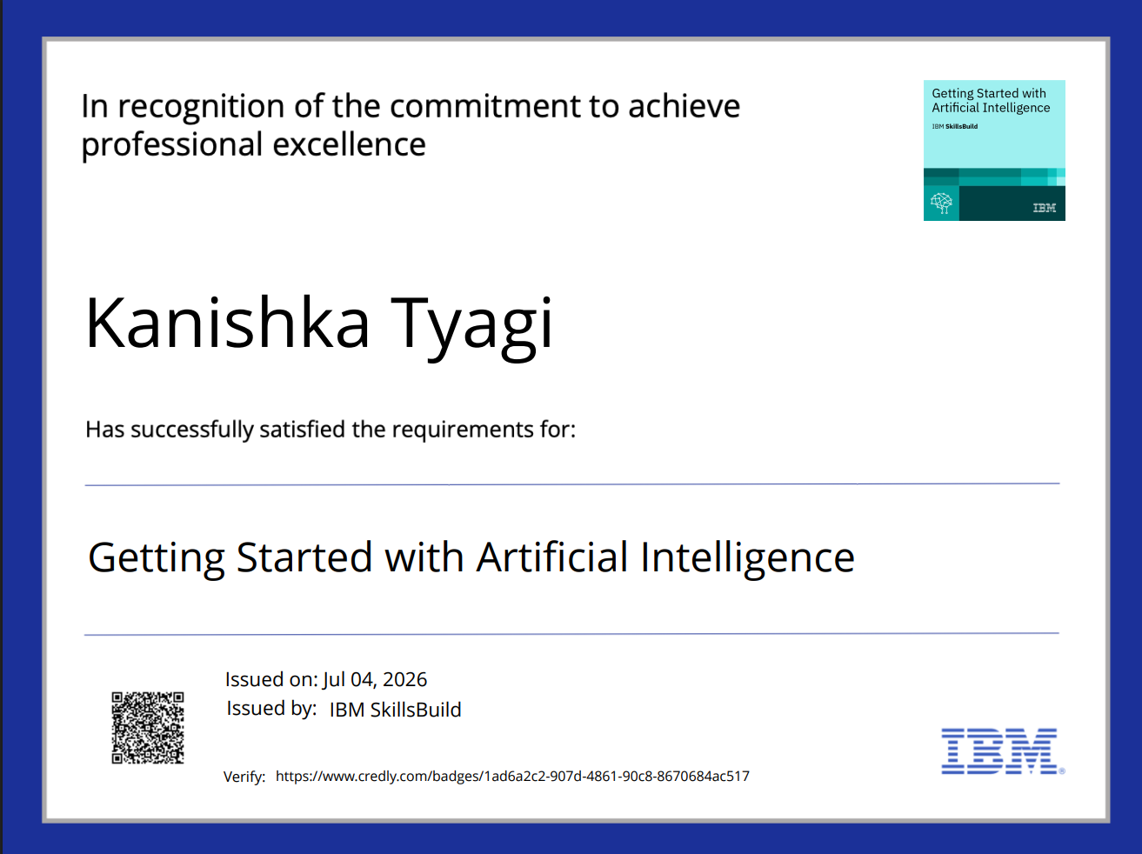
Certificates Earned:

Slide 15
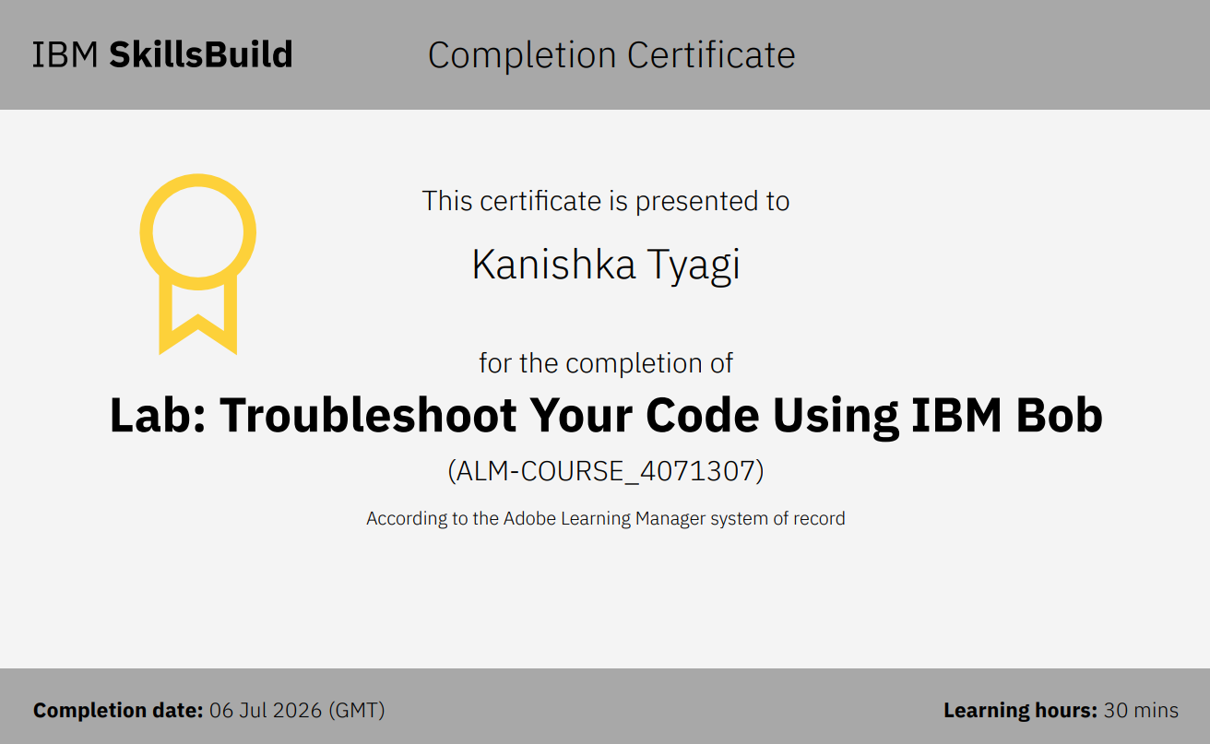
Certificates Earned:​

Slide 16


