Slide 1
EXECUTIVE BUSINESS PERFORMANCE & MARGIN OPTIMIZATION
Unlocking Sustainable EBITDA Growth Through Pricing Discipline and Supply Chain Efficiency
VirtuBox Data Analyst Assessment | Global Commercial Operations Analysis (51,290 Transactions)

Slide 2
Slide 2: Business Problem, Context & Methodology
Diagnosing the disconnect between revenue growth and operating profit
• The Core Dilemma: Top-line revenue reached $12.64M across 51,290 global orders, but net operating margin stalled at 11.6% ($1.47M profit), revealing structural margin leaks.
• Dataset Scope & Integrity: Analyzed 51,290 verified global transactions across 147 countries, 7 regional markets, 3 customer segments, and 17 product lines.
• Data Engineering Pipeline: Cleaned legacy date fields, standardized non-US postal records (41,296 rows preserved), and engineered key metrics: Unit Cost, Profit Margin %, Shipping Days, and Discount Bands.
• Analytical Approach: Applied exploratory data analysis (EDA), cohort elasticity analysis, hypothesis testing on B2B vs Consumer unit economics, and operational fulfillment SLA benchmarking.

Slide 3
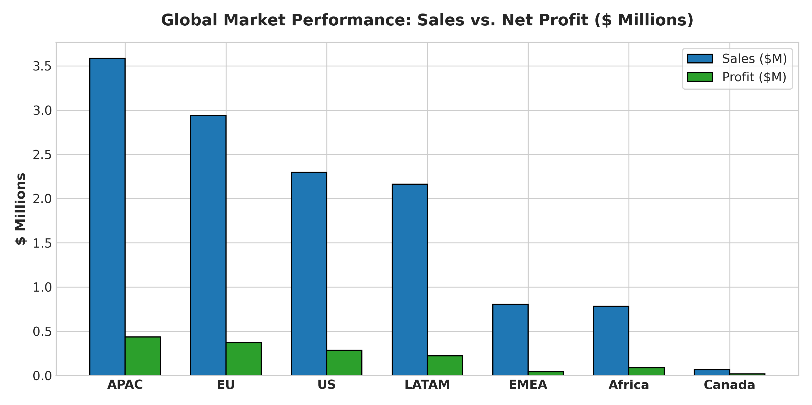
Slide 3: Executive Key Findings Overview
Four critical strategic realities uncovered across the enterprise
• Discount Destruction: Discounts over 20% directly eliminated $814,800 in cumulative net profit, operating at deep negative margins (-25.8% to -111%).
• Loss Centers in Catalog: The 'Tables' sub-category alone lost -$64,083 (-8.5% margin), driven by bulky shipping fees and excessive promotional discounts.
• Regional Powerhouses: APAC ($436K profit) and EU ($373K profit) generate over 55% of global profit with consistent 12%+ margins.
• Fulfillment Friction: Critical orders fulfill in 1.8 days but freight cost consumes 26.5% of sales, eroding expedited order profitability.

Slide 4
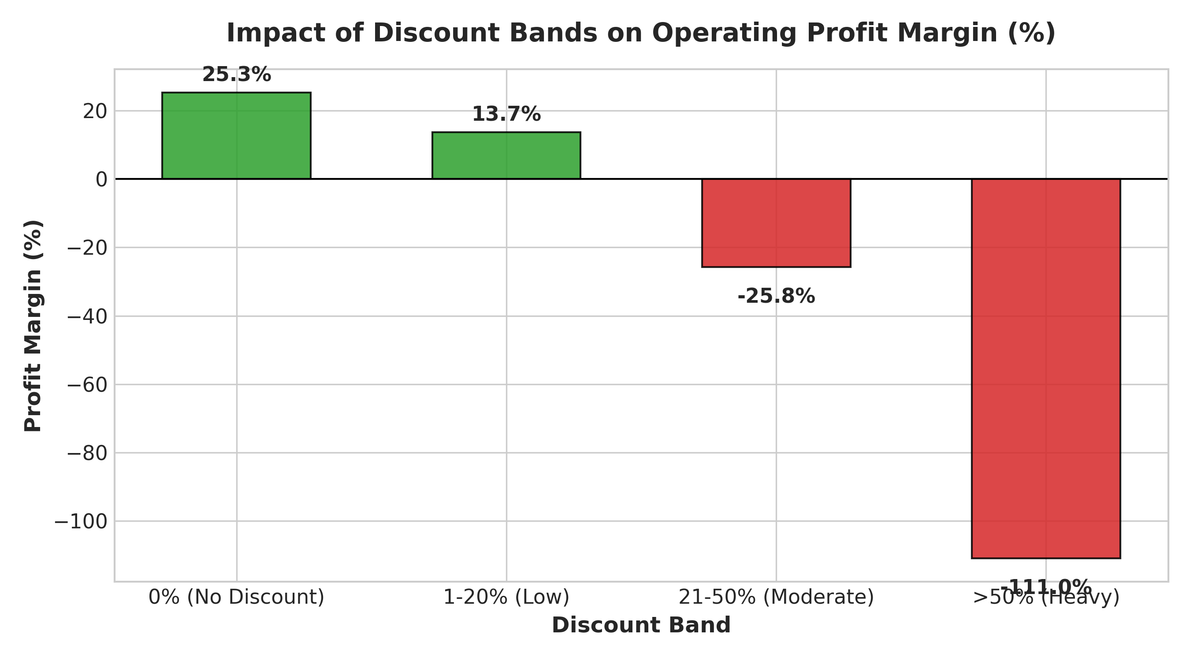
Slide 4: Deep-Dive — The Heavy Discount Margin Trap
Proving that discounts >20% destroy value rather than driving profitable volume
• Initial Expectation: Management expected higher volume discounts to win enterprise accounts and maximize total gross dollar profit.
• Empirical Reality: 0% discount orders yielded 25.3% margin (+$1.77M profit). 1-20% discount yielded 13.7% margin (+$511K profit). When discounts crossed 20%, profits plunged to -$402K (21-50% tier) and -$412K (>50% tier).
• Root Cause Analysis: Field reps used unmonitored high discounts to close commodity orders, unaware that manufacturing cost plus freight exceeded discounted pricing.
• Strategic Takeaway: Volume elasticity is an illusion beyond 20% discount. Eliminating deep discounts immediately restores ~$500K to EBITDA.

Slide 5
Slide 5: Actionable Strategic Recommendations
Three prioritized initiatives to drive margin expansion and operational excellence
• 1. Implement Dynamic Pricing Floors (Priority: HIGH | Owner: CCO): Enforce automated system guardrails: 15% maximum discretionary rep discount. Any quote exceeding 20% discount requires algorithmic VP approval with margin verification.
• 2. Overhaul Unprofitable Sub-Categories (Priority: MEDIUM | Owner: VP Merchandising): Reprice Tables catalog by +12%, renegotiate wholesale supplier agreements, and transition bulky furniture to drop-ship delivery models to eliminate -$64K in losses.
• 3. Reallocate Capital to APAC & EU B2B Growth (Priority: HIGH | Owner: CMO / Sales VPs): Shift 25% of underperforming regional expansion budget into high-yield APAC and EU enterprise sales teams to capture 12.5%+ operating margins.

Slide 6
Slide 6: Expected Business Impact & Success Metrics
Quantifying the financial upside and governance scorecard
• Financial Impact: Recover $400K–$500K in annual EBITDA by eliminating negative-margin transactions and optimizing product mix.
• Margin Expansion Target: Lift overall enterprise operating margin from 11.6% to 15.2% within 12 months.
• Logistics Cost Rationalization: Reduce freight-to-sales expense ratio on expedited orders by 400 basis points via customer shipping co-pays.
• Governance KPI Scorecard: 1. Blended Gross & Net Margin %
2. Discount Compliance Rate (>98%)
3. Sub-Category Net Contribution ($)
4. On-Time In-Full (OTIF) Delivery SLA %

Slide 7
Slide 7: Analytical Limitations & Roadmap Ahead
Prudent analytical boundaries and next strategic milestones
• Data Limitation 1 (Customer Acquisition): Transaction logs lack marketing spend and CAC, precluding full cohort-level LTV:CAC calculations.
• Data Limitation 2 (Competitor Pricing): Absence of real-time market rate benchmarking requires prudent, phased A/B price testing rather than drastic global price shifts.
• Unsafe Conclusion Warning: Do NOT eliminate moderate discounts (1-10%). Moderate discounts remain highly profitable (+13.7% margin) and preserve customer retention.
• Phase 2 Analytics Roadmap: 1. Deploy interactive Google Looker Studio executive dashboard for weekly regional tracking.
2. Ingest customer NPS and delivery feedback to correlate shipping lead times with retention.
3. Build predictive price elasticity machine learning models for dynamic B2B quotes.

