Slide 1

AI TINKERERS · CALGARY · JUNE 23, 2026
Context Engineering
Inside the Harness
Which way of forgetting keeps a long-running agent alive? A live tour.
Kanishk Patel · Founsi AI · Learn Agentic AI

Slide 2

THE WHOLE IDEA
The model is rented.
The harness is the part you build.
And the single most important thing it does is decide what to forget. Get that wrong and the agent drifts, repeats, and dies. Tonight: the code that gets it right, and how the memory systems you already use actually perform.
Founsi.
2

Slide 3
THE ARCHITECTURE
Three moving parts.
Agent loop
perceive → think → act → repeat (harness/loop.py, ~80 lines)
ContextManager
maybe_compact(): over budget? forget the middle
Compaction policy
1 of 7, swappable
Store
raw, retrievable
Every run → a folder
manifest · every prompt · results · figures (judge-scored, reproducible)
Founsi.
Founsi.
3
3

Slide 4
THE CONSTRAINT THAT BITES EVERYONE
Never split a tool-call from its result.
def _safe_split(body, proposed):
# the kept tail can't start on a 'tool' message
idx = proposed
while body[idx].role == 'tool':
idx += 1
return idx
Cut the transcript between a call and its result, and a real API rejects the whole thing.
5 lines. The difference between an agent that runs and a 400 error.
Trade-off: you can't always cut exactly at the budget line.
Founsi.
4

Slide 5
LIVE
Watch it grow, COMPACT, snap back, keep going.
python run.py · cat run/notes.md
python -m harness.compare "..." # 7 policies, one needle, who keeps it
Offline. No key. The window forgets; the scratchpad does not.
Founsi.
5

Slide 6
YOU ARE NOT ALONE
The famous memory systems are the same seam.
LangChain summary-buffer
→ compact. A rolling summary. Literally my 15-line recency.
Chroma
→ externalize. A vector store behind the same add / retrieve.
Mem0
→ externalize, but an LLM extracts and dedupes facts first.
MemGPT / Letta
→ pin + externalize. Agent-managed core blocks + an archival DB.
Anthropic multi-agent
→ isolate. Sub-agents, each a fresh window.
All points on one map. So I wrapped each behind the same interface and benched it.
Founsi.
6

Slide 7
AND I MEASURED THEM
The defaults are not the right choice.
vs
our 15-line recency 0.45
LangChain summary-buffer 0.35
The framework default bought a dependency, not accuracy — and cost more tokens.
vs
nv-embedqa store 0.50
MiniLM (general, local) 0.35
Same policy, swap only the embedder: the embedding model alone is +0.15.
Mem0 distills raw text → deduped facts
Trailed storing the raw chunks, and cost an LLM call on every write. Compression lost the needle.
Founsi.
7

Slide 8
WAR STORY
The metric that almost fooled me
0.21 → 0.62
Substring scoring made my best policy look like the worst. An LLM judge that credits paraphrase flipped it to best.
Lesson Your eval can quietly invert your conclusion.
Founsi.
8

Slide 9
WAR STORY
The agent that froze at 0% CPU
no error. just gone.
Runs hung forever, Python idle, past the library timeout. Fix: a hard wall-clock watchdog on a worker thread (nim.py).
Lesson Do not trust a library's timeout.
Founsi.
9

Slide 10
WAR STORY
The reasoning model that wouldn't shut up
2k–20k token 'summaries'
Asked to compress, it rambled; turning thinking off corrupted it. Fix: a split summarizer (fast model compacts, reasoning model answers).
Lesson Reasoning models are bad compactors.
Founsi.
10

Slide 11
WAR STORY
The confound I caught the day before
0.67 → 0.53
My 70B headline win shrank once I held the summarizer constant. The win was partly the summarizer, not the answer model.
Lesson Isolate your variable, even when it costs the headline.
Founsi.
11

Slide 12
WAR STORY
Making the famous systems actually run
py3.9. torch. input_type.
nv-embedqa needs an input_type the stock client never sends. Torch too old for the GPU embedders. Mem0's vector store would not import on Python 3.9.
Lesson Half of 'use the famous system' is making it run at all.
Founsi.
12

Slide 13
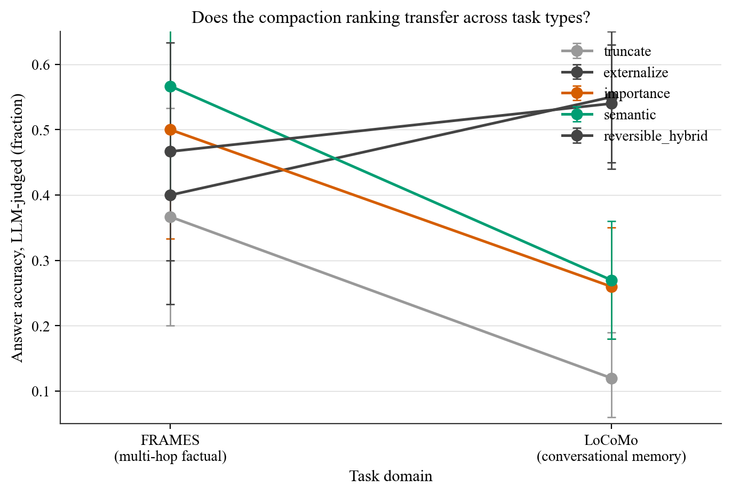
AND SO WHAT?
The best way to forget depends on the task.
Same 7 policies, two task types, three model sizes.
The ranking INVERTS: summarize for factual, keep-the-raw for memory.
The one policy never in the loser group keeps BOTH a summary and the raw.
Error bars are bootstrap 95% CIs (FRAMES is still noisy at n=30).
Founsi.
13

Slide 14
AND SO WHAT?
The policy that ships in most agents is weak.
recency summary = truncation's accuracy, 7× the cost.
Summarizing the stale middle bought nothing over just dropping it, under pressure.
Sub-agent isolation: same accuracy as keeping turns, 5× the cost. A trap on this task.
Both are cost-normalized negatives that anyone running agents can use today.
Founsi.
14

Slide 15
Keep the raw retrievable.
One principle survives task type, model size, and the OSS systems: forget cheaply in-window, but keep the detail recoverable.
Founsi.
15

Slide 16
HOW TO CHECK ME
Every number is a folder you can open.
Each run: experiments/runs/EXP-NNN__slug__UTC/ — config + git sha, every prompt and response, results.csv, the figure.
Bootstrap CIs + McNemar tests (experiments/stats.py); seeded; rate-limited + cached so re-runs are free.
The bar: a stranger clones the repo and regenerates any figure. The whole study cost $0 (free NIM API).
DECISIONS.md logs every call we made and every one we changed.
Founsi.
16

Slide 17




FIND ME
Clone it. Break it. Tell me I'm wrong.
Repo
Learn Agentic AI
X · @above_almighty
LinkedIn
github.com/kanishkpatel1995/agent-harness
Founsi.
17

