Slide 1

AI TINKERERS · CALGARY · JUNE 23, 2026
Context Engineering
Inside the Harness
Which way of forgetting keeps a long-running agent alive? I built the bake-off to find out.
Kanishk Patel · Founsi AI · Learn Agentic AI

Slide 2

THE PROBLEM
Brilliant at 5 steps. Dead at 50.
step 05 search("France GDP 2023") ✓ found step 06 reason → draft answer ✓ step 48 search("France GDP 2023") ✓ step 49 search("France GDP 2023") ↺ already knew step 50 search("France capital") ↺ looping step 51 ... ✗ context_length_exceeded (8192 tok)
Same model. Same code.
Nothing changed in the model — something filled up.
Founsi.
2

Slide 3
WHY IT DIES
The window is a budget, not a backpack.
Stateless model: every turn you re-send the whole history. Cost and latency climb with it.
Attention spreads thin — models read the middle of a long context worst (“lost in the middle”).
Raw context collapses 0.62 → 0.12 as the run grows. A short clean summary holds near 0.58.
EXP-002 · needle recall vs. run length, Llama-3.1-8B. Bigger window raises the ceiling; it doesn't bend the curve.
Founsi.
3

Slide 4
THE REFRAME
Engineer what the model sees,
every single turn.
The model is a commodity you rent. The harness is the part you build.
Founsi.
4

Slide 5
THE MENTAL MODEL
The list IS the mind.
Perceive
read tool results
Think
the LLM call
Act
call a tool
every turn, the harness rebuilds one list of messages and hands it over
The model remembers nothing. That freshly-built list is the agent's entire mind for the turn.
If the agent forgot its goal, the goal wasn't in the list. No magic — just: what do we put in the list?
Founsi.
5

Slide 6
THE DESIGN SPACE
Five architectures keep an agent alive.
Truncate
Compact
Externalize
Isolate
Hybrid
drop the
oldest turns
summarize
the middle
move raw
to a store
fan out to
sub-agents
keep both
at once
When the window's over budget, every system makes one of these moves — plus a choice of where the dropped bytes go. Yours, LangChain's, MemGPT's, Mem0's: all points on one map.
truncate · compact · externalize · isolate · hybrid (composes the rest). Full map: docs/ARCHITECTURES.md.
Founsi.
6

Slide 7
YOU'RE NOT ALONE
How the famous memory systems map.
LangGraph · trim_messages → truncate. Keep the last N tokens, drop the rest.
LangChain · summary-buffer → compact. The shipped default — and it loses to truncate under pressure.
Mem0 → externalize. An LLM extracts + dedupes facts into a vector/graph store.
MemGPT / Letta → pin + externalize. Agent-managed core blocks + an archival DB.
Anthropic multi-agent research → isolate. Sub-agents, each with its own fresh context window.
Sakana Fugu · shipped Jun 22 2026 → isolate / orchestrate. Routes across models — cited, not benched.
Founsi.
7

Slide 8
THE LEVERS
Five moves. One matters tonight.
Pin keep the goal + system prompt — never dropped.
Truncate cap giant tool outputs before they land.
Compact summarize the stale middle, drop the raw turns — where agents live or die.
Externalize write findings to disk; the window stays small.
Cap hard limits on steps, tokens, dollars.
I could give a talk on each. Tonight I go deep on compaction — it's the one doing the real work.
Founsi.
8

Slide 9
MOVE 1 / 5 · CONTEXT.PY
Pin
Keep the goal + system prompt fixed at the top — never dropped.
PINNED
goal + system
everything else can be dropped.
this block cannot.
tool result (old)
tool result
recent turn
Pinned: survives every compaction. The agent never forgets why it's here.
Founsi.
9

Slide 10
MOVE 2 / 5 · CONTEXT.PY
Truncate
Cap a giant tool output before it lands in the window.
tool output
200 KB
first 2 KB
kept
rest → notes.md
Keep the head; the full text goes to disk. One 200 KB page can't drown the window.
Founsi.
10

Slide 11
MOVE 3 / 5 · CONTEXT.PY
Compact
Summarize the stale middle into one note; drop the raw turns.
before
after
sys + goal
sys + goal
turn A
summary A–C
turn B
recent
turn C
The middle is the low-attention zone anyway — replace it with a tight summary.
Founsi.
11

Slide 12
MOVE 4 / 5 · MEMORY.PY
Externalize
Write findings to disk; keep only a pointer in the window.
goal + system
notes.md (disk)
full findings, unbounded
[saved #3] ↩
[saved #4] ↩
recent turn
The window stays small; memory is unbounded — and compaction becomes safe.
Founsi.
12

Slide 13
MOVE 5 / 5 · BUDGET.PY
Cap
Hard limits on steps, tokens, and dollars — the kill switch.
steps
18 / 30
tokens
9.9k / 50k
dollars
$0.12 / $1.00
red line = the cap
Fail soft: when a cap trips, stop and return the best answer so far. Never crash.
Founsi.
13

Slide 14
THE HEART
Compact: summarize the middle.
before
after
def maybe_compact(msgs, budget):
if tokens(msgs) <= budget:
return msgs # under budget
head, mid, tail = split(msgs)
mid = safe_split(mid) # keep pairs
summary = llm.summarize(mid)
return head + [summary] + tail
system + goal
system + goal
tool: 2KB page
summary
tool: 2KB page
recent turn
tool: 2KB page
The gotcha: never split a tool-call from its result — real APIs reject that transcript. _safe_split handles it.
But compaction always forgets something — on purpose. So which way of forgetting loses the least?
Founsi.
14

Slide 15
LIVE DEMO
Watch it compact — and keep going.
$ python run.py "context engineering for long-running agents" [FakeLLM: offline, deterministic — no API key, no network] STEP 6 tokens=3,662 context [███████████████████·············] 53% STEP 7 tokens=5,516 context [██████████████████████████████···] 77% ⚙ COMPACTED → window 1,336 tok. old turns summarized. STEP 8 context back down — agent keeps working → finish() ═══ DONE 10 steps · facts intact in run/notes.md ═══
the bar crosses the threshold, snaps back, and the run survives — 5 steps vs 50.
Run it yourself: git clone github.com/kanishkpatel1995/agent-harness && python run.py — no API key. Swap models with --model.
Founsi.
15

Slide 16
LIVE DEMO · ONE INTERFACE, SEVEN WAYS
Watch them forget — side by side.
$ python -m harness.compare "quantum networking startups" policy architecture llm fact? truncate truncate 0 ✗ lost recency compact 1 ✗ lost importance compact 1 ✓ kept semantic compact 2 ✗ lost externalize externalize 0 ✓ kept subagent isolate 6 ✗ lost ← priciest, still loses reversible_hybrid hybrid 1 ✓ kept ← cheap, and recovers
Same planted fact, seven policies, one offline command (no key). Truncate drops it, summaries blur it, the sub-agent fan-out is priciest and still loses — the hybrid is the cheap one that recovers it.
Founsi.
16

Slide 17
ZERO TO ONE · WHICH COMPACTION?
Which way of forgetting loses the least?
Compaction stays bounded by forgetting — on purpose. Each policy below forgets differently (drop · summarize · externalize · or both). I measured which keeps the most answer-relevant facts per token.
policy
how it forgets
cost
truncate
drop the oldest raw turns
$
recency
summarize stale middle (the shipped default)
$$
importance
keep highest-signal turns verbatim
$$$
semantic
cluster by topic, summarize each
$$$$
externalize
write raw to a store, retrieve at answer
$
reversible_hybrid
summary in window + raw retrievable (ours)
$$
Plant checkable facts in the sources; count how many survive each policy, per token spent. Judged by a fixed 70B. (+subagent in appendix.)
Founsi.
17

Slide 18
HOW WE TEST IT
The bake-off: what we actually ran.
read sources
the agent reads
compact
under each policy
answer
the question
judge
fixed 70B
A tight 1.5k-token budget forces 10–20 compactions per question — so the policy actually matters. Oracle sources isolate compaction from search.
Llama 3.1 8B the dev model — runs the bulk of the cells.
Llama 3.3 70B does the 8B ranking hold as the model gets stronger?
Nemotron 30B-A3B a reasoning model — does answer-time reasoning change the ranking?
70B judge (fixed) the same grader across every arm and model — the metric held constant.
Founsi.
18

Slide 19
THE DATASETS & THE METRIC
Two task types, one judge.
FRAMES — multi-hop factual QA
LoCoMo — conversational memory
Q “Who was U.S. president when the maker of the iPhone was founded?” A Gerald Ford — Apple was founded in 1976.
Q “What pet did Maria say she adopted last spring?” A a rescue greyhound named Pip — said back in session 4.
824 questions · reason across several gold articles.
10 convos · ~19 sessions · facts scattered across the history.
The metric: an LLM judge (fixed 70B) credits a correct-but-paraphrased answer — a naive substring match inverted the ranking. FRAMES rewards a summarized reasoning chain; LoCoMo rewards exact scattered facts.
Q/A examples are illustrative of each task type.
Founsi.
19

Slide 20
OUR TECHNIQUE
How reversible-hybrid differs from the five.
policy
compressed gist
in-window
lossless raw
retrievable
truncate
—
—
recency · importance · semantic
✓
—
externalize
—
✓
reversible_hybrid
✓
✓
Every other policy keeps ONE thing. reversible-hybrid keeps both — so it can pick up whichever mechanism the task needs (gist for reasoning, raw for exact facts).
Founsi.
20

Slide 21
RESULTS · THE BAKE-OFF
Under pressure, the policies separate.
EXP-003b · FRAMES, 8B, high pressure, judged (n=30).
The shipped default (recency) is Pareto-dominated by plain truncation — 7x the cost, same accuracy.
Sub-agent isolation: 5x the cost of importance, no accuracy gain.
Structure-preserving (semantic, importance) lead on accuracy; reversible-hybrid is Pareto-efficient.
Accuracy by policy. Cost (tokens/q) is in the appendix table.
Founsi.
21

Slide 22
THE RESULT
Never the best. Never the worst. Everywhere.
arm
FR-8B
FR-70B
LC-8B
LC-70B
reversible_hybrid
0.47
0.67
0.54
0.53
externalize
0.40
0.63
0.55
0.55
importance
0.50
0.60
0.26
0.23
semantic
0.57
0.53
0.27
0.17
truncate
0.37
0.27
0.12
0.09
reversible-hybrid is in the top group of every cell — the only arm that is. The single winner is task-dependent (semantic on factual, externalize on memory) — the ranking even inverts.
FR = FRAMES (factual), LC = LoCoMo (memory). n=30, judged by a fixed 70B; SE ≈ 0.09. Full matrices in appendix.
Founsi.
22

Slide 23




THE ONE SENTENCE
The model is a commodity you rent.
The harness — what it forgets — is the part you build.
Clone it tonight — it runs with no API key. Any model, one flag.
Repo
Learn Agentic AI
@above_almighty
LinkedIn
Founsi.
23

Slide 24
APPENDIX
The full trace
Landscape · the 7 policies · our technique · setup · every result · protocol · references.
Founsi.
24

Slide 25
THE LANDSCAPE
Everyone compacts. Nobody measured which way.
Anthropic names the moves — compaction, structured note-taking, “context rot.”
Cognition (Devin) “context engineering is the #1 job”; don't fragment it across agents.
LangChain · LlamaIndex memory abstractions — summary buffers, vector memory.
MemGPT · Letta treat the window like RAM; page facts to an external store.
RAG (Lewis, 2020) retrieve from a store instead of stuffing the prompt.
Founsi.
25

Slide 26
THE TECHNIQUES · AT A GLANCE
Seven ways to forget.
policy
what it does
keeps
cost
truncate
drop the oldest raw turns
recent only
$
recency
summarize stale middle (default)
summary + recent
$$
importance
keep highest-signal turns
key turns
$$$
semantic
cluster by topic, summarize
topic structure
$$$$
externalize
write to store, retrieve
all (indexed)
$
subagent
isolate sub-tasks
per-task context
$$$$$
reversible_hybrid
summary + raw retrievable
both
$$
Founsi.
26

Slide 27
THE TECHNIQUES · FLOW
Drop it, or summarize the middle.
truncate
window
old … recent
drop old
no LLM
recent only
facts lost
Cheapest. Loses the most — old facts vanish without a trace.
recency
window
old … recent
summarize middle
1 LLM call
summary + recent
stale flattened
The shipped default (Claude Code / LangChain). Flattens the middle.
Both are summary-or-drop: once a fact leaves the window, only the (possibly lossy) summary remains.
Founsi.
27

Slide 28
THE TECHNIQUES · FLOW
Keep the signal, or cluster the topics.
importance
window
turns
rank by signal
score turns
keep top verbatim
structure kept
Keeps the highest-signal turns word-for-word; drops the chatter.
semantic
window
turns
cluster by topic
embeddings
summarize each
topic map
Groups by topic, summarizes each cluster — preserves the shape of the work.
Structure-preserving: these led on FRAMES factual QA, where a summarized reasoning chain helps.
Founsi.
28

Slide 29
THE TECHNIQUES · FLOW
Page it out, or spin up a fresh mind.
externalize
window
turns
write → store
embeddings
retrieve at answer
k-NN lookup
Pages raw turns to a vector store; pulls the relevant ones back at answer time.
subagent
task
sub-goal
fresh window
isolated run
return result
5x the cost
Isolates a sub-task in its own clean window — the multi-agent move. Expensive.
Retrieval-based: externalize keeps the literal fact, which wins on conversational memory.
Founsi.
29

Slide 30
OUR TECHNIQUE
reversible-hybrid: keep the summary AND the raw.
summary
in the window
answer prompt
summary + recent
retrieve top-k
raw, on demand
stale window
old turns
raw turns
→ embedding store
Summary keeps the gist cheaply in-window; raw stays losslessly retrievable. Prior systems do one or the other — we keep both.
Prediction (and result): never the single best, but never in the loser group — robust across task type and model size.
Founsi.
30

Slide 31
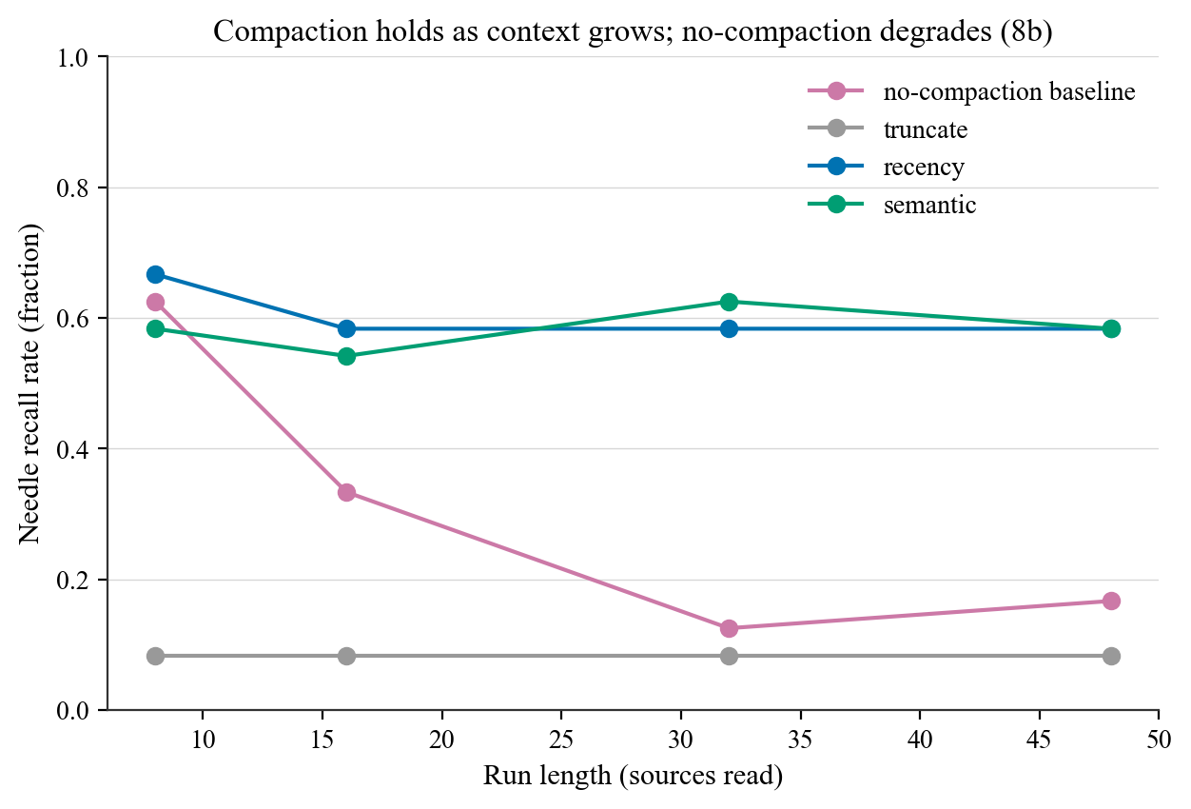
RESULTS · MECHANISM
Facts survive, and compaction beats raw.
EXP-001: planted facts survive a compaction — truncation drops them, summaries keep ~2-3x more.
EXP-002: raw context collapses with length while compaction holds flat. Crossover ≈ 16 sources.
The mechanism behind every impact result.
Founsi.
31

Slide 32
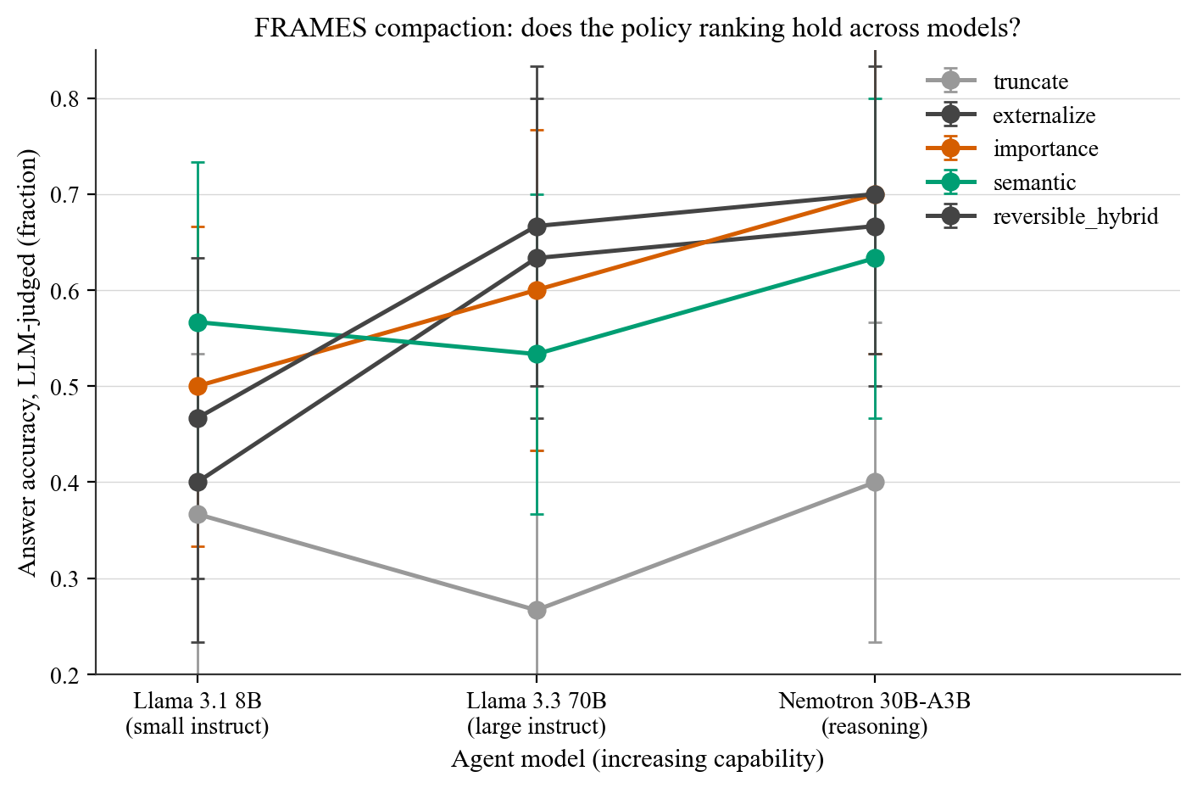
RESULTS · THE MODEL AXIS
Capability widens the smart-vs-blind gap.
Five arms across 8B → 70B → reasoning, judge fixed at 70B.
Blind truncation never improves (0.37, 0.27, 0.40) — a better model can't recover dropped context.
Every structure/retrieval arm climbs; the gap to truncation grows ~0.2 → ~0.3.
Founsi.
32

Slide 33
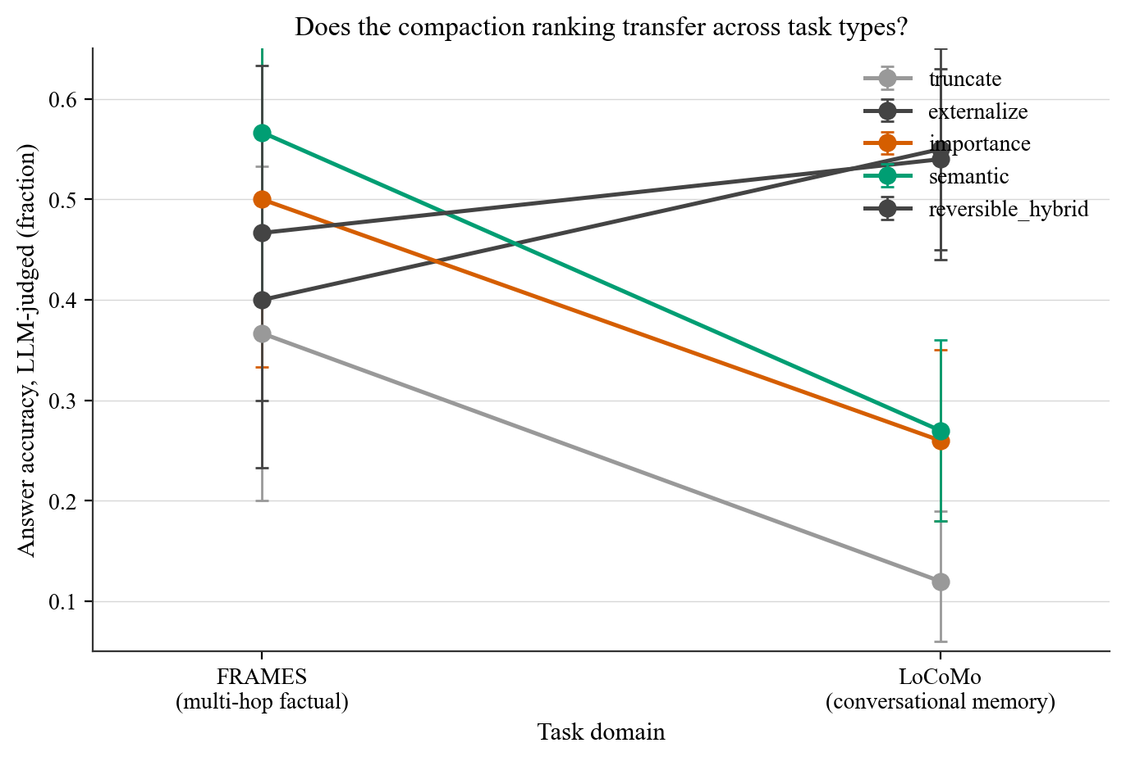
RESULTS · CROSS-DOMAIN
The ranking inverts — the hybrid spans both.
Same arms on LoCoMo (memory) vs FRAMES (factual).
Inversion: on memory, retrieval wins (externalize 0.55); pure summary collapses (semantic 0.27).
reversible-hybrid is top-group in BOTH (0.47 / 0.54) — it keeps both mechanisms.
Founsi.
33

Slide 34
RESULTS · FRAMES MODEL AXIS
FRAMES · 8B / 70B / reasoning (n=30).
arm
8B
70B
reason
truncate
0.37
0.27
0.40
externalize
0.40
0.63
0.67
importance
0.50
0.60
0.70
semantic
0.57
0.53
0.63
reversible_hybrid
0.47
0.67
0.70
Reasoning tier uses a fast 8B summarizer for compaction (the reasoning model self-summarized too slowly); it only answers.
Founsi.
34

Slide 35
RESULTS · COST & LATENCY
What each policy costs to run.
arm
accuracy*
tokens/q
rel. latency
truncate
0.37
1.2k
fastest
externalize
0.40
1.9k
fast (+embed)
reversible_hybrid
0.47
9.9k
moderate
importance
0.50
14.2k
slow
semantic
0.57
18.7k
slowest
*FRAMES 8B high pressure (EXP-003b). Latency observed: 8B ~2s, 70B ~6-8s; reasoning models bill ~6x tokens.
Founsi.
35

Slide 36
THE THROUGH-LINE
Six claims, backed by evidence.
Policy matters only under pressure — at low pressure they tie.
The metric must credit paraphrase — a careless substring metric inverts the ranking.
The shipped default (recency-summary) is weak — Pareto-dominated by truncation under pressure.
The smart-vs-blind gap widens with capability (FRAMES) and persists on memory (LoCoMo).
The best single policy is task-dependent — summary on factual, retrieval on memory.
reversible-hybrid is the robust hedge: top group across task type AND model size. Keep the raw retrievable.
Founsi.
36

Slide 37
THIS MATCHES WHAT OTHERS SEE
We're not alone.
Lost in the Middle (2307.03172) long contexts attend to the ends — our EXP-002 crossover is the same effect.
MemGPT / Mem0 / Letta page facts to an external store — our externalize & hybrid win where memory matters.
ACON (2510.00615) compress agent context; we add the which-way-is-best measurement.
RAG (Lewis, 2020) retrieval-as-compaction — our hybrid is RAG fused with summary memory.
Founsi.
37

Slide 38
FUTURE WORK · HOW YOU CAN HELP
Where this goes next.
Hold the summarizer constant across tiers; a reasoning tier on LoCoMo; larger N for tight bars.
Trained importance/semantic rankers instead of heuristics; a tuned reversible store.
LangChain summary-memory as a head-to-head baseline arm.
You can help: try a policy on your agent, add a dataset, or PR an arm. It's all reproducible.
Founsi.
38

Slide 39
HOW WE KEEP IT HONEST
Every experiment is a traceable run.
Hypothesis + assumptions stated before any code is written.
Each run writes EXP-NNN__slug__<UTC>/ with manifest.yaml · prompts.jsonl · results.csv · figures/ · README.
Rate-limited + cached so reruns are free; seed everything; fail soft per cell; a watchdog kills hung calls.
Founsi.
39

Slide 40
HOW TO READ THIS REPO
What's in the project.
agent-harness/
├─ harness/ the teaching harness: the loop + ContextManager
├─ experiments/ the research: bench/ + applied/ (FRAMES, LoCoMo)
│ └─ runs/ one folder per run: manifest + prompts + results
├─ docs/research-track/ curriculum · paper · literature · protocol
├─ presentation/ this deck + Founsi brand + figures
└─ tests/ offline tests (no API key needed)
Start at harness/loop.py (the loop), then experiments/applied/policies.py (the seven arms).
Founsi.
40

Slide 41
REFERENCES
The literature this stands on.
Lost in the Middle, Liu et al., arXiv:2307.03172.
RULER 2404.06654 · HELMET 2410.02694 · NoLiMa 2502.05167.
MemGPT 2310.08560 · Mem0 2504.19413 · ACON 2510.00615.
Judging LLM-as-a-Judge, Zheng et al., 2306.05685.
FRAMES 2409.12941 · LoCoMo 2402.17753 · RAG (Lewis) 2005.11401.
Founsi.
41

