Slide 1
The Battle of Neighborhoods
CAPSTONE PROJECT PRESENTATION
By-Dilip

Slide 2
INTRODUCTION
The success of establishing a new restaurant depends on several factors: demand, brand loyalty, quality of food, competition, and so on
. In most cases, a restaurant's location plays an essential determinant for its success. Hence, it is advantageous and of utmost importance to determine the most strategic location for establishment in order to maximize business profits.
This project intends to strategically allocate location for establishing an Asian restaurant for our Client.

Slide 3
PROBLEM STATEMENT
A client seeks to establish a franchised Asian restaurant, with a niche in Southeast Asian cuisine, in a Toronto neighborhood.
1. Which neighbourhood would appear to be the optimal and most strategic location for the business operations?
2)Would our Client get back his returns
3) The objective of this capstone project is to locate the optimal neighborhood for operation

Slide 4
Data
Data:The Foursquare API will be used to explore neighborhoods in Toronto, more specifically, we will be using the explore function to get the most common venue categories in each neighborhood.
Neighbourhood names, alongside their corresponding boroughs and postal codes, scraped from Wikipedia: (https://en.wikipedia.org/w/index.php?title=List_of_postal_codes_of_Canada:_M&oldid=945633050)
The Toronto's census data for its social demographic characteristics will be distilled from Toronto's Neighborhood Profile (https://bit.ly/3airrOJ).
Geographical coordinates of each neighbourhood: (https://cocl.us/Geospatial_data)
For returning the number of Asian restaurants in the vicinity of each neighbourhood, we will be utilizing Foursquare API, more specifically, its explore function. One has to register for a Foursquare developer account https://foursquare.com/developers/apps to access their API credentials.

Slide 5
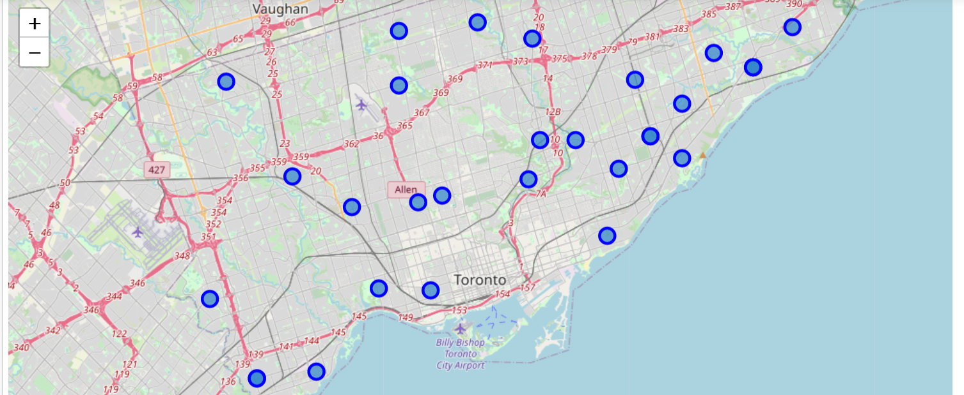
Neighborhoodmarked on map of Toronto
The Geograpical Co-ordinate of Seattle,Washington are 43.773077, -79.257774.

Slide 6
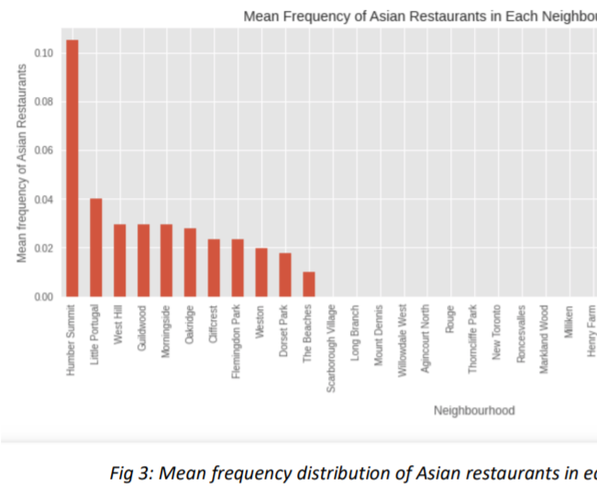
Frequency Distibution of Asian Resturant

Slide 7
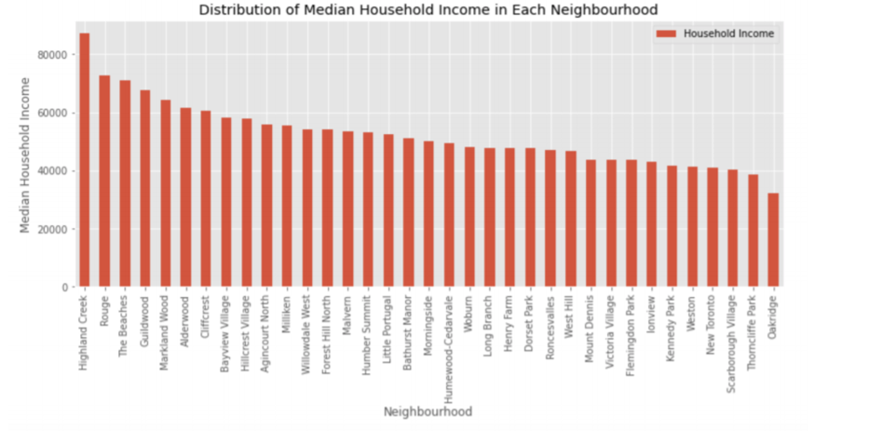
Median House Income

Slide 8
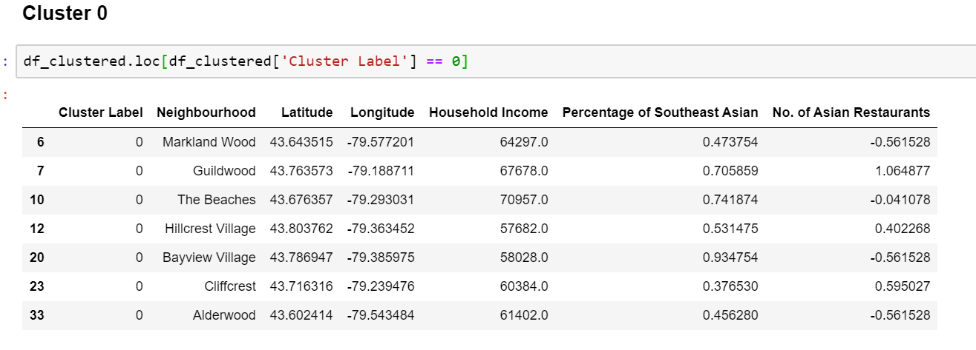
Cluster O
• MID Spending Power
• MID Percentage of Target Customers
• LOW Number of Competitors

Slide 9
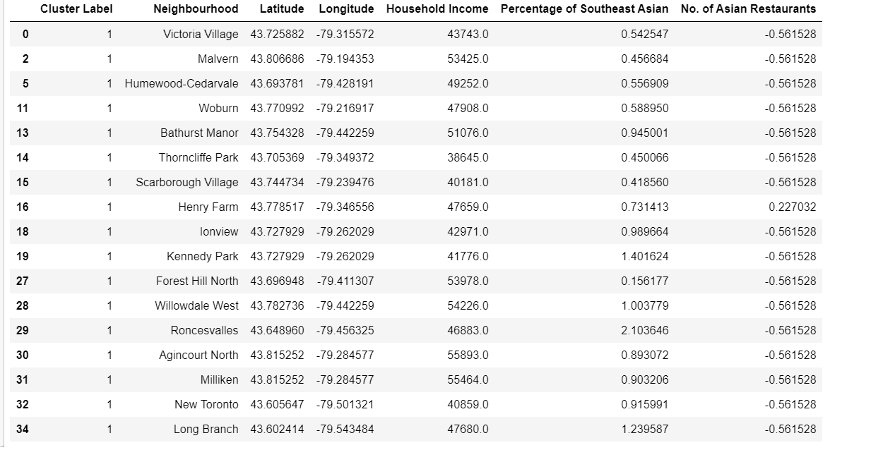
Cluster 1
• LOW Spending Power
• MID Percentage of Target Customers
• LOW Number of Competitors

Slide 10
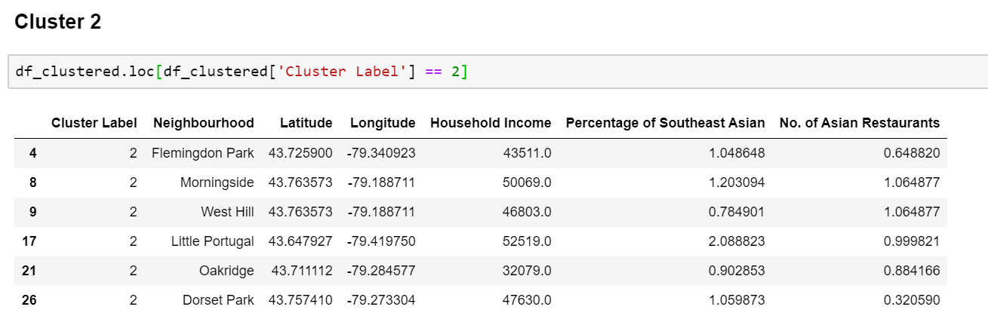
Cluster 2
• LOW Spending Power
• HIGH Percentage of Target Customers
• HIGH Number of Competitors

Slide 11
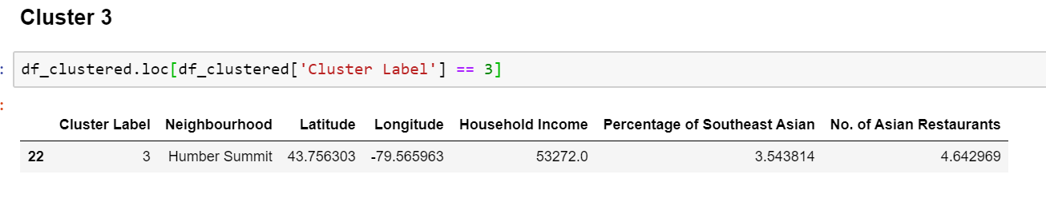
Cluster 3
• MID Spending Power
• HIGH Percentage of Target Customers
• HIGH Number of Competitors

Slide 12
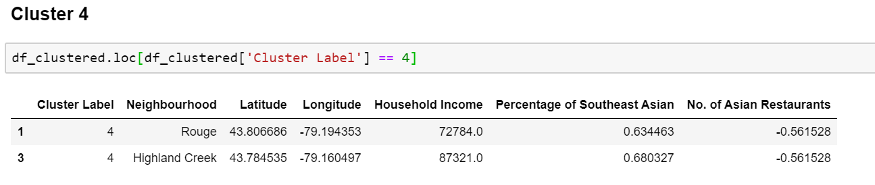
Cluster 4
• HIGH Spending Power
• MID Percentage of Target Customers
•LOW Number of Competitors

Slide 13
Conclusion
In this study, I have labeled the neighbourhoods corresponding to their characteristics-- spending power, percentage of target customers, and the number of competitors. The most promising group of neighbourhoods for opening an Asian Restaurant, with a niche in Southeast Asian cuisine, appears to be ‘Cluster Label 4’
The higher spending power of the neighbourhoods in this cluster allows them to readily afford the slightly upscaled prices of the client’s Asian restaurant menu.

