Slide 1
Log Analyzer
A custom log analyzer tool to present a holistic view with analysis of incoming data

Slide 2
Problem Statement:
A typical deployment of 7 node stack with every user login session being distributed to one of the 7 nodes. The problem was manifolds:
Pool in multiple data sets from several nodes to analyze an issue/behavior
To Identify the most active customers
Identify the Product Usage pattern based on Customers
To project a trend based on user activity
To troubleshoot a customer’s issue
Identify a flight risk customer

Slide 3
Solution Design:
Use Hadoop to map reduce the data set generating a structured data output.
Use the map-reduced output to push the data fast, easily searchable database
Use a tool to analyze large data sets and generate Trends and analysis models

Slide 4
LEARNINGS
Using Hadoop to output JSON files which can be consumed by Elastic Search
Processing JSON post the map-reduce
Understanding the implementation of Elastic Search
Understanding the integration and usage of Elastic Search - Kibana

Slide 5
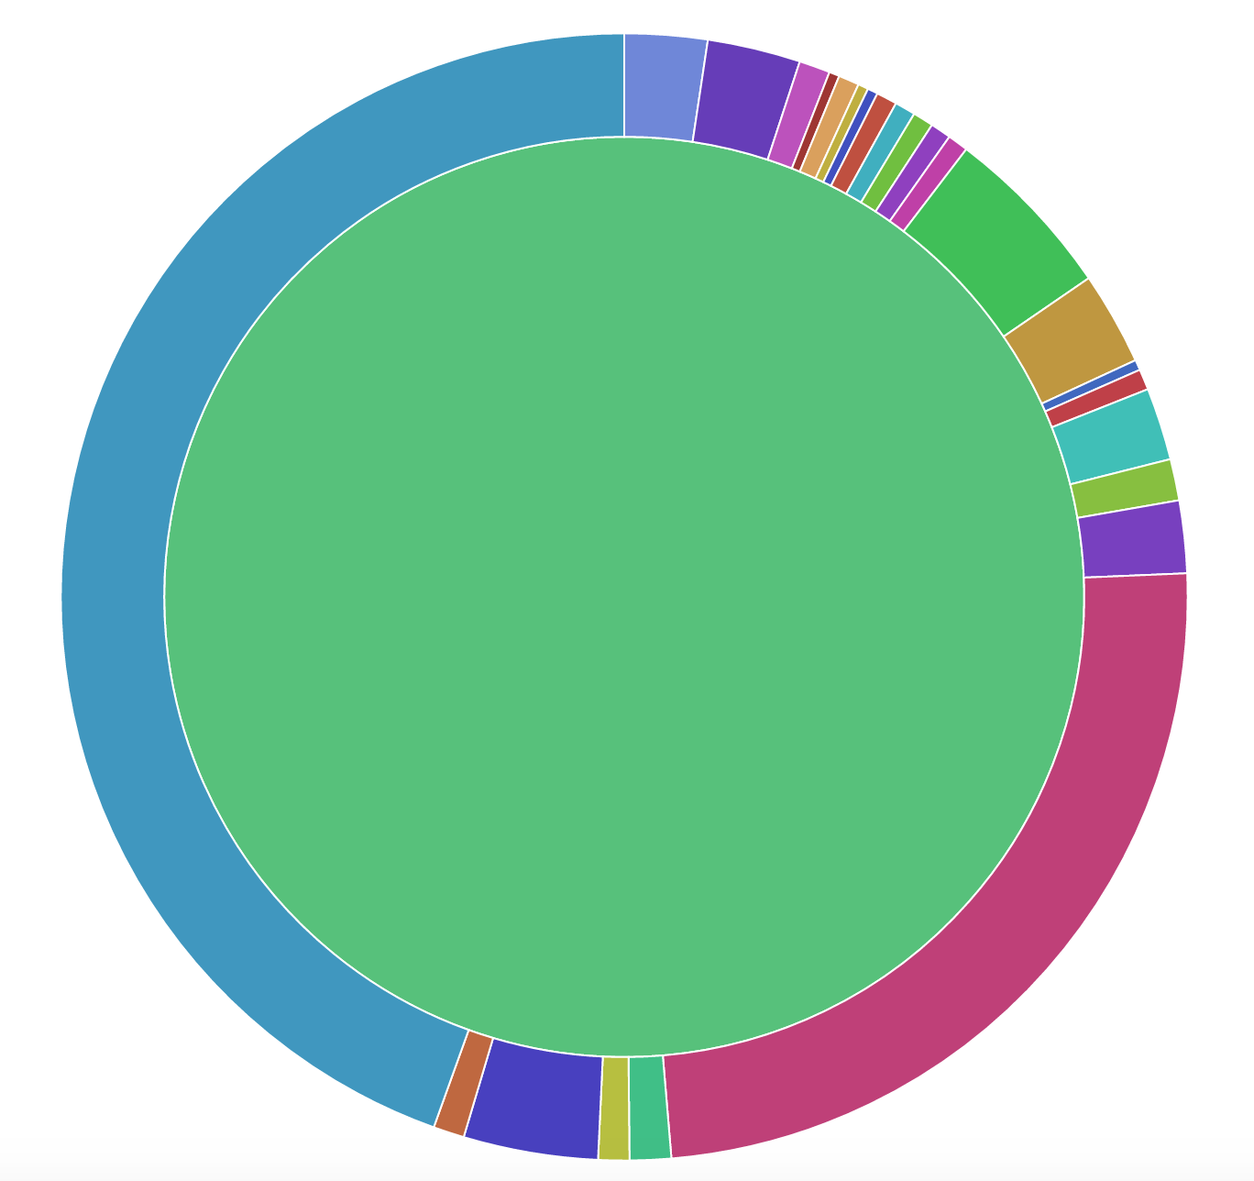
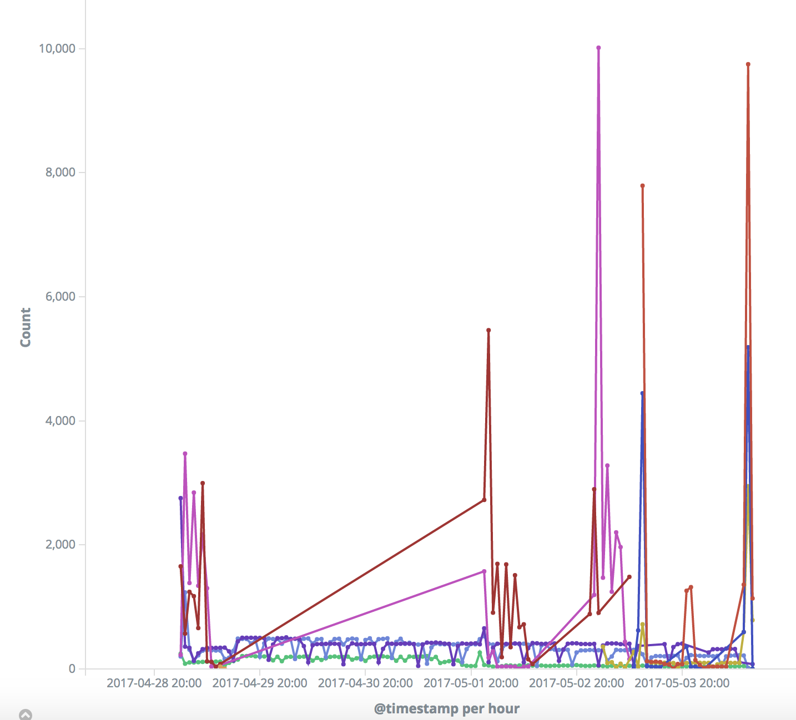



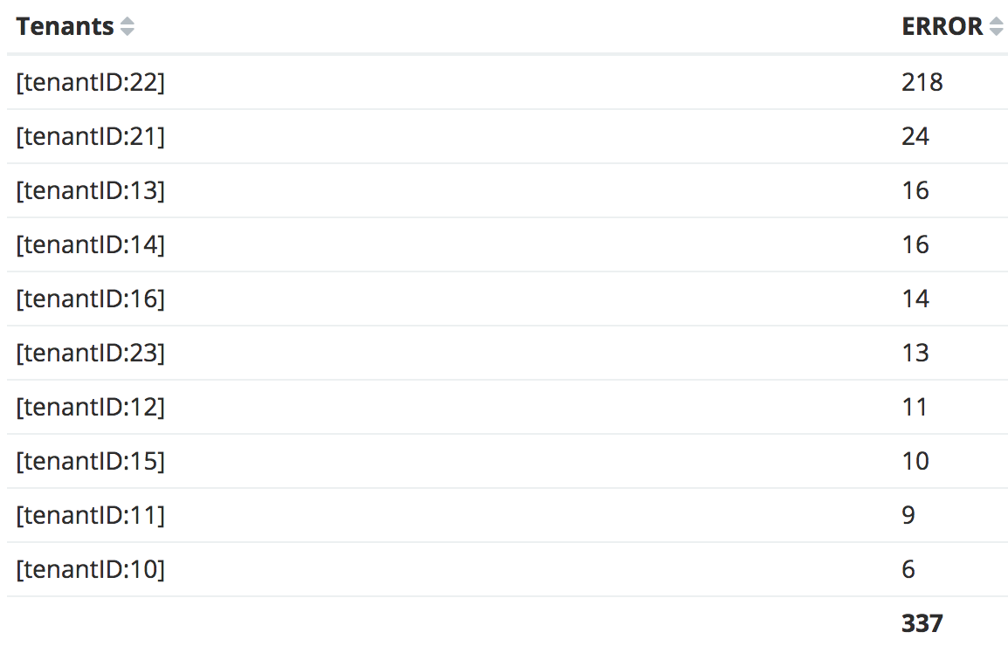

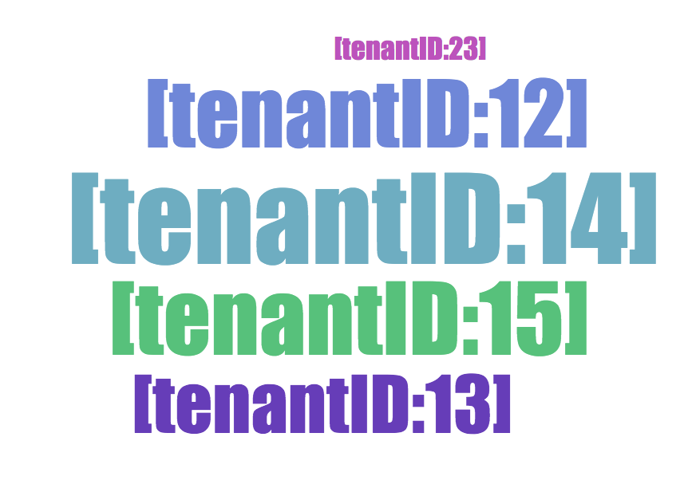
DESIGN
Multi-node stack
Error
Distribution
Activity Trend
Cloud sizing
Customer Trends

Slide 6
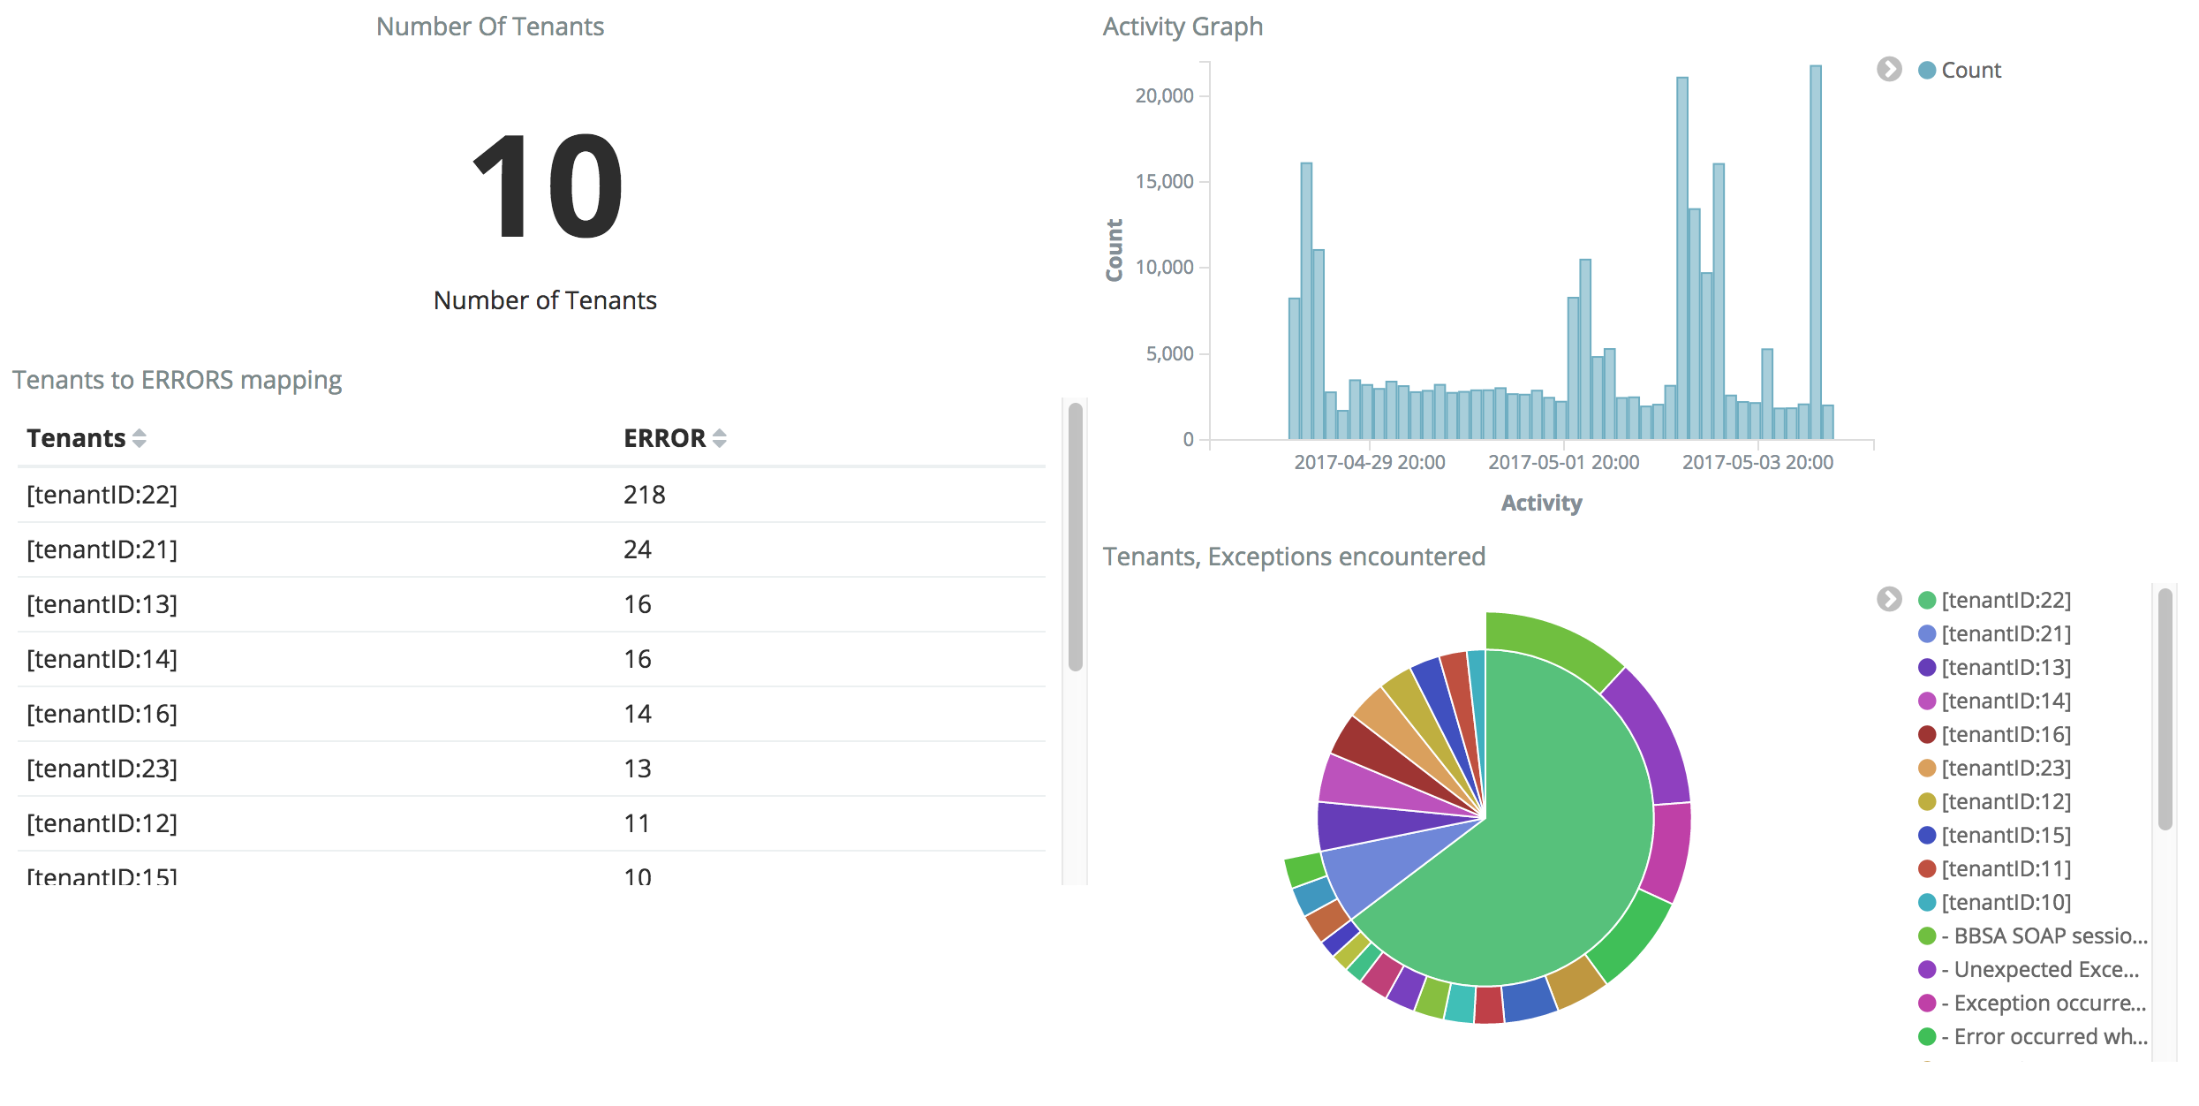
Dashboard View

Slide 7
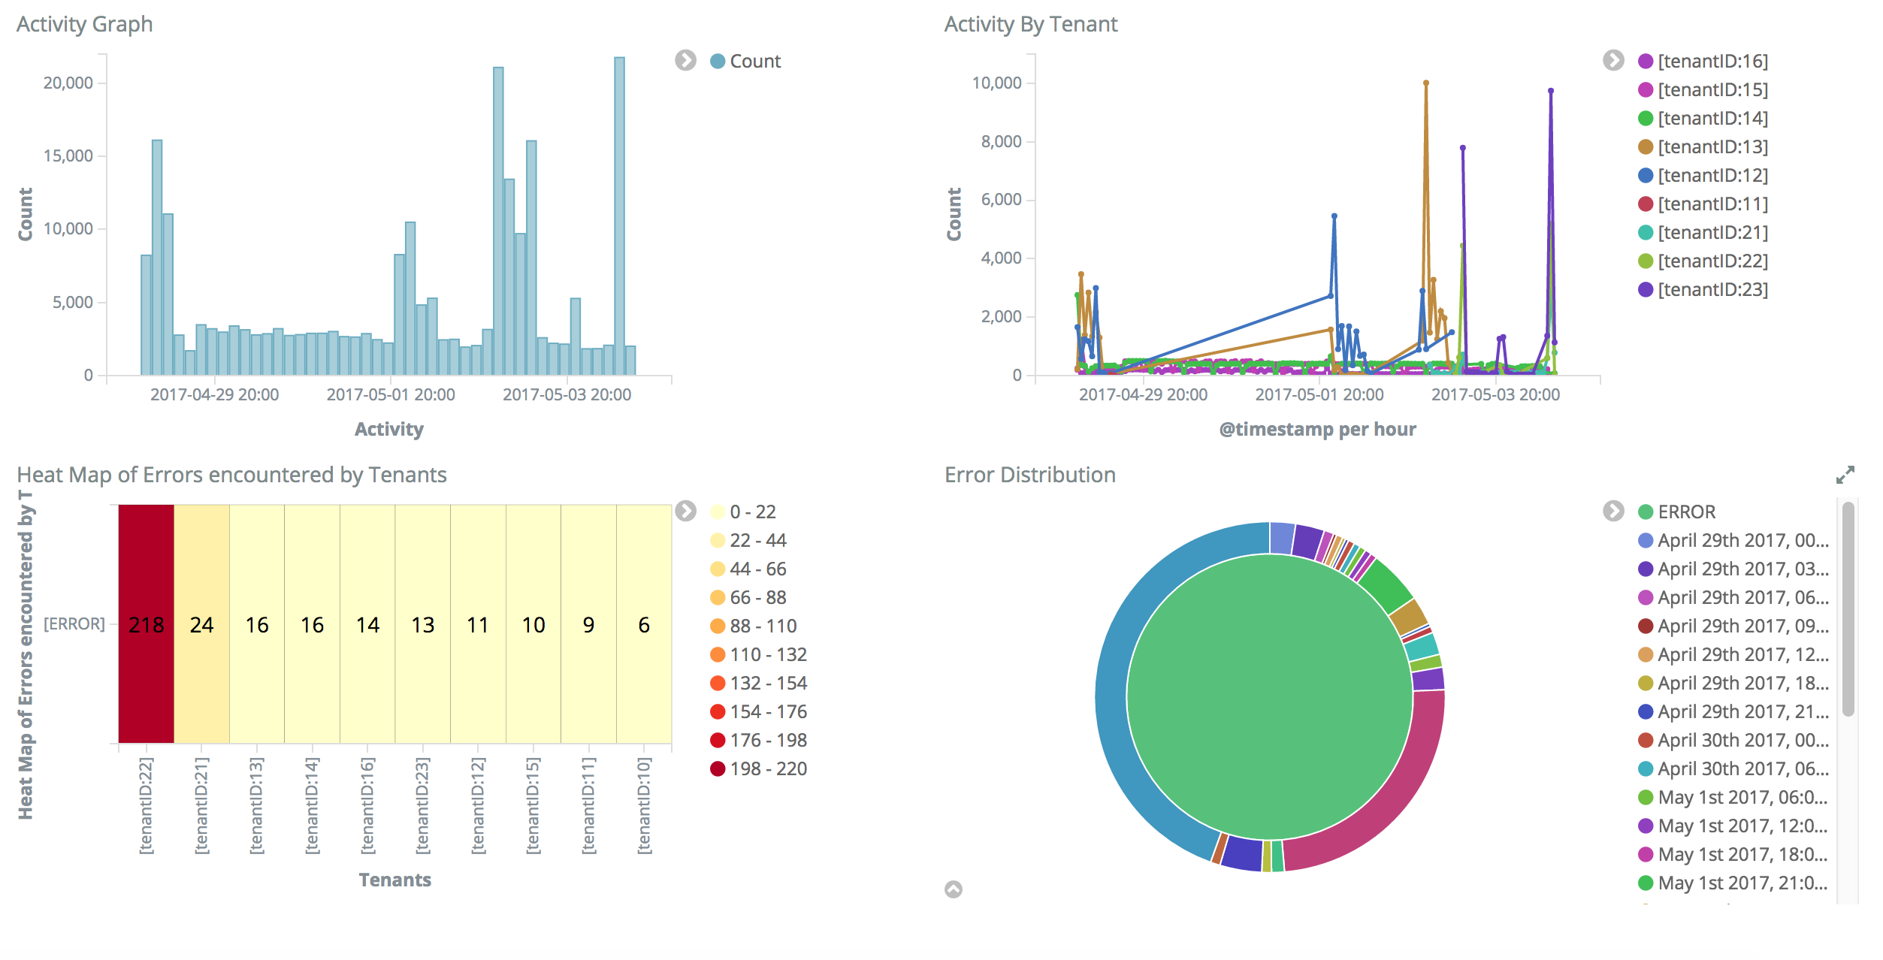
Dashboard View

Slide 8
Road Ahead..
The work on this project is not over yet
Will be used by the Dev Ops team to monitor the customer Activity
Enhancement request:
Categorize Errors from Critical to Low and collate that with the Exceptions seen in the Customer Trends chart helping in determining the Severity of the Issue
Determine a customer based Usage pattern
Create a model to highlight deviation or flight risks

