Slide 1

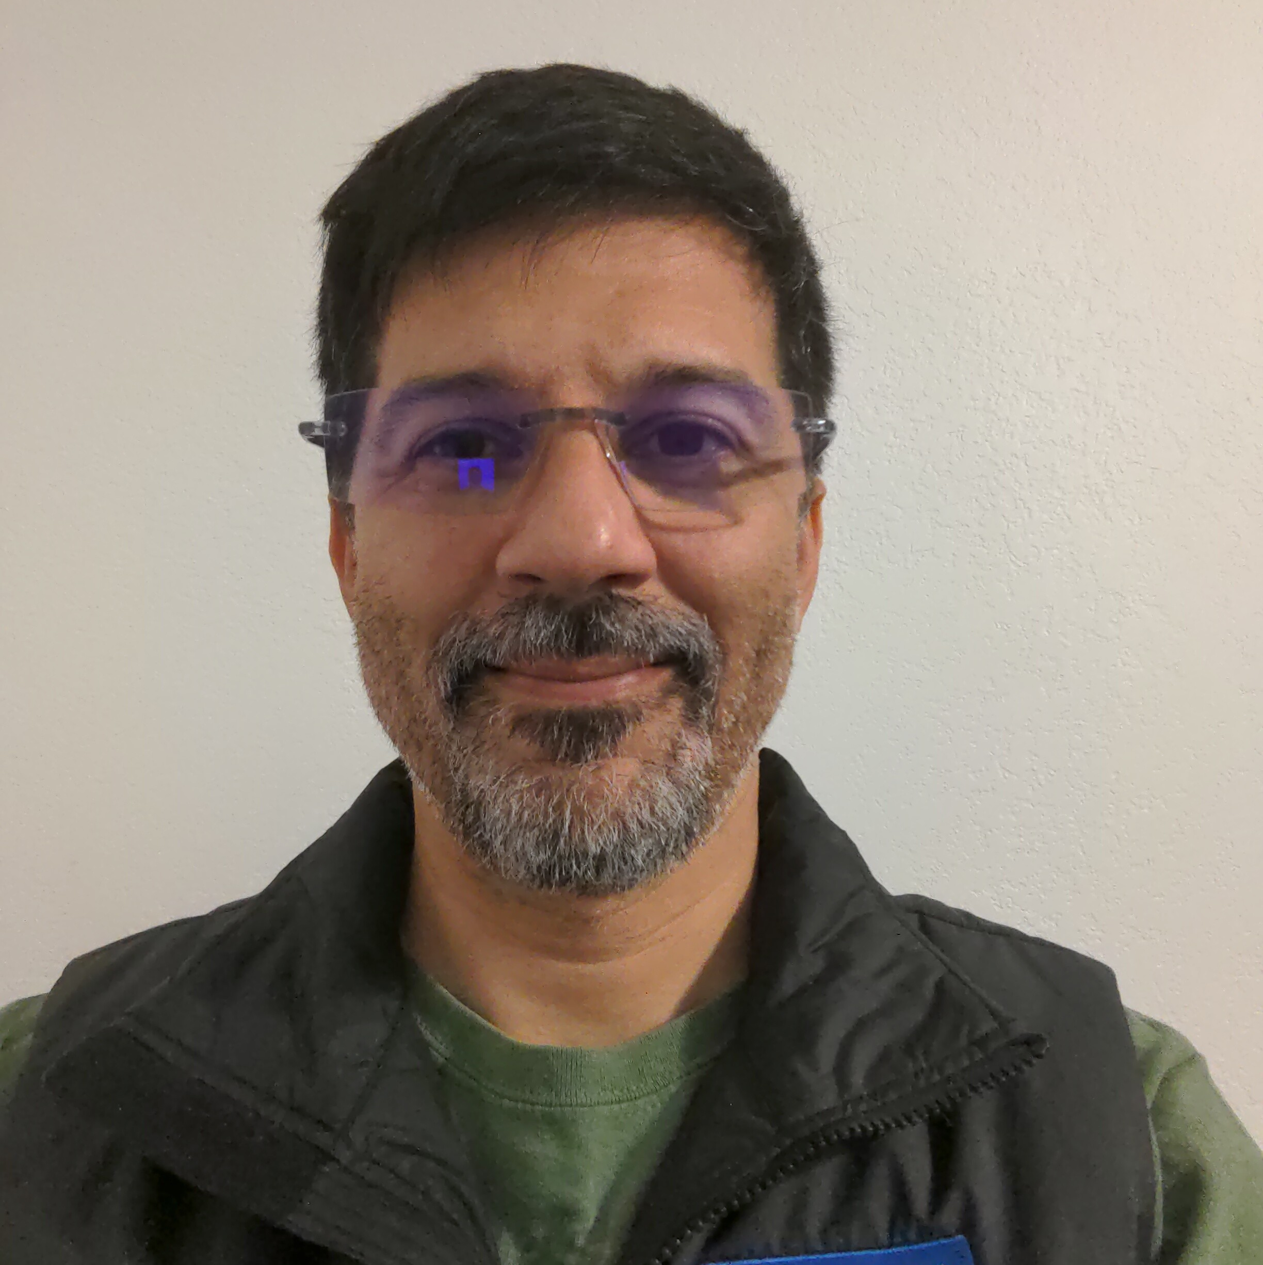
Kubernetes Data Protection Requires Orchestration: Kanister.io Delivers
Michael Courcy
Mark Lavi
Solution Architect
Michael.Courcy@Veeam.com
Principal, Cloud Native Product Manager
Mark.Lavi@Veeam.com
Notes:
Veeam RO: https://veeamsoftwarecorp-my.sharepoint.com/:p:/g/personal/mark_lavi_veeam_com/EfR8pfcjwIRLtPktAsDL8aYBuJ6HTmoUMYWFzBKAkfpaxQ?e=ERI7f7
Public: https://github.com/kanisterio/demo/tree/main/webinar/cncf.io/CNCF.ioWebinar-Kanister.io-Blueprints.pptx

Slide 2
Introductions: Michael and Mark
Data Protection on Kubernetes: Overview
Agenda
Discussion and Demonstration of Kubernetes Data Protection with Kanister.io Blueprints
Conclusions and Resources
Questions and Answers and Thank You!

Slide 3
Data Protection on Kubernetes
An overview of the data protection challenges:
Kubernetes: Stateful versus Stateless Workloads
Why etcd Backup is a Poor Strategy
What is Application Consistent Backup?
How Kanister.io Orchestrates App Consistent Data Protection

Slide 4
Kubernetes: Stateful versus Stateless Workloads
Myth 1: Everything is stateless on Kubernetes!
Kubernetes cluster and application configuration as well as etcd, have state
Secrets, RBAC, DNS, etc.
CNCF Study 2020: 55% of respondents running stateful workloads:
Databases
Virtual Machines (https://KubeVirt.io)
Audit requirements unsatisfied: proof of point in time cluster state configuration
Myth 2: With GitOps, if I lose a cluster, I get a new one and redeploy my applications.
A variation on the above; does not satisfy persistence, data operations, audit, and …
Disaster Recovery (DR): backup artifacts must leave the cluster; clusters are cattle
Myth 3: With public cloud, I am protected.
Public clouds have outages, they recommend disaster recovery!

Slide 5
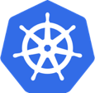
From Stateless to Stateful
v1.0 July 2015
v1.3 July 2016
v1.9 Dec. 2017
v1.13 Dec. 2018
v1.20 Dec. 2020
Today
Stateless applications
Stateful applications and capabilities
“Cattle” PersistentVolumes
Pet Sets Alpha
StatefulSets GA CSI Alpha
CSI GA Operator Framework
VolumeSnapshot GA
Data Service Maturity
86%
14%
started adopting 2+ years ago¹
started adopting in last two years¹
¹ 2021 Data on Kubernetes Report (N=502)
Notes:
Thanks to Matt Bator for creating this summary of DoK.community report

Slide 6
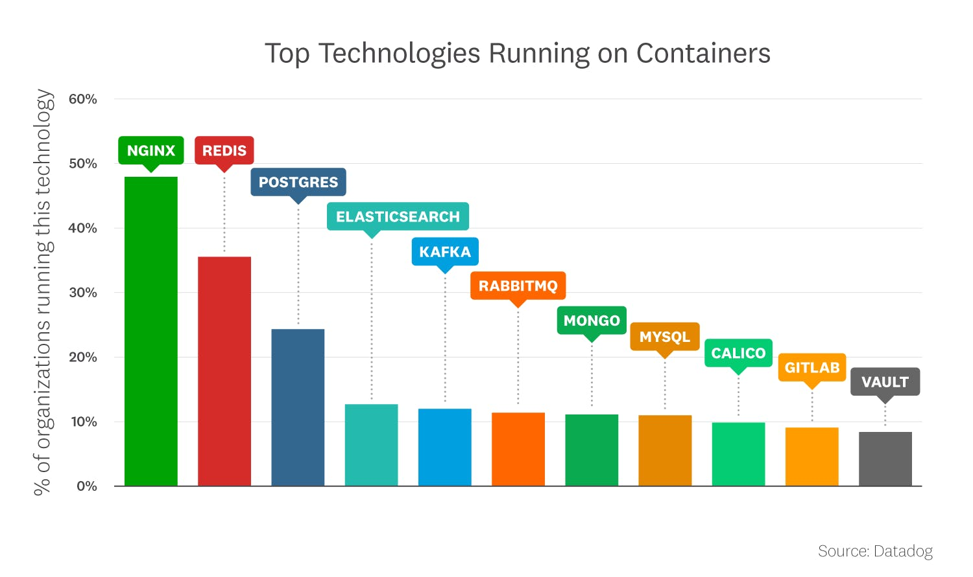
As Kubernetes has matured
Stateful applications are common
Datadog Real-World Container Use Report – Nov 2022
Notes:
Thanks to Matt Bator for creating this summary of DataDogreport
Why would people want to run on cluster?
Duplicating work and in turn reducing value of your Kubernetes investment, potentially detracting from your organization’s goals in adopting container orchestration
The downside is that by maintaining a non-Kubernetes resource outside your cluster, you need to have a way of monitoring processes, performing configuration management, performing load balancing and service discovery for that application. You are essentially duplicating work by setting up a parallel software workflow outside Kubernetes.
1.5+ billion containers
10,000+ Datadog customers
The same report also saw increases in usage of statefulsets and PVCs
Tie in ”we use CI/CD for all of our app deployments” – doesn’t solve for data gravity for things like app mobility when storing state outside of cluster
Praveen – the apps are still doing something with data – do you have a DR plan, how do you deal with recovery for those stateless apps, compliance for these apps? They’re stateless in that they’re focusing on apps running Kubernetes, but the overall environment is not. The critical thing is RECOVERY EXPERIENCE - could be a collection of scripts and they’re OK with it, knowing at scale it will get out of hand but they’re not there yet.
We provide the assurance, the reporting, the ability to easily test.
At shows they only have a few minutes to understand what we do – hard to pack in that value
From Praveen - If we can help make the value prop more concise to deliver faster
If you run into Devs, they’re isolated from being responsible for data protection, so they don’t get the value or risk – how do we get these personas to go back to their teams and influence. Providing proof of compliance, you’ve got a script that one person wrote – have you ever inherited someone else’s code?

Slide 7
Why etcd Backup is a Poor Strategy
Myth: Backing up etcd is needed for Kubernetes!
While good for forensic and audits, in practice, nobody:
restores etcd in production
can easily extract etcd content
Because the cluster state will drift constantly, etcd restoral will fail to bring the cluster back perfectly, requiring further remediation.
Conclusion: you are only as good as your last etcd restoral; test this myth.

Slide 8
What is an Application Consistent Backup?
Direct
Generic
Snapshot
Logical
System
Myth: CSI VolumeSnapshot is good enough to backup my Persistent Volumes!
Direct: using Storage Provider volume snapshots
Generic: mount a filesystem, backup every file
Snapshot: CSI VolumeSnapshot
Problem: All the above are not crash consistent until the application and data are at rest
Logical: Application utility used for backup (e.g.: MySQLdump)
Problem: constantly growing monolithic file or BLOB, not incremental
System: Lock application, flush buffers to storage, CSI VolumeSnapshot, and unlock
Best of both worlds; can be made incremental to save time and storage
Requires orchestration across multiple domains (app, cluster, storage)!
Conclusion: backup on Kubernetes requires orchestration, performance, storage efficiency, and application considerations.

Slide 9
Kubernetes Challenges for Backup and Recovery
Infrastructure Challenges
Managing Backup and Recovery
Switch from AWS S3 to Azure blob storage?
Deal with operations over a fragile network connection? (Mobile, edge)
Manage incremental backup of your PVC?
Discover the content of a secret, deployment, or any object without unmaintainable JSONpath expressions, such as: '.metadata.annotations.kubenetes.io/hostname}'
how do you wait for a scale down or a scale up operation, how do you wait for a status before switching to the next action ?
how do retrieve in a consistent manner credentials of your backup location ?
log all operations in a single place?

Slide 10
Discussion and Demonstration

Slide 11

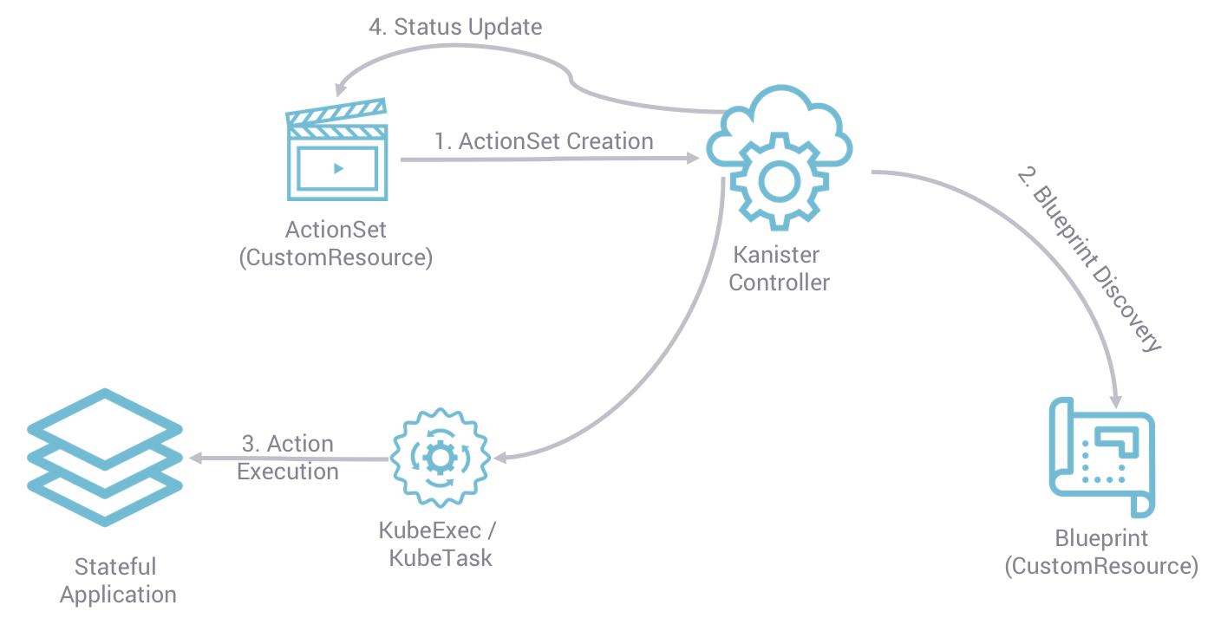
How Kanister.io Orchestrates Data Protection
A cloud native, extensible framework for app consistent operations
A Kanister controller, installed by Helm chart, provides new Custom Resource Definitions:
ActionSet: an instance of a Blueprint operation
Blueprint: orchestrated actions for backup and recovery
Profile: infrastructure endpoint config

Slide 12
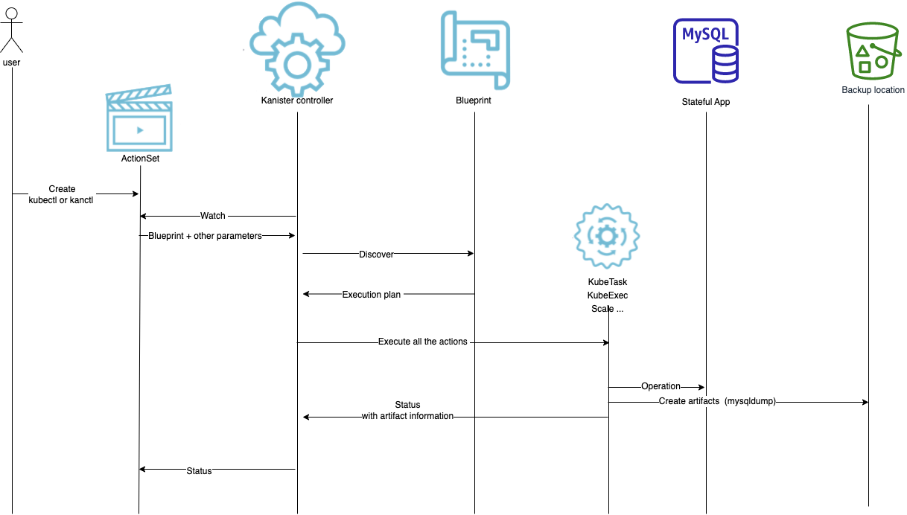
Kanister: in Action

Slide 13
Conclusion

Slide 14
Resources: Where to Go from Here?
Kanister.io is a cloud-native, open source, extensible framework for Kubernetes data protection! Please adopt and join us at:
https://Kanister.io
References
Community: biweekly Zoom meetings and Slack
Tutorial on https://KubeCampus.io
Example blueprints: https://github.com/kanisterio/kanister/tree/master/examples
Today’s webinar materials: https://github.com/kanisterio/demo/tree/main/webinar/cncf.io/
CNCF Survey 2020 https://www.cncf.io/wp-content/uploads/2020/11/CNCF_Survey_Report_2020.pdf
https://Dok.Community: 2021 Report
DataDogHQ.com/container-report/
Kubernetes Data Protection Working Group: Charter and White Paper
KEP-3314 Change Block Tracking

Slide 15
Questions?

Slide 16
Thank You

