Slide 1
Module 4: Overview of Database Design Using the E-R Model

Slide 2
Outline
Overview of the Design Process
The Entity-Relationship Model
Complex Attributes
Mapping Cardinalities
Primary Key
Removing Redundant Attributes in Entity Sets
Reducing ER Diagrams to Relational Schemas

Slide 3
ER model -- Database Modeling
The ER data mode was developed to facilitate database design by allowing specification of an enterprise schema that represents the overall logical structure of a database.
The ER data model employs three basic concepts:
  entity sets,
  relationship sets,
  attributes.
The ER model also has an associated diagrammatic representation, the ER diagram, which can express the overall logical structure of a database graphically.

Slide 4
Entity Sets
An entity is an object that exists and is distinguishable from other objects.
  Example: specific person, company, event, plant
An entity set is a set of entities of the same type that share the same properties.
  Example: set of all persons, companies, trees, holidays
An entity is represented by a set of attributes; i.e., descriptive properties possessed by all members of an entity set.
  Example:
  instructor = (ID, name, salary )
  course= (course_id, title, credits)
A subset of the attributes form a primary key of the entity set; i.e., uniquely identifying each member of the set.

Slide 5
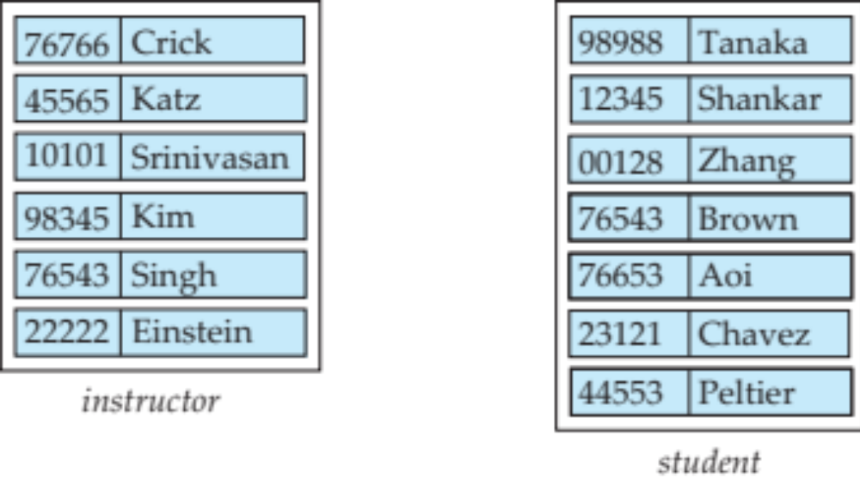
Entity Sets -- instructor and student

Slide 6

Representing Entity sets in ER Diagram
Entity sets can be represented graphically as follows:
  Rectangles represent entity sets.
  Attributes listed inside entity rectangle
  Underline indicates primary key attributes

Slide 7
Relationship Sets
A relationship is an association among several entities
Example:
44553 (Peltier) advisor 22222 (Einstein)
student entity relationship set instructor entity
A relationship set is a mathematical relation among n ≥ 2 entities, each taken from entity sets
{(e₁, e₂, … e_{n}) | e₁ ∈ E₁, e₂ ∈ E₂, …, e_{n} ∈ E_{n}}
where (e₁, e₂, …, e_{n}) is a relationship
  Example:
  (44553,22222) ∈ advisor

Slide 8
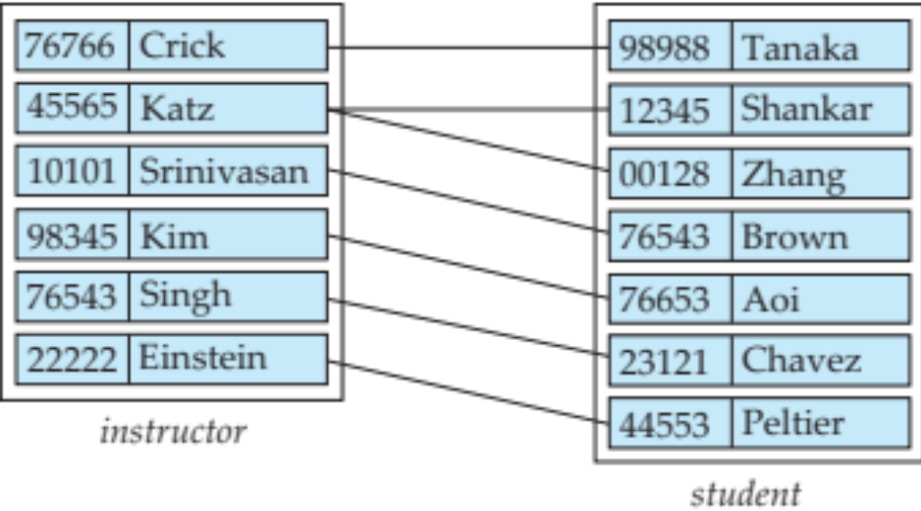
Relationship Sets (Cont.)
Example: we define the relationship set advisor to denote the associations between students and the instructors who act as their advisors.
Pictorially, we draw a line between related entities.

Slide 9
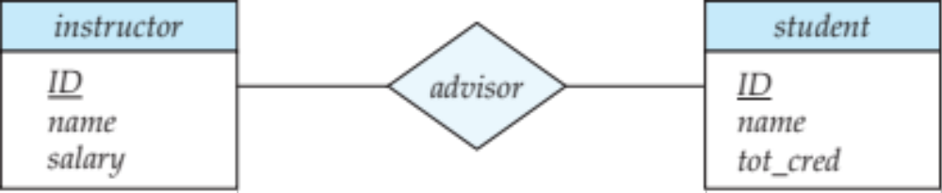
Representing Relationship Sets via ER Diagrams
Diamonds represent relationship sets.

Slide 10
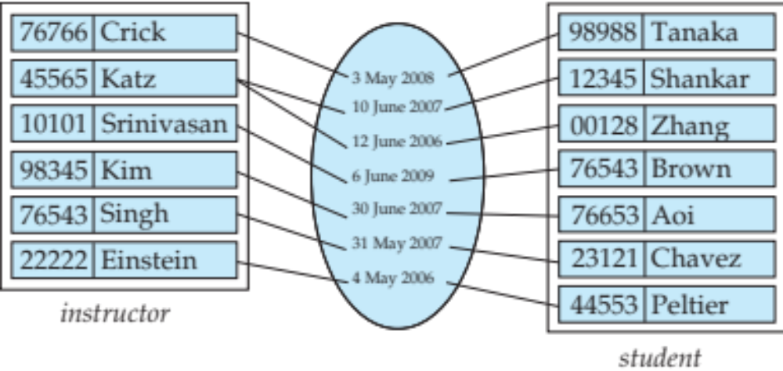
Relationship Sets (Cont.)
An attribute can also be associated with a relationship set.
For instance, the advisor relationship set between entity sets instructor and student may have the attribute date which tracks when the student started being associated with the advisor

Slide 11
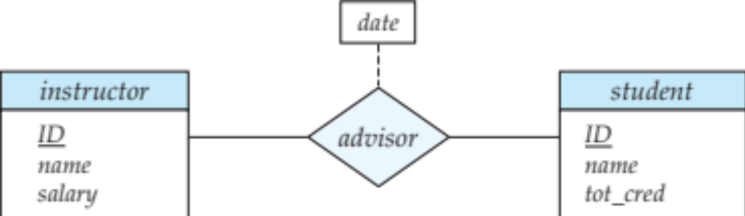
Relationship Sets with Attributes

Slide 12
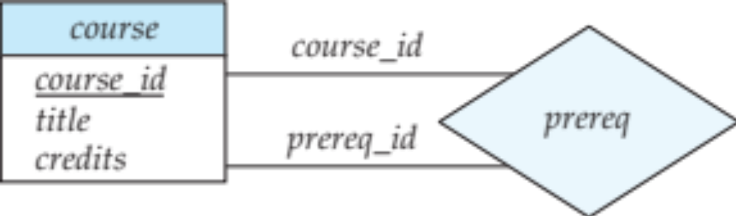
Roles
Entity sets of a relationship need not be distinct
  Each occurrence of an entity set plays a “role” in the relationship
The labels “course_id” and “prereq_id” are called roles.

Slide 13
Degree of a Relationship Set
Binary relationship
  involve two entity sets (or degree two).
  most relationship sets in a database system are binary.
Relationships between more than two entity sets are rare. Most relationships are binary. (More on this later.)
  Example: students work on research projects under the guidance of an instructor.
  relationship proj_guide is a ternary relationship between instructor, student, and project

Slide 14
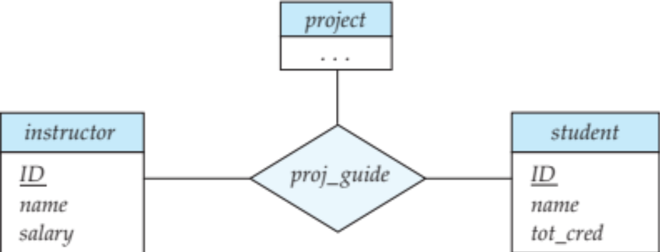
Non-binary Relationship Sets
Most relationship sets are binary
There are occasions when it is more convenient to represent relationships as non-binary.
E-R Diagram with a Ternary Relationship

Slide 15
Complex Attributes
Attribute types:
  Simple and composite attributes.
  Single-valued and multivalued attributes
    Example: multivalued attribute: phone_numbers
  Derived attributes
    Can be computed from other attributes
    Example: age, given date_of_birth
Domain – the set of permitted values for each attribute

Slide 16
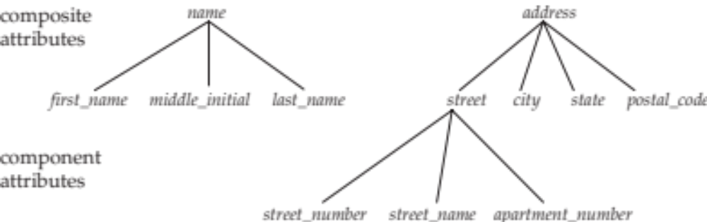
Composite Attributes
Composite attributes allow us to divided attributes into subparts (other attributes).

Slide 17
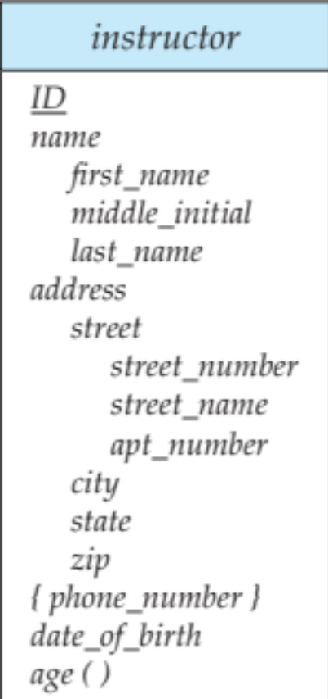
Representing Complex Attributes in ER Diagram

Slide 18
Mapping Cardinality Constraints
Express the number of entities to which another entity can be associated via a relationship set.
Most useful in describing binary relationship sets.
For a binary relationship set the mapping cardinality must be one of the following types:
  One to one
  One to many
  Many to one
  Many to many

Slide 19

Mapping Cardinalities
One to one
One to many
Note: Some elements in A and B may not be mapped to any
elements in the other set

Slide 20

Mapping Cardinalities
Many to one
Many to many
Note: Some elements in A and B may not be mapped to any
elements in the other set

Slide 21
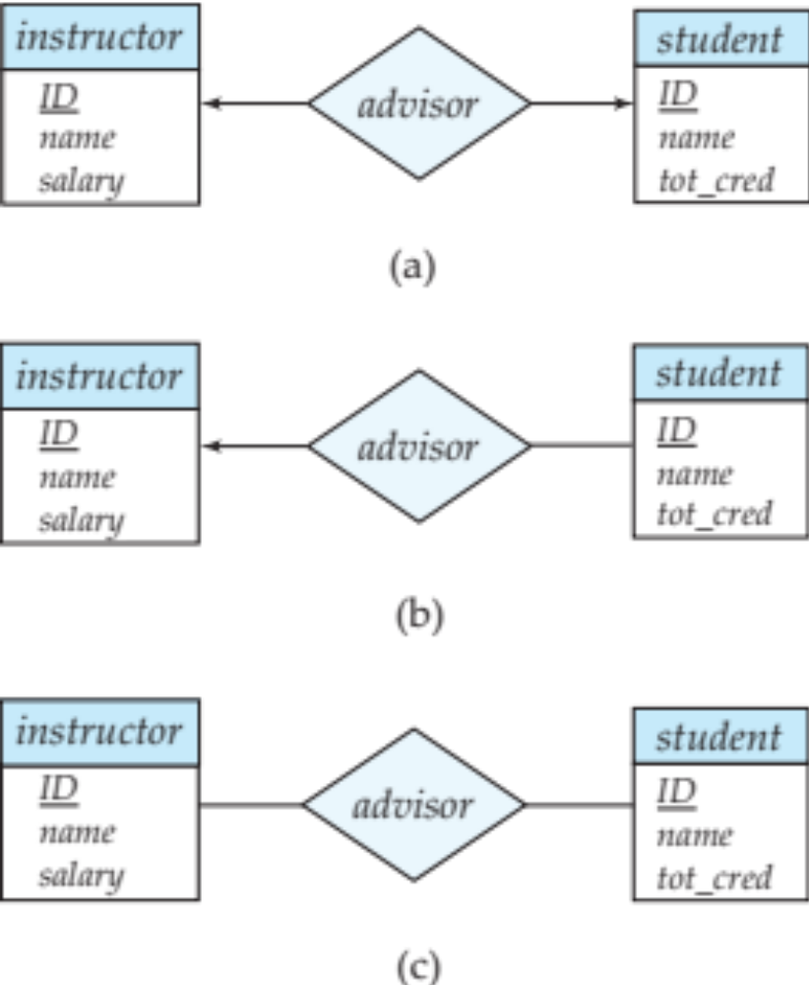
Representing Cardinality Constraints in ER Diagram
We express cardinality constraints by drawing either a directed line (→), signifying “one,” or an undirected line (—), signifying “many,” between the relationship set and the entity set.
One-to-one relationship between an instructor and a student :
  A student is associated with at most one instructor via the relationship advisor
  A student is associated with at most one department via stud_dept

Slide 22
One-to-Many Relationship
one-to-many relationship between an instructor and a student
  an instructor is associated with several (including 0) students via advisor
  a student is associated with at most one instructor via advisor,

Slide 23
Many-to-One Relationships
In a many-to-one relationship between an instructor and a student,
  an instructor is associated with at most one student via advisor,
  and a student is associated with several (including 0) instructors via advisor

Slide 24
Many-to-Many Relationship
An instructor is associated with several (possibly 0) students via advisor
A student is associated with several (possibly 0) instructors via advisor

Slide 25

Total and Partial Participation
Total participation (indicated by double line): every entity in the entity set participates in at least one relationship in the relationship set
  participation of student in advisor relation is total
    every student must have an associated instructor
Partial participation: some entities may not participate in any relationship in the relationship set
  Example: participation of instructor in advisor is partial

Slide 26
Weak Entity Sets
Consider a section entity, which is uniquely identified by a course_id, semester, year, and sec_id.
Clearly, section entities are related to course entities. Suppose we create a relationship set sec_course between entity sets section and course.
Note that the information in sec_course is redundant, since section already has an attribute course_id, which identifies the course with which the section is related.
One option to deal with this redundancy is to get rid of the relationship sec_course; however, by doing so the relationship between section and course becomes implicit in an attribute, which is not desirable.

Slide 27
Weak Entity Sets (Cont.)
An alternative way to deal with this redundancy is to not store the attribute course_id in the section entity and to only store the remaining attributes section_id, year, and semester.
  However, the entity set section then does not have enough attributes to identify a particular section entity uniquely
To deal with this problem, we treat the relationship sec_course as a special relationship that provides extra information, in this case, the course_id, required to identify section entities uniquely.
Aweak entity set is one whose existence is dependent on another entity, called its identifying entity
Instead of associating a primary key with a weak entity, we use the identifying entity, along with extra attributes called discriminator to uniquely identify a weak entity.
An entity set that is not a weak entity set is termed a strong entity set.

Slide 28
Weak Entity Sets (Cont.)
Every weak entity must be associated with an identifying entity; that is, the weak entity set is said to be existence dependent on the identifying entity set.
The identifying entity set is said to own the weak entity set that it identifies.
The relationship associating the weak entity set with the identifying entity set is called the identifying relationship.
Note that the relational schema we eventually create from the entity set section does have the attribute course_id, for reasons that will become clear later, even though we have dropped the attribute course_id from the entity set section.

Slide 29

Expressing Weak Entity Sets
In E-R diagrams, a weak entity set is depicted via a double rectangle.
We underline the discriminator of a weak entity set with a dashed line.
The relationship set connecting the weak entity set to the identifying strong entity set is depicted by a double diamond.
Primary key for section – (course_id, sec_id, semester, year)

