Slide 1
1
S y s t e m s A n a l y s i s a n d D e s i g n
Systems, Roles, and Development Methodologies
1-1

Slide 2
Why Project Fails
Did not support business strategy & objectives
Poor planning and project management
Failure to understand user requirement
inadequate cost vs benefit analysis
Myriad of design defect/errors
Installation of incompatible or inadequate technology
No adequate control implemented
Unstructured and un-maintainable software

Slide 3
The Bad News
30% of large IT projects are cancelled
before completion
50% of IT projects are over-budget by more than 200%
The majority of completed projects deliver
60% or less of prescribed functionality
Many delivered information systems are under-used because they don’t meet user needs and/or expectations

Slide 4
Software Horror Stories
Bank of America spent $23,000,000 on a 5- year project to develop a new accounting system. Spent over $60,000,000 trying to make new system work, finally abandoned it. Loss of business estimated in excess of $1,000,000,000
The B1 Bomber required an additional
$1,000,000,000 to improve its air defense
software, but the software still isn’t working to
specification
Ariane 5, Flight 501
The loss of a $500,000,000 spacecraft was ultimately attributed to errors in requirements, specifications and inadequate software reuse practices.

Slide 5
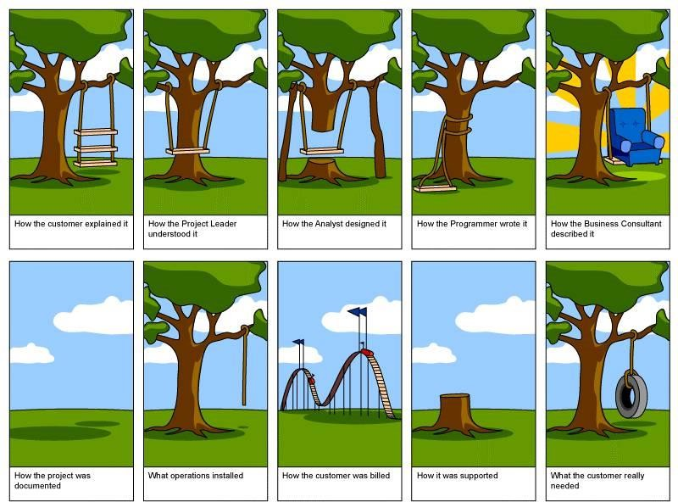

Slide 6
Information—A Key Resource
Fuels business and can be the critical factor in determining the success or failure of a business
Needs to be managed correctly
Managing computer-generated information differs from handling manually produced data
1-6

Slide 7
System
What is system?
A system is a group of interrelated components that function together to achieve a desired result.
What is information system?
An IS is an arrangement of
people, data, processes, and
information technology
that interact to collect, process, store, and provide as output the information needed to support an organization.

Slide 8
Information System (cont.)
Information systems are software applications which manage large amounts of data.
Most of the software out there is information systems software,
written in languages such as Java, C++, .NET and the like.

Slide 9
Type of Systems
Information systems fall into one of the following eight categories:
Transaction Processing System (TPS) Office Automation Systems (OAS) Knowledge Work Systems (KWS) Management Information Systems Decision Support Systems (DSS) Expert Systems (ES)
Group Decision Support Systems (GDSS) Executive Support Systems (ESS)

Slide 10












Why study System Analysis Design
Model
Pseudo code Code
Ser
ve food
Cook food
Buy raw material

Slide 11
Learning Objectives
Understand the need for systems analysis and design in organizations.
Realize roles of the systems analyst.
Comprehend fundamentals of three development methodologies:
SDLC
The agile approach
Object-oriented systems analysis and design
1-11

Slide 12
Need for Systems Analysis and Design
Remember, finding and fixing a fault after software delivery is 100x more expensive than finding and fixing it during systems analysis or early design phases
Installing a system without proper planning
Leads to great user dissatisfaction and
Frequently causes the system to fall into disuse
User involvement throughout the systems demand for system analysis
New technologies are also driving the need for systems analysis
1-13

Slide 13
What is Systems Analysis?
The collection of
Notations
Methodologies and
Tools
Used to gather details and
Analyze a problem situation
prior to information system design and implementation

Slide 14
What is Systems Analysis?
Systems analysis (or, requirements analysis) must ensure that the proposed information system meets
User needs,
Can be delivered on time, and
Can be updated inexpensively.
Problems in "getting the systems analysis right",
such as ill-defined situations, ambiguities, inconsistencies, mixing requirements with design

Slide 15
Roles of the Systems Analyst
The analyst must be able to work with
people of all descriptions
experienced in working with computers
Three primary roles:
Consultant
Supporting expert
Agent of change

Slide 16
Roles of the Systems Analyst
System analyst as a consultant
Advantage
can bring with them a fresh perspective that other people in an organization do not possess.
Disadvantage
true organizational structure can never be known to an outsider.

Slide 17
Roles of the Systems Analyst
Supporting expert:
play as professional expertise concerning computer hardware and software and their uses in the business.
Serves as a resource for those who are working on and managing other projects

Slide 18
Roles of the Systems Analyst
Agent of change:
A person who serves as a catalyst for
Change,
Develops a plan for change, and
Works with others in facilitating that change.

Slide 19
Systems Analysts
a specialist who studies the
problems and needs of an organization to determine
how people, data, processes, and information technology
can best accomplish improvements for the business.

Slide 20
Qualities of the Systems Analyst
Problem solver
Communicator
Strong personal and professional ethics
Self-disciplined and self- motivated

Slide 21
Qualities of the Systems Analyst
Problem solver
views the analysis of problems as a challenge and enjoys devising workable solutions
Communicator
Capable of relating meaningfully to other people over extended periods over time.
Need enough computer experience to program, to understand the capabilities of computers,
glean information requirements from users, and
communicate what is needed to programmers.
1-22

Slide 22
Design Methodology
Several design methodology are used to communicate between technical people and the business people
There are three approaches to designing new system.
SDLC
Agile
UML

Slide 23
Systems Development Life Cycle (SDLC)
is a systematic and orderly approach
to solving business problems, and
developing and supporting resulting information systems.
Developed through the use of a specific cycle of analyst and user activities
Each phase has unique user activities and certain deliverable

Slide 24
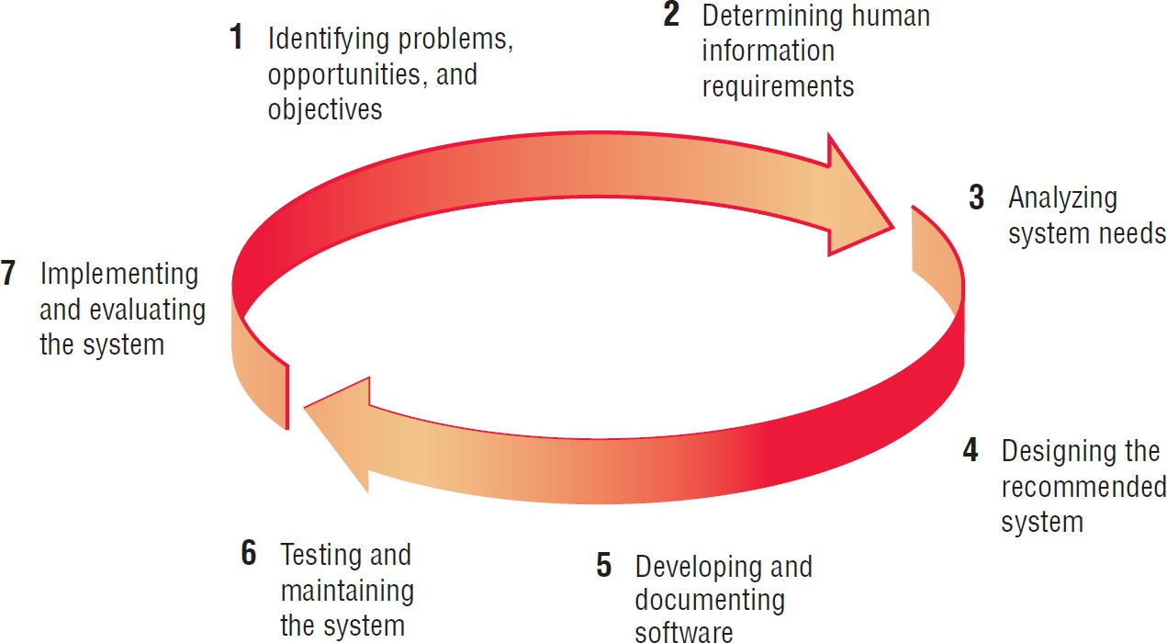
The Seven Phases of the Systems Development Life Cycle (Figure 1.1)

Slide 25
Incorporating Human-Computer Interaction (HCI) Considerations
The demand for analysts who are capable of incorporating HCI into the systems development process keeps increasing,
as companies begin to realize that the quality of systems and the quality of work life can be improved by taking a human-centered approach at the outset of a project

Slide 26
Identifying Problems, Opportunities, and Objectives
Problems: -Recognize the Problem, Define the problem
Opportunities : situations that the analyst believes can be improved through the use of computerized information systems.
Objectives : how can the business reach its objectives by addressing specific problems or opportunities.

Slide 27
Identifying Problems, Opportunities, and Objectives
Activity:
Interviewing user management
Summarizing the knowledge obtained
Estimating the scope of the project
Documenting the results

Slide 28
Identifying Problems, Opportunities, and Objectives
Output:
Feasibility report containing
Problem definition and
Objective summaries from which
Management can make a decision on whether to proceed with the proposed project

Slide 29
The primary purpose of Phase II is to understand what users need to perform their jobs.
Formal process of using
2) Determining Human Information Requirements (HCI)
Research,
Interview,
Questionnaires,
Sampling And Other Techniques To Collect Information About
System,
Requirements And
Preferences

Slide 30
Activity:
Determining Human Information Requirements (HCI)
Interviewing
Sampling and investing hard data
Questionnaires
Observe the decision maker’s behavior and
environment
Prototyping
Learn the who, what, where, when, how, and why of the current system

Slide 31
Determining Human Information Requirements (HCI)
There are several questions an analyst must answer in this phase:
Who—the people who are involved
What—the business activity
Where—the environment in which the work takes place
When—the timing
How—how the current procedures are performed
Why—why the system uses the current system
1-32

Slide 32
Determining Human Information Requirements (HCI)
OUTPUT:
The analyst understands how users accomplish their work when interacting with a computer.
Begin to know how to make the new system more useful and usable
Know the business functions
Have complete information on the:
People
Goals
Data
Procedure involved

Slide 33
3) Analyzing System Needs
The primary purpose of Phase III is to determine what information and processes are needed to resolve a problem or take advantage of an opportunity.
Typical tools used in this phase are:
Data flow diagrams
Data dictionaries
Analyzing structured decisions using structured English, decision tables, and decision trees
Analyzing semi-structured decisions using the tradeoff process and the use of weighting methods

Slide 34
3) Analyzing System Needs
Deliverables:
Data Flow Diagram and optionally a Data Dictionary.
Presentation of a Systems Proposal.
Updated Schedule
Updated Risk Management Document

Slide 35
4) Designing the Recommended System
The primary purpose of Phase IV is to design the logical and physical components necessary to implement the recommended system.
This includes
database design,
input/output layouts,
logical data flow,
structured & semi-structured decision designs, and the architectural design.
In addition, controls and backup procedures are
documented.
1-36

Slide 36
4) Designing the Recommended System
Typical tools used in this phase are:
Prototyping Tools
ERD Tool
Data Dictionary Tools

Slide 37
4) Designing the Recommended System
Activity:
Design procedures for data entry
Design the human-computer interface
Design system controls
Design database and/or files
Design backup procedures
Output
Model of the actual system

Slide 38
Deliverables:
Presentation of Detail Design Document to developers which includes:
Data Flow Diagrams, ERD's, & Data Dictionary
Controls & Backup Procedure
Input/Output Layouts
Logical & Physical Designs
Architectural Design
Updated Project Schedule
Updated Vision/Scope Document
Updated Risk Management Document
1-39

Slide 39
5) Developing and Documenting Software
Purpose of Phase V is to build the recommended system.
This includes purchasing hardware & software, building custom software components, and preparing for full system testing.

Slide 40
5) Developing and Documenting Software
Typical tools used in this phase are:
Software Development Tools
Development Environment
Documentation Tools

Slide 41
5) Developing and Documenting Software
Activity:
System analyst works with programmers to develop any original software
Works with users to develop effective documentation
Programmers design, code, and remove syntactical errors from computer programs
Document software with help files, procedure manuals, and Web sites with Frequently Asked Questions

Slide 42
(5) Developing and Documenting Software
Output:
Computer programs
System documentation

Slide 43
(6) Testing and Maintaining the System
Activity:
Test the information system
System maintenance
Maintenance documentation
Output:
Problems, if any
Updated programs
Documentation

Slide 44
(7) Implementing and Evaluating the System
Activity:
Train users
Analyst plans smooth conversion from old system to new system
Review and evaluate system
Output:
Trained personnel
Installed system

Slide 45
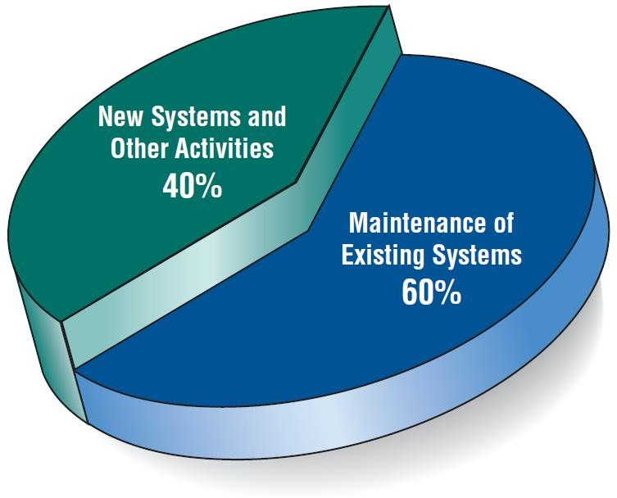
Some Researchers Estimate that the Amount of Time Spent on Systems Maintenance May Be as Much as 60 Percent of the Total Time Spent on Systems Projects (Figure 1.2)

Slide 46
The Impact of Maintenance
Maintenance is performed for two reasons:
Removing software errors
Enhancing existing software
Over time the cost of continued maintenance will be greater than that of creating an entirely new system.
At that point it becomes more feasible to perform a new systems study.

Slide 47
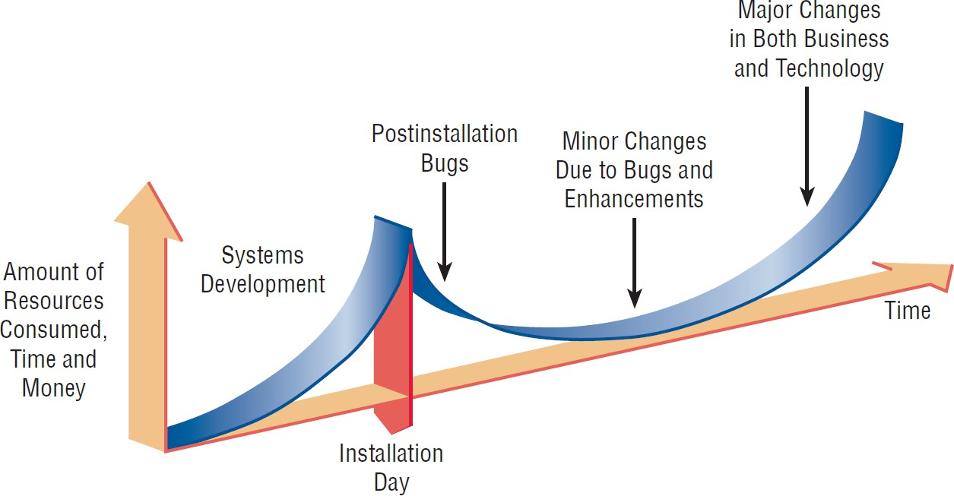
Resource Consumption over the System Life (Figure 1.3)

Slide 48
Case Tools
CASE tools are set of software application programs, which are used to automate SDLC activities.
These tools simplify various stages of SDLC
Use of CASE tools accelerates the development of project to produce desired result and
helps to uncover flaws before moving ahead with next stage in software development.
Analysis tools, Design tools, Project management tools, Database Management tools, Documentation tools
1-50

Slide 49
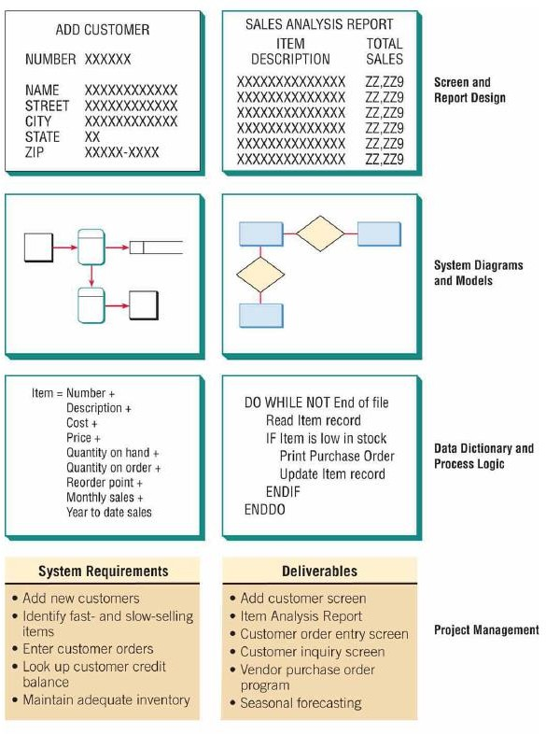
Rational Rose
JDeveloper
Visual Paradigm

Slide 50
The Agile Approach
Agile is a software development approach.
Agile is a term used to describe approaches to software development emphasizing incremental delivery, collaboration and
continual learning
Based on:
Values
Principles
Core practices

Slide 51
Values:
People > Tools
Working software > Documentation
Customer collaboration > Contracts
Change > Fixed plans
Principles:
Deliver software frequently
Embrace changes
Work with customers regularly
Keep a sustainable pace
Improve continuously
Core Practices:
Work in short cycles
Daily meetings
Test frequently
Collaborate as a team

Slide 52
The four values are
Agile Values
Communication
Simplicity
Feedback
Courage
We recommend that systems analysts adopt these values in all projects they undertake, not just when adopting the
agile approach.
1-56

Slide 53
Four Agile Resources
Agile methods can ensure successful completion of a project by adjusting the important resources of
Time
Cost
Quality
Scope
When these four control variables are properly included in the planning, there is a state of balance between the resources and the activities needed to complete the project

Slide 54
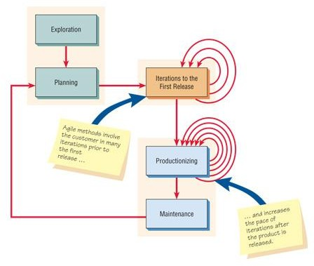
Developmental Process for an Agile Project
Five Stages of Agile Development
Exploration
Planning
Iterations to the first release
Productionizing
Maintenance

Slide 55
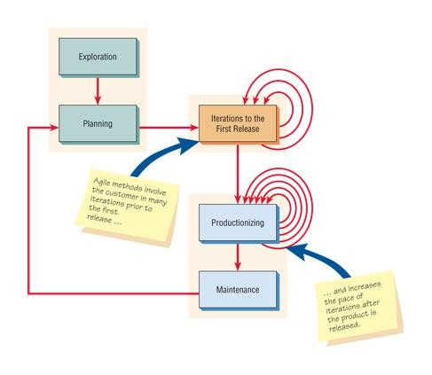
Agile Project Development Process
1-59

Slide 56

three red arrows that loop back into the
“Iterations” box symbolize
Incremental changes created through Repeated Testing and Feedback that eventually lead to a
Stable but Evolving system.
Multiple Looping Arrows that feed back into the productionizing phase.
These symbolize that the pace of iterations is increased after a product is released.
1-60

Slide 57
The red arrow is shown leaving the maintenance stage and returning to the planning stage,
so that there is a continuous feedback loop involving customers and the development team as they agree to alter the evolving system.
1-61

Slide 58
EXPLORATION:
explore Environment, assemble the team, and assess team member skills
take from a few weeks to few month
examining potential technologies needed to build the new system
Estimating the time
playful and curious attitude toward the work environment, its problems, technologies, and people
1-62

Slide 59
PLANNING
planning may take a few days to accomplish
Story cards in the planning game briefly describe the task, provide notes, and provide an area for task tracking.
Customers decide what the development team should tackle first.
Their decisions will set priorities and check functionalities throughout the process.
1-63

Slide 60
ITERATIONS TO THE FIRST RELEASE
iterations are cycles of testing, feedback, and change
Run customer-written functional tests at the end of each iteration
should question whether the schedule needs to be altered
celebrate your progress
1-64

Slide 61
PRODUCTIONIZING
feedback cycle speeds up
daily briefings so everyone knows what everyone else is doing.
product released may be improved by adding other features
1-65

Slide 62
MAINTENANCE
New features may be added,
riskier customer suggestions may be considered,
team members may be rotated on or off the team
1-66

Slide 63
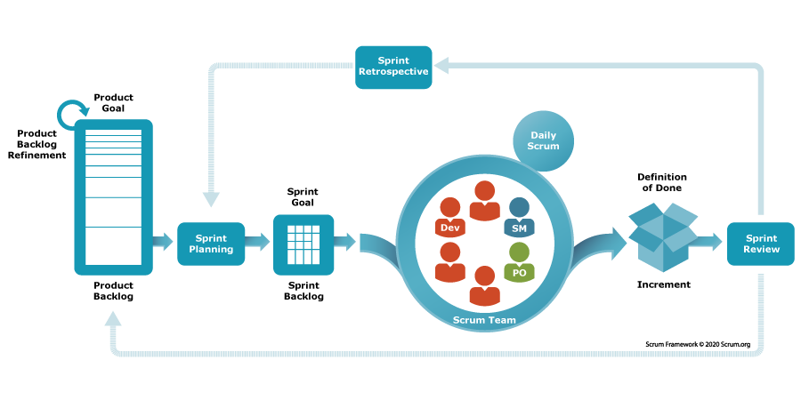
SCRUM

Slide 64
Object-Oriented (O-O) Systems Analysis and Design
Object-oriented (O-O) analysis and design is an approach that is intended to facilitate the development of systems that must change rapidly in response to dynamic business environments.
1-67

Slide 65
Object-Oriented (O-O) Systems Analysis and Design
It works well in situations in which complicated information systems are undergoing continuous maintenance, adaptation, and redesign.
Object-oriented approaches use the industry standard for modeling object-oriented systems, called the unified modeling language (UML), to break down a system into a use case model.
1-68

Slide 66
Object-Oriented (O-O) Systems Analysis and Design
Object-Oriented Systems Analysis and Design (OOAD) is a methodology for designing and analyzing systems that are based on object-oriented principles. In OOAD, the focus is on objects and their interactions rather than traditional data flow or functional decomposition. It uses classes, objects, inheritance, polymorphism, encapsulation, and abstraction as core concepts.

Slide 67
Object-Oriented (O-O) Systems Analysis and Design
The cycle repeats with analysis, design, and implementation of the next part and this repeats until the project is complete
Examines the objects of a system

Slide 68
Object-Oriented (O-O) Systems Analysis and Design
Iterative Development Process:
Object-oriented methodologies often focus on small, quick iterations of development, often called the spiral model.
Analysis is performed on a small part of the system, typically starting with high-priority items or those with the greatest risk.
Followed by design and implementation, the cycle is repeated with analysis, design, and implementation until the project is completed.
Reworking diagrams and components is normal in this iterative process.

Slide 69
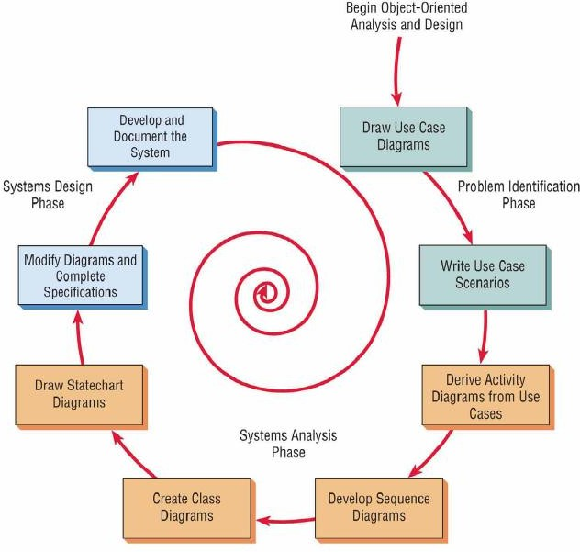

Slide 70
Unified Modeling Language (UML) Phases
Define the use case model:
Use case diagram
Use case scenarios
Create UML diagrams
Develop class diagrams
Draw statechart diagrams
Modify the UML diagrams
Develop and document the system

Slide 71
Choosing a Method
Choose either:
SDLC
Agile
Object-oriented methodologies

Slide 72
When to Use SDLC
Systems have been developed and documented using SLDC
It is important to document each step
Upper level management feels more comfortable or safe using SDLC
There are adequate resources and time to complete the full SDLC
Communication of how new systems work is important

Slide 73
When to Use Agile
There is a project champion of agile methods in the organization
Applications need to be developed quickly in response to a dynamic environment
A rescue takes place (the system failed and there is no time to figure out what went wrong)
The customer is satisfied with incremental improvements
Executives and analysts agree with the principles of agile methodologies

Slide 74
When to Use Object- Oriented
The problems modeled lend themselves to classes
An organization supports the UML learning
Systems can be added gradually, one subsystem at a time
Reuse of previously written software is a possibility
It is acceptable to tackle the difficult problems first

Slide 75
Difference
Aspect | Agile | SDLC (Structured) | OOAD
Approach | Iterative, incremental | Linear, sequential | Object-oriented, iterative
Flexibility | High adaptability to change | Low adaptability to change | Moderate flexibility, but more upfront design
Documentation | Minimal, just enough | Extensive documentation for each phase | Detailed modeling using UML
Team Involvement | High collaboration, cross-functional | Silos between phases (analysts, developers) | Collaboration, but more focused on modeling
Development Process | Short sprints with regular feedback | Clear, structured phases | Focus on designing objects and their behavior
Best for | Rapidly changing requirements | Well-defined, stable projects | Complex, long-term, scalable systems

Slide 76
Open Source Software
An alternative of traditional software development where proprietary code is hidden from the users
Open source software is free to distribute, share, and modify
Characterized as a philosophy rather than simply the process of creating new software
Examples: Linux Operating System, Apache Web Server, Mozilla Firefox

Slide 77
Four Types of Open Source Communities:
Ad hoc
Standardized
Organized
Commercial

Slide 78
Six Key Dimensions that Differentiate Open Source Communities
General structure
Environment
Goals
Methods
User community
Licensing

Slide 79
Reasons for Participating in Open Source Communities
Rapidity with which new software can be developed and tested
Faster to have a committed group of experts develop, test, and debug code
This fosters creativity
Have many good minds work with innovative applications

Slide 80
Reasons for Participating in Open Source Communities
Potential to reduce development costs
Bolster their self-image
Contribute something worthwhile to the software development community

Slide 81
Open Source Contribution and Differentiation
Contributions to the open community and differentiation from the open community are for the following reasons:
Cost
Managing resources
Time it takes to bring a new product to the market

Slide 82
Reasons for Analyst Participation in the Open Source Community
Curiosity about software benefits
Achieve collective design
Incorporate open source software design into:
Proprietary products
Processes
Knowledge
IT artifacts

Slide 83
Collective Design
Through a process of collective design the IT artifact is imbued with
Community and organizational structures
Knowledge
Practices

Slide 84
Summary
Information is a key resource
Integration of traditional systems with new technologies
Roles and qualities of the systems analyst
The systems development life cycle
CASE tools
Agile systems development
Object-oriented systems development
Open source systems

Slide 85
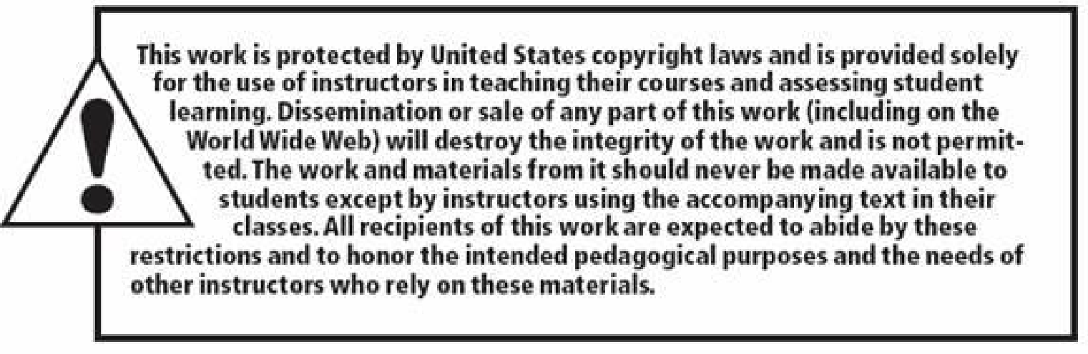

Copyright © 2014 Pearson Education, Inc.
Publishing as Prentice Hall

