Slide 1
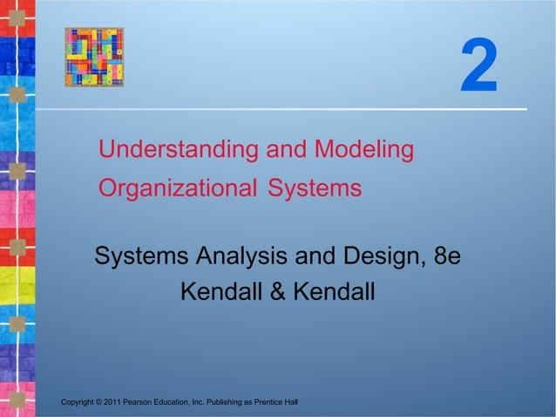

Slide 2


Learning Objectives
Understand that organizations and their members are systems and that analysts need to take a systems perspective.
Depict systems graphically using context- level data flow diagrams, and entity- relationship models, use cases, and use case scenarios.
Recognize that different levels of
management require different systems.
Comprehend that organizational culture
impacts the design of information systems.
Copynght yo11 Pearson Esuction, inc. Publishing as Pr emice i-iali
2-2

Slide 3


Three Main Forces Interacting to Shape Organizations
Levels of management
Design of organizations
Organizational cultures
Copynght yo11 Pearson Esuction, inc. Pubi'shing as Prem<e i-iali
20

Slide 4


Organizations Are Composed of
Interrelated Subsystems
Influenced by levels of management decision makers that cut horizontally across the organizational system
Operations
Middle management
Strategic management
Influenced by organizational cultures
and subcultures
Copynght yo11 Pearson Esuction, inc. Pubi'shing as Prem<e i-iali
2w

Slide 5


Major Topics
Organizations as systems
Depicting systems graphically
Data flow diagram
Entity-relationship model
Use case modeling
Levels of management
Organizational culture
Copynght yo11 Pearson Esuction, inc. Publishing as Pr emice i-iali

Slide 6


Organizations as Systems
Conceptualized as systems designed to accomplish predetermined goals and objectives
Composed of smaller, interrelated systems serving specialized functions
Specialized functions are reintegrated to form an effective organizational whole.
Copynght yo11 Pearson Esuction, inc. Pubi'shing as Prem<e i-iali
2k

Slide 7


Interrelatedness and
Independence of Systems
All systems and subsystems are interrelated and interdependent.
All systems process inputs from their environments.
All systems are contained by boundaries separating them from their environments.
System feedback for planning and control
An ideal system self-corrects or self-regulates itself.
Copynght yo11 Pearson Esuction, inc. Pubi'shing as Prem<e i-iali
2-/

Slide 8
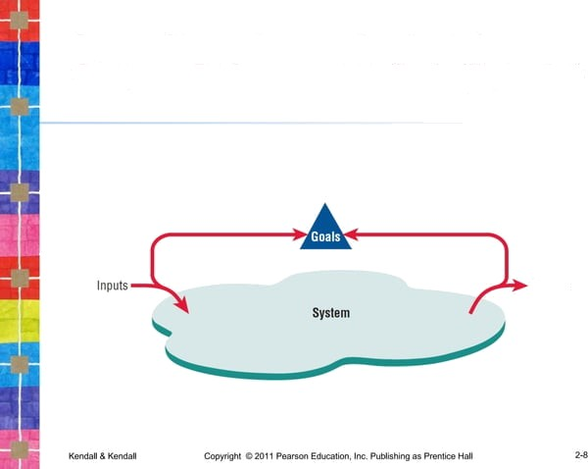
System Outputs Serve as Feedback that
Compares Performance with Coals (Figure 2.1)

Slide 9


Organizational Environments
Community
Physical location
DemOgraphic profile (education, income)
Economic
Market factors
Competition
Political
State and local government
Legal
Federal, state, regional, local laws, and guidelines
Copynght yo11 Pearson Eouc‹mion, inc. Pubi'shing as Prem<e Nali
2-#

Slide 10


Openness and Closedness
Open
Free flow of information
Output from one system becomes input to
another
Closed
Restricted access to information
Limited by numerous rules
Information only on a ”need to know” basis
Copynght yo11 Pearson Esuction, inc. Pubi'shing as Prem<e i-iali
2- r0

Slide 11


Virtual Organizations and Virtual
Teams
A virtual organization has parts of the organization in different physical locations.
Computer networks and communications technology are used to bring virtual teams together to work on projects.
Copynght yo11 Pearson Esuction, inc. Pubi'shing as Prem<e i-iali
2- r i

Slide 12


Benefits of Virtual Organizations
and Teams
Possibility of reducing costs of physical facilities
More rapid response to customer needs
Helping virtual employees to fulfill their familial obligations to children or aging parents
Copynght yo11 Pearson Esuction, inc. Pubi'shing as Prem<e i-iali
2- r2

Slide 13


Taking a Systems Perspective
Allows system analyst to understand
businesses before they begin their tasks
It is important that members of subsystems realize that they are interrelated with other subsystems.
Problems occur when each manager thinks that his/her department is the most important.
Bigger problems may occur when that manager rises through the ranks.
Copynght yo11 Pearson Esuction, inc. Pubi'shing as Prem<e i-iali

Slide 14



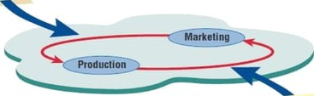
Taking a Systems Perspective (Figure 2.2)
Outputs from one department sarva as inputs for another such that subsystems are interrelated.
2-t4

Slide 15
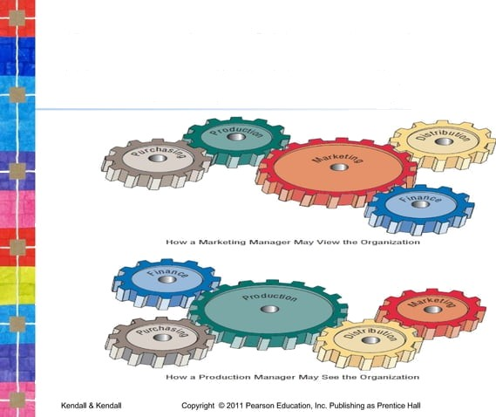
Perspective of Functional Managers (FIGURE 2.3)

Slide 16


Enterprise Resource Planning
Enterprise Systems or Enterprise Resource Planning (ERP) describes an integrated organizational information system.
Software that helps the flow of information between the functional areas within the organization
Copynght yo11 Pearson Esuction, inc. Pubi'shing as Prem<e i-iali
2- rG

Slide 17
Enterprise Resource Planning
Enterprise Systems or Enterprise Resource Planning (ERP) describes an integrated organizational information system
Software that helps the flow of information between the functional areas within the organization
Centralized Data
Real-Time Access
Customization

Slide 18
ERP systems include:
Manufacturing components
Sales and operations planning
Distribution
Managing the supply train
Problems with implementation:
Difficult to analyze a system currently in use and then fit the ERP model to that system
Companies tend to design their business processes before ERP is implemented
ERP, although growing in use is also being viewed with some skepticism.

Slide 19
ERP and the Organization
ERP can affect every aspect of the organization, including:
Design of employees’ work
Skills required for job competency
Strategic positioning of the company

Slide 20
Issues to be Overcome for ERP Success
Many issues must be overcome for the ERP installation is to be declared a success:
User acceptance
Integration with legacy systems and the supply chain
Upgrading functionality (and complexity) of ERP modules
Reorganizing work life of users and decision makers
Expanded reach across several organizations
Strategic repositioning of the company

Slide 21


Depicting Systems Graphically
Context-level data flow diagrams
Entity-relationship model
Use case modeling
Copynght yo11 Pearson Esuction, inc. Pubi'shing as Prem<e i-iali
2- r •

Slide 22
Context-Level Data Flow Diagrams
The first model is the context-level data flow diagram (also called an environmental model).
Data flow diagrams focus on the data flowing into and out of the system and the processing of the data.
These basic components of every computer program can be described in detail and used to analyze the system for accuracy and completeness.

Slide 23
Context-Level Data Flow Diagrams
Shows the scope of the system:
What is to be included in the system
The external entities are outside the scope of the system
The context-level data flow diagram serves as a good starting point for drawing the use case diagram

Slide 24
Context-Level Data Flow Diagrams
the context-level data flow diagram employs only
three symbols:
a rectangle with rounded corners,
a square with two shaded edges, and
an arrow

Slide 25
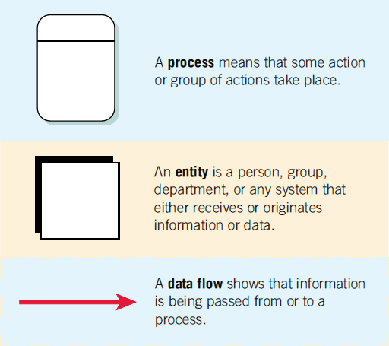
The Basic Symbols of a Data Flow Diagram

Slide 26
Processes transform incoming data into outgoing information, and the context level has only one process, representing the entire system.
The external entity represents any entity that supplies or receives information from the system but is not a part of the system.
This entity may be a person, a group of people, a corporate position or department, or other systems.
The lines that connect the external entities to the process are called data flows, and they represent
data.
2-27

Slide 27
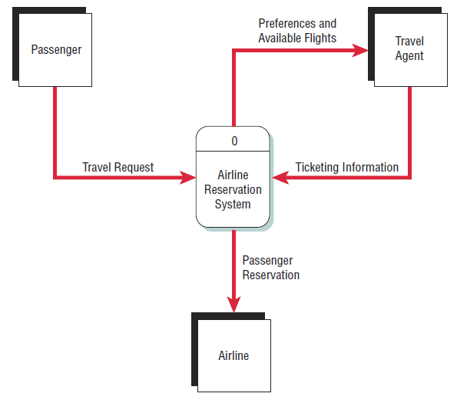
Airline Reservation System
The passenger (an entity) initiates a travel request (data flow).
A context-level data
flow diagram
for an airline reservation system

Slide 28
Entity-Relationship Model
Another way a systems analyst can show the scope of the system and define proper system boundaries is to use an entity- relationship model.
The elements that make up an organizational system can be referred to as entities.
An entity may be a person, a place, thing, or an event.
Focus is on the entities and their relationships
within the organizational system
A relationship is the association that describes the interaction among the entities.

Slide 29
Relationships
Relationships show how the entities are connected
Three types of relationships:
One-to-one
One-to-many
Many-to-many

Slide 30
Relationships
One-to-one —one employee is assigned to one phone extension.
One-to-many —many employees are assigned to a department.
Many-to-many —many passengers fly to many destinations.

Slide 31
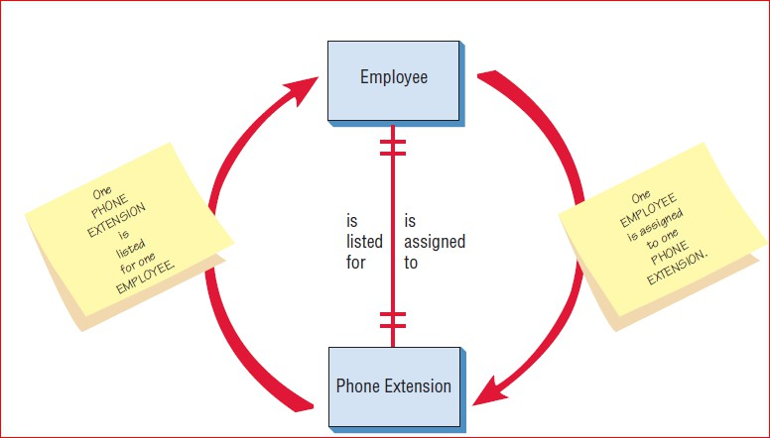
Entity-Relationship Example
a one-to-one relationship

Slide 32
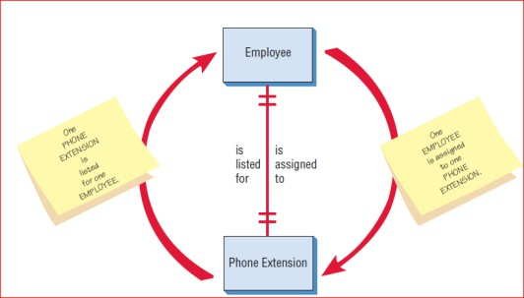
a one-to-one relationship
Two entities are linked together by a line.
the end of the line is marked with two short parallel marks (| |), signifying that
this relationship is one-to-one.
The red arrows are not part of the entity- relationship diagram.
The phrase on the right side of the line is read from top to bottom as follows:
One EMPLOYEE is assigned to one PHONE EXTENSION

Slide 33
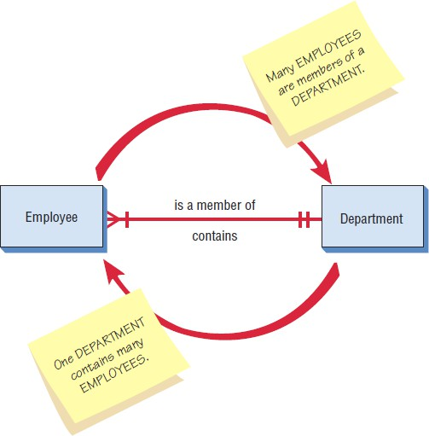
Entity-Relationship Example
a many-to-one relationship

Slide 34
a many-to-one relationship
The crow’s foot and the single mark do not literally mean that this end of the relationship must be a
mandatory “many.”
Instead, they imply
that this end could be anything from one to many.
2-34

Slide 35
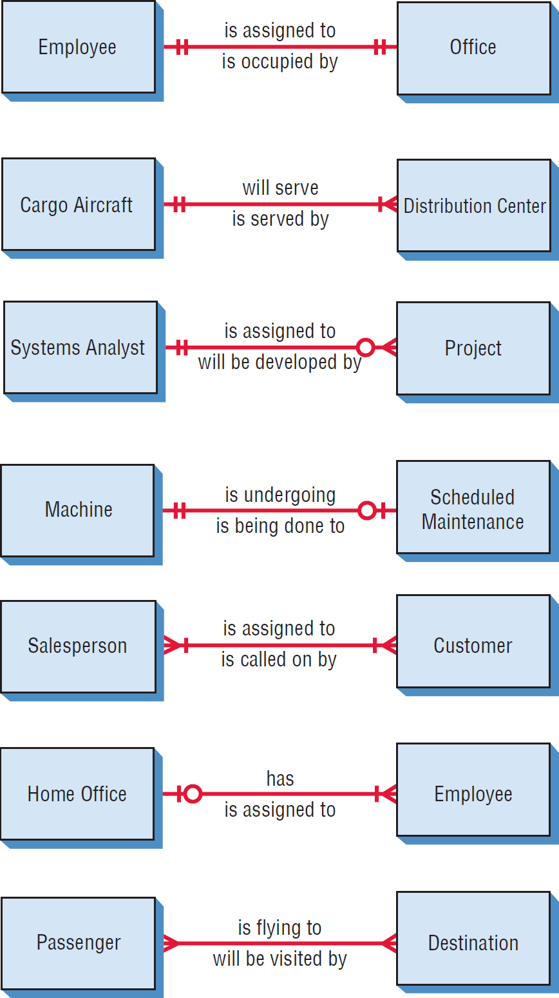
Examples of Different Types of Relationships in E-R
Diagrams (Figure 2.8)

Slide 36
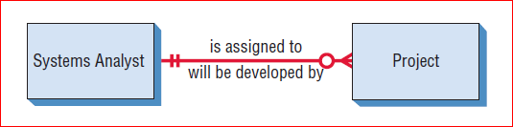
Relationships in E-R Diagrams
The third has a circle at one end
It can be read as “A SYSTEMS ANALYST may be assigned to MANY PROJECTS,”
meaning that the analyst can be assigned to no projects, one, or many projects.
no projects that is what the circle (O), for zero, is for.

Slide 37

Relationships in E-R Diagrams
The circle (O) indicates that none is possible in the relationship.
Short mark means one
“A MACHINE may or may not be undergoing SCHEDULED MAINTENANCE.”

Slide 38

Many to Many
“One or many SALESPEOPLE (plural of SALESPERSON) are assigned to one or more CUSTOMERs

Slide 39
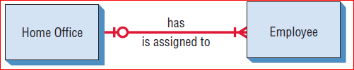
“The HOME OFFICE can have one or many EMPLOYEEs,”
or “One or more EMPLOYEEs may or may not be assigned to the HOME OFFICE.”
Once again, the I and O together imply a Boolean situation;
in other words, one or zero.

Slide 40
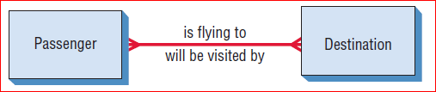
Relationships in E-R Diagrams
“Many PASSENGERs are flying to many DESTINATIONs.”

Slide 41
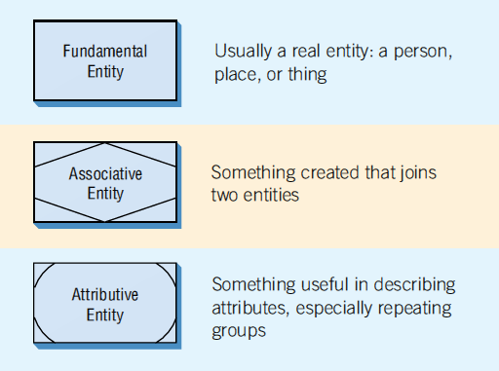
Three Different Types of Entities Used in E-R Diagrams (Figure 2.9)

Slide 42
Entities
Fundamental entity
Associative entity
Attributive entity
An Associative Entity can only exist if it is connected to at least two other entities.
Also call it a gerund, a junction, an intersection, or a concatenated entity

Slide 43
Associative Entities
Sometimes, we create new items in the process of developing an information system.
Some examples are invoices, receipts, files, and databases.
When we want to describe how a person relates to a receipt, it becomes convenient to indicate the receipt in a different way, as an associative entity.

Slide 44
Attributive Entities
Attributive: when an analyst wants to show data that are completely dependent on the existence of a fundamental entity, an attributive entity should be used.

Slide 45
Attribute
For example, when a library had multiple copies of the same book, an attributive entity could be used
to designate which copy of the book is being checked out.
The attributive entity is useful for showing repeating groups of data.

Slide 46
Example
suppose we are going to model the relationships that exist when a customer gets tickets to a train.
At first glance the CUSTOMER gets a reservation for a TRAIN, and the
TRAIN can be said to have made a booking for a CUSTOMER.
CUSTOMER actually makes a RESERVATION
The Reservation is For a Train.

Slide 47
The TRAIN holds the RESERVATION, and the RESERVATION is in the name of the CUSTOMER.
We added an associative entity here because a RESERVATION was created
due to the information system required to relate the CUSTOMER and the TRAIN

Slide 48
Attributes
Data attributes may be added to the diagram.
Patron Name Patron address Patron phone Patron credit card
Patron

Slide 49
Creating Entity-Relationship Diagrams
List the entities in the organization
Choose key entities to narrow the scope of the problem
Identify what the primary entity should be
Confirm the results of the above through data gathering

Slide 50
Notations for the components of ERD:
Entities
Attribute
Relationships
Cardinality

Slide 51
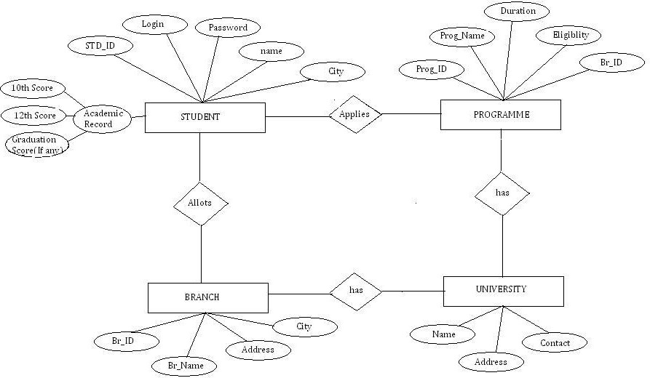

Slide 52
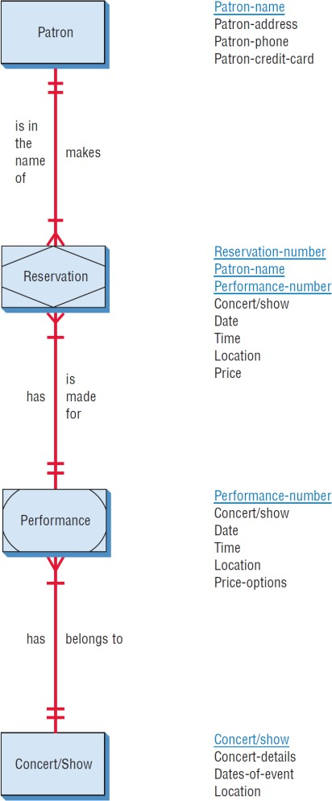
A More Complete E-R Diagram Showing Data Attributes of the Entities (Figure 2.12 )

Slide 53
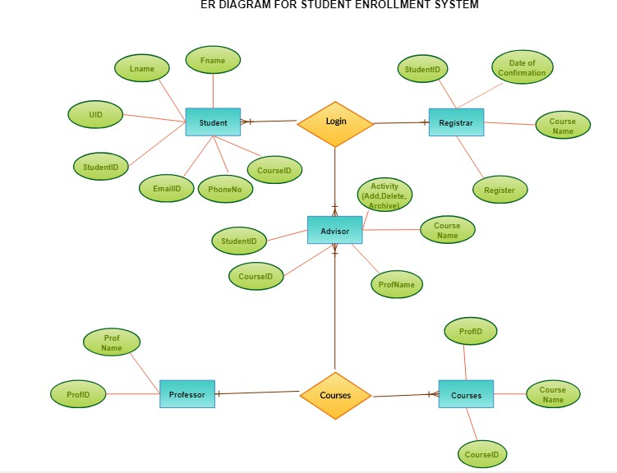

Slide 54


Use Case Modeling
Describes what a system does without describing loathe system does
A logical model of the system
Use case is a view of the system requirements
Analyst works with business experts to develop requirements
Copynght yo11 Pearson Esuction, inc. Publishing as Pr emice i-iali

Slide 55


Use Case Diagram
Actor
Refers to a particular role of a user of the system
Similar to external entities; they exist outside of the system
Use case symbols
An oval indicating the task of the use case
Connecting lines
Arrows and lines used to diagram behavioral relationships
Copynght yo11 Pearson Esuction, inc. Publishing as Pr emice i-iali
2-3 i

Slide 56


Actor
Divided into two groups
Primary actors:
Supply data or receive information from the system.
Provide details on what the use case should do.
Supporting actors:
Help to keep the system running or provide
help.
The people who run the help desk, the analysts, programmers, and so on.
Copynght yo11 Pearson Esuction, inc. Publishing as Pr emice i-iali
2-32

Slide 57


A Use Case Always Provides
Three Things
An actor that initiates an event
The event that triggers a use case
The use case that performs the actions triggered by the event
Copynght yo11 Pearson Esuction, inc. Pubi'shing as Prem<e i-iali

Slide 58


Use Case Relations
Behavioral relationships
Communicates
Used to connect an actor to a use case
Includes
Describes the situation in which a use case contains behavior that is common to more than one use case
Copynght yo11 Pearson Esuction, inc. Publishing as Pr emice i-iali

Slide 59


Use Case Relations
Behavioral relationships (continued)
Extends
Describes the situation in which one use case possesses the behavior that allows the new case to handle a variation or exception from the basic use case
Generalizes
Implies that one thing is more typical than the other thing
Copynght yo11 Pearson Esuction, inc. Publishing as Pr emice i-iali

Slide 60




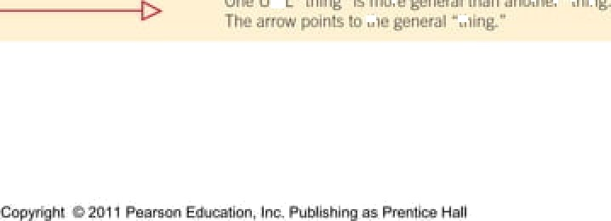
Some Components of Use Case Diagrams Showing Actors, Use Cases, and Relationships for a Student Enrollment Example (Figure 2.13)
sjma<i

Slide 61
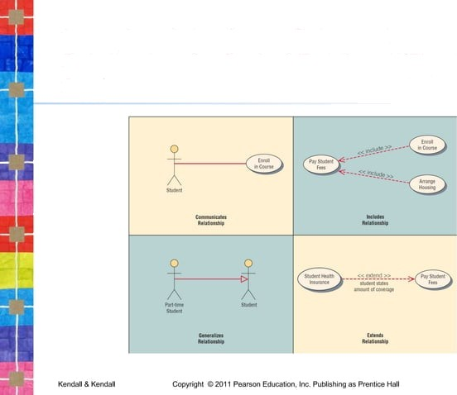
Examples of Use Cases, Behavioral Relationships for Student Enrollment (Figure 2.14)

Slide 62


Scope
System scope defines its boundaries:
What is in or outside the system
Project has a budget that helps to define scope
Project has a start and an end time
Actors are always outside of scope
Communication lines are the boundaries and define the scope
Copynght yo11 Pearson Esuction, inc. Publishing as Pr emice i-iali

Slide 63


Developing Use Case
Diagrams
Review the business specifications and identify the actors involved.
May use agile stories.
Identify the high-level events and develop the primary use cases that describe those events and how the actors initiate them.
Review each primary use case to determine the possible variations of flow through the use case.
The context-level data flow diagram could act as a starting point for creating a use case.
Copynght yo11 Pearson Esuction, inc. Pubi'shing as Prem<e i-iali

Slide 64
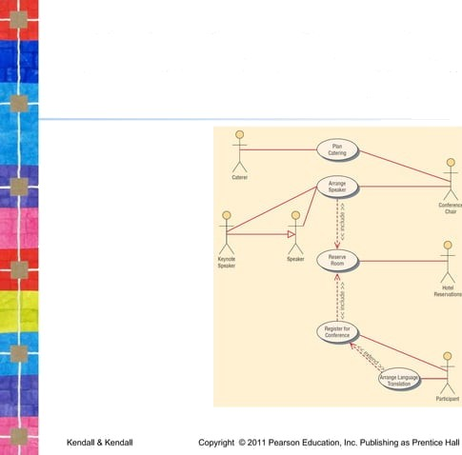
A Use Case Diagram Representing a System Used to Plan a Conference (Figure 2.15 )
2Mv

Slide 65


Developing the Use Case Scenarios
The description of the use case
Three main areas:
Use case identifiers and initiators
Steps performed
Conditions, assumptions, and questions
Copynght yo11 Pearson Esuction, inc. Pubi'shing as Prem<e i-iali
2V

Slide 66

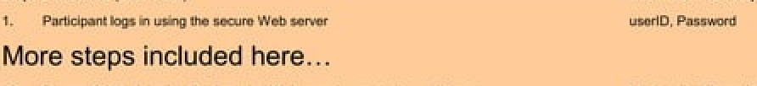

A Use Case Scenario Is Divided into Three Sections (Figure 2.16)
:
a
:
2A

Slide 67


Use Case Header Area
Has a name and a unique ID.
Include application area.
List actors.
Include stakeholders.
Include the level.
Has a brief description of the use case.
Copynght yo11 Pearson Esuction, inc. Pubi'shing as Prem<e i-iali
2VI

Slide 68


Use Case Levels
Use case levels describe how global or detailed the use case description is:
White (like clouds): enterprise level
Kite: business unit or department level
Blue (sea level): user goals
Indigo (or fish): functional or subfunctional
Black (or clam): most detailed
Copynght yo11 Pearson Esuction, inc. Publishing as Pr emice i-iali
2W‹

Slide 69


Alternative Scenarios
Extensions or exceptions to the main use case
Number with an integer, decimal point, integer
Steps that may or may not always be used
Copynght yo11 Pearson Esuction, inc. Pubi'shing as Prem<e i-iali
2V?

Slide 70


Use Case Footer Area
Preconditions need to be met before use case can be performed
Postconditions or the state of the system after the use case has finished
Assumptions
Minimal guarantee
Success guarantee
Outstanding issues
Optional priority and risk
Copynght yo11 Pearson Esuction, inc. Publishing as Pr emice i-iali

Slide 71


Four Steps Used to Create Use Cases
Use agile stories, problem definition objectives, user requirements, or a features list.
Ask about the tasks that must be done.
Determine if there are any iterative or looping actions.
The use case ends when the customer goal is complete.
Copynght yo11 Pearson Eouc‹mion, inc. Pubi'shing as Prem<e Nail
2M?

Slide 72


Why Use Case Diagrams Are
Helpful
Identify all the actors in the problem domain.
Actions that need to be completed are also clearly shown on the use case diagram.
The use case scenario is also
worthwhile.
Simplicity and lack of technical detail
Copynght yo11 Pearson Esuction, inc. Pubi'shing as Prem<e i-iali
2MS

Slide 73
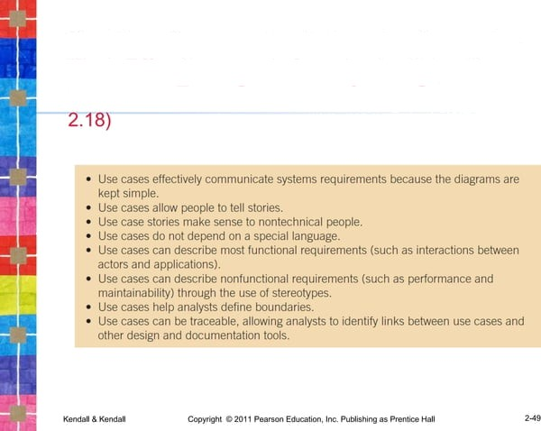
The Main Reasons for Writing Use Cases Are Their Effectiveness in Communicating with Users and Their Capturing of User Stories (Figure

Slide 74
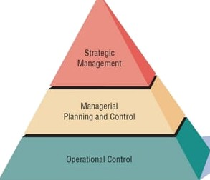
Management in Organizations Exists on Three Horizontal Levels: Operational Control, Managerial Planning and Control, and Strategic Management

Slide 75


Operations Control
Make decisions using predetermined rules that have predictable outcomes.
Oversee the operating details of the
organization.
Copynght yo11 Pearson Esuction, inc. Pubi'shing as Prem<e i-iali
2-ñJ

Slide 76


Managerial Planning and Control
Make short-term planning and control decisions about resources and organizational objectives.
Decisions may be partly operational and partly strategic.
Copynght yo11 Pearson Esuction, inc. Pubi'shing as Prem<e i-iali
2-ñ2

Slide 77


Strategic Management
Look outward from the organization to
the future.
Make decisions that will guide middle and operations managers.
Work in highly uncertain decision- making environment.
Define the organization as a whole.
Copynght yo11 Pearson Esuction, inc. Publishing as Pr emice i-iali

Slide 78


Managerial Levels
Different organization structure
Leadership style
Technological considerations
Organization culture
Human interaction
All carry implications for the analysis and design of information systems
Copynght yo11 Pearson Esuction, inc. Publishing as Pr emice i-iali

Slide 79


Organizational Culture
Organizations have cultures and
subcultures.
Learn from verbal and nonverbal symbolism.
Copynght
yo11 Pearson Esuction, inc. Pubi'shing as Prem<e i-iali

Slide 80

Verbal Symbolism
Myths
Metaphors
Humor

Slide 81


Nonverbal Symbolism
Shared artifacts
Trophies, etc.
Rites and rituals
Promotions
Birthdays, etc.
Clothing worn
Office placement and decorations
Copynght yo11 Pearson Esuction, inc. Pubi'shing as Prem<e i-iali
2-ñ7

Slide 82


Summary
Organizational fundamentals
Organizations as systems
Levels of management
Organizational culture
Graphical representation of systems
DFD
ERD
Use case diagrams and scenarios
Copynght yo11 Pearson Esuction, inc. Publishing as Pr emice i-iali

Slide 83


Summary (Continued)
Levels of managerial control
Operational
Middle management
Strategic
Organizational culture
Eogynght B 2011 Pass Eounalion, Inc. Publishing es Pren1+be Hell

Slide 84




This w•rk i› prete‹1ed Ly Unncd 51.Item ‹•ryriuht Iawr.end o pt evided solely
lot the use uf inscruc‹ors in te.aching their tour set .and .\sse sting student
\enrning. Dissem in.Clio n or na Te of any part o4 I his w ark Tink Iu fiing on the world wide web) will de*t ay ‹he integrity of the work .Ind i* not yermi - ted. The work and m.at+ri.aTs from it yhouTd never he m.ade .av.aiT.aT Te to
studenls ex¥ep\ by instructors using the .›ctemp.anyzng text in their
tTattes. AU recipients of thit work .are c zpe¥ red to .nbidc' fry These
r+strip tions and to honor the intended pedagogic.aT purposes apd the need* of other inttrucyow who rely oo chc«e m.ntcri.Us
All rights reserved. No part of lhis publication may be reproduced, stored in a retrieval syslem, or transmitted. in any form or by any means. electronic, mechanical, photocopying, recording, or otherwise. without the prior written permission of lhe publisher. Printed in the United States of America.
Copyright 2011 Pearson Education. Inc.
Publishing as Prentice Hall

