Slide 1
Basic Networking Concepts
Course: CSE 320 Computer Networks Lab

Slide 2
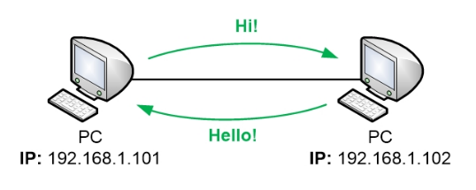
What is an IP Address?
An IP address is a logical numerical identifier assigned to a device in a network. It allows devices to locate and communicate with each other.

Slide 3
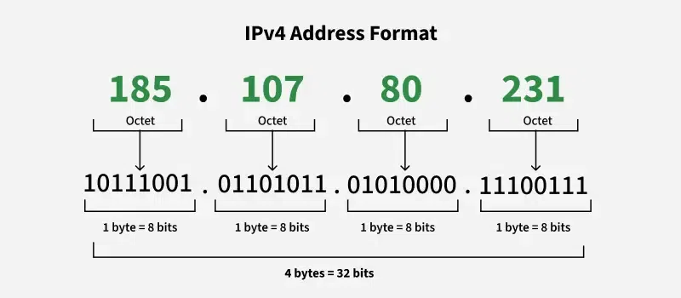
IPv4 Address Structure
IPv4 addresses use 32 bits and are written in dotted decimal notation. Example: 192.168.1.1. Each octet ranges from 0 to 255.

Slide 4
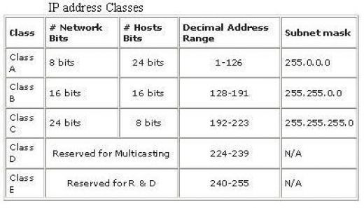
Network Classes
IPv4 addresses are divided into classes. Class A (1–126), Class B (128–191), Class C (192–223). Each class has a default subnet mask.

Slide 5
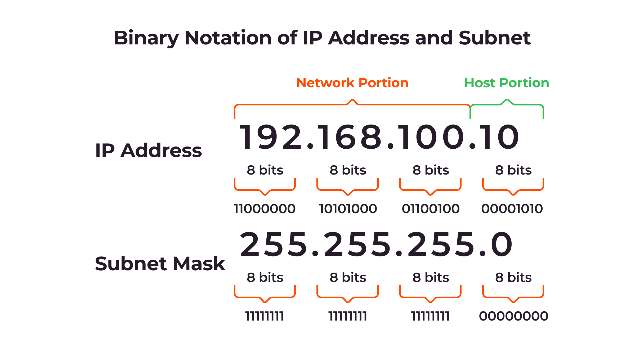
Subnet Mask
A subnet mask determines the network and host portion of an IP address. It helps devices identify whether another device is on the same network.

Slide 6
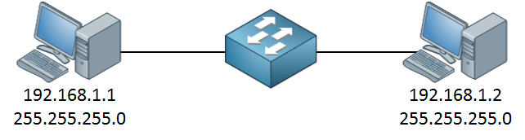
Default Gateway
The default gateway is the router interface IP address. It allows devices to send data outside their local network.

Slide 7
Subnetting
Subnetting is the process of dividing a large IP network into smaller logical networks called subnets. Each subnet allows devices to communicate efficiently, improving network performance, security, and manageability.

Slide 8
Example: IP- 192.168.10.0 Subnet Mask- 255.255.255.224
Find out-
a. Block size?
b. Number of subnets?
c. Number of hosts?
d. What is the network address?
e. What is the broadcast address?
f. Find the first and last Valid host?
Ans: Block size= block size – host per subnet
Number of subnet= 2^x (x= number of 1’s in host octet)
Number of valid host= 2^y – 2 (y= number of 0’s in host octet)
subnet mask: 255.255.255.224
binary : 11111111. 11111111. 11111111. 11100000
Block size = 256-224= 32
No of subnet= 2^3=8
No of hosts= 2^5 – 2= 32-2=30

Slide 9
Network address | 0 | 32 | 64 | 96 | 128 | 160 | 192 | 224
First valid host | 1 | 33 | 65 | 97 | 129 | 161 | 193 | 225
Last valid host | 30 | 62 | 94 | 126 | 158 | 190 | 222 | 254
Broadcast address | 31 | 63 | 95 | 127 | 159 | 191 | 223 | 255
Subnet A-
Network address: 192.168.0.0
Broadcast address: 192.168.0.31
First and Last valid host: 192.168.0.1-30

