Slide 1
Multi-Objective Biomarker Selection
From reproducible signatures to translational-ready panels
Presented by Wenze Ding

Slide 2

Talk Overview
Motivation: clinical translation demands more than high AUC on a single cohort
Key gaps: transferability, patent, shadow contribution of non-selected markers
What OptiMark does: explicit objectives and constraints → a clinically feasible solution set
Contributions: a framework, scalability, applications

Slide 3
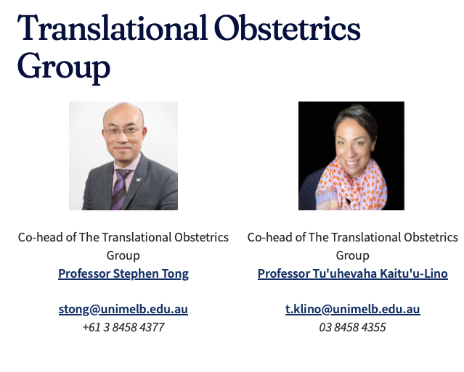
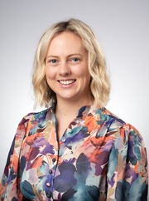
Problem motivation
Translational Obstetrics Group
from Melbourne Medical School
Use blood analytes to predict
Fetal Growth Restriction (FGR)
Postdoctoral Research
Fellow
Lucy Bartho

Slide 4
Brief backgrounds of FGR
Pregnancy is a complicated process with maternal, placental and fetal factors determine pregnancy outcomes.
Fetal growth restriction (FGR) affects ~5% of pregnancies.
FGR increases risk of stillbirth, neonatal complications, and long-term disease.
Better biomarkers could guide timely interventions and reduce preventable harm.

Slide 5
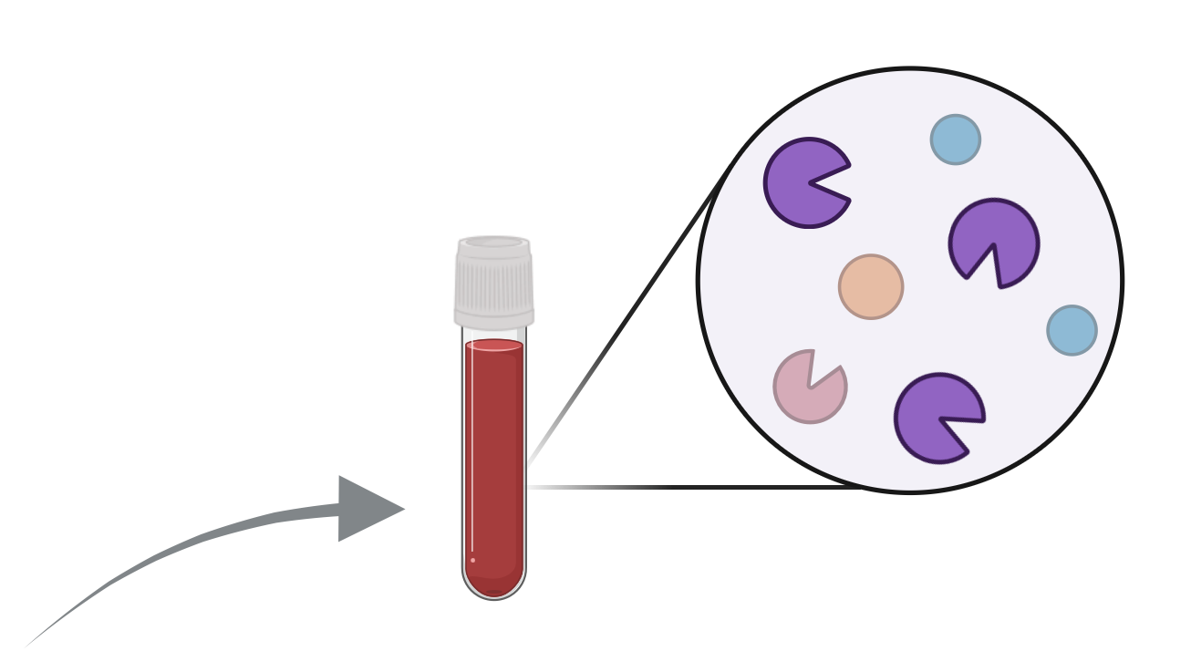
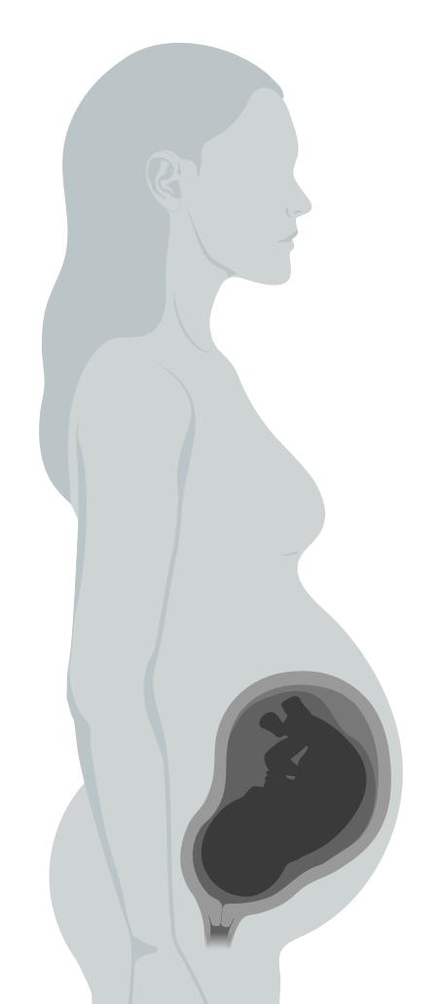
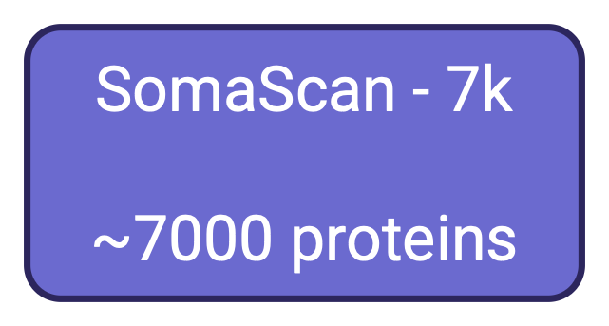


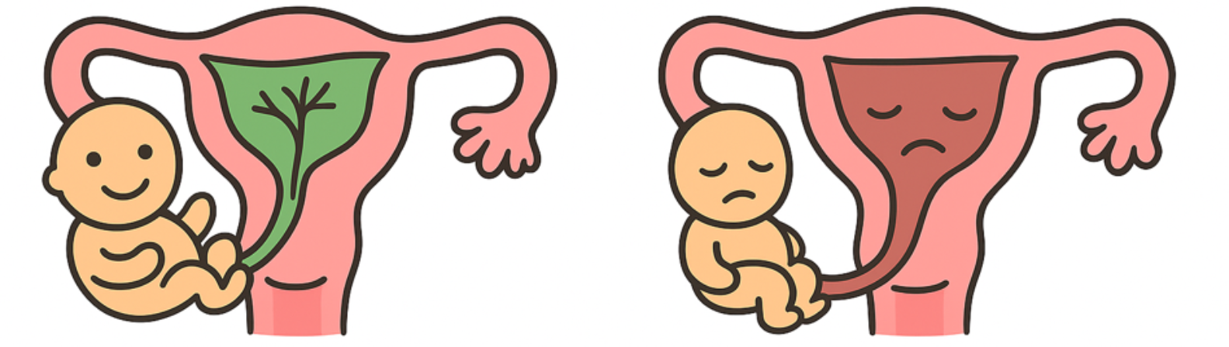
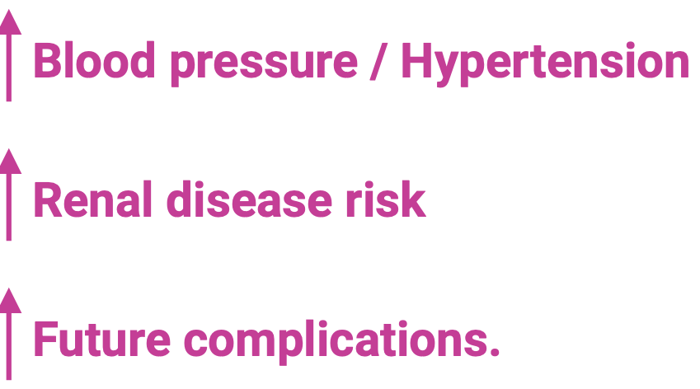
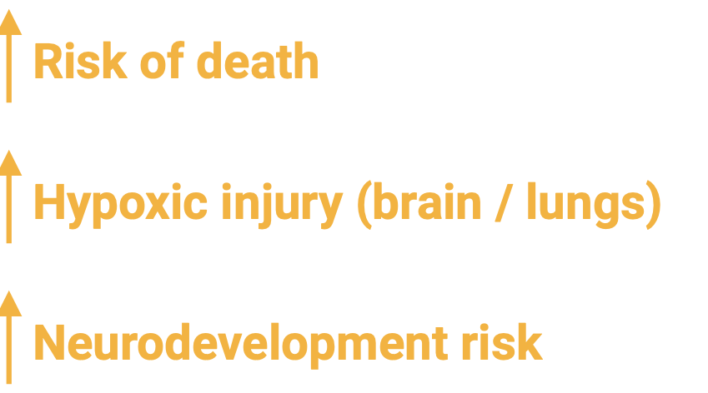

Slide 6
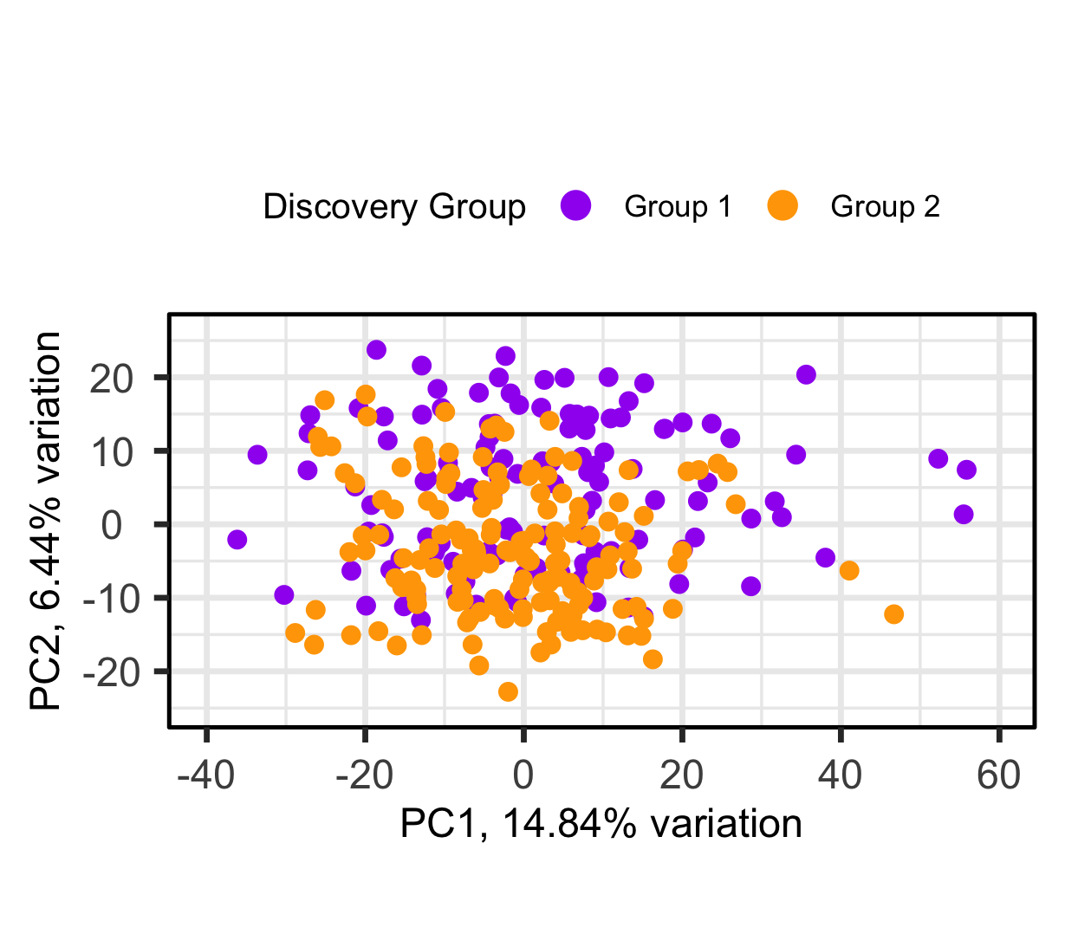
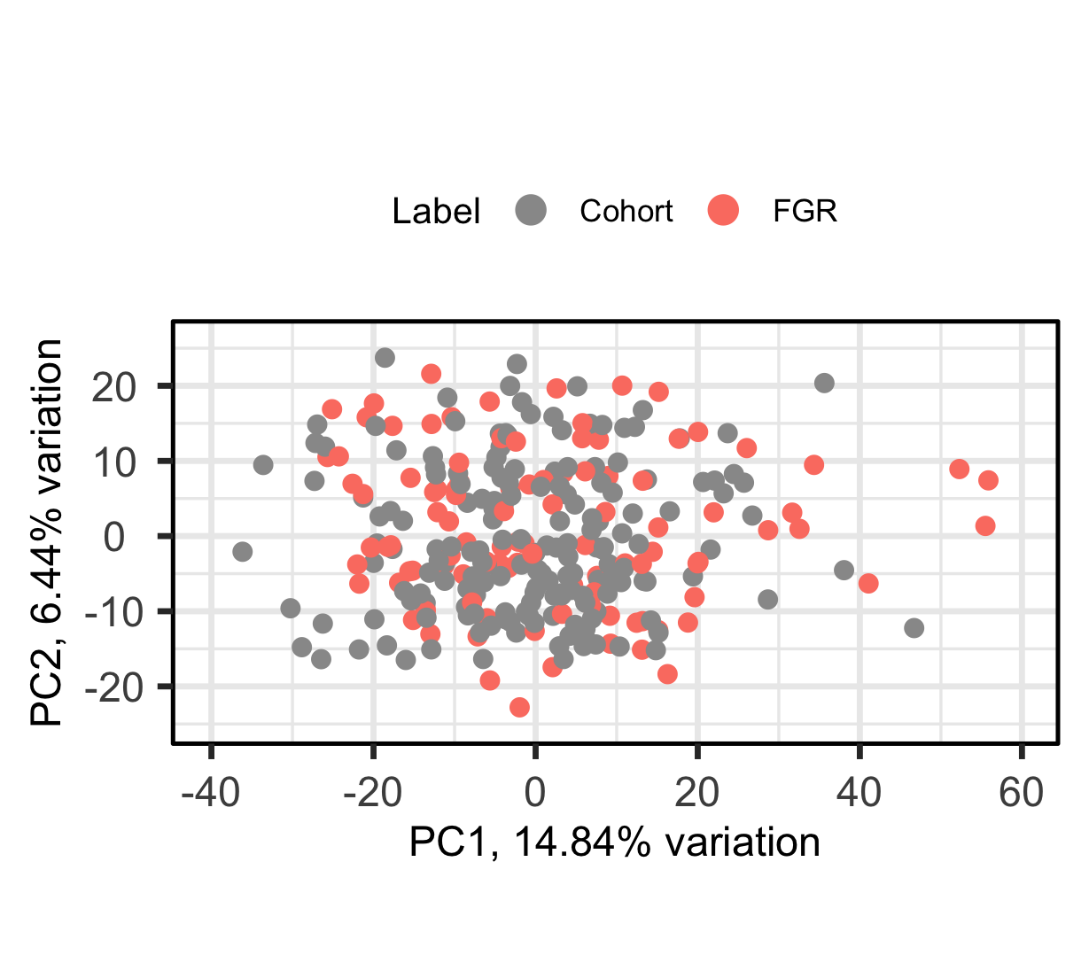
We have 2 Cohorts
Collaborator’s data arrived in two batches (1 & 2).
No biological reason for which cohort a sample was assigned to.
Cohort 1 (n = 126), Cohort 2
(n = 156).
Our goal is to use cohort 1 as discovery and cohort 2 as validation.

Slide 7
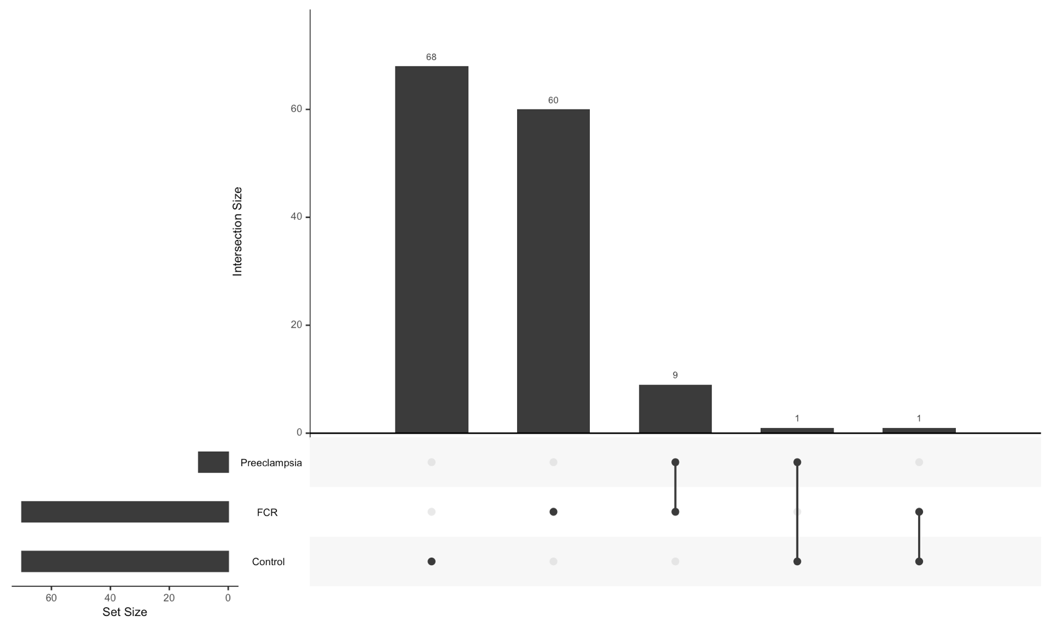
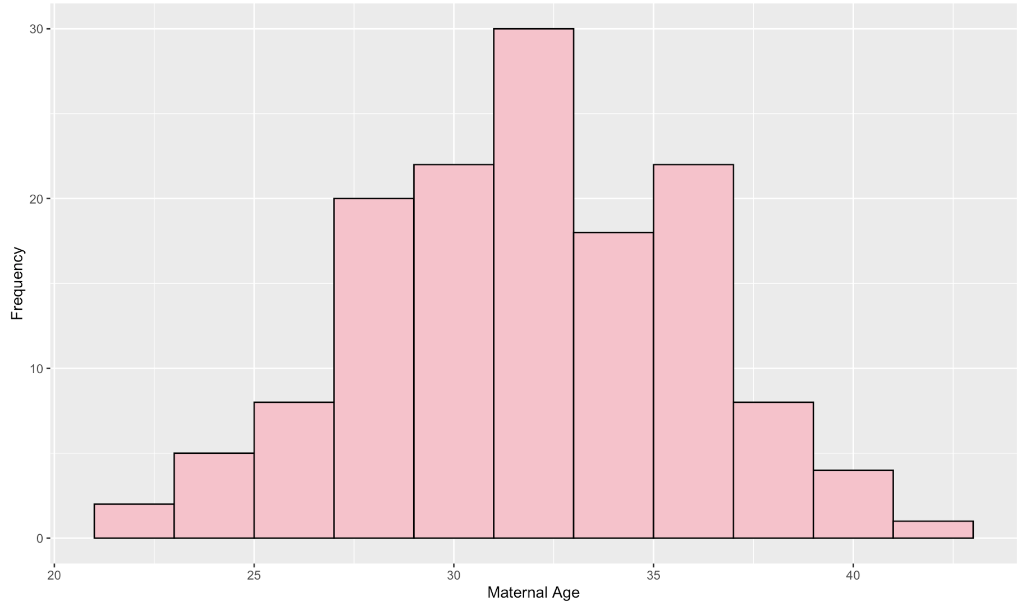
A sense of Metadata

Slide 8
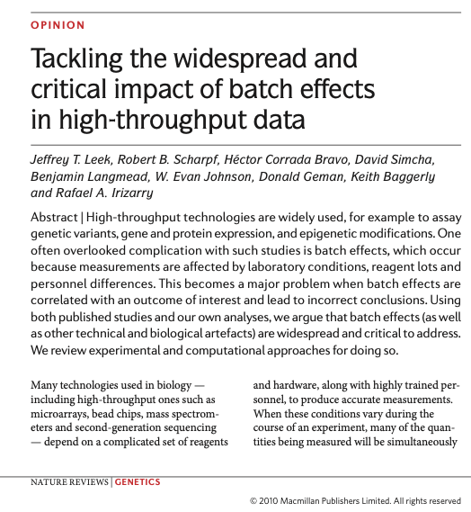
What is special in this biomarker discovery project ?
Since the early 2000s, there are probably >150,000 biomarker discovery papers
Yet translation is strikingly slow, we are struggling to get from bench-to-bedside, only on the order of ~100 looked clinically useful.
A little while ago, people think the issue is reproducibility – but that didn't quite fix the problem

Slide 9
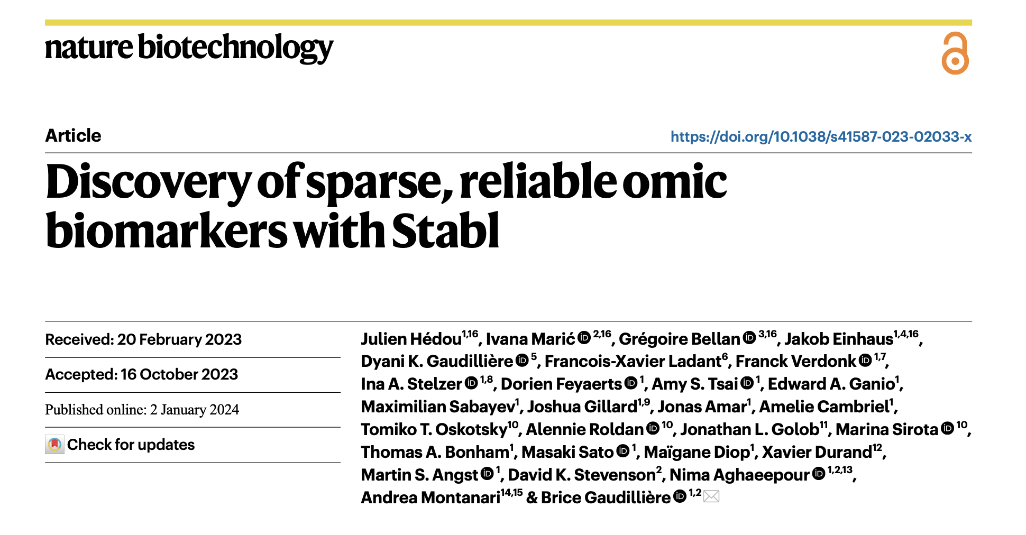

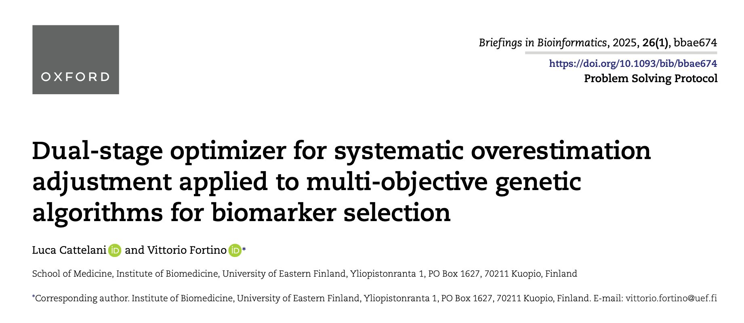

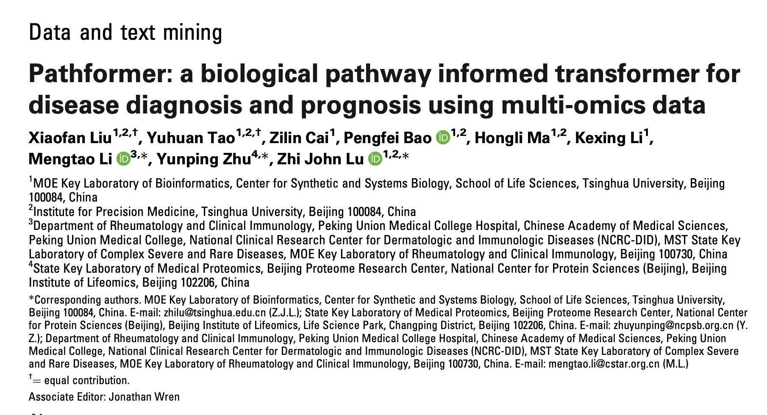
What has been being addressed and what has not?
Reproducibility & batch effects
Assay migration: discovery (thousands)
≠ implementation (less than 5)
Misaligned evaluation targets:
AUC/F1->sensitivity@specificity
Transferability & risk of bias
Patents

Slide 10
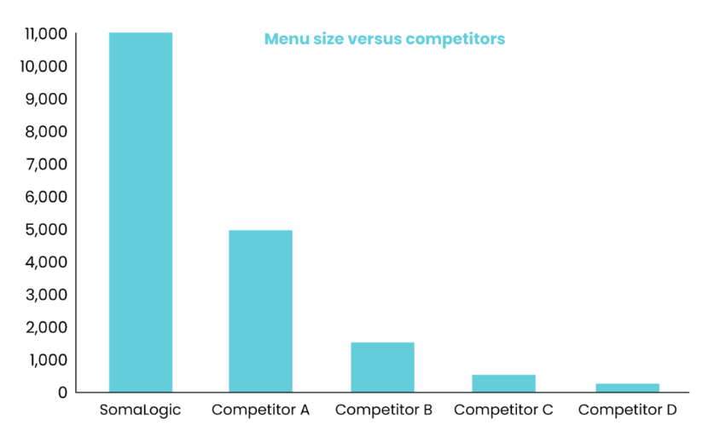
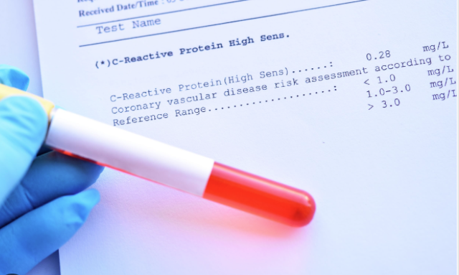
Assay migration→ small panel
Discovery research (from SomaScan webpage)
Clinical implementation (Generally 1-5 biomakers)

Slide 11
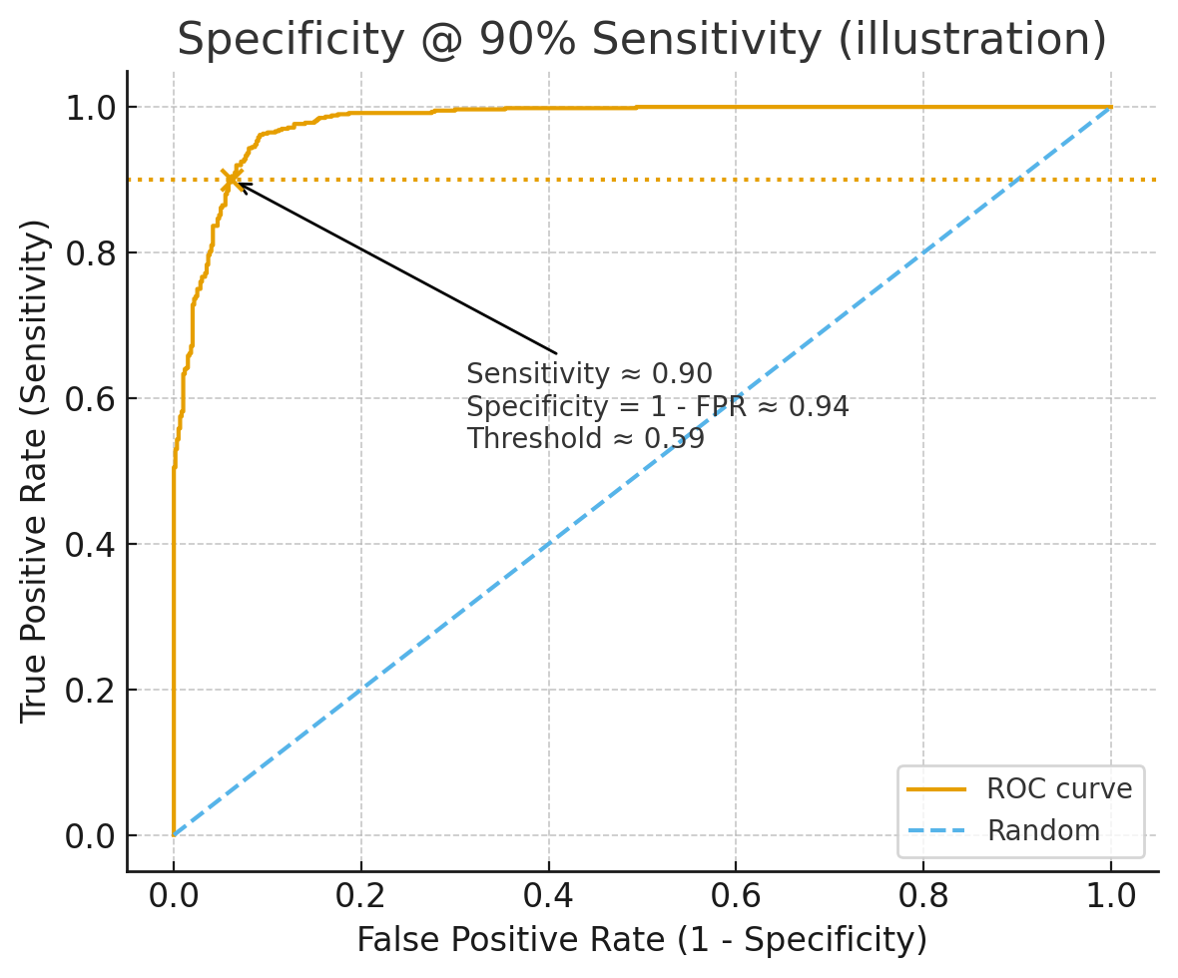
Misaligned evaluation Different language – better translation between disciplines
Clinical focus: Sensitivity @ 90% Specificity
AUC and Sensetivity@Specifity is not always aligned

Slide 12
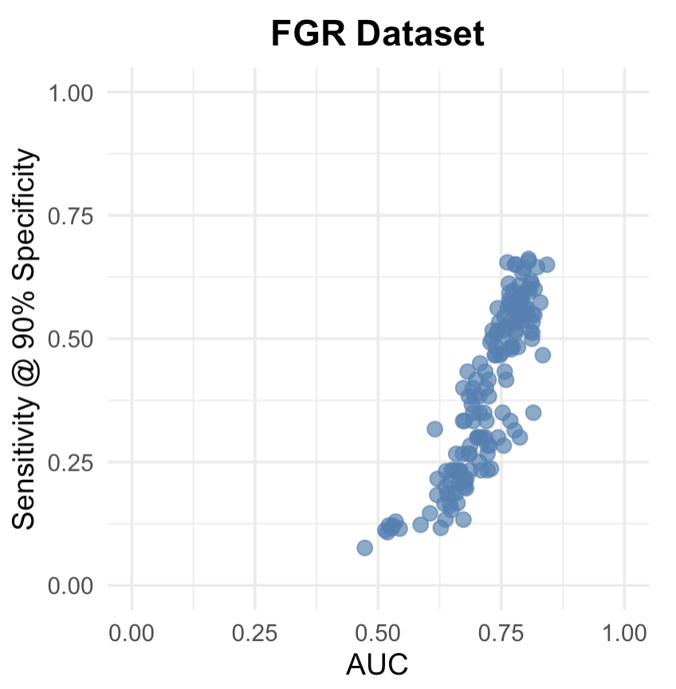
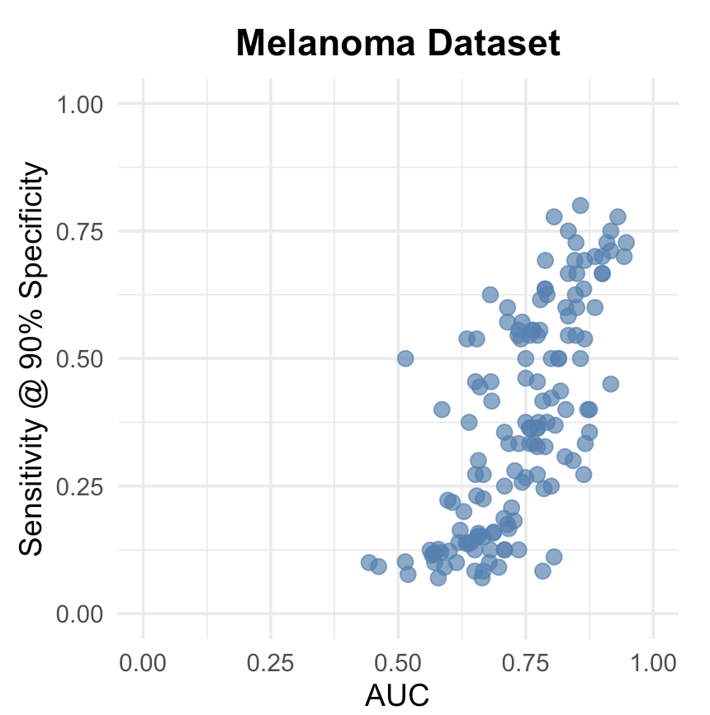
Misaligned evaluation Different language – better translation between disciplines
Clinical focus: Sensitivity @ 90% Specificity
AUC and Sensetivity@Specifity is not always aligned

Slide 13
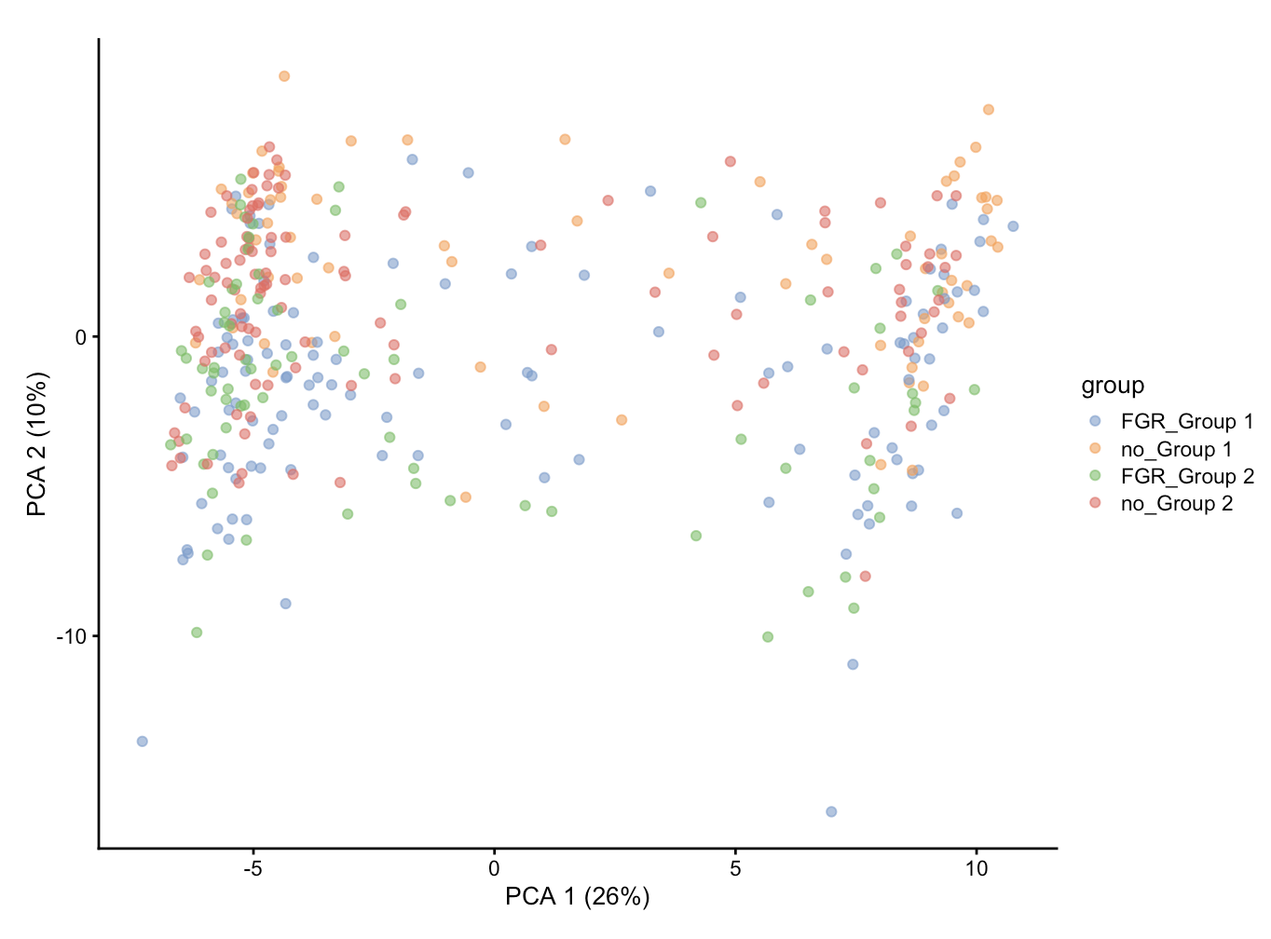
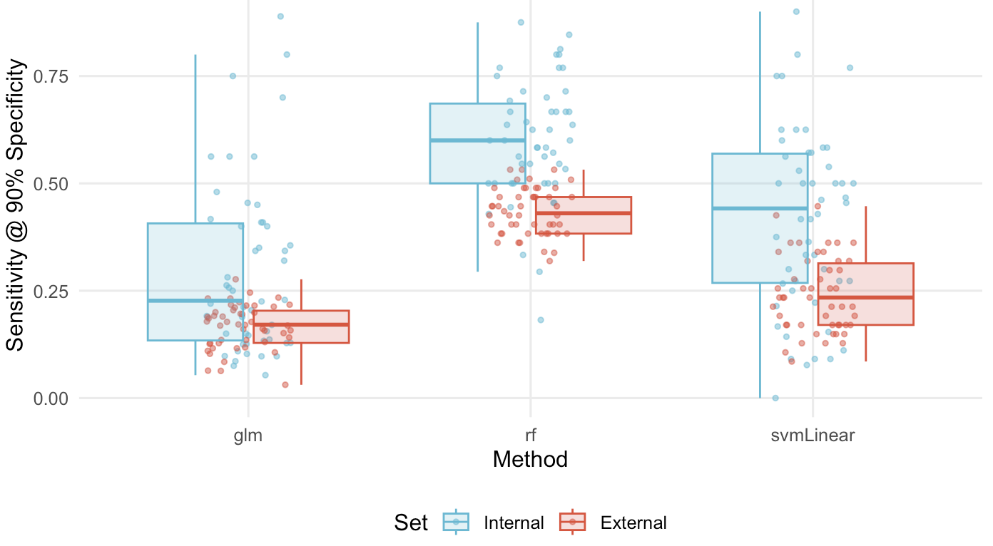
Transferability
Two cohorts have distribution shift
Traditional machine learning feature selection methods does not work

Slide 14
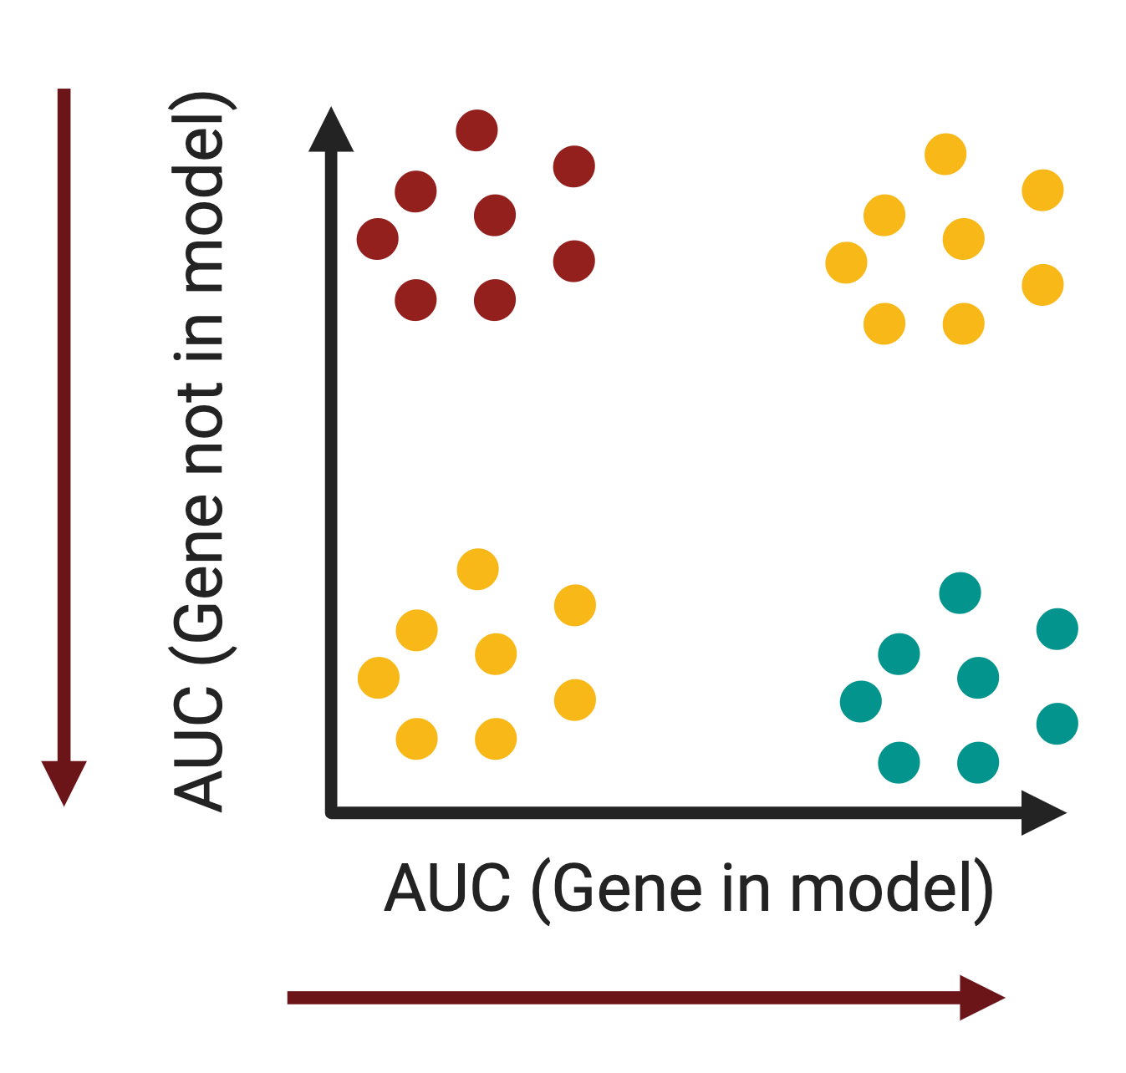
Patent issues in biomarker discovery
1. When trying to patent a set of genes. You need to smallest number (2-5).
2. If I have a 5 gene panel, but someone uses 4 of those, that is ok.
3. To avoid this, we want to know what genes are critical for model building.
4. Gene X is needed to build good models. But if absent, no model can be built.
We need to find these gene Xs.

Slide 15
Brief summary: From Omics to Clinic
High-resolution molecular profiles (transcriptome, proteome, metabolome) enable precision medicine
Clinical reality: adoption requires robustness, reproducibility, low redundancy, assay feasibility and compliance
Transferability across cohorts/platforms is critical for real-world utility
Take-home: Clinical adoption requires transferability and assay feasibility, not just high internal AUC.

Slide 16

OptiMark – Biomarker Discovery via MOO
Enumerate all solutions that meet pre-defined clinical criteria (Clinical-Ready Set)
Jointly optimize:
predictive power,
transferability,
stability
translational objectives (future work)

Slide 17
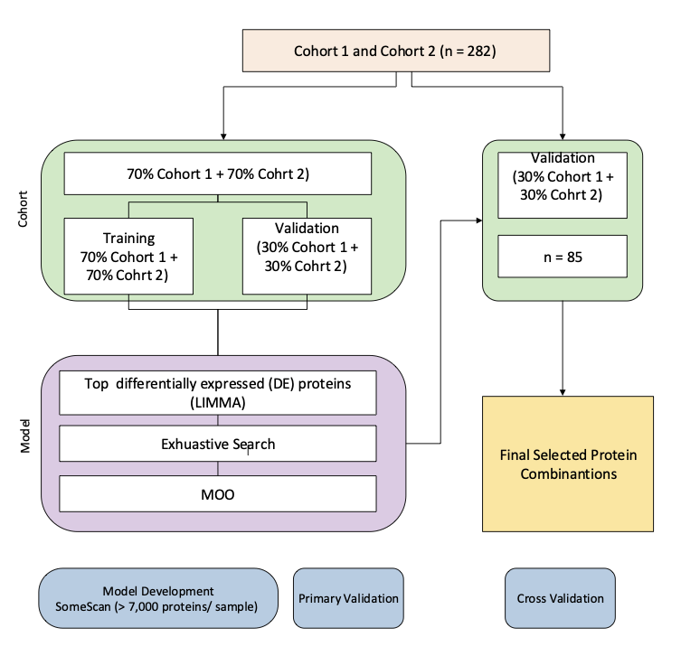
Cross Validation workflow

Slide 18
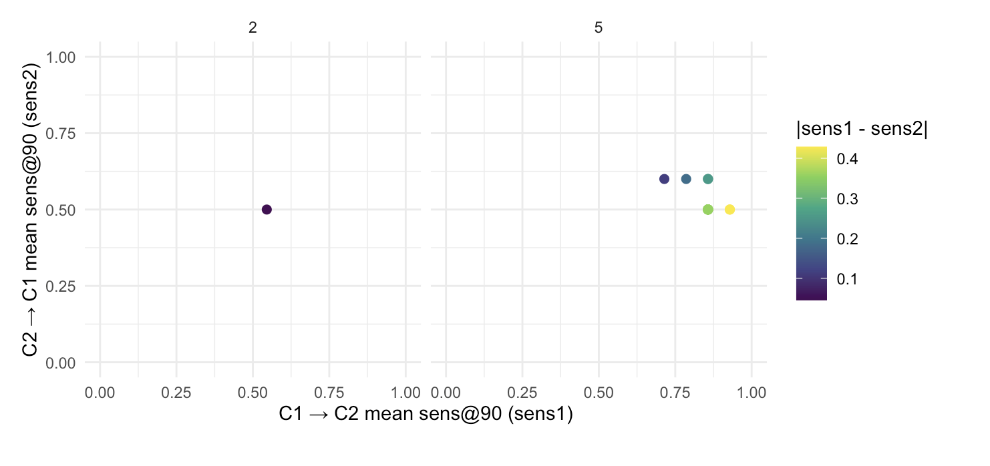
Results of exhaustive search (Cross validation of 5 repeats)
Repeat
Repeat

Slide 19
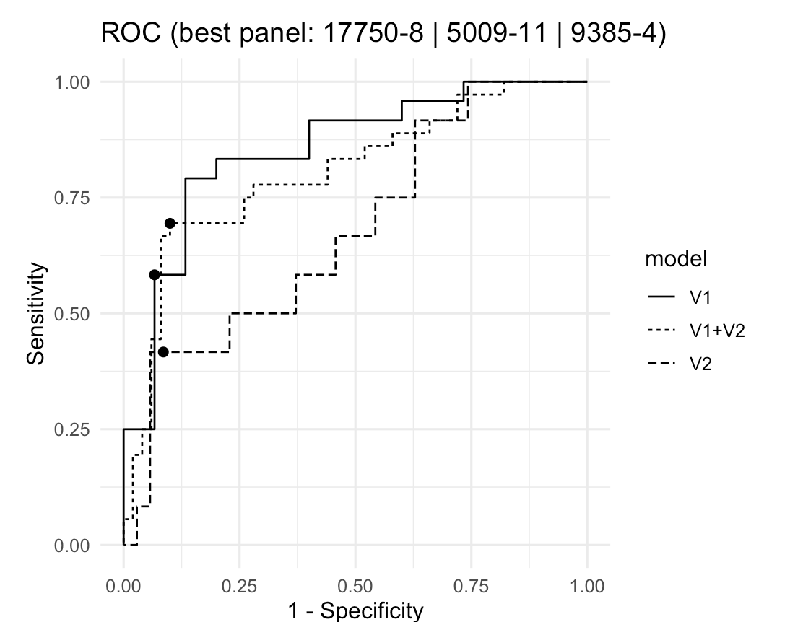
Results of exhaustive search (Cross validation of 5 repeats)
Repeat
Repeat

Slide 20
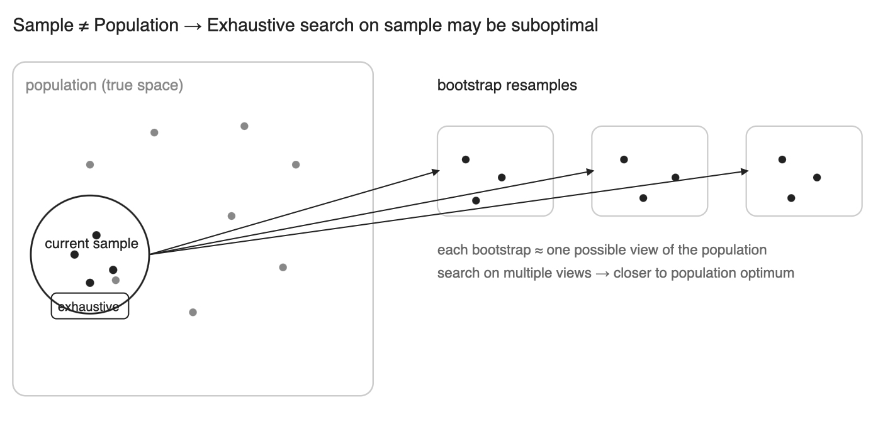
Why exhaustive search might not be the ground truth

Slide 21
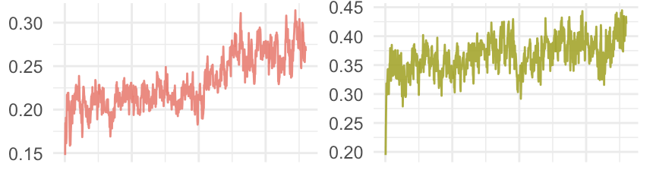
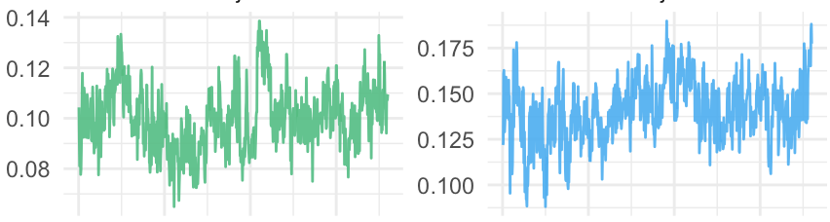
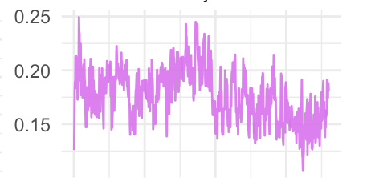
Results of MOO
Object1: C1->C2 Average Sen90
Object2: C2->C1 Average Sen90
We have 5 Objectives
related to Sensitivity@90%
Specificity on 2 train-validate
procedures: (1) Cohort1 → Cohort2
(2) Cohort2 → Cohort1
Object3: C1->C2 Sen90 Std
Object4: C2->C1 Sen90 Std
Object5: |Object1-Object2|

Slide 22
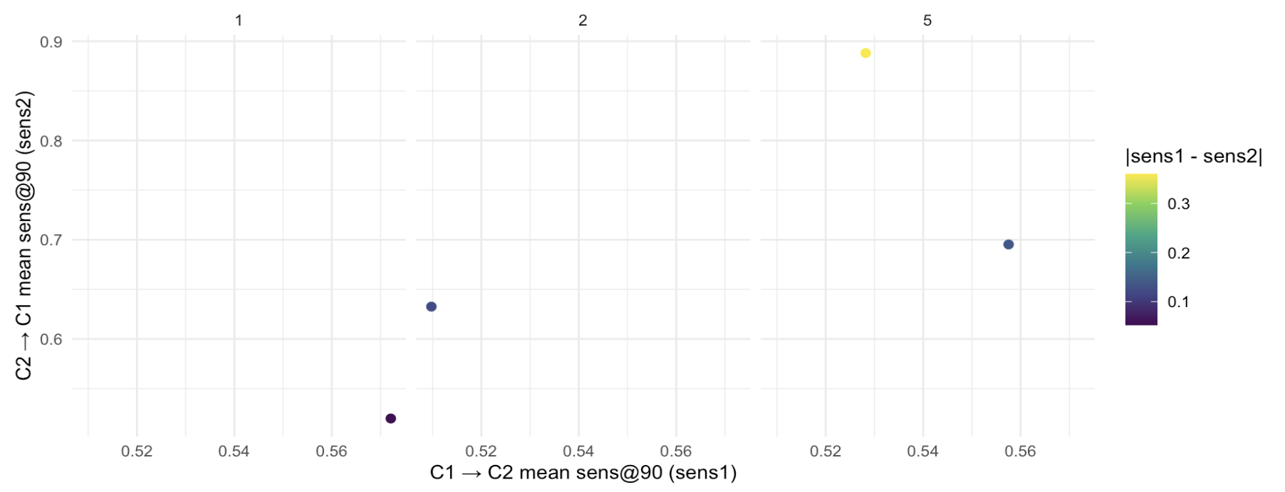
Results of MOO (Cross validation of 5 repeats)

Slide 23
Future work
Jointly optimize more meaningful objectives:
transferability,
translational objectives
Improve searching strategies:
Online learning
Reinforcement learning

Slide 24
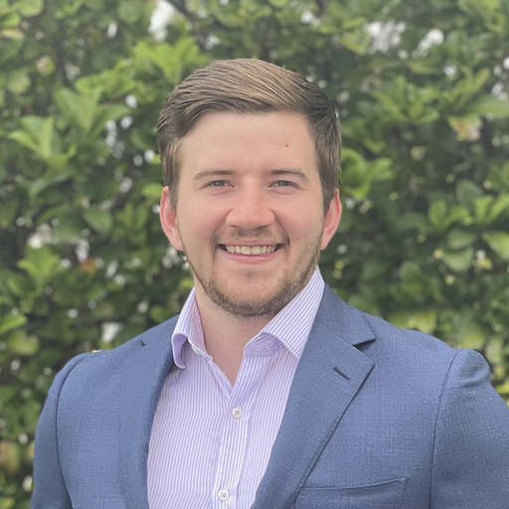
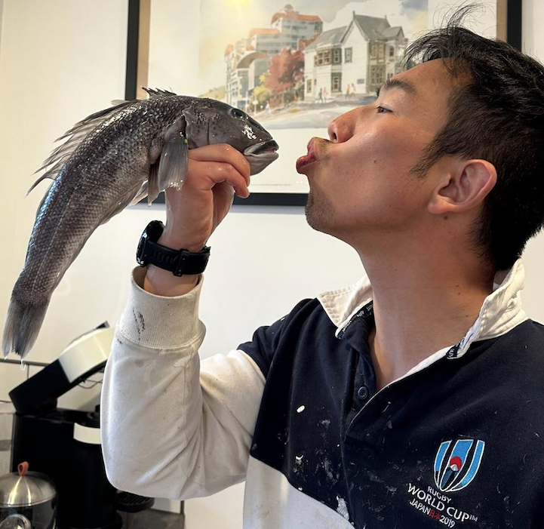
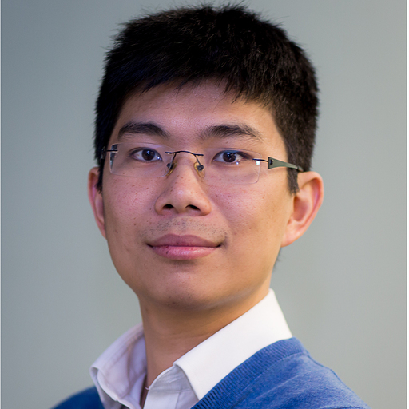
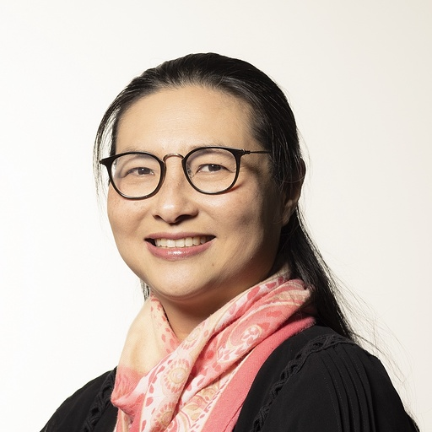
Acknowledgments
Acknowledgments: Sydney Precision Data Science Centre
Our Team
Harry Robertson
Supervisor:
Prof. Jean Yang
Dr. Jie Kang
Dr. Kevin Wang

Slide 25
THANK YOU

