Slide 1
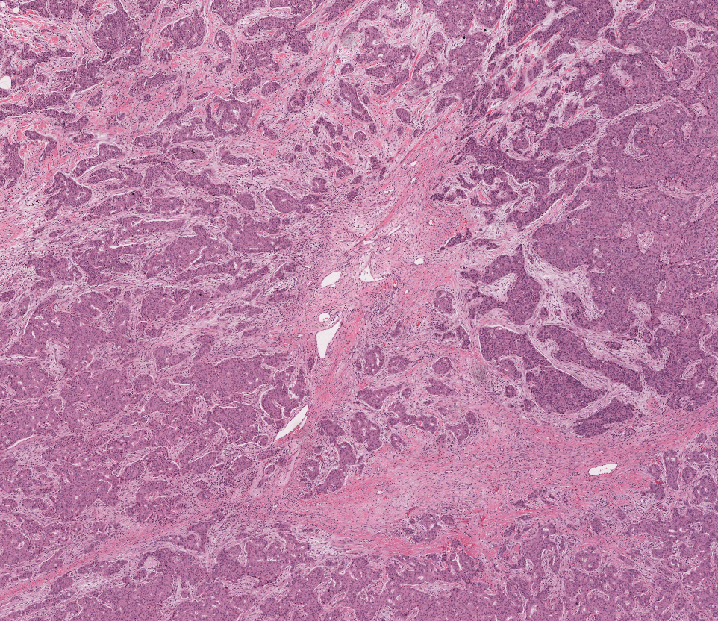
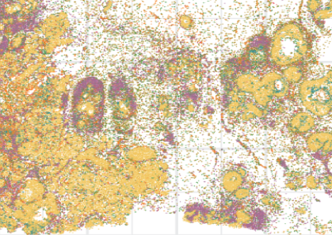


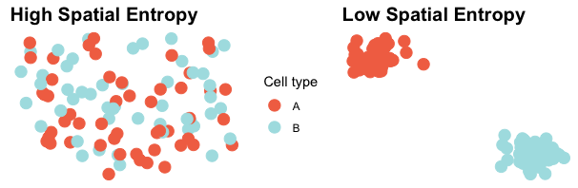
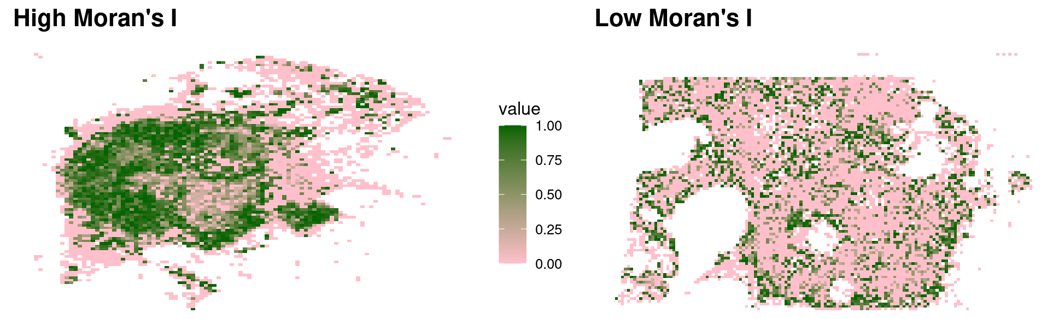


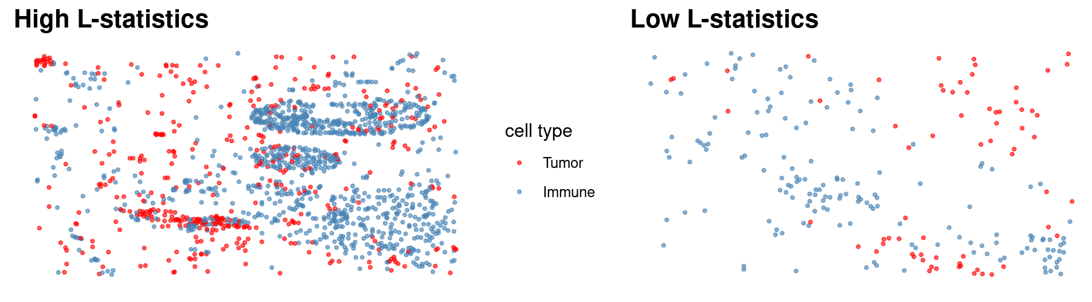
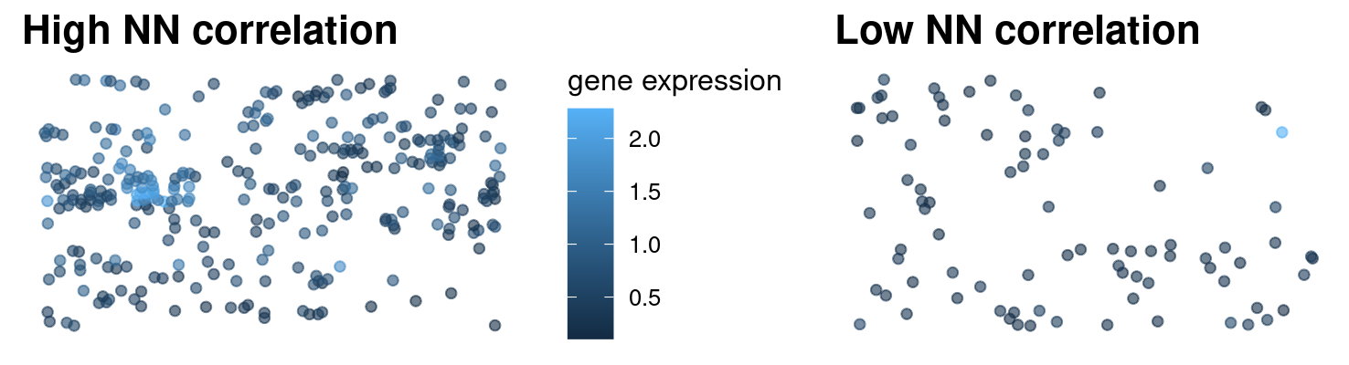
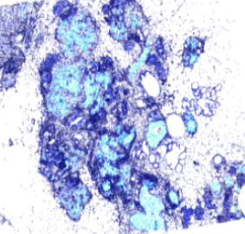
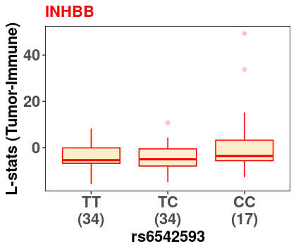
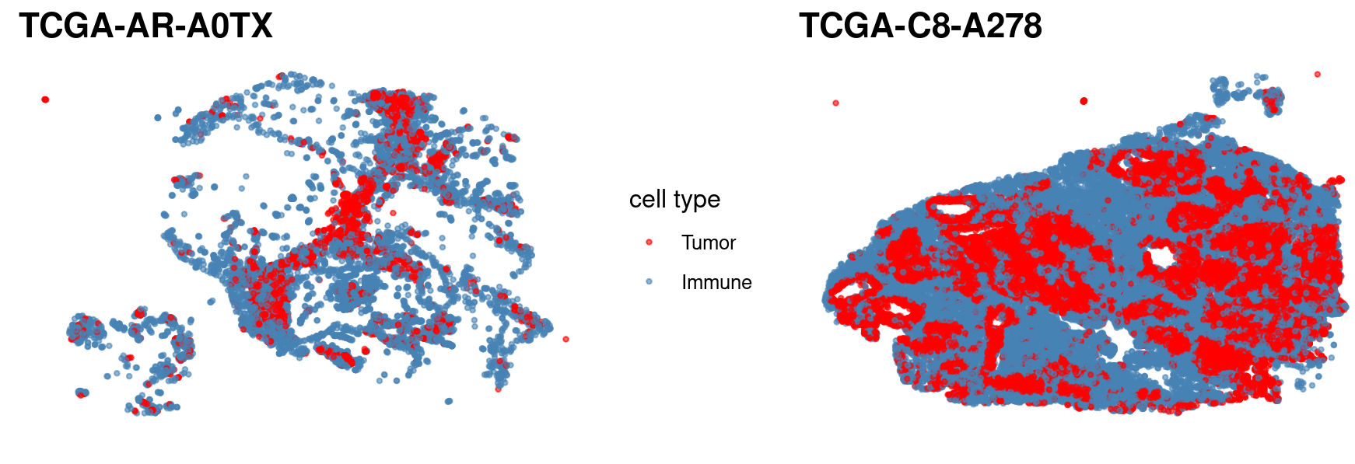
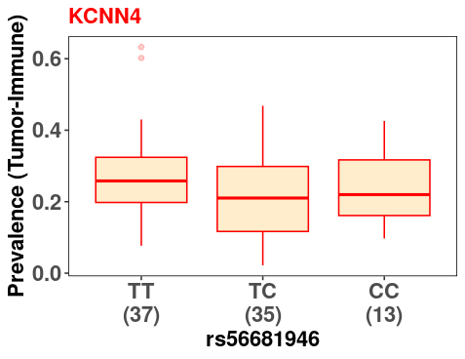
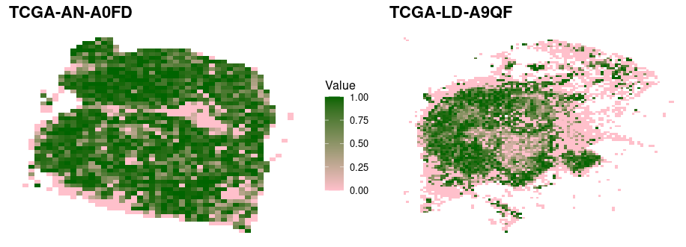
Uncovering genetic effects on single-cell spatial pattern using multiple spatial metrics
Beilei Bian¹, Yue Cao¹, Helen Fu¹ and Jean Y. H. Yang^{1*}
¹ School of Mathematics and Statistics, Faculty of Science, the University of Sydney, Australia
*Corresponding author (jean.yang@sydney.edu.au)
INTRODUCTION
Background
Spatial transcriptomics (ST) has offered unprecedented opportunities to study disease heterogeneity at spatial level. With the latest deep learning framework, we generate a large number of in-silico single-cell spatial gene expression using H&E histology of TCGA breast cancer patients.
Aim
To investigate how different each spatial metric is in data integration of genomic profiles and single-cell spatial gene expression.
METHODS
Spatial heterogeneity
Spatial autocorrelation
Spatial entropy
Moran’s I
Pre-trained model
with Xenium breast cancer data
TCGA BRCA patients
Histology images
AA | BRCA1+ | Deletion
Calculate multiple spatial metrics for each patient
Link genetic information to spatial metrics
Spatial point pattern
Spatial autocorrelation
AG | BRCA2+ | Duplication
L-function
Nearest neighbour correlation
GG | Wildtype | Normal
Breast cancer GWAS SNPs
BRCA1/BRCA2 status
Genetic profile (SNPs, pathogenic variants, somatic mutation, CNA)
Clinical characteristics
Spatial QTLs
Differential spatial pattern
In-silico single-cell spatial gene expression
Copy number alteration
RESULTS
Associations between breast cancer SNPs and L-statisitics /prevalence of high spatial entropy
Associations between copy number alteration and nearest neighbourhood correlation
Downloaded HRC imputed genotyping data of TCGA cohort from Genomic Data Commons.
Combined Breast cancer GWAS SNPs were from multiple published papers (NG2015, Nature 2017, NC2020).
Calculate L statistics between all pairwise cell types using scFeatures (Ref).
Calculate prevalence of high spatial entropy (representing spatial heterogeneity)
Each slide was split into grids by a fixed increment of 800 on both axis.
For each grid square, calculate Shannon’s entropy for immune and tumour cells.
Calculate proportion of grids that show high entropy (>0.75) for each slide.
5. Regress each GWAS SNP (#2) against L-statistics (#3) adjusting for clinical characteristics (ER status, tumour stage, age, age at menopause).
Focal copy number alteration (CNA) was estimated using the Genomic Data Common (GDC) pipeline with the GISTIC method implemented and then threshold to -1, 0, 1, representing deletion, normal copy, or amplification.
We selected all genes that have both deletion and amplification with a frequency >= 5, which resulted in 2,177 CNA genes.
For a given CNA_gene, we compared between two groups of individuals, patients showing CNA_gene loss (-1) and CNA_gene gain (+1).
For these two groups, we identified differential patterning (DP) genes where spatial patterning was measured by NN correlation.
[DO WE NEED A statement to talk about DP hotspot]
INHBB
KCNN4
SNPs and L-statistics
SNPs and prevalence of high entropy
Top SNPs | Gene | P-value
15:91509215 | RCCD1 | 0.013
2:121156136 | INHBB | 0.014
10:64563702 | ADO | 0.017
16:87085237 | C16orf95 | 0.019
Top SNPs | Gene | P-value
19:44283031 | KCNN4 | 0.003
1:42137311 | EDN2 | 0.025
8:128372172 | POU5F1B | 0.035
1:50829879 | LMO4 | 0.067
Acknowledgement
School of Mathematics and Statistics
Sydney Precision Data Science Centre
Conclusion
The genetic effect on differential spatial pattern can be uncovered by multiple spatial metrics. It would be interesting to check the overlapping identified genetic variants using different metrics and further investigate the clinical utility of genetic variants associated with spatial pattern.

