Slide 1

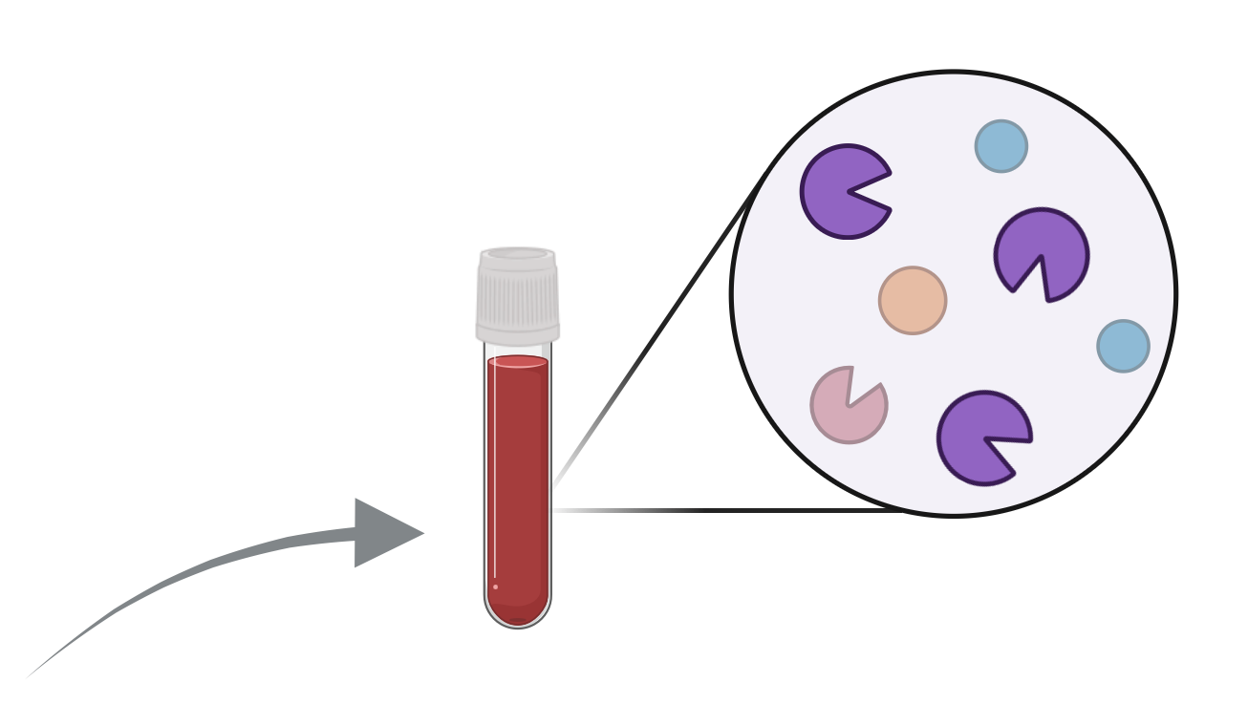

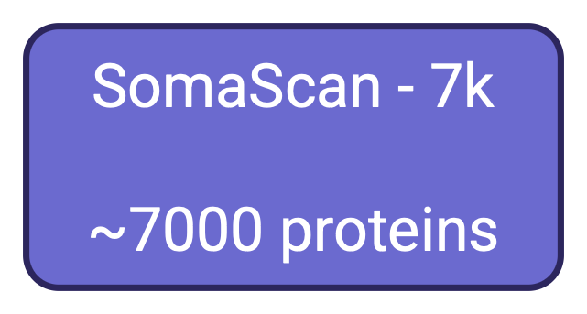



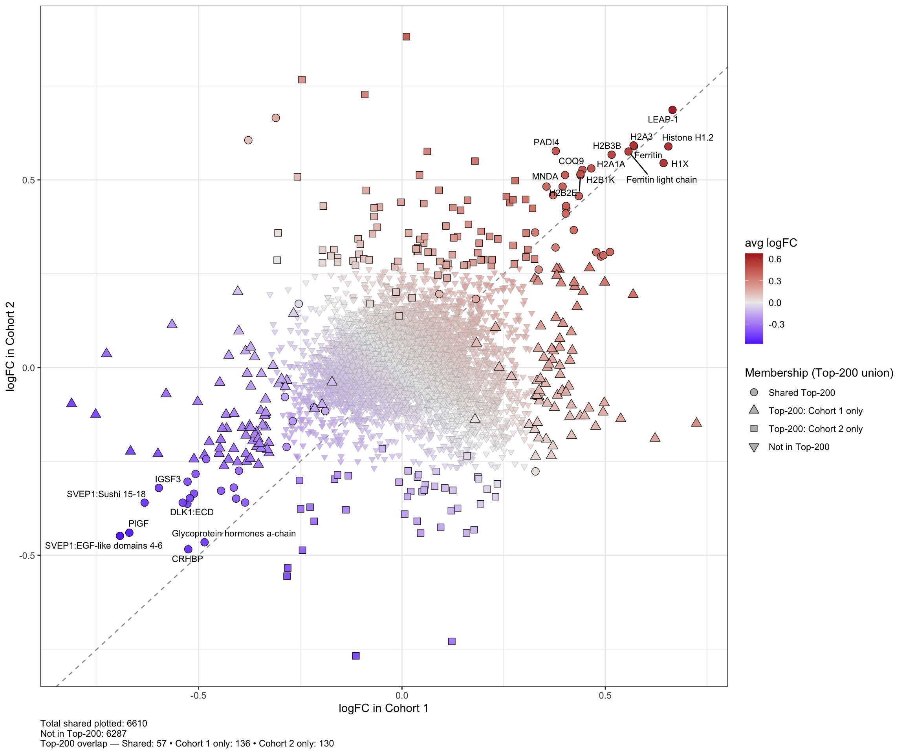
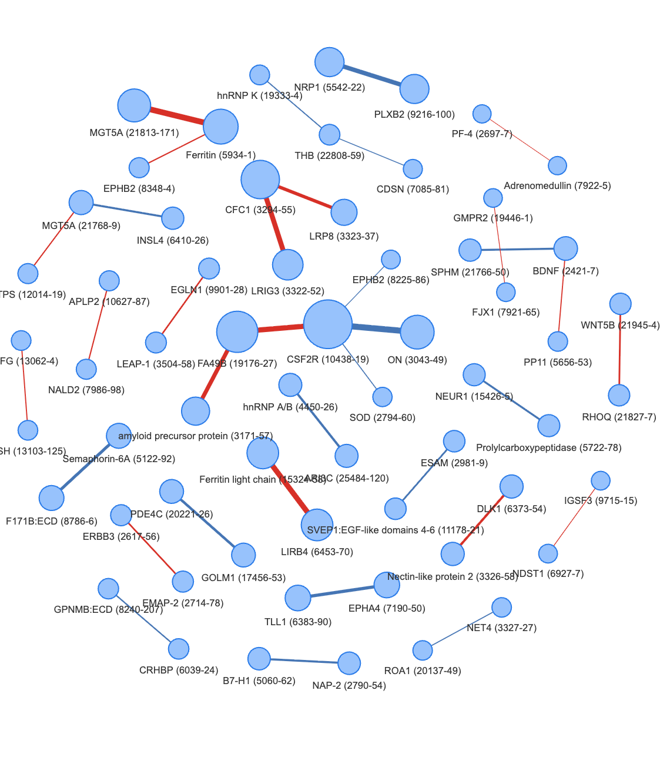
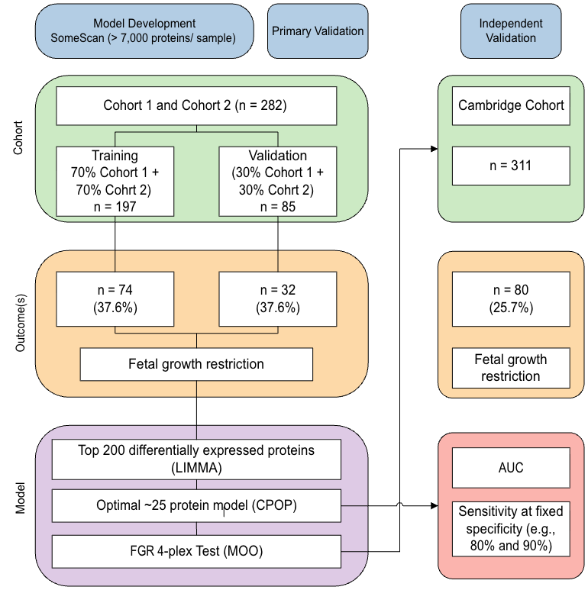
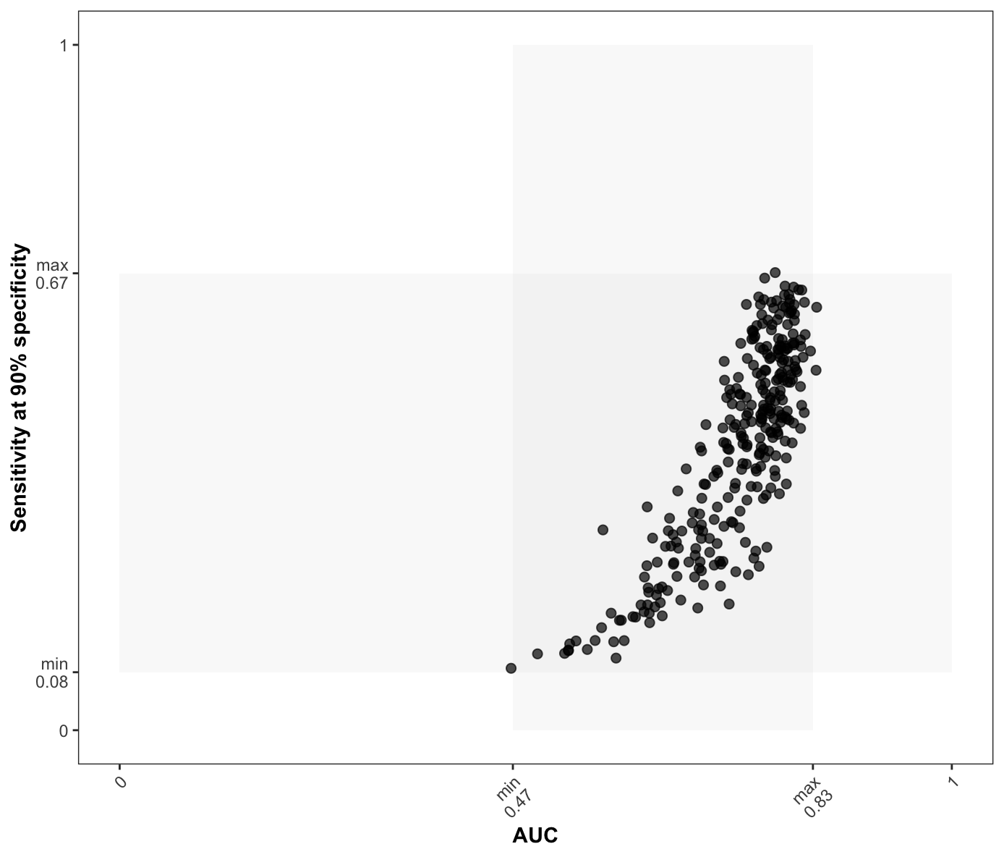
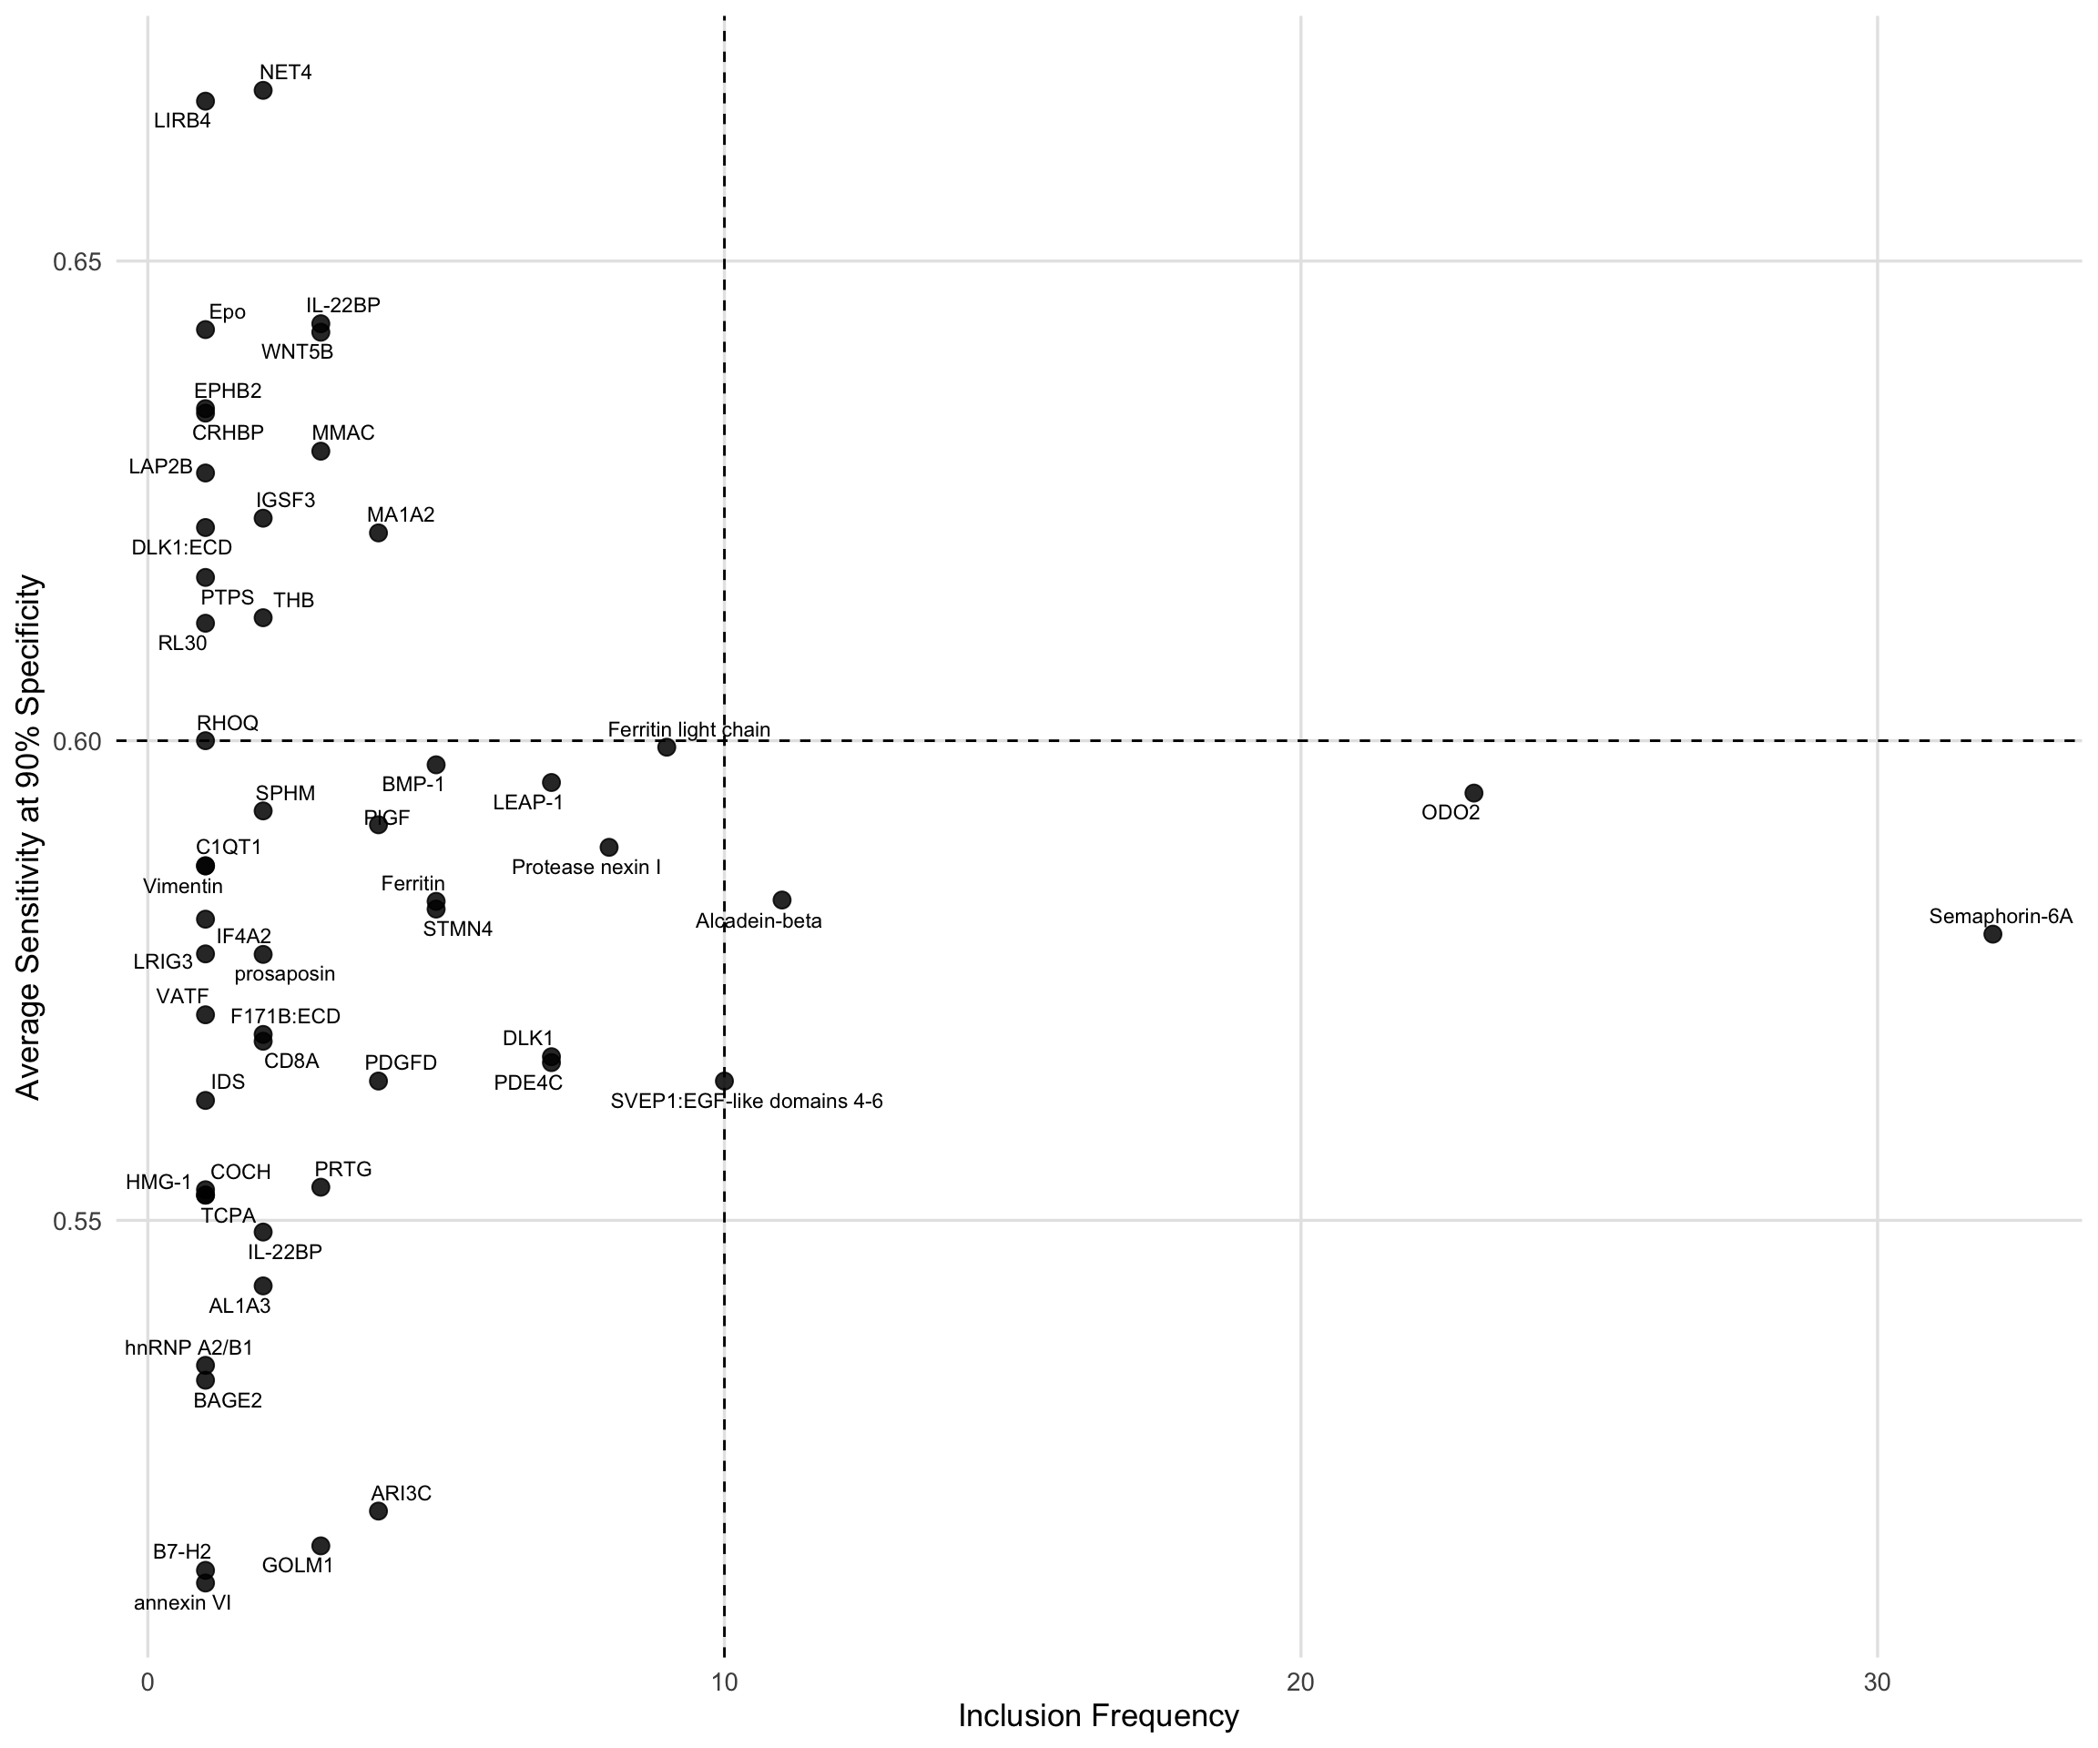
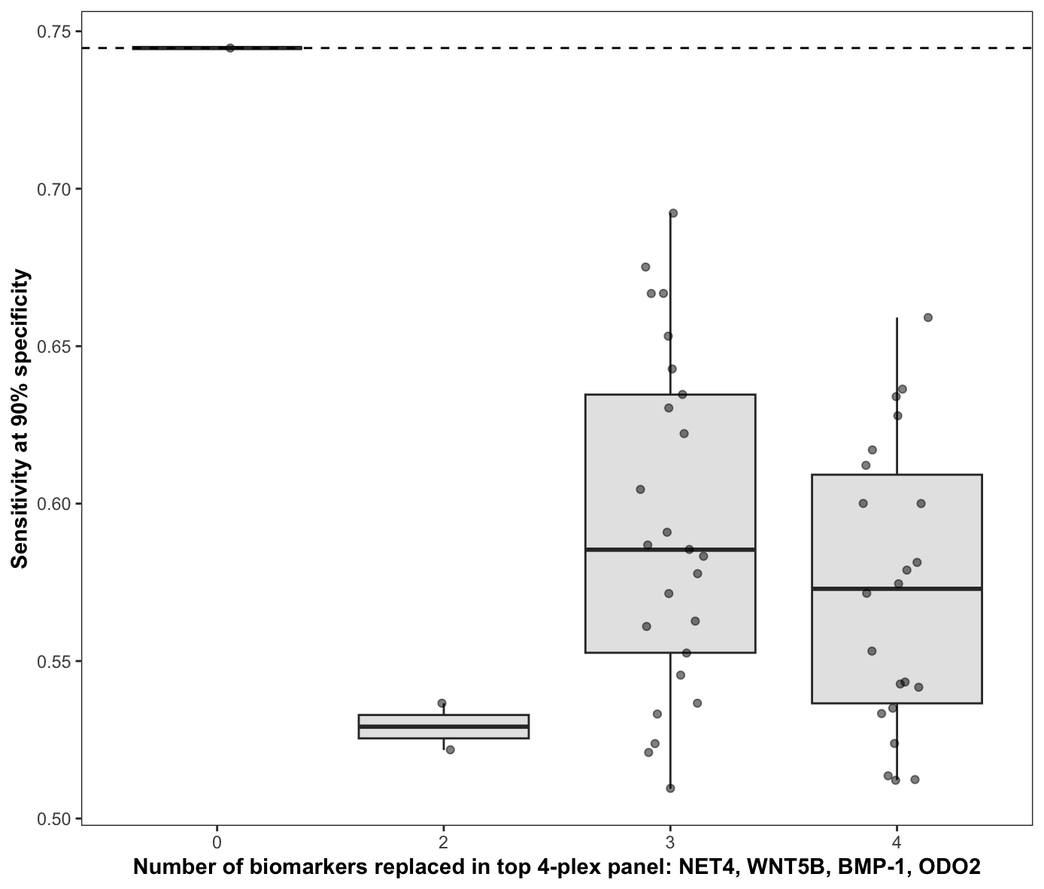


Multi-objective optimisation for biomarker identification, transferability and translation in precision medicine
Jie Kang^{1,2,3}, Lucy Bartho⁴, Wenze Ding^{1,2,3}, Harry Robertson^{1,2,3}, Kevin Wang², Yingxin Lin², Stephen Tong⁴, Tu’uhevaha Kaitu'u-Lino⁴ and Jean Yang^{1,2,3}
¹ Charles Perkins Centre, The University of Sydney
² Sydney Precision Data Science Centre, University of Sydney ³ School of Mathematics and Statistics, The University of Sydney ⁴Translational Obstetrics Group, Mercy Hospital for Women, University of Melbourne
Aptamer-based biomarker for fetal growth restriction (FGR)
Challenges
Motivations
FGR affects 3–9% of pregnancies in high-income countries and ~25% in low- and middle-income regions (Damhuis et al., 2021).
FGR increases the risk of stillbirth, neonatal complications and long-term disease.
High-resolution ultrasound can detect FGR but is costly, highlighting the need for better biomarkers to enable timely intervention and reduce harm.
Challenges of biomarker identification in precision medicine:
Transferability – Biomarkers often fail across cohorts due to distributional shift (demographics, prevalence, assay differences).
ML vs clinical metrics – Model selection typically relies on ML metrics (AUC) that don’t reflect clinical performance requirements (sensitivity and specificity).
Platform size – Diagnostic platforms have strict panel limits (e.g., 3–4 markers), restricting feasible biomarker sets.
Patentability – Biomarker panels must be resilient to substitution to maintain commercial and IP protection.
A multi-objective optimisation (MOO) framework is needed to balance predictive performance with these real-world requirements.
Objective I - Transferability
A clinically deployable biomarker must generalise beyond its training set. Transferability is essential: selected aptamers must maintain effect direction and magnitude across cohorts and platforms, regardless of demographic, prevalence, assay or batch differences.
1. Framework for assessing transferability
To evaluate transferability, we implemented a multi-cohort workflow combining model development (Cohort 1 + Cohort 2), repeated cross-validation, internal hold-out testing and external validation in the Cambridge cohort.
This framework allows us to quantify internal model stability under resampling and assess external validity under a true distributional shift using an independent cohort.
3. Transferable models
CPOP (Cross-Platform Omics Prediction; Wang et al., 2022) enhances transferability by representing proteins as log-ratio features and retaining only those pairs that satisfy CPOP’s cross-cohort effect-consistency criterion. This reduces platform-, batch- and normalisation-induced variation and yields a modelling basis composed of log-ratio features that remain transferable under distributional shift.
Edges represent log-ratio features retained because their effect estimates meet CPOP’s cross-cohort effect-consistency requirement.
Edge colour encodes the sign of the log-ratio effect. Red is positive and blue is negative.
2. Transferable biomarkers
LIMMA differential expression (DE) analyses in Cohort 1 and Cohort 2 show strong concordance for top DE proteins.
The preserved effect direction and magnitude demonstrate that the underlying biological signal is transferable across cohorts, providing a stable foundation for model building.
Nodes represent proteins.
Node size reflects the magnitude of the CPOP effect estimate (“strength”) for each protein.
Objective II – Performance
Objective III – Size
Objective IV – Patentability
AUC shows limited variation, but sensitivity at 90% specificity varies widely, meaning models with similar AUC differ substantially at the clinical decision threshold.
Translation relies on fixed-specificity performance, so AUC alone is not sufficient.
Translation requires a compact biomarker panel.
The MOO algorithm selects the top 4-plex panels, and we evaluate each biomarker’s average sensitivity and inclusion frequency to identify markers that provide robust performance for translation.
Patentability requires that compact biomarker panels are not easily substituted.
When biomarkers in the top 4-plex panels are replaced, sensitivity at 90% specificity drops, demonstrating that the panel functions as an integrated, non-interchangeable set.
Scan for more from SCDNEY
References:
Damhuis, SE. et al. Abnormal fetal growth: small for gestational age, fetal growth restriction, large for gestational age: definitions and epidemiology. Obstet Gynecol Clin North Am. 2021;48(2):267–279.
Wang, Kevin YX, et al. "Cross-Platform Omics Prediction procedure: a statistical machine learning framework for wider implementation of precision medicine." npj Digital Medicine 5.1 (2022): 85.
NEXT STEP: We will incorporate pathway-level biological information to prioritise biomarker panels that are not only statistically robust but also mechanistically coherent. Adding pathway context is expected to improve the translatability, transferability, and patentability of the selected 4-plexes. In parallel, we will package the MOO optimisation into an open-source R package to support reproducible biomarker panel development.

