Slide 1


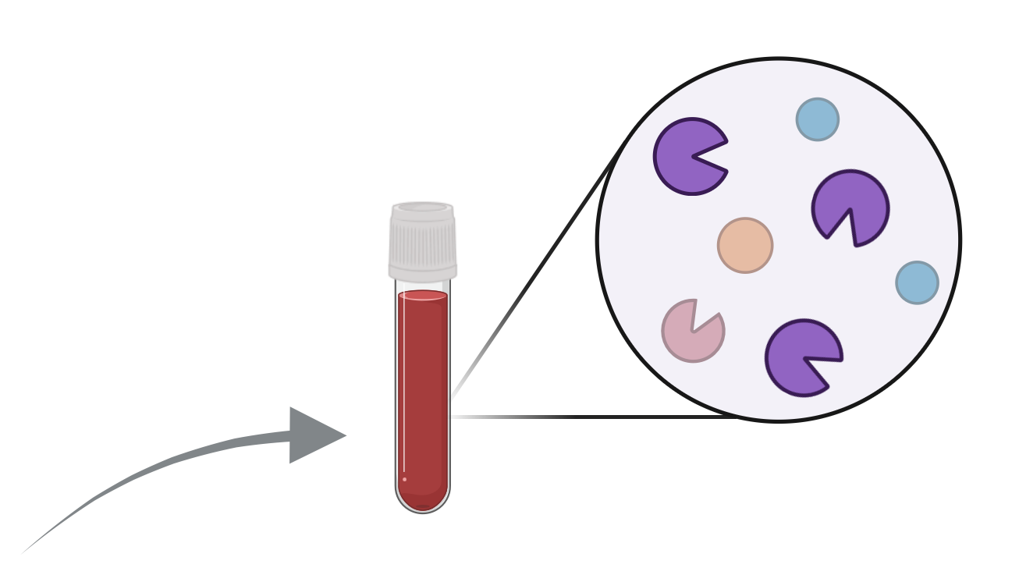
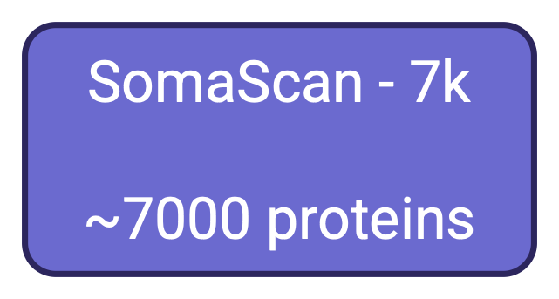



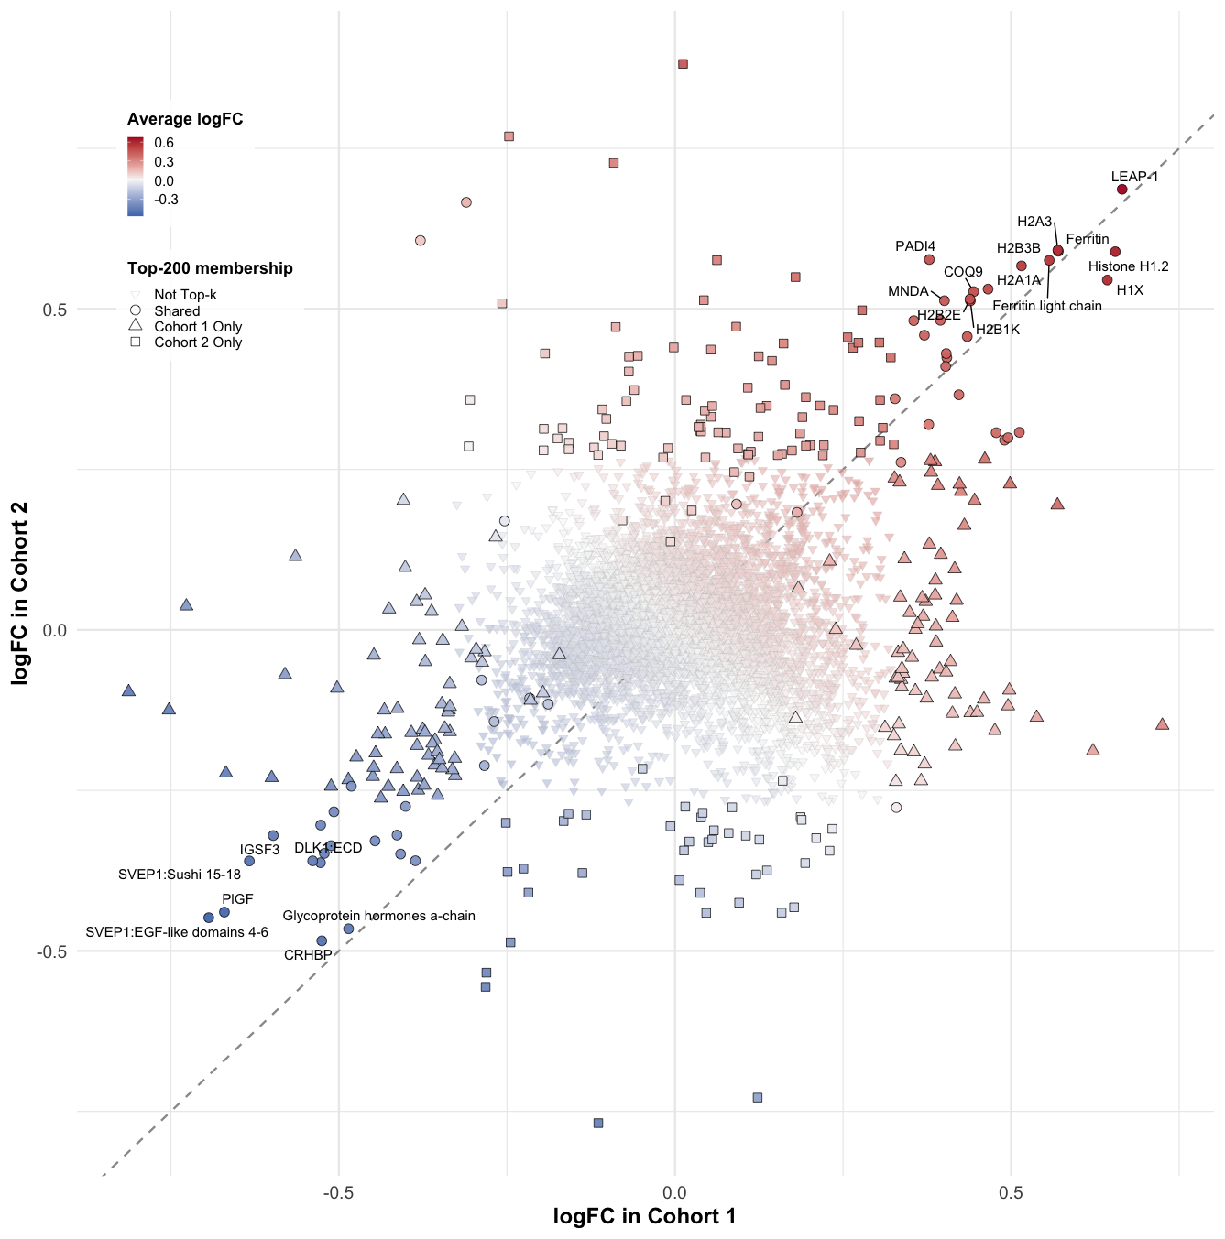
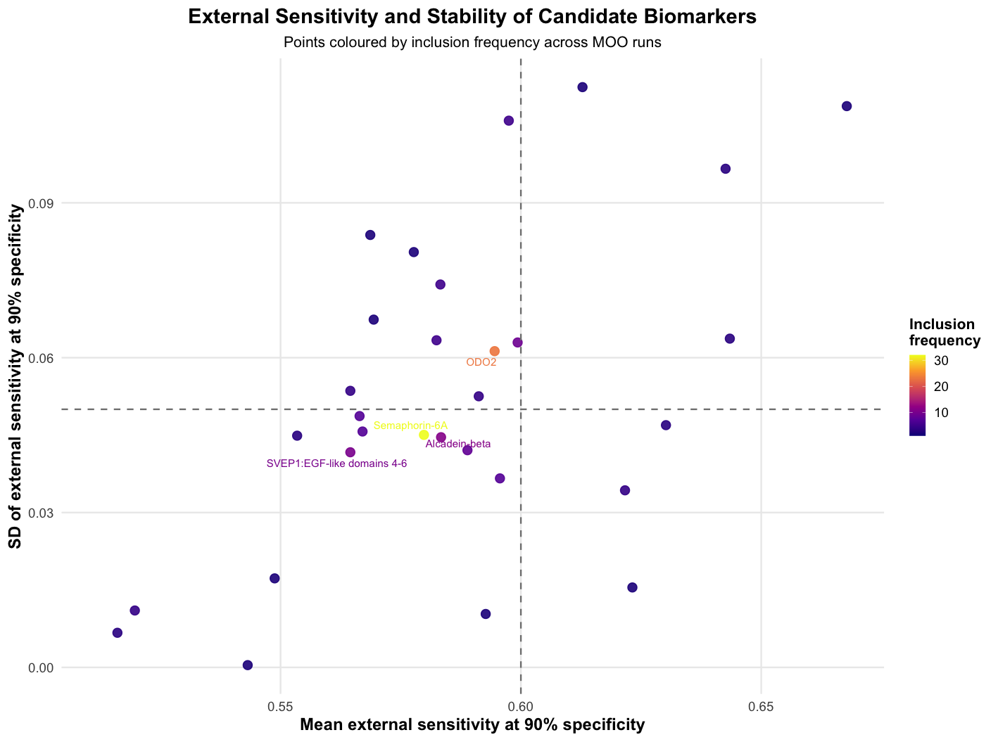
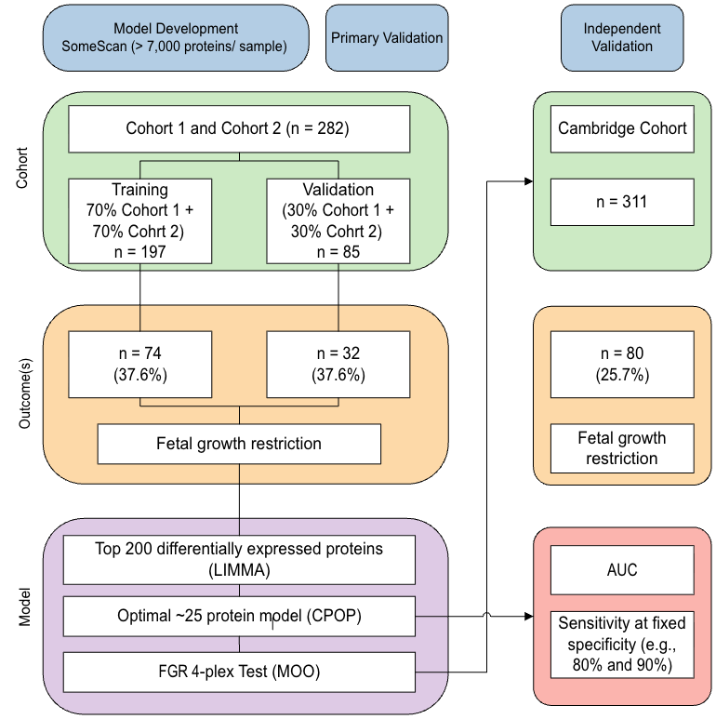
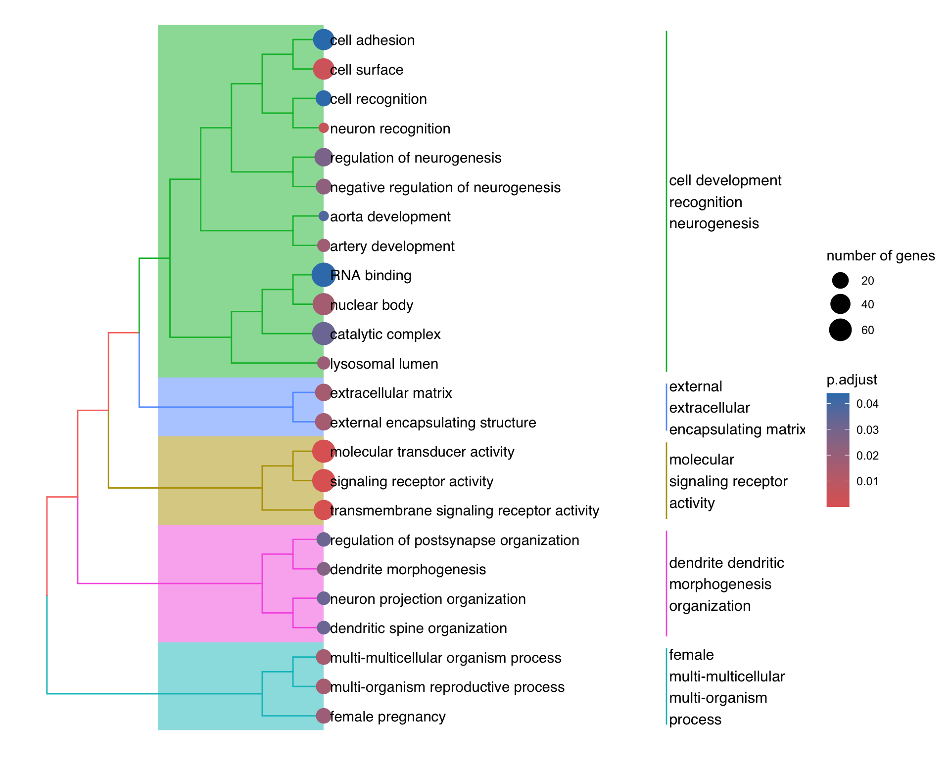


Multi-objective optimisation for biomarker identification, transferability and translation in precision medicine
Jie Kang^{1,2,3}, Lucy Bartho⁴, Wenze Ding^{1,2,3}, Harry Robertson^{1,2,3}, Kevin Wang², Yingxin Lin², Stephen Tong⁴, Tu’uhevaha Kaitu'u-Lino⁴ and Jean Yang^{1,2,3}
¹ Charles Perkins Centre, The University of Sydney
² Sydney Precision Data Science Centre, The University of Sydney ³ School of Mathematics and Statistics, The University of Sydney ⁴Translational Obstetrics Group, Mercy Hospital for Women, University of Melbourne
Aptamer-based biomarker for fetal growth restriction (FGR)
Challenges
Motivations
FGR affects 3–9% of pregnancies in high-income countries and ~25% in low- and middle-income regions (Damhuis et al., 2021).
FGR increases the risk of stillbirth, neonatal complications and long-term disease.
High-resolution ultrasound can detect FGR but is costly, highlighting the need for better biomarkers to enable timely intervention and reduce harm.
Challenges of biomarker identification in precision medicine:
Transferability – Biomarkers often fail across cohorts due to distributional shift (demographics, prevalence, assay differences).
ML vs clinical metrics – Model selection typically relies on ML metrics (AUC) that don’t reflect clinical performance requirements (sensitivity and specificity).
Platform size – Diagnostic platforms have strict panel limits (e.g., 3–4 markers), restricting feasible biomarker sets.
Patentability – Biomarker panels must be resilient to substitution to maintain commercial and IP protection.
A multi-objective optimisation (MOO) framework is needed to balance predictive performance with these real-world requirements.
Multi-objective optimisation (MOO) framework
Performance
A clinically deployable biomarker must generalise beyond its training set. Transferability is essential: selected aptamers must maintain effect direction and magnitude across cohorts and platforms, regardless of demographic, prevalence, assay or batch differences.
External performance was assessed using the mean and standard deviation of sensitivity at 90% specificity, with colour indicating inclusion frequency. A subset of biomarkers, including BMP-1, NET4, WNT5B, IL-22BP, and THB, showed both high mean sensitivity and moderate variability, indicating consistently strong performance across cohorts. In contrast, proteins such as SPHM, ARL3C, and GOLM1 displayed lower or less stable sensitivity. Higher inclusion frequency generally aligned with better-performing markers, highlighting those repeatedly favoured by the optimisation process.
1. Framework for assessing transferability
To evaluate transferability, we implemented a multi-cohort workflow combining model development (Cohort 1 + Cohort 2), repeated cross-validation, internal hold-out testing and external validation in the Cambridge cohort.
This framework allows us to quantify internal model stability under resampling and assess external validity under a true distributional shift using an independent cohort.
2. Transferable biomarkers
LIMMA differential expression (DE) analyses in Cohort 1 and Cohort 2 show strong concordance for top DE proteins.
The preserved effect direction and magnitude demonstrate that the underlying biological signal is transferable across cohorts, providing a stable foundation for model building.
Biology
3. Transferable models
We used a multi-objective optimisation (MOO) to identify biomarker panels that remain predictive across cohorts. Each candidate panel was evaluated bidirectionally, trained on one cohort and tested on the other, using objectives that capture sensitivity, variability and cross-cohort agreement. Panels meeting minimum sensitivity threshold were then prioritised based on inclusion frequency and pathway relevance. Final panels were fitted with GLMs and assessed on held-out external-validation sets.
The enriched GO terms point to processes disrupted in FGR, including cell adhesion, extracellular matrix organisation and receptor signalling—features consistent with impaired trophoblast invasion and communication. Vascular development terms further indicate defective placental vascularisation, suggesting the biomarker set captures core pathways underlying abnormal placental growth in FGR.
Scan for more from SCDNEY
References:
Damhuis, SE. et al. Abnormal fetal growth: small for gestational age, fetal growth restriction, large for gestational age: definitions and epidemiology. Obstet Gynecol Clin North Am. 2021;48(2):267–279.
Wang, Kevin YX, et al. "Cross-Platform Omics Prediction procedure: a statistical machine learning framework for wider implementation of precision medicine." npj Digital Medicine 5.1 (2022): 85.
NEXT STEP: We will extend the multi-objective optimisation (MOO) framework by incorporating pathway-level biological information directly into the objective space. This will allow the algorithm to prioritise 4-plex panels that are not only high-performing and stable across cohorts, but also biologically coherent. We will also package the enhanced MOO workflow into an open-source R package to support transparent, reproducible, and scalable biomarker panel development.

