Slide 1

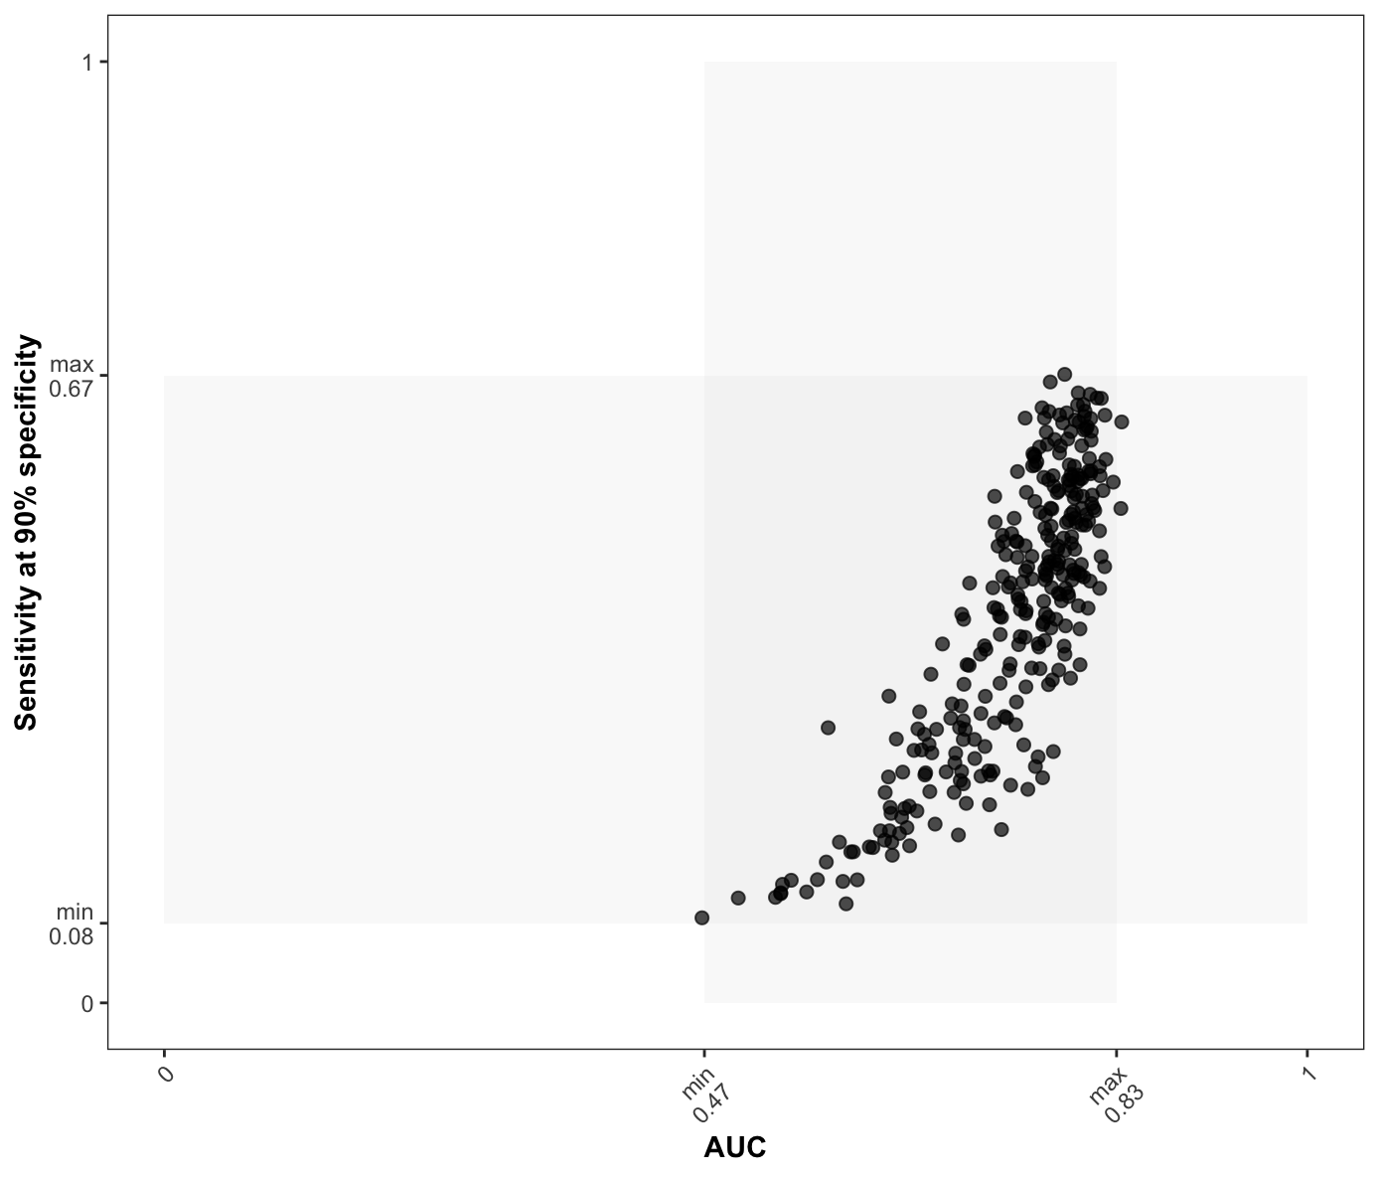
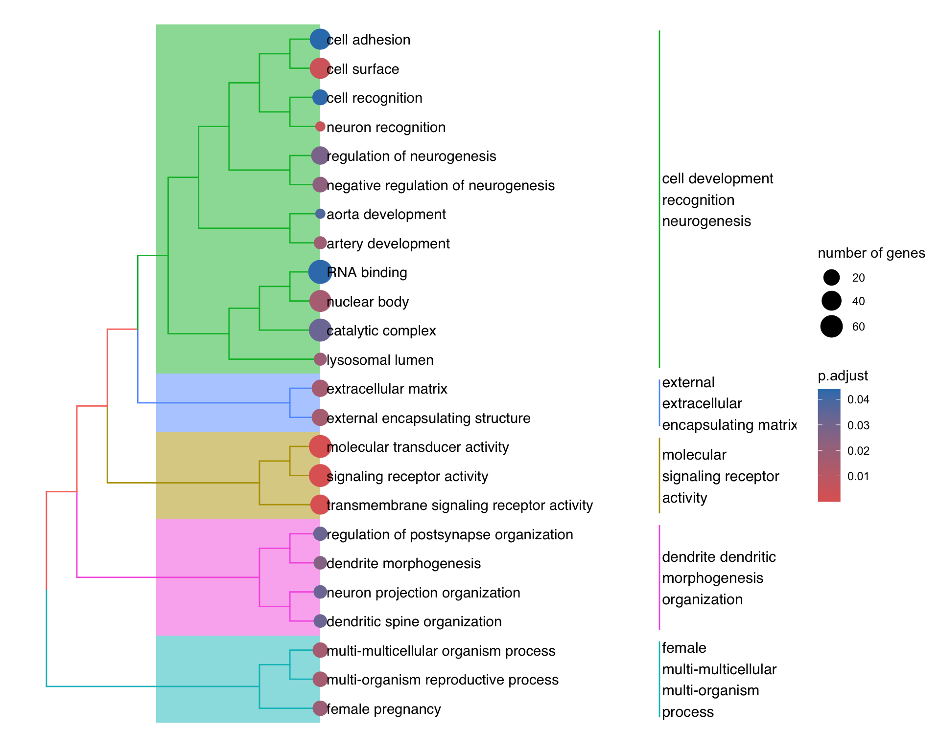


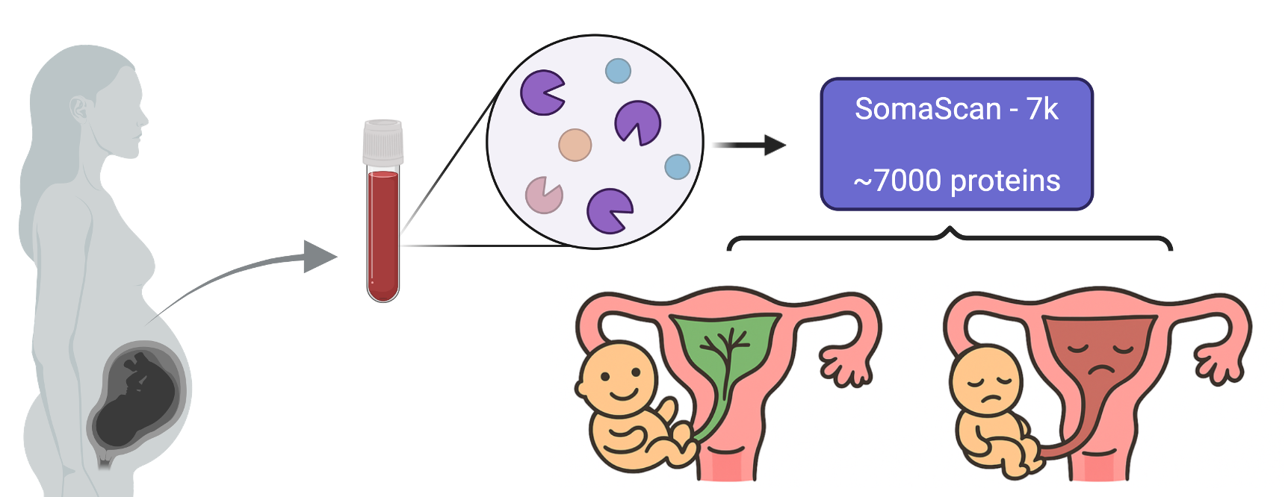

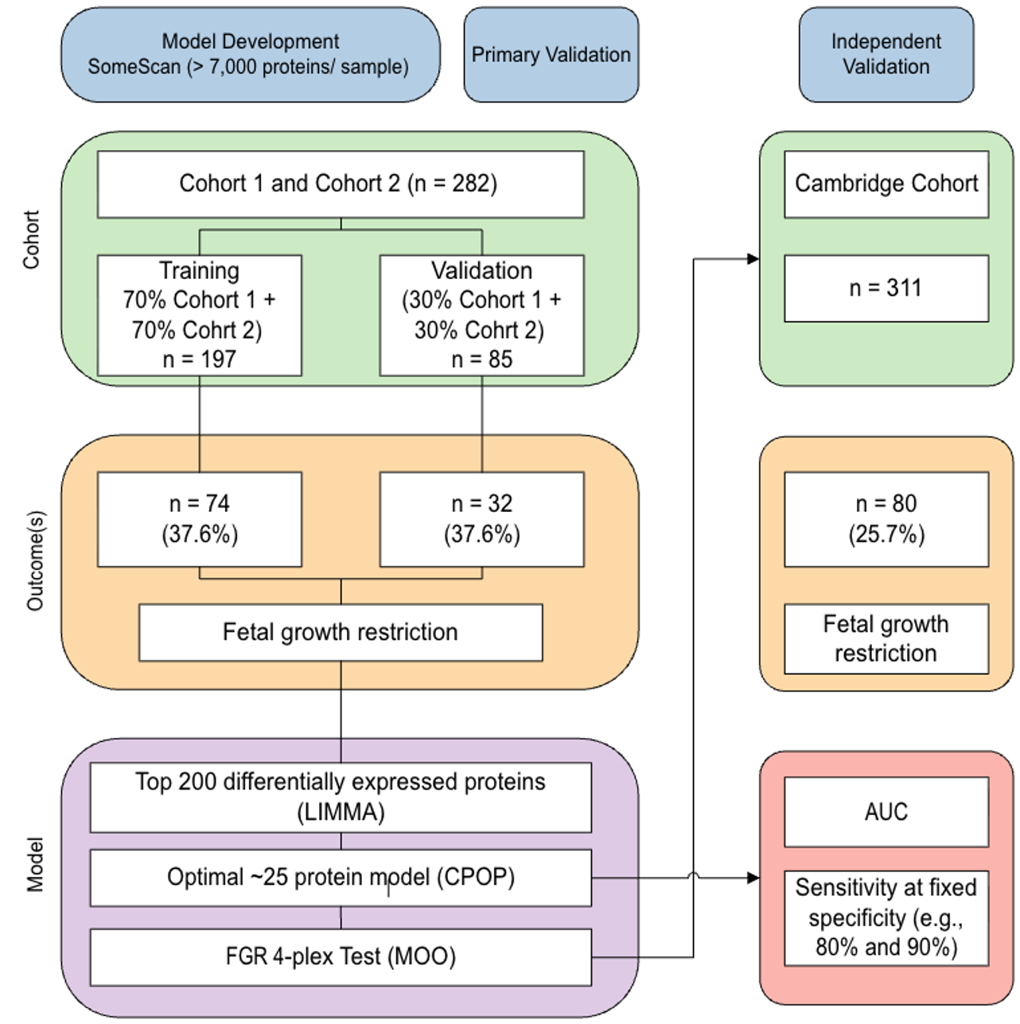
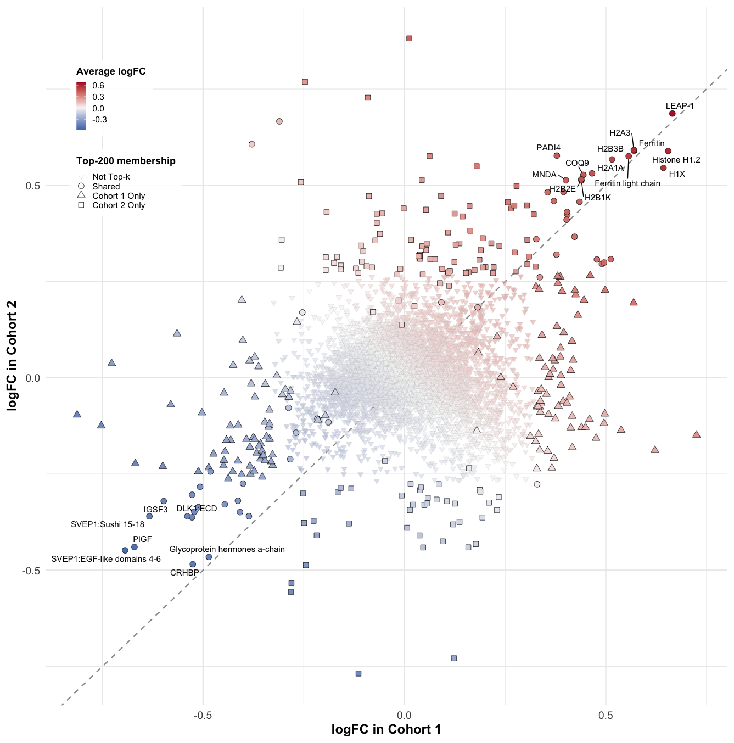

Biomarker for fetal growth restriction (FGR)
Challenges
Next step
Motivations
FGR affects 3–9% of pregnancies in high-income countries and ~25% in low- and middle-income regions (Damhuis et al., 2021).
FGR increases the risk of stillbirth, neonatal complications and long-term disease.
High-resolution ultrasound can detect FGR but is costly, highlighting the need for better biomarkers to enable timely intervention and reduce harm.
Multi-objective optimisation (MOO) framework

