Slide 1
Multi-Objective Biomarker Selection
From reproducible signatures to translational-ready panels
Presented by Wenze Ding

Slide 2

Talk Overview
Motivation: clinical translation demands more than high AUC on a single cohort
Key gaps: transferability, patent, shadow contribution of non-selected markers
What OptiMark does: explicit objectives and constraints → a clinically feasible solution set
Contributions: a framework, scalability, applications

Slide 3

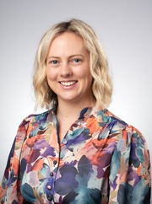
Problem motivation
Translational Obstetrics Group
from Melbourne Medical School
Use blood analytes to predict
Fetal Growth Restriction (FGR)
Postdoctoral Research
Fellow
Lucy Bartho

Slide 4
Brief backgrounds of FGR
Pregnancy is a complicated process with maternal, placental and fetal factors. They determine pregnancy outcomes.
Fetal growth restriction (FGR) affects ~5% of pregnancies.
FGR increases risk of stillbirth, neonatal complications, and long-term disease.
FGR can be detected by high resolution ultrasound; however, that is “costly” and not everyone routinely does it
Better biomarkers could guide timely interventions and reduce preventable harm.

Slide 5
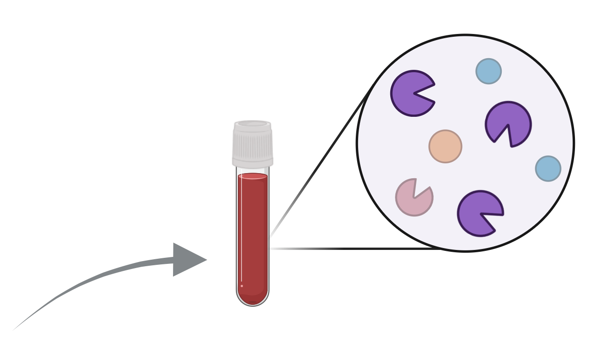
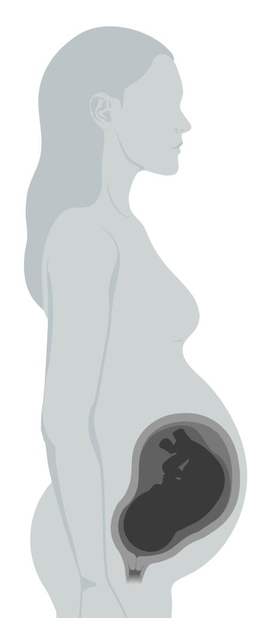
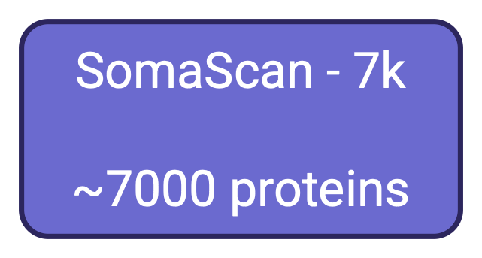


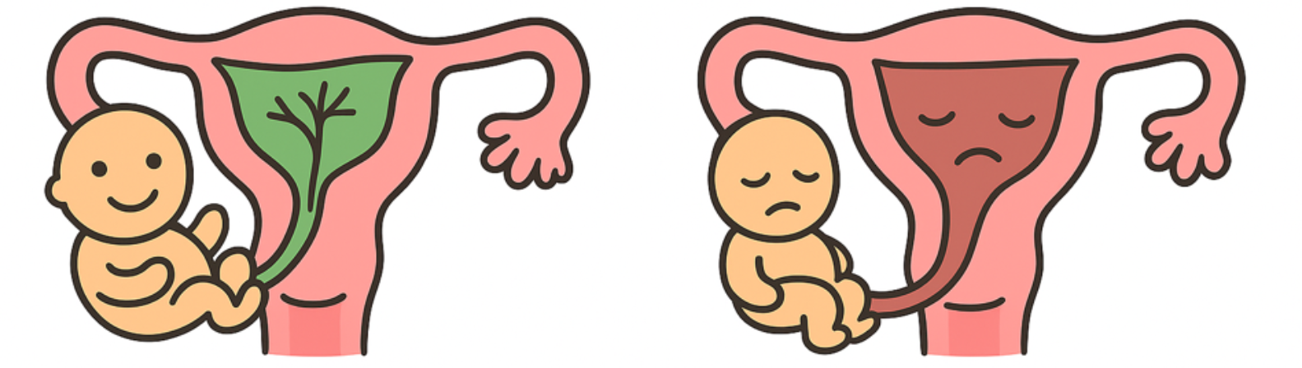
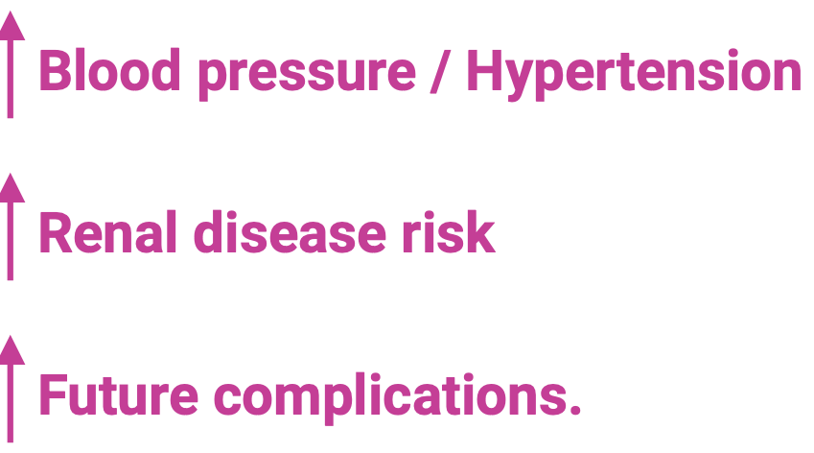
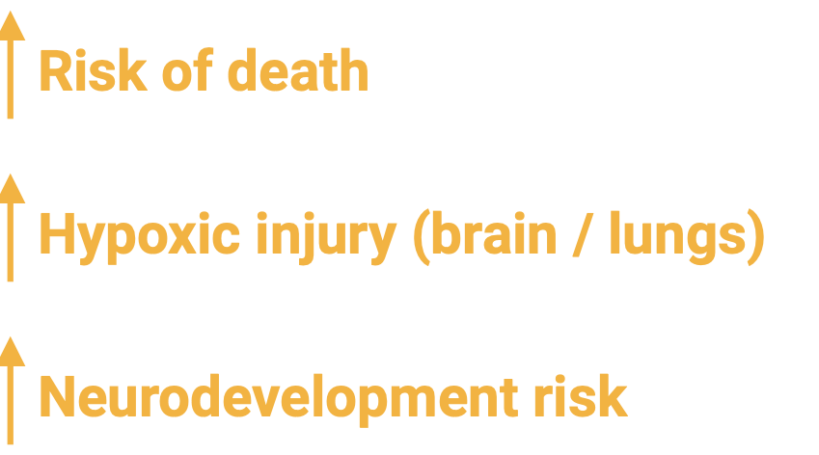

Slide 6
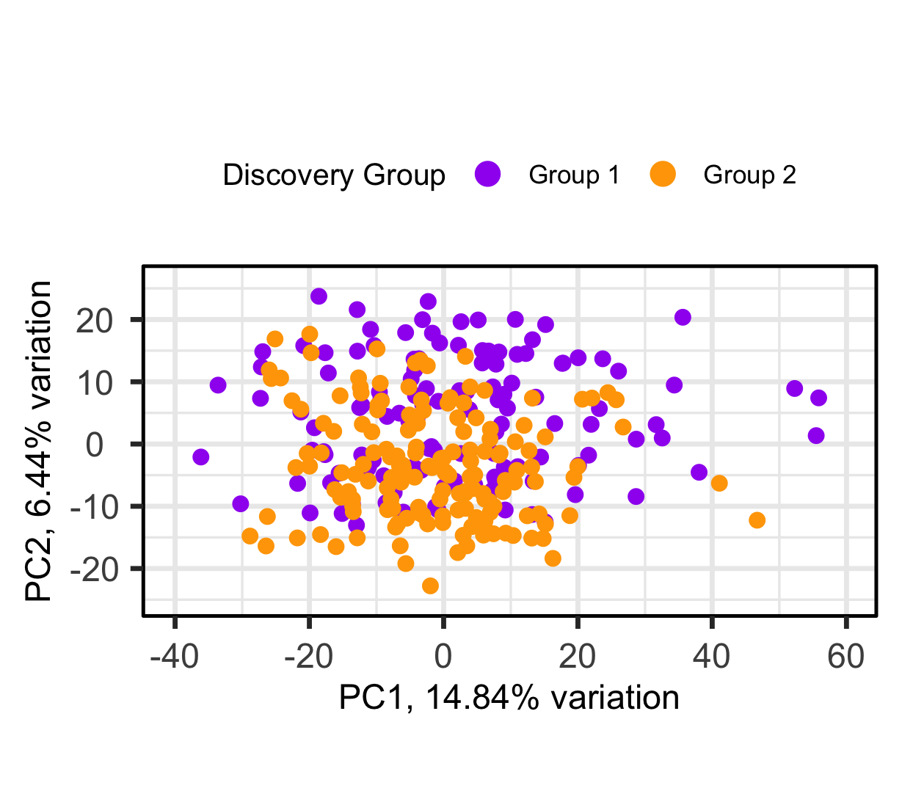
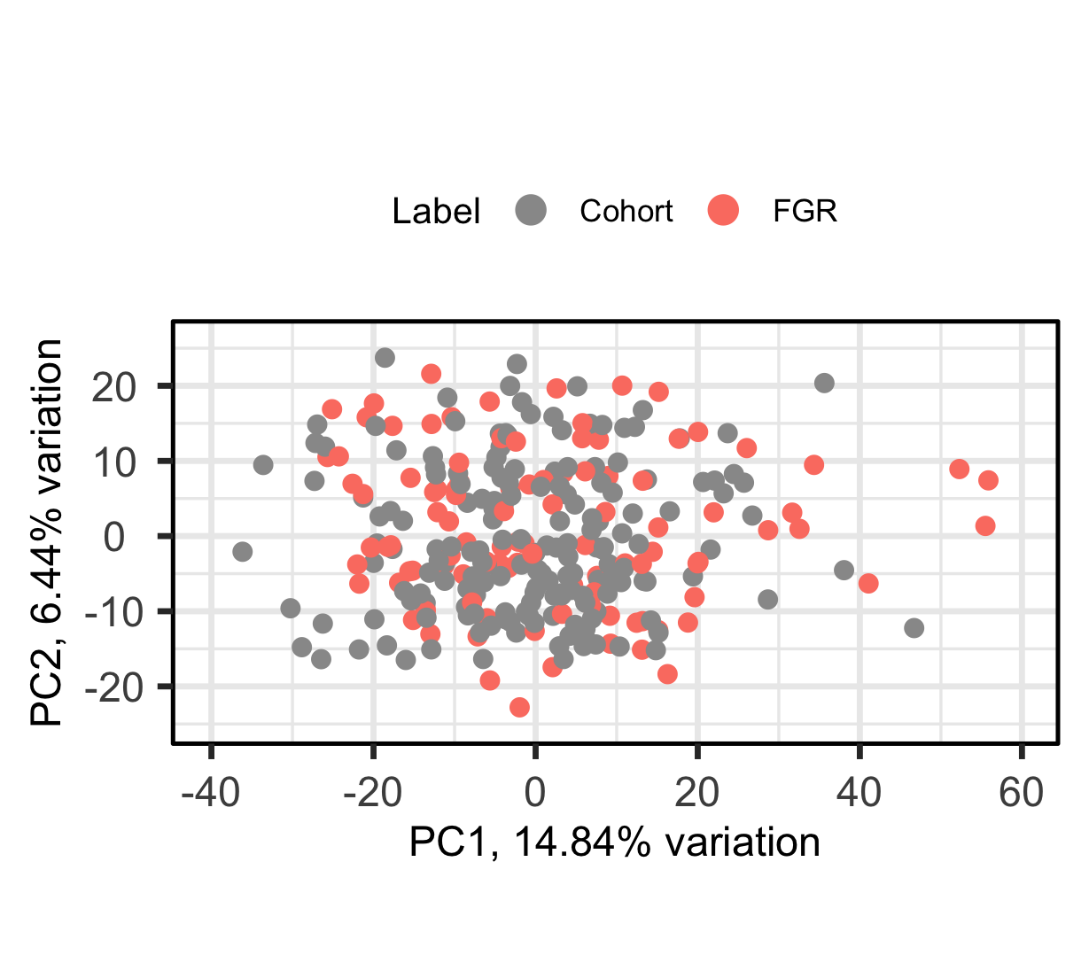
We have 2 Cohorts
Collaborator’s data arrived in two batches (1 & 2).
Cohort 1 (n = 126), Cohort 2
(n = 156).
These two cohorts had their protein expression measured at two different times→ much of the difference is unwanted variation.
We need a test that does not require normalisation or batch correction, because we could not "normalise" the incoming samples in practical settings.

Slide 7
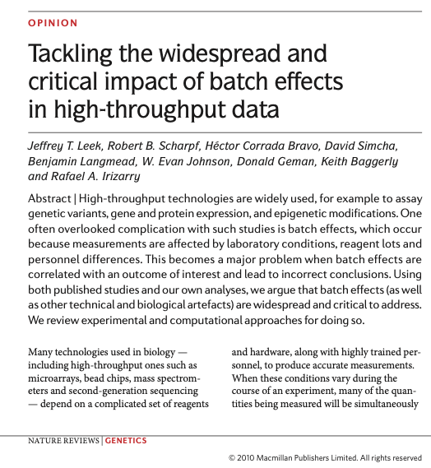
What is special in this biomarker discovery project ?
Since the early 2000s, there are probably >150,000 biomarker discovery papers
Yet translation is strikingly slow, we are struggling to get from bench-to-bedside, only on the order of ~100 looked clinically useful.
A little while ago, people think the issue is reproducibility – but that didn't quite fix the problem

Slide 8
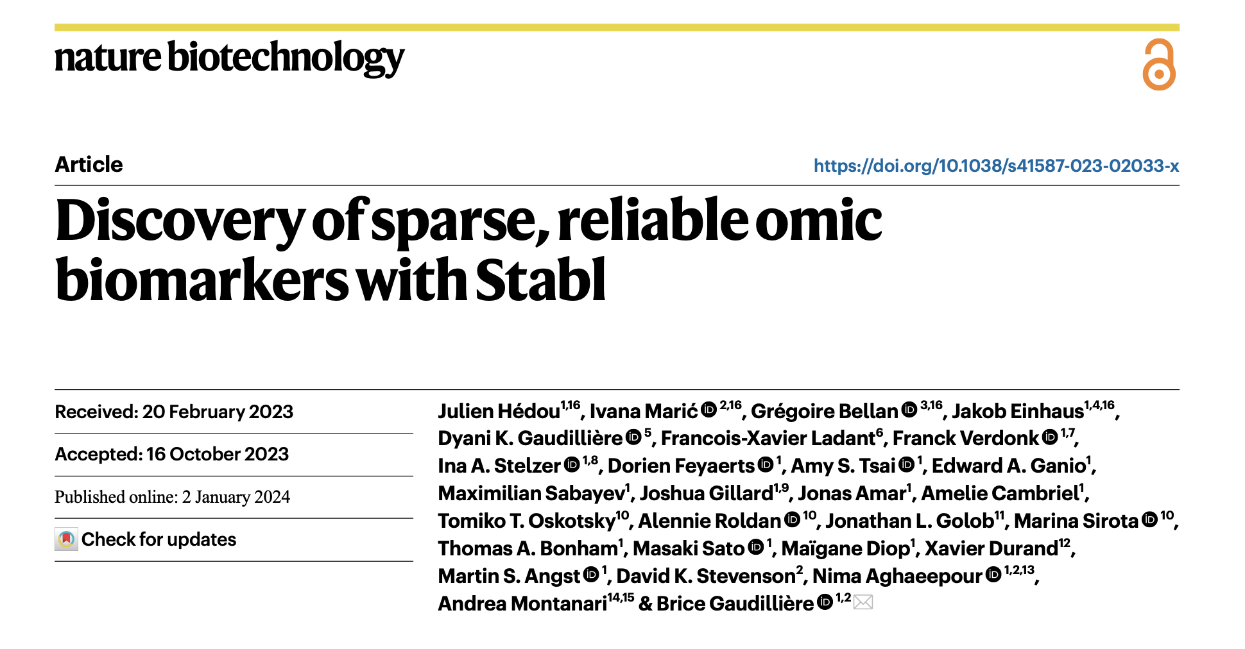

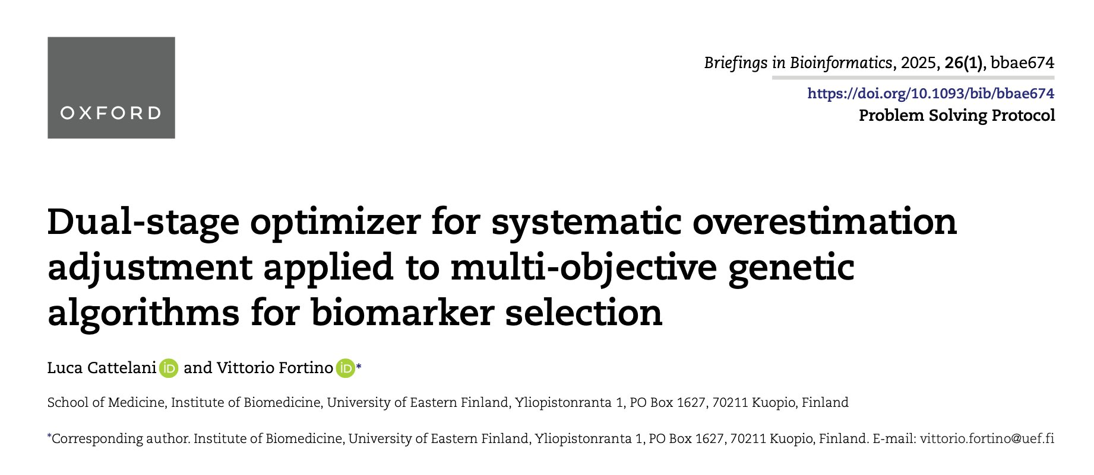

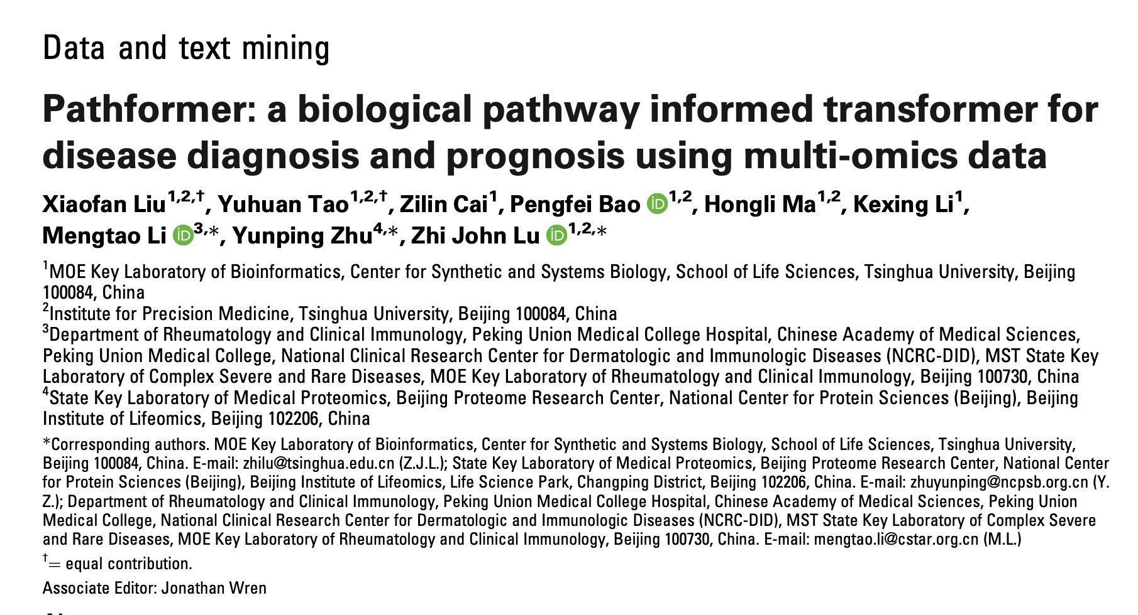
What has been being addressed and what has not?
Reproducibility
Assay migration: discovery (thousands)
≠ implementation (less than 5)
Misaligned evaluation targets:
AUC/F1->sensitivity@specificity
Transferability
Patents

Slide 9
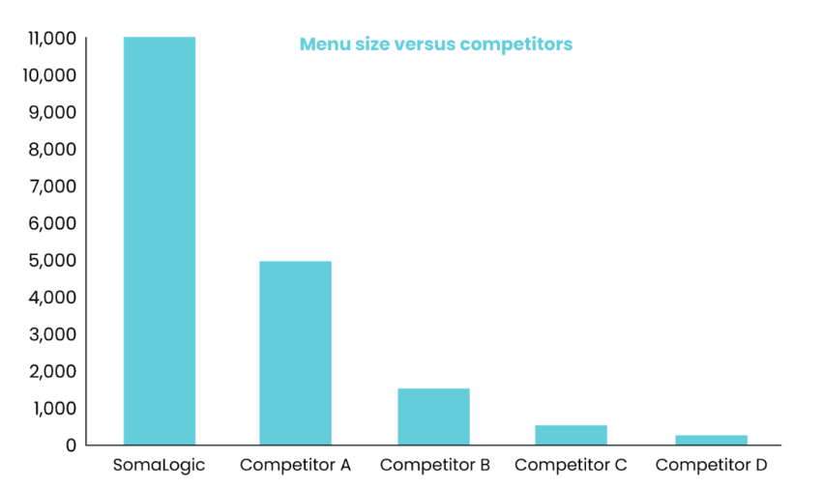
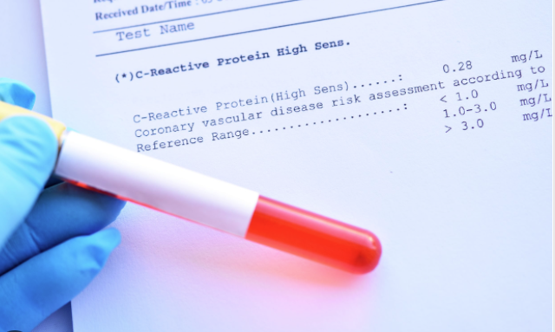
Assay migration→ small panel
Clinical implementation (Generally 1-5 biomakers)
Discovery research
(from SomaScan webpage)
So the selection process in discovery research has to anticipate that we will drop most features later.
Great looking models on the big assay will fail at clinical implementation.

Slide 10
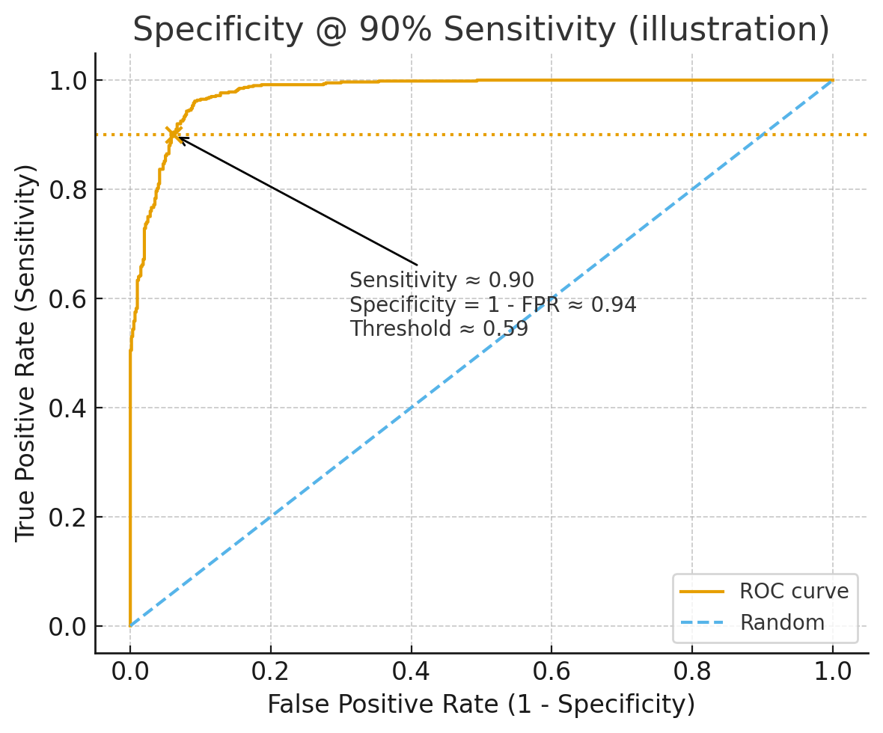
Misaligned evaluation Different language – better translation between disciplines
Clinical focus: Sensitivity @ 90% Specificity
Clinicians need high specificity, like 90 percent, otherwise they will over manage too many patients.
The relationship.

Slide 11
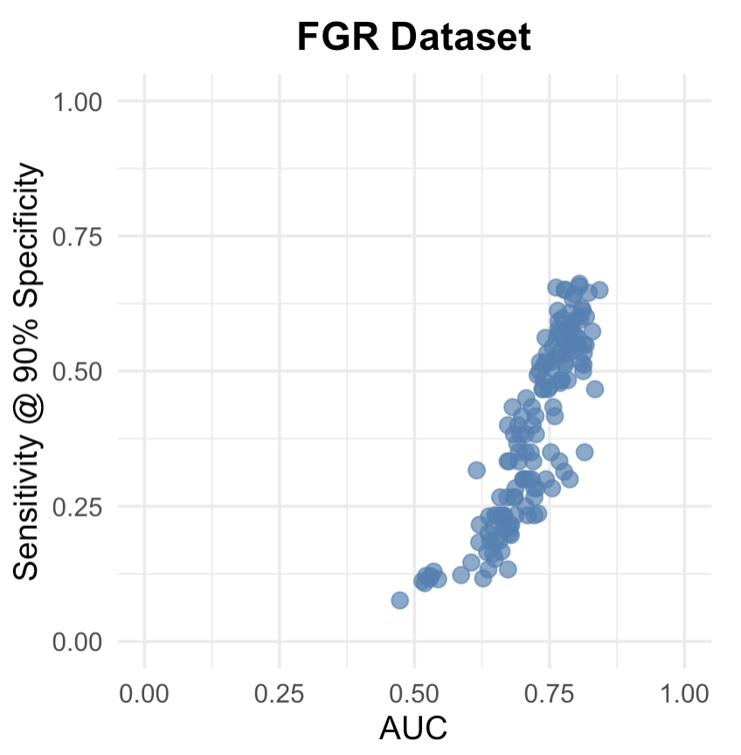
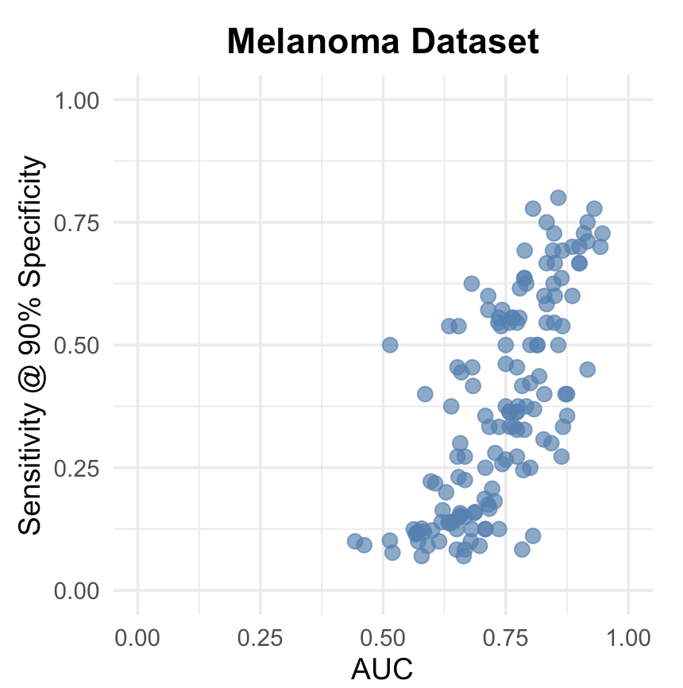
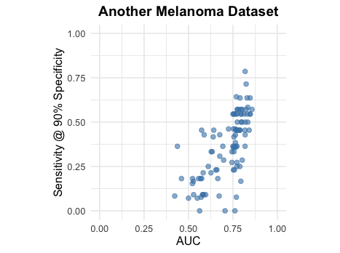
Misaligned evaluation Different language – better translation between disciplines
Clinical focus: Sensitivity @ 90% Specificity
AUC and Sensetivity@Specifity is not always aligned
Notes:
Another one

Slide 12
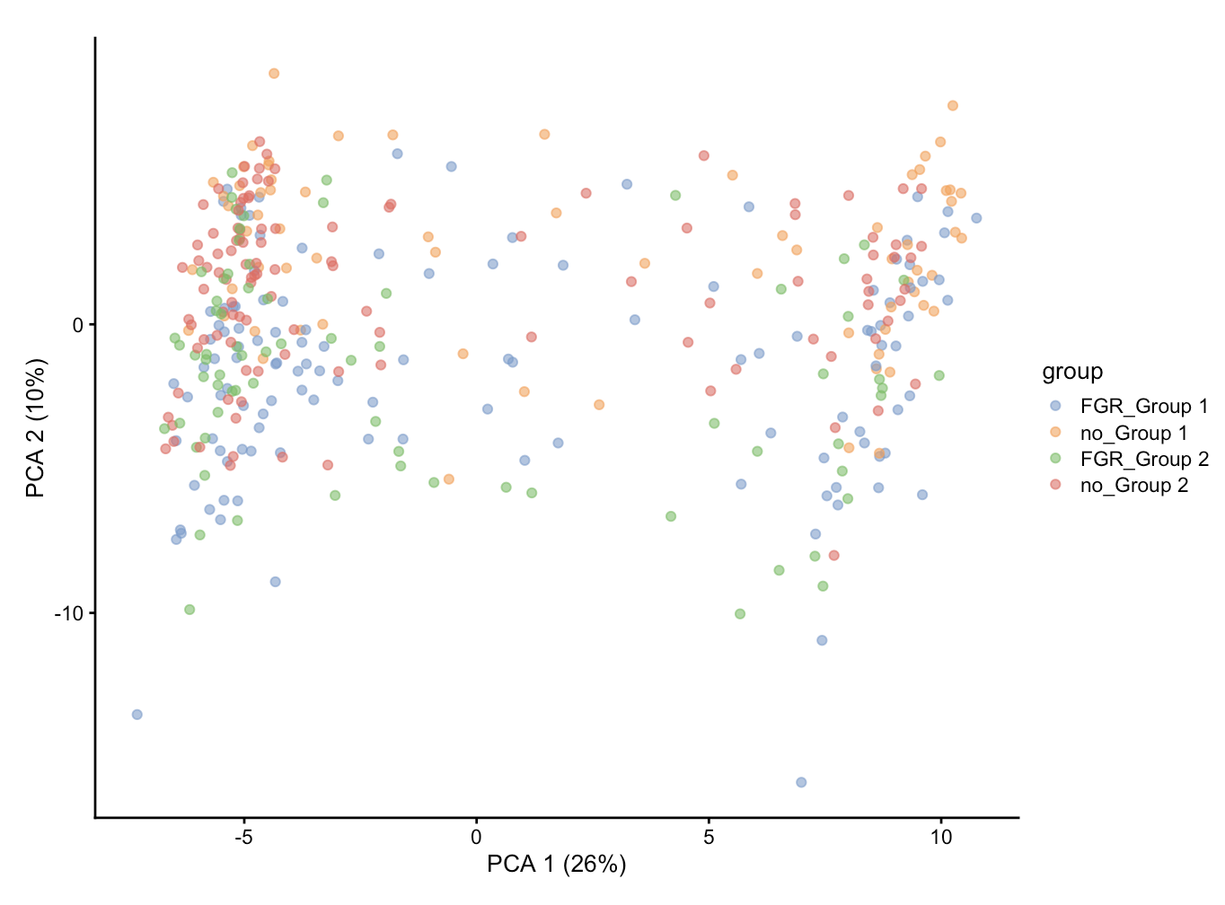
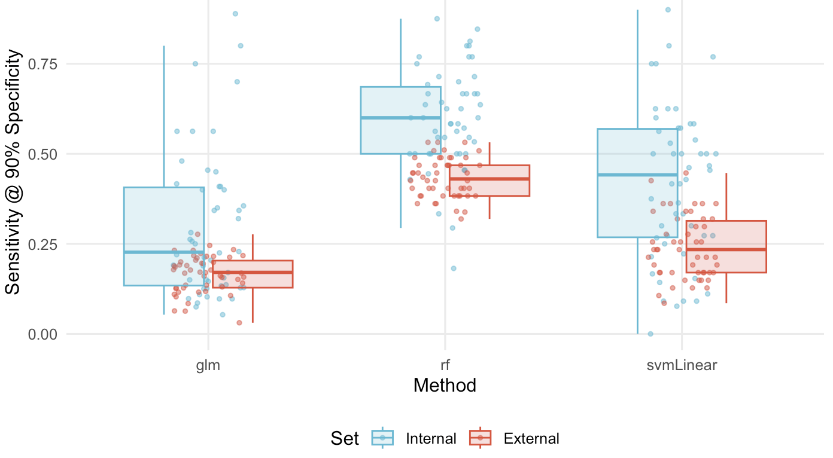
Transferability
Two cohorts have distribution shift
We don not want a norm pre-process
Traditional machine learning feature selection methods does not work

Slide 13
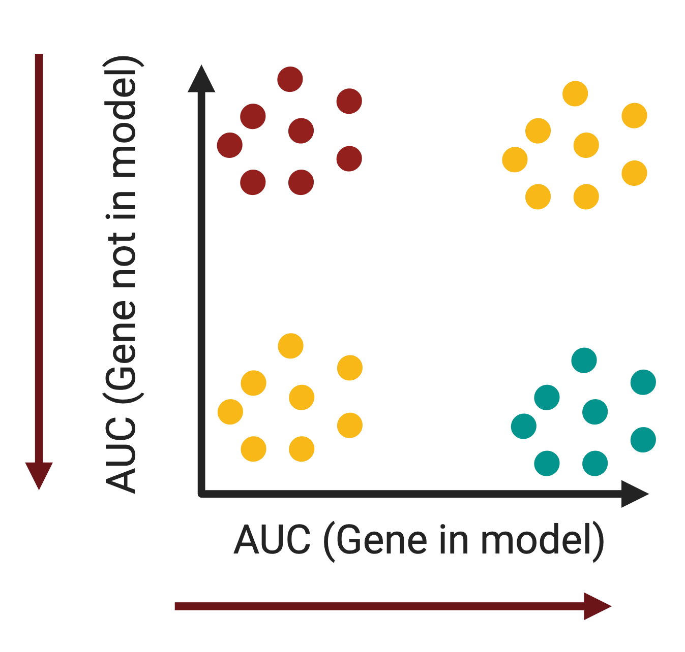
Patent issues in biomarker discovery
1. When trying to patent a set of genes. You need to smallest number (2-5).
2 If we publish five proteins, someone might try to implement four. That is ok.
3. To avoid this, we want to know which proteins survive across different settings.
4. The important or hard to replace proteins are those essential ones. And generally speaking, they would also be high-frequency proteins among different searchings.

Slide 14
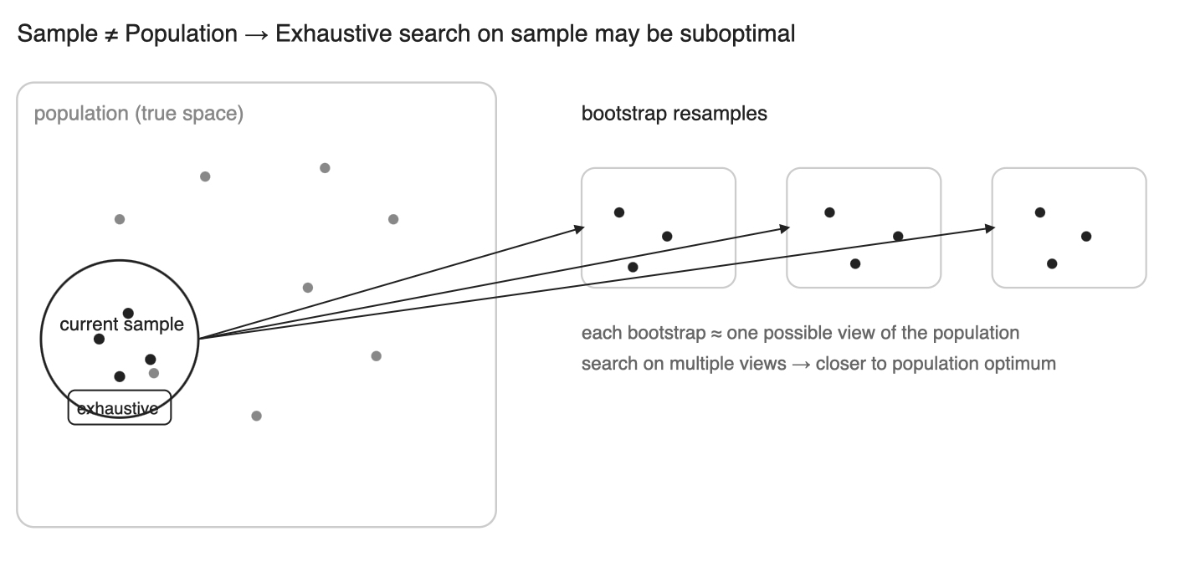
Stability is IMPORTANT here: Bootstrap is essential
Cohorts might be bias compared with whole population.
Meanwhile cohorts with small sample size are jumpy: a few samples can change the selected features.

Slide 15
Brief summary: From Omics to Clinic
High-resolution molecular profiles (transcriptome, proteome, metabolome). Rich signals enable precision medicine
Clinical reality: small, stable, transferable and patentable marker set, and there are several goals at the same time.
That is exactly the situation where a multi-objective formulation helps.
Take-home: Clinical adoption requires transferability and assay feasibility, not just high internal AUC.

Slide 16
Framework of Our Algorithm
For each candidate panel we evaluate in both directions.
We record not only the average but also how variable it is across bootstraps.
Then we let a multi-objective search explore.
After the results have been generated, we also have a post-hoc selection to give a final answer.

Slide 17
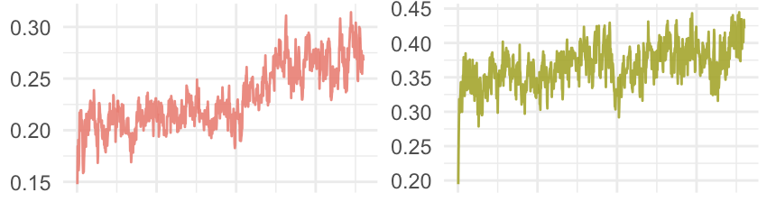
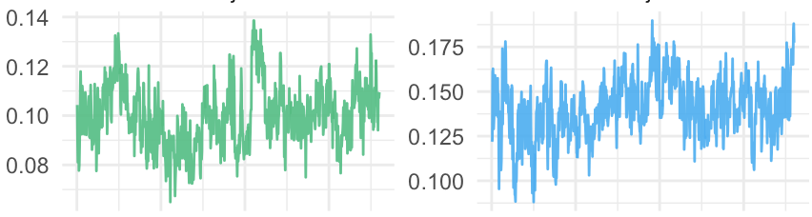
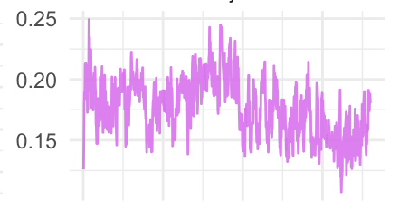
Results of MOO
Object1: C1->C2 Average Sen90
Object2: C2->C1 Average Sen90
We have 5 Objectives
related to Sensitivity@90%
Specificity on bi-direction
procedures: (1) Cohort1 → Cohort2
(2) Cohort2 → Cohort1
Object3: C1->C2 Sen90 Std
Object4: C2->C1 Sen90 Std
Object5: |Object1-Object2|
During the panel searching process, all objectives are optimized jointly.
For MOO, we don’t have to collapse them into one score.

Slide 18
Validation process
Separate our data into 70% and 30%.
The major 70% is used to our algorithm as shown before to generate one solution.
The 30% untouched data is used to evaluation how the solution performs in general.

Slide 19
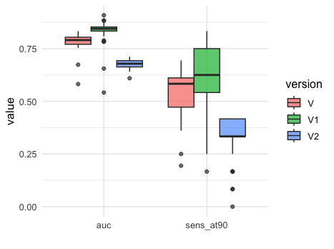
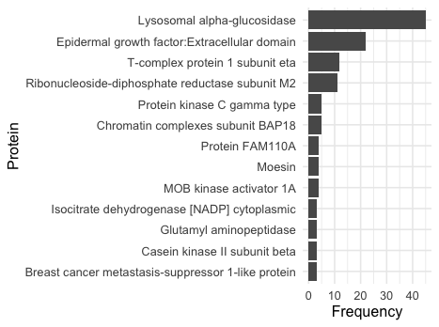
Results of MOO
Auc and Sens@90
Protein frequency

Slide 20
Most frequent proteins align to prior biological knowledge
· Lysosomal alpha-glucosidase (GAA): related to metabolic dysfunction in placenta;
· EGF extracellular domain: reduced EGF/EGFR signaling would weaken trophoblast proliferation and invasion;
· T-complex protein 1 subunit eta (CCT7): folding chaperonin related to protein-synthesis and ER-stress problems
· Ribonucleotide-diphosphate reductase M2 (RRM2): driving DNA synthesis and cell proliferation, insufficiency could limit placental growth and thus favor FGR

Slide 21
Future work
Jointly optimize more meaningful objectives:
transferability,
translational objectives
Improve searching strategies:
Online learning
Reinforcement learning

Slide 22
Acknowledgments
Acknowledgments: Sydney Precision Data Science Centre
Our Team
Harry Robertson
Dr. Jie Kang
Dr. Kevin Wang
Supervisor: Prof. Jean Yang

Slide 23
THANK YOU

