Slide 1
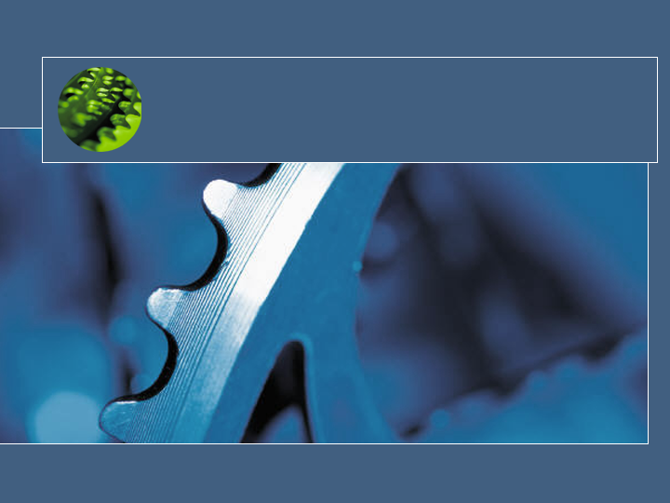
Linux Device Drivers & Project3 preview
CSC345

Slide 2

Project 3 Preview
Write a device driver for a pseudo stack device
Idea from http://www.cs.swarthmore.edu/~newhall/cs45/f01/proj5.html
Linux character device type supports the following operations
  Open: only one is allowed.
  Write: writes an char string to top of the device stack. Error if stack is empty
  Read: reads an item from top of the device stack. Error if stack is empty
  Release: release the device
Install with LKM.
Test: It will be a dedicated standalone machine in the lab. Root password may be given out. If you mess up, you will re-install the

Slide 3
What is a device driver?
A programming module with interfaces
  Communication Medium between application/user and hardware
In Unix,
  Kernel module
  device driver interface = file interface
  What are normal operations?
  Block vs. character

Slide 4
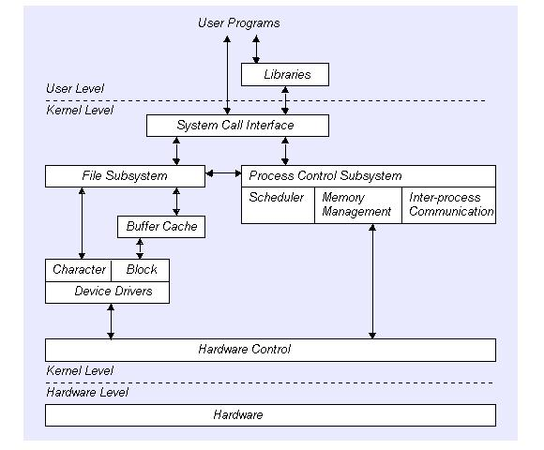
User program & Kernel interface
Note: This picture is excerpted from Write a Linux Hardware Device Driver, Andrew O’Shauqhnessy, Unix world

Slide 5
Loadable Kernel Module (LKM)
A new kernel module can be added on the fly (while OS is still running)
LKMs are often called “kernel modules”
They are not user program

Slide 6
Types of LKM
Device drivers
Filesystem driver (one for ext2, MSDOS FAT16, 32, NFS)
System calls
Network Drivers
TTY line disciplines. special terminal devices.
Executable interpreters.

Slide 7
Basic LKM (program)
Every LKM consist of two basic functions (minimum) :
  int init_module(void) /*used for all initialition stuff*/
  {
  ...
  }
  void cleanup_module(void) /*used for a clean shutdown*/
  {
  ...
  }
Loading a module - normally retricted to root - is managed by issuing the follwing command: # insmod module.o

Slide 8
LKM Utilities cmd
insmod
  Insert an LKM into the kernel.
rmmod
  Remove an LKM from the kernel.
depmod
  Determine interdependencies between LKMs.
kerneld
  Kerneld daemon program
ksyms
  Display symbols that are exported by the kernel for use by new LKMs.
lsmod
  List currently loaded LKMs.
modinfo
  Display contents of .modinfo section in an LKM object file.
modprobe
  Insert or remove an LKM or set of LKMs intelligently. For example, if you must load A before loading B, Modprobe will automatically load A when you tell it to load B.

Slide 9
Common LKM util cmd
Create a special device file
  % mknode /dev/driver c 40 0
Insert a new module
  % insmod modname
Remove a module
%rmmod modname
List module
  % lsmod
  Or % more /proc/modules
    audio 37840 0
    cmpci 24544 0
    soundcore 4208 4 [audio cmpci]
    nfsd 70464 8 (autoclean)

Slide 10
Linux Device Drivers
A set of API subroutines (typically system calls) interface to hardware
Hide implementation and hardware-specific details from a user program
Typically use a file interface metaphor
Device is a special file

Slide 11
Linux Device Drivers (continued)
Manage data flow between a user program and devices
A self-contained component (add/remove from kernel)
A user can access the device via file name in /dev , e.g. /dev/lp0

Slide 12
General implementation steps
Understand the device characteristic and supported commands.
Map device specific operations to unix file operation
Select the device name (user interface)
  Namespace (2-3 characters, /dev/lp0)
(optional) select a major number and minor (a device special file creation) for VFS interface
  Mapping the number to right device sub-routines
Implement file interface subroutines
Compile the device driver
Install the device driver module with loadable kernel module (LKM)
or Rebuild (compile) the kernel

Slide 13
Read/write (I/O)
Pooling (or synchronous)
Interrupt based

Slide 14
Device Driver interface
Note: This picture is excerpted from Write a Linux Hardware Device Driver, Andrew O’Shauqhnessy, Unix world

Slide 15
VSF & Major number
principal interface between a device driver and Linux kernel

Slide 16

File operation structure
struct file_operations Fops = {
  NULL, /* seek */
  xxx_read,
  xxx_write,
  NULL, /* readdir */
  NULL, /* select */
  NULL, /* ioctl */
  NULL, /* mmap */
  xxx_open,
  NULL, /* flush */
  xxx_release /* a.k.a. close */
};
struct file_operations Fops = {
  read: xxx_read,
  write: xxx_write,
  open: xxx_open,
  release: xxx_release, /* a.k.a. close */
  };
Watch out compatibility issue with Linux version

Slide 17
Device special file
Device number
  Major (used to VFS mapping to right functions)
  Minor (sub-devices)
mknod /dev/stk c 38 0
ls –l /dev/tty
  crw-rw-rw- 1 root root 5, 0 Apr 21 18:33 /dev/tty

Slide 18
Register and unregister device
  int init_module(void) /*used for all initialition stuff*/
  {
      /* Register the character device (atleast try) */
      Major = register_chrdev(0,
      DEVICE_NAME,
      &Fops);
      :
  }
  void cleanup_module(void) /*used for a clean shutdown*/
    {ret = unregister_chrdev(Major, DEVICE_NAME);
  ...
  }

Slide 19
Register and unregister device
compile
    -Wall -DMODULE -D__KERNEL__ -DLINUX –DDEBUG -I /usr/include/linux/version.h -I/lib/modules/`uname -r`/build/include
Install the module
    %insmod module.o
List the module
    %lsmod
If you let the system pick Major number, you can find the major number (for special creation) by
    % more /proc/devices
Make a special file
    % mknod /dev/device_name c major minor

Slide 20
Device Driver Types
A character device driver ( c )
  Most devices are this type (e.g.Modem, lp, USB
  No buffer.
A block device driver (b)
  through a system buffer that acts as a data cache.
  Hard drive controller and HDs

Slide 21
Implementation
Assuming that your device name is Xxx
Xxx_init() initialize the device when OS is booted
Xxx_open() open a device
Xxx_read() read from kernel memory
Xxx_write() write
Xxx_release() clean-up (close)
init_module()
cleanup_module()

Slide 22
kernel functions
add_timer()
  Causes a function to be executed when a given amount of time has passed
cli()
  Prevents interrupts from being acknowledged
end_request()
  Called when a request has been satisfied or aborted
free_irq()
  Frees an IRQ previously acquired with request_irq() or irqaction()
get_user*()
  Allows a driver to access data in user space, a memory area distinct from the kernel
inb(), inb_p()
  Reads a byte from a port. Here, inb() goes as fast as it can, while inb_p() pauses before returning.
irqaction()
  Registers an interrupt like a signal.
IS_*(inode)
  Tests if inode is on a file system mounted with the corresponding flag.
kfree*()
  Frees memory previously allocated with kmalloc()
kmalloc()
  Allocates a chu nk of memory no larger than 4096 bytes.
MAJOR()
  Reports the major device number for a device.
MINOR()
  Reports the minor device number for a device.

Slide 23
kernel functions
memcpy_*fs()
  Copies chunks of memory between user space and kernel space
outb(), outb_p()
  Writes a byte to a port. Here, outb() goes as fast as it can, while outb_p() pauses before returning.
printk()
  A version of printf() for the kernel.
put_user*()
  Allows a driver to write data in user space.
register_*dev()
  Registers a device with the kernel.
request_irq()
  Requests an IRQ from the kernel, and, if successful, installs an IRQ interrupt handler.
select_wait()
  Adds a process to the proper select_wait queue.
*sleep_on()
  Sleeps on an event, puts a wait_queue entry in the list so that the process can be awakened on that event.
sti()
  Allows interrupts to be acknowledged.
sys_get*()
  System calls used to get information regarding the process, user, or group.
wake_up*()
  Wakes up a process that has been put to sleep by the matching *sleep_on() function.

Slide 24
Stop here 5/1/2003

Slide 25
Pitfalls
Using standard libraries: can only use kernel functions, which are the functions you can see in /proc/ksyms.
Disabling interrupts You might need to do this for a short time and that is OK, but if you don't enable them afterwards, your system will be stuck
Changes from version to version

Slide 26
Resources
Linux Kernel API: http://kernelnewbies.org/documents/kdoc/kernel-api/linuxkernelapi.html
Kernel development tool http://www.jungo.com/products.html
Linux Device Drivers 2nd Edition by Rubini & Corbet, O'Reilly Pub, ISBN 0-596-00008-1

