Slide 1
ZigBee Set up Classes

Slide 2
Overview
In this session we are going to discuss COSEM interface classes required for the external configuration and management of a ZigBee® network to allow interfacing with a multi-part installation that internally uses ZigBee® communications
Each PAN has one device designated as ZigBee® coordinator, which has responsibility for creating and managing the network, and which normally acts also as a ZigBee® Trust Center for the management of ZigBee® network
There is a process of PAN creation (and corresponding destruction) which is performed by the coordinator; this declares the existence of the network without any devices apart from the coordinator forming part of it.
Other ZigBee® devices can join a network created with cooperation of the coordinator, and equally can choose to leave, or can be invited to leave by the coordinator

Slide 3
To create a PAN the coordinator has to receive an external trigger and needs to have setup information including:
• extended PAN ID
• link keys or install code (for initial communication with new devices)
• radio channel information.
Normally devices do not repeatedly join and leave.
Next Figure shows an example architecture with a Comms hub on the left, that comprises a DLMS/COSEM server as well as the ZigBee® coordinator.
The DLMS/COSEM server has interface objects needed to set up and control the ZigBee® network and may have other COSEM objects to support a metering application.
Further, there are two native ZigBee® devices and on the right another DLMS/COSEM server – an electricity meter or another meter type which is also a “normal” ZigBee® network device.

Slide 4
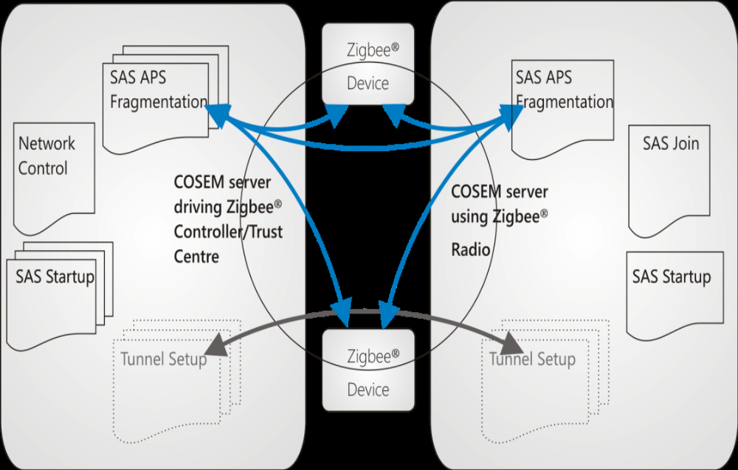
CH/Coordinator
DLMS/COSEM Server

Slide 5
What is role of COSEM interface object in the process of creating the PAN ??
To set up ZigBee® parameters and allow a DLMS/COSEM client to trigger actions.
Operation of the ZigBee® network is not the responsibility of DLMS/COSEM.
ZigBee SAS startup (Class_id : 101)
Instances of this IC are used to configure a ZigBee® PRO device with information necessary to create or join the network.
Used in both Coordinator and ZigBee devices.

Slide 6
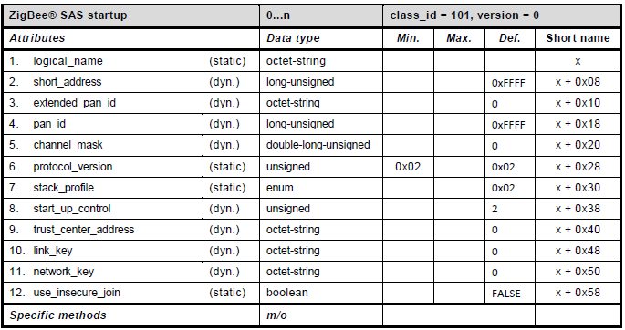

Slide 7
Short Address
Defines the 16-bit address by which this device is known locally on the ZigBee® network. Value 0x0000 is given to a coordinator / Trust Center device, and only to these devices.
Extended_pan_ID
Defines the unique address by which the network is known externally. The length of the octet-string is 8 octets.
Pan_ID
Defines the 16-bit address by which network is known locally.
Channel_mask
Defines (as a bit mask) the set of radio channels which this PAN is permitted to use.

Slide 8
Protocol_version
Defines the version of the ZigBee® protocol to be used on the network.
Stack_profile
Identifies the capabilities of the ZigBee ® stack.
enum:
(1) ZigBee®,
(2) ZigBee® PRO
Start_up_control
Indicates the commissioning state of the ZigBee® device.
2: un-commissioned. Indicates that the device will seek to join the network if/when it is established;
0: commissioned. Indicates that the device should consider itself a part of the network indicated by the extended_pan_id attribute. In this case it will not perform any explicit join or rejoin operation.

Slide 9
Trust_center_ address
Defines the unique extended address of the Trust Center used for this network. This is often, but not necessarily, the address of the ZigBee® coordinator.
The length of the octet-string is 8 octets.
Link_key
Defines the key value used to secure point-to-point communications between particular devices within the Smart Energy Profile. The length of the octet-string is 16 octets.
Network_key
Defines the key value used to secure general communications between devices. The length of the octet-string is 16 octets.
Use_insecure_join
Indicates whether the coordinator is permitted to allow insecure joining.

Slide 10
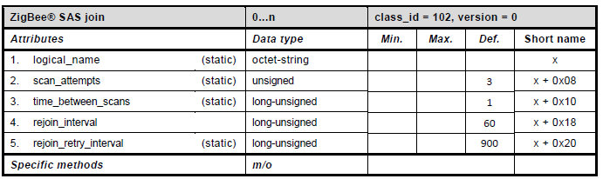
ZigBee SAS join (Class_id : 102)
Instances of this IC configure the behaviour of a ZigBee® PRO device on joining or loss of connection to the network.
“ZigBee® SAS join” objects are present in all devices where a DLMS/COSEM server controls the ZigBee® Radio behaviour, but it is not used when a device is acting as coordinator.

Slide 11
Scan_attempts
Defines the number of consecutive scans that a ZigBee® device will perform on each attempt to rejoin a network, in the event of losing contact.
Time_between_ scans
Defines the period in seconds between consecutive scans in a single attempt to rejoin a network.
Rejoin_interval
Defines the period in seconds that the device should wait after apparently becoming disconnected from a network, before attempting to rejoin.
Rejoin_retry_ interval
Defines the period in seconds for which the device should wait after a failed attempt to rejoin a network before trying again.

Slide 12
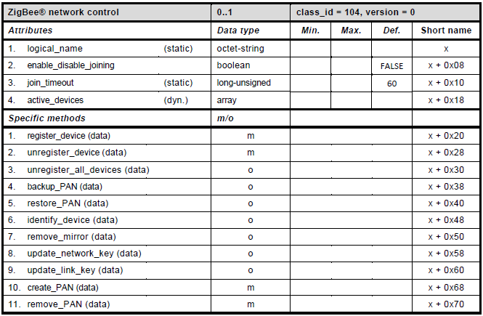
ZigBee® network control (class_id: 104)
There will be a single instance of the “ZigBee® network control” IC in any device that can act as a ZigBee® coordinator.

Slide 13
enable_disable_ joining
A flag controlling whether devices are allowed to join the ZigBee® network. The flag is normally FALSE (joining disabled). At certain times – when a new device is expected to join – the flag is set externally to TRUE.
Join_timeout
Defines the time period in seconds during which the coordinator device will permit joining of new devices, following setting of the enable_disable_joining flag.
Active_devices
This attribute shows all of the currently authorised devices within the ZigBee® PAN.
array: active_device

Slide 14
active_device ::= structure
{
mac_address: octet-string,
status: bit-string,
maxRSSI: integer, //Received Signal Strength Indication
averageRSSI: integer,
minRSSI : integer,
maxLQI: unsigned, //Link quality indicator
averageLQI: unsigned,
minLQI : unsigned,
last_communication_date-time: octet-string,
number_of_hops: unsigned,
transmission_failures: unsigned,
transmission_successes: unsigned,
application_version: unsigned,
stack_version: unsigned
}
Note: Above all terms are described in ZigBee Specifications.

Slide 15
Method Descriprion
register_device(data)
This method is called to instruct the coordinator that a device should be added to the list of authorised devices. This method does not actually join the devices to the network, they are just authorised to join at some time in the future.
data ::= structure
{
ieee_address: octet-string, // 8 octet
key_type: enum,
key: octet-string, //max: 16 octet
device_type: enum,
}
key type enum:
(0) Pre-configured Link Key,
(1) Install code,
(2)…(255) Reserved,

Slide 16
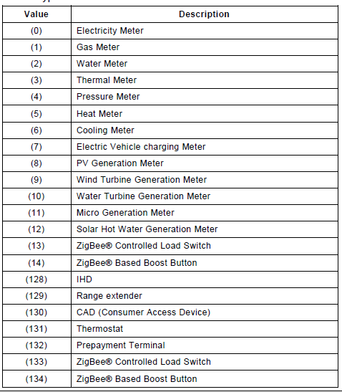
Device Type:
Enum

Slide 17
unregister_device(data)
This method is called to instruct the coordinator that a device should leave the network.
data ::= octet-string, // 8 octet ieee_address.
unregister_all_ devices (data)
This method is called to instruct the coordinator that all devices should leave the network.
data ::= integer (0)
backup_PAN (data)
This method instructs the coordinator to create a back-up of information that would be necessary to re-create the PAN.
The storage location of the back-up is not currently defined
data ::= integer (0)

Slide 18
Method invocation return parameters are detailed below:
data ::= structure
{
date_time: octet-string,
extended_PAN_ID: octet-string,
devices_to_backup: array device_to_backup
}
device_to_backup ::= structure
{
MAC_address: octet-string,
hashed_link_key: octet-string
}
Note: Method of hashing is not part of this specification it is defined in ZigBee® Smart Energy Specification. Currently MMM is used.

Slide 19
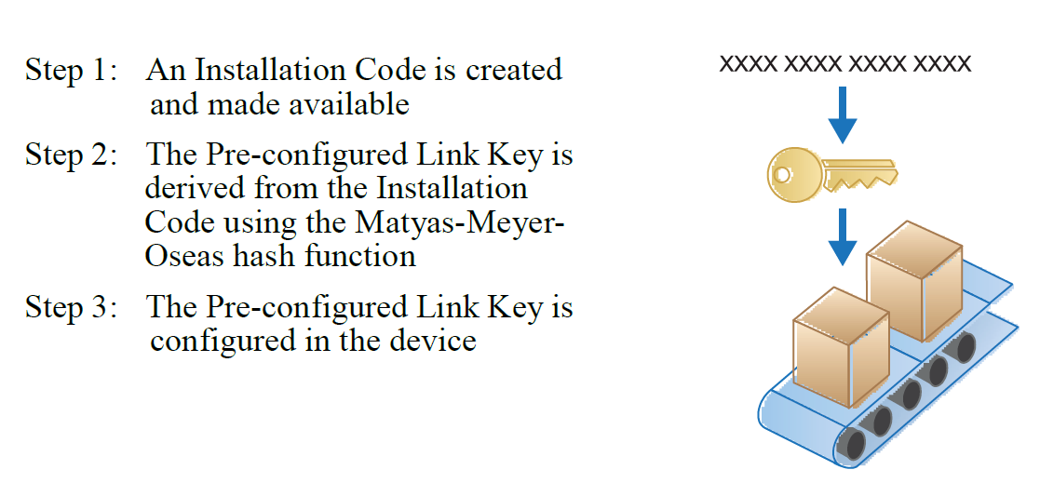
Hashing is used to derive link key from Install key.
Trust center

Slide 20
restore_PAN (data)
This method instructs the coordinator to restore a PAN using backup information.
The storage location of the back-up is not currently defined.
data ::= structure
{
extended_PAN_ID: octet-string,
devices_to_restore: array device_to_restore
}
device_to_restore ::= structure
{
MAC_address: octet-string,
hashed_TC_link_key: octet-string
}

Slide 21
identify_device (data)
This method is called to instruct a device to identify itself to present on site, for example by sounding a buzzer.
data ::= ieee_address
ieee_address: octet-string
remove_mirror (data)
This method causes the removal of a ZigBee® mirror that reflects the real device identified by the mac_address parameter.
data ::= structure
{
mac_address: octet-string,
mirror_control: bit-string
}
The mirror_control parameter is provided to support the execution of implementation-specific actions, which should be defined in a project specific companion specification.

Slide 22
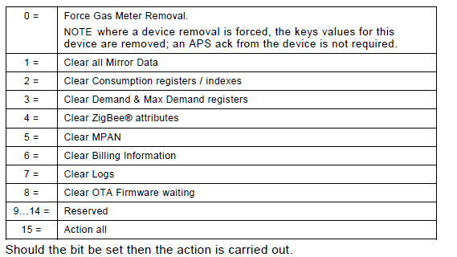

Slide 23
update_network_key (data)
This method requests that the ZigBee® coordinator updates the network key and propagate it to all devices on the PAN. details of ZigBee® key management, see the ZigBee® specification.
update_link_key (data)
This method requests that the ZigBee® coordinator updates the link key and propagate it to the identified device on the PAN.
data ::= ieee_address
ieee_address: octet-string
create_PAN (data)
This method is called externally to instruct a coordinator to create a network
remove_PAN (data)
This method is called externally to instruct a coordinator to destroy a network by turning off the ZigBee® radio and removing all of the settings associated with the current PAN.

Slide 24
ZigBee® tunnel setup (class_id: 105)
A ZigBee® tunnel is established between two ZigBee® PRO devices to allow DLMS APDUs to be transferred between them.
The ZigBee® tunnel setup objects would be present on the coordinator and on all other DLMS/COSEM devices that are not connected to the WAN.
Creation of the tunnel is invisibly from the point of view of the DLMS/COSEM client.
Attributes
maximum_incoming_transfer_size: Define max size in octets in the payload of single TransferData (ZigBee parameter) command.
maximum_incoming_transfer_size
close_tunnel_timeout: Defines the time, in seconds that the ZigBee® server waits before closing an inactive tunnel on its own (without waiting for the CloseTunnel Command from the client within the ZigBee® specification) and freeing its resources

