Slide 1
ZigBee
The Application Support Sub-Layer

Slide 2
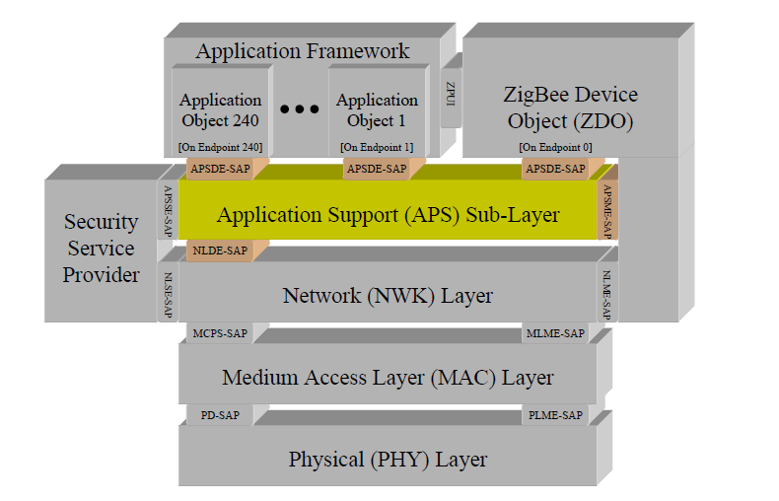

Slide 3
The application support sub-layer provides the interface between the network layer and the application layer through a general set of services for use by both the ZigBee device object (ZDO) and the manufacturer-defined application objects.
These services are offered via two entities: the data service and the management service.
The APS data entity (APSDE) provides the data transmission service via
its associated SAP, the APSDE-SAP. The APS management entity (APSME)provides the management service via its associated SAP, the APSME-SAP, and maintains a database of managed objects known as the APS information base(AIB).

Slide 4
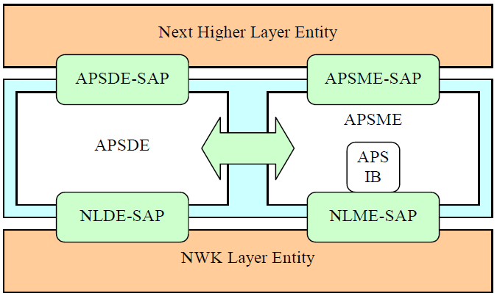
The APS Sub-Layer Reference Model

Slide 5
Application Support Sub-Layer Data Entity (APSDE)
The APSDE will provide the following services.
Generation of the application level PDU (APDU),
Binding,
Group address filtering,
Reliable transport,
Duplicate rejection,
Fragmentation.

Slide 6
Application Support Sub-Layer Management Entity (APSME)
The APSME will provide the following services.
Binding management,
AIB management (APS information base),
Security,
Group management.

Slide 7

Application Support Sub-Layer
APSDE
APSME
Data service Primitives
APSDE-DATA.request
APSDE-DATA.confirm
APSDE-DATA.indication
Management service Primitives
APSME-BIND.request
APSME-BIND.confirm
APSME-UNBIND.request
APSME-UNBIND.confirm

Slide 8
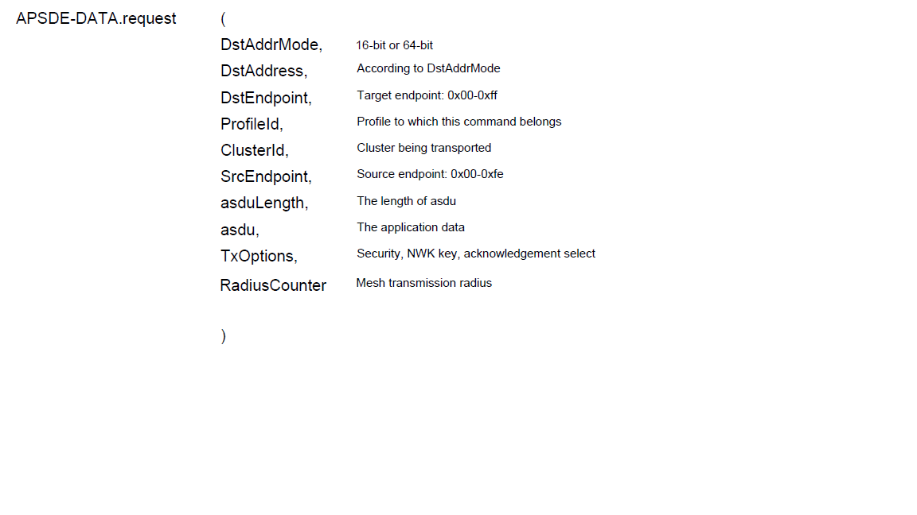

0x01 = Security enabled transmission
0x02 = Use NWK key
0x04 = Acknowledged transmission
0x08 = Fragmentation permitted
0x10 = Include extended nonce in APS
security frame.

Slide 9
APSDE-DATA.confirm
{
DstAddrMode, 0-0x0ff
DstAddress,
DstEndpoint, 0-0x0ff
SrcEndpoint, 0-0xfe
Status,
TxTime
}
SUCCESS,
NO_SHORT_ADDRESS,
NOT_SUPPORTED,
NO_BOUND_DEVICE,
SECURITY_FAIL,
NO_ACK,
ADSU_TOO_LONG

Slide 10

APSDE-DATA.indication {
DstAddrMode,
DstAddress,
DstEndpoint,
SrcAddrMode,
SrcAddress,
SrcEndpoint,
ProfileId,
ClusterId,
asduLength,
asdu,
Status,
Security Status,
LinkQuality,
RxTime
}
DEFRAG_UNSUPPORTED
DEFRAG_DEFERRED
UNSECURED,
SECURED_NWK_KEY,
SECURED_LINK_KEY

Slide 11
APS Management Service
APSME-BIND
APSME-UNBIND
APSME-GET
APSME-SET
APSME-ADD-GROUP
APSME-REMOVEGROUP
APSME-REMOVEALL-GROUPS

Slide 12
APSME-(UN)BIND.request {
SrcAddr, 64-bit IEEE address
SrcEndpoint, 0x01 – 0xfe
ClusterId, 0x0000 – 0xffff
DstAddrMode, 0x00 – 0xff
DstAddr,
DstEndpoint 0x01 – 0xff
}

Slide 13
APSME-(UN)BIND.confirm {
SrcAddr,
SrcEndpoint,
ClusterId,
DstAddrMode,
DstAddr,
DstEndpoint
Status
}
SUCCESS,
ILLEGAL_REQUEST,
TABLE_FULL,
INVALID_BINDING
APSME-(UN)BIND.confirm

Slide 14
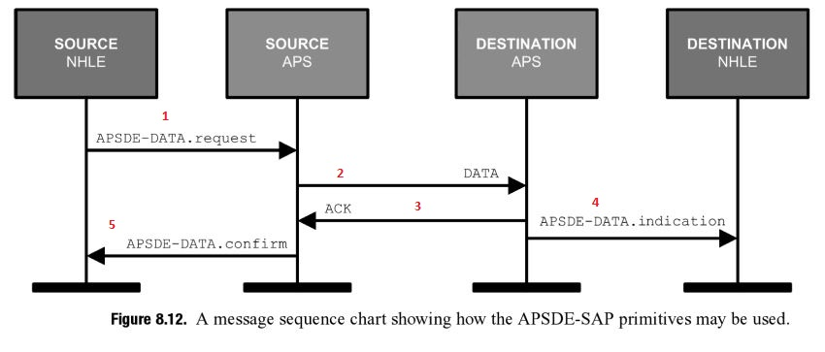
Cont..

Slide 15
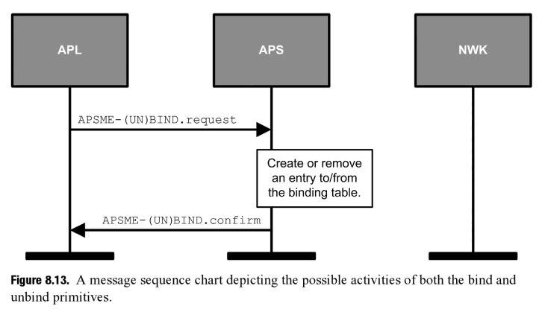

Slide 16
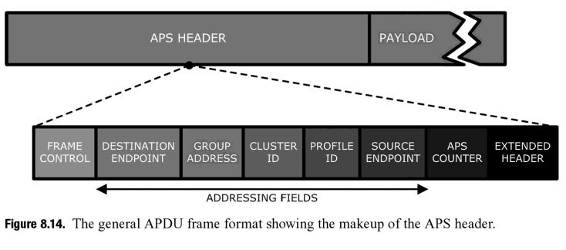

Slide 17
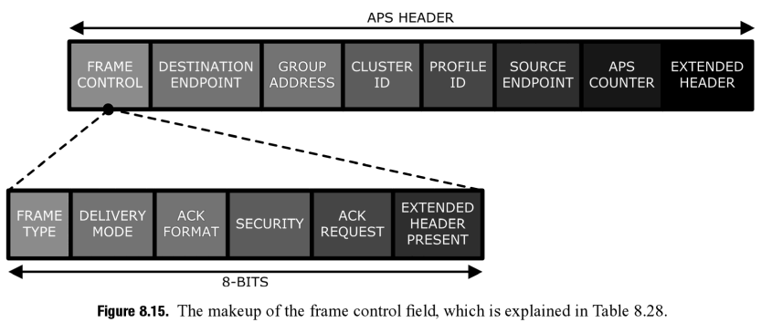
8-bit
16-bits
8-bits
00 Normal unicast delivery
01 Reserved
10 Broadcast
11 Group addressing
00 Data
01 Command
10 Acknowledgement
11 Reserved

Slide 18
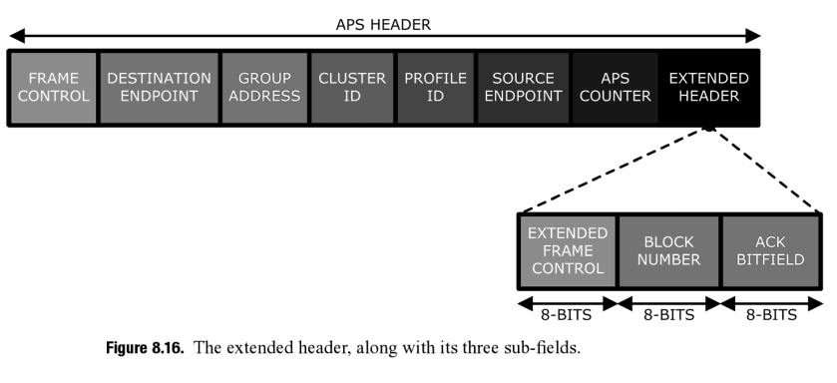
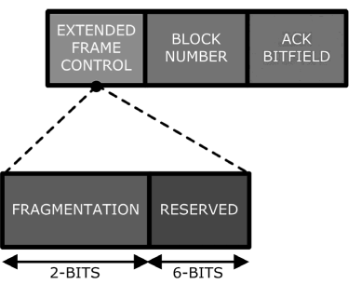
00 Transmission is not fragmented.
01 Frame is first fragment of a
fragmented transmission.
10 Frame is part of a fragmented
transmission but not the first part.
11 Reserved

Slide 19
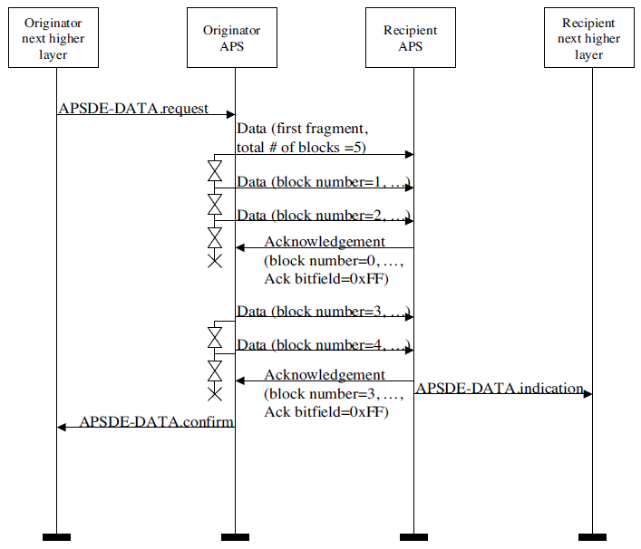

Slide 20
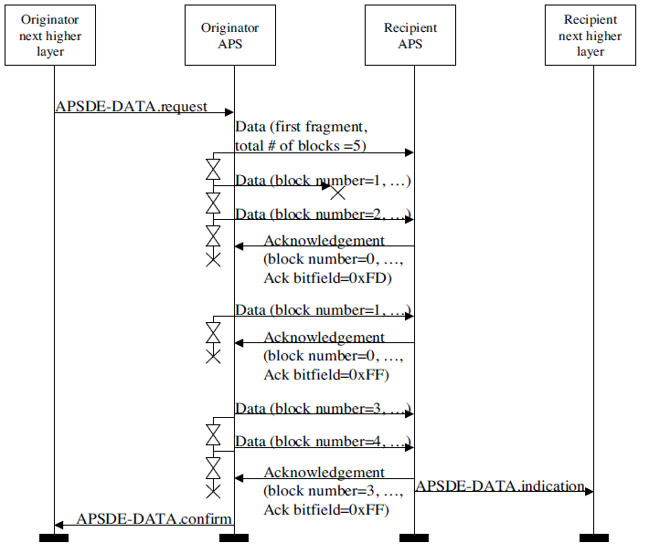

Slide 21
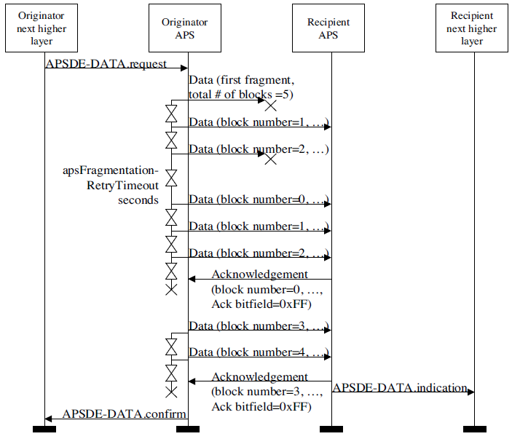

Slide 22
Key Points:
Each block is transmitted in a separate frame.
Multicast and broadcast transmissions are not permitted to use fragmentation.

Slide 23
Thank You

