Slide 1
ZCL format

Slide 2
What is ZCL ?
The ZigBee Cluster Library (ZCL) is intended to act as a repository for cluster functionality that is developed by ZigBee Alliance.
It will be a working library with regular updates as new functionality is added.
The ZigBee Cluster Library introduces the concept of attributes and commands to the ZigBee specification.
Attributes are data items or states defined within a cluster. Commands are actions the cluster must perform.
For example, a Home Automation On/Off Light uses the On/Off Cluster, cluster ID 0x0006. An attribute of the On/Off Cluster indicates whether the light is on (0x01) or off (0x00). However there are also commands which turn the light on(0x01), off (0x00), or toggle it (0x02), which affect the state of the On/Off attribute.

Slide 3
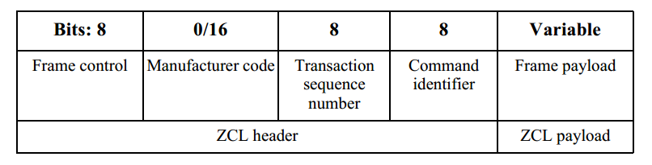
ZCL Format
The ZCL frame format is composed of a ZCL header and a ZCL payload.

Slide 4
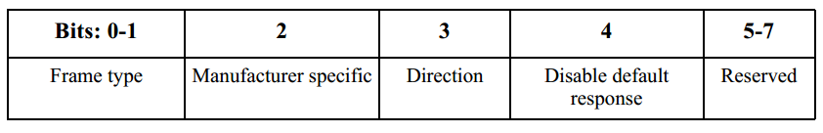
Cont.
1) Frame Control Field
The frame control field is 8 bits in length and contains information defining the command type and other control flags.
Bits 5-7 are reserved for future use and shall be set to 0.

Slide 5
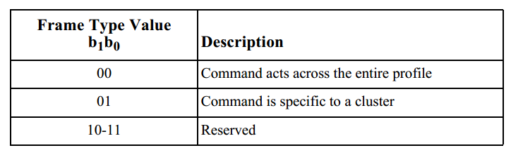
Cont.
1.(a) Frame Type Sub-field
The frame type sub-field is 2 bits in length.

Slide 6
Cont.
1.(b) Manufacturer Specific Sub-field
The manufacturer specific sub-field is 1 bit in length and specifies whether this command refers to a manufacturer specific extension to a profile.
If this value is set to 1, the manufacturer code field shall be present in the ZCL frame.
If this value is set to 0, the manufacturer code field shall not be included in the ZCL frame.

Slide 7
Cont.
1.(c) Direction Sub-field
The direction sub-field specifies the client/server direction for this command.
If this value is set to 1, the command is being sent from the server side of a cluster to the client side of a cluster.
If this value is set to 0, the command is being sent from the client side of a cluster to the server side of a cluster.

Slide 8
Cont.
1.(d) Disable Default Response Sub-field
The disable default response sub-field is 1 bit in length.
If it is set to 0, the Default response command will be returned, under the conditions specified :
1) A device receives a unicast command that is not a default response command
2) No other command is sent in response to the received command, using the same Transaction sequence number as the received command
3) The Disable default response bit of its Frame control field is set to 0 or when an error results.

Slide 9
Cont.
If it is set to 1, the Default response command will only be returned if there is an error, also under the conditions specified :
if a device receives a command in error through a broadcast or multicast transmission, the command shall be discarded and the default response command shall not be generated.
If the identifier of the received command is not supported on the device, it shall set the command identifier field to the value of the identifier of the command received in error. The error code field shall be set to the either:
UNSUP_CLUSTER_COMMAND,
UNSUP_GENERAL_COMMAND,
UNSUP_MANUF_CLUSTER_COMMAND or
UNSUP_MANUF_GENERAL_COMMAND,as appropriate.

Slide 10
Cont.
2) Manufacturer Code Field
The manufacturer code field is 16 bits in length and specifies the ZigBee assigned manufacturer code for proprietary extensions to a profile.
This field shall only be included in the ZCL frame:
if the manufacturer specific sub-field of the frame control field is set to 1.

Slide 11
Cont.
(3) Transaction Sequence Number Field
The transaction sequence number field is 8 bits in length and specifies an identification number for the transaction so that a response-style command frame can be related to a request-style command frame.
The application object itself shall maintain an 8-bit counter that is copied into this field and incremented by one for each command sent. When a value of 0xff is reached, the next command shall re-start the counter with a value of 0x00.
The transaction sequence number field can be used by a controlling device, which may have issued multiple commands, so that it can match the incoming responses to the relevant command.

Slide 12
Cont.
(4) Command Identifier Field
The command identifier field is 8 bits in length and specifies the cluster command being used.
If the frame type sub-field of the frame control field is set to 0b00, the command identifier corresponds to one of the non-reserved values.
If the frame type sub-field of the frame control field is set to 0b01, the command identifier corresponds to a cluster specific command.

Slide 13
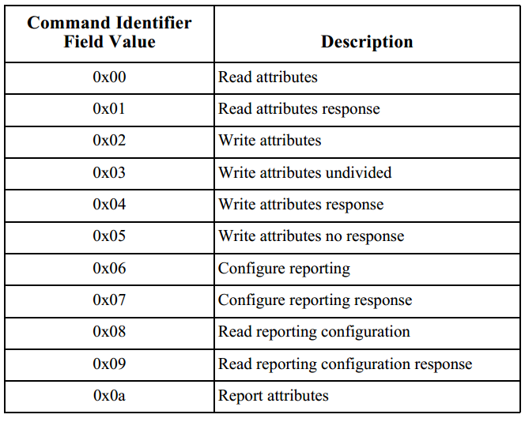
Cont.
ZCL command frame

Slide 14
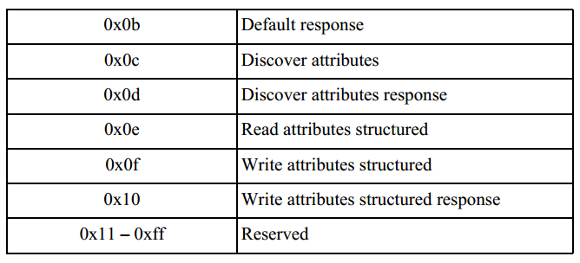
Cont.
ZCL command frame

Slide 15
Cont.
(5) Frame Payload Field
The frame payload field has a variable length and contains information specific to individual command types.
The maximum payload length for a given command is limited by the stack profile in use, in conjunction with the applicable cluster specification and application profile.
Fragmentation will be used where available.

Slide 16
Thank You

