Slide 1


CAB DATA ANALYSIS
To improve efficiency of Cab companies

Slide 2
OBJECTIVE& METHODOLOGY
Objective : Exploring Cab dataset to come up with various predictions and solve the data science problems.
To predict the trip duration.
Approach: Data Preparation, EDA.
To predict number of passengers availing cab from stand on next day
Approach: Data Preparation, outliers detection, Time series forecasting – ARIMA.
To predict the next path on the path or the final destination.
Approach: Data Preparation.

Slide 3

CAB DATASET
Rows: 1700000 approx.
Size: 1.8GB
Timestamp: 1 year (2013-2014)
Attributes: 9
Attribute characteristics: Datetime/numerical/Boolean.
Missing values: Yes

Slide 4

DATA PREPROCESSING
Important Attributes
TIMESTAMP
DATE
TIME
DAY
POLYLINE
LENGTH
DISTANCE
LAT_LONGS

Slide 5
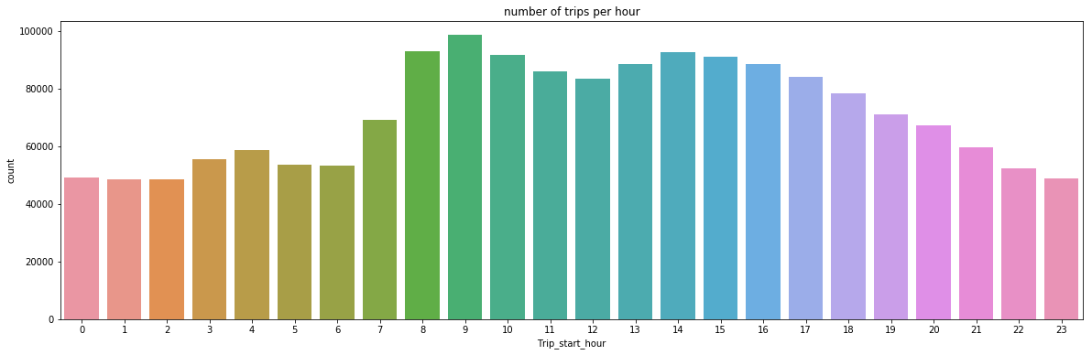
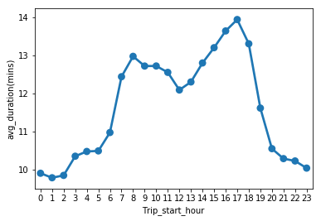
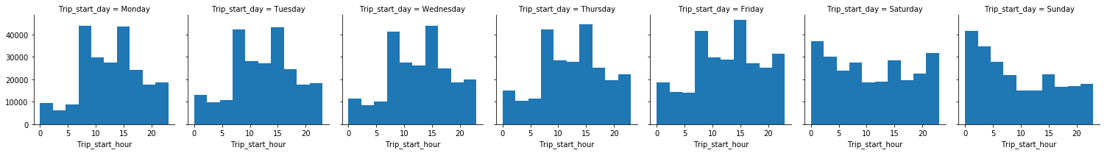
Exploratory Data Analysis

Slide 6
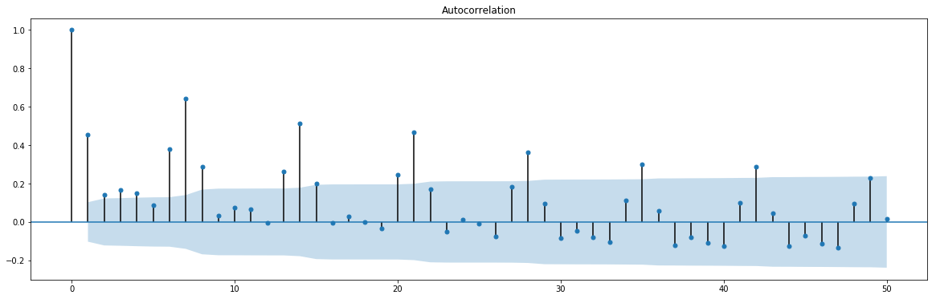
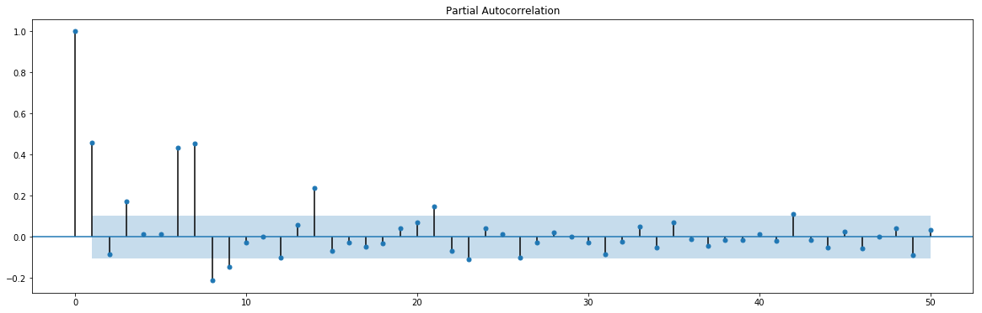
Time Series Forecasting – contd.
ADF test for stationarity:
Null hypothesis: The time series is stationary
Alternate hypothesis: The time series is non-stationary
Here, the obtained p-value is > 0.05. So, we fail to reject the null hypothesis and conclude that the data is stationary.

Slide 7
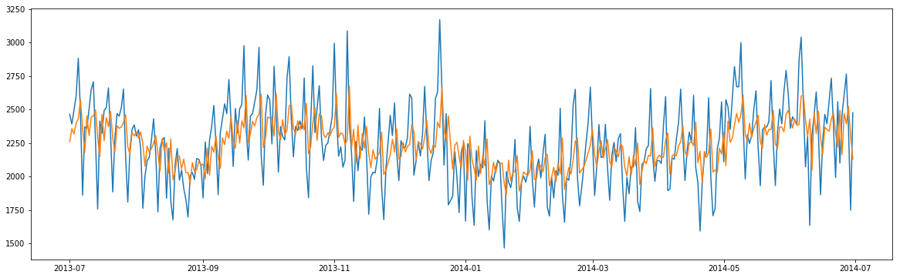
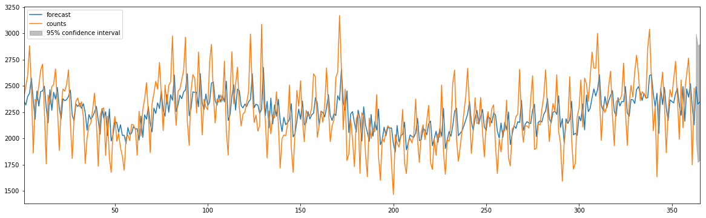
Time Series Forecasting – contd.
Fitted vs Actual plot
Model: ARIMA
Predicted values Predicted value: 2492

Slide 8
Results and Recommendations
Trip Duration: Exploratory data analysis reveals that the duration varies over weekends and the distribution is almost same during the week.
Number of Passengers: ARIMA model predicted number of people who avail the cab from stand on the next day is 2492.
Next Path and final destination: With the average of the distance between all the points in the trip, one can predict the next point in the trip or the final destination.
Further Analysis: We can implement few such predictions based on the cabs being booked on Holidays which would help Cab companies to plan the expected traffic of cabs on such days.

Slide 9

QUESTIONS?

