Slide 1

AI ASD prediction Web-platform

Slide 2

Background
According to 2017 to 2023 data, Hong Kong Autism children is increasing
Lack of resources to detect and treat them.
Maybe they need to wait until 1 to a half years for government hospital therapy
Miss golden treatment period

Slide 3
Propose system
Face detection
Behaviour detection
Spinning
Head banging
Arm flapping
AI chatbot

Slide 4
Key Technology
RNN
CNN
Transformer

Slide 5
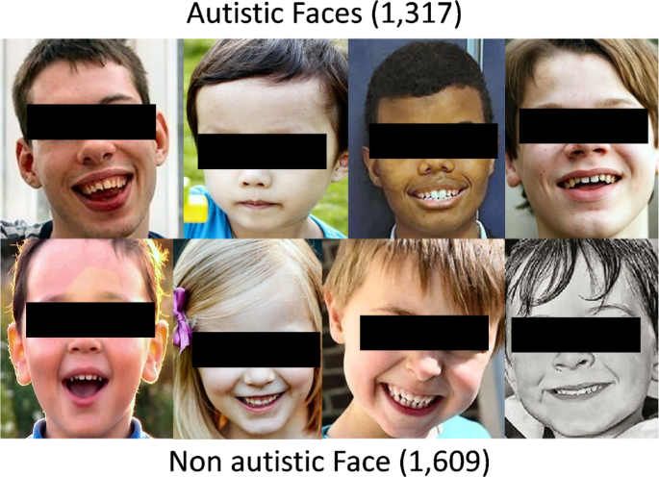
Face detection technology
YOLOv8(model)
Collected children face data from Kaggle around 3000 images

Slide 6
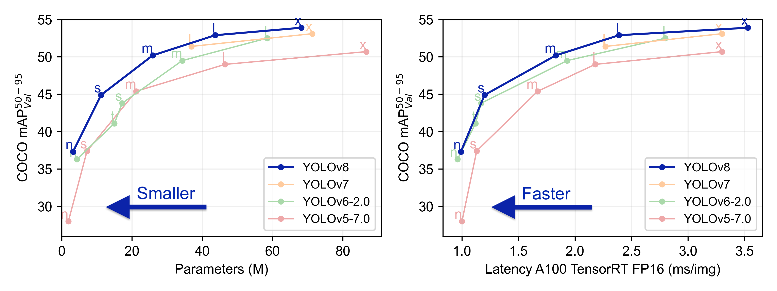
Advantage of YOLO
Good accuracy for short-time prediction
Flexibility in Deployment
Support CPU, GPU

Slide 7
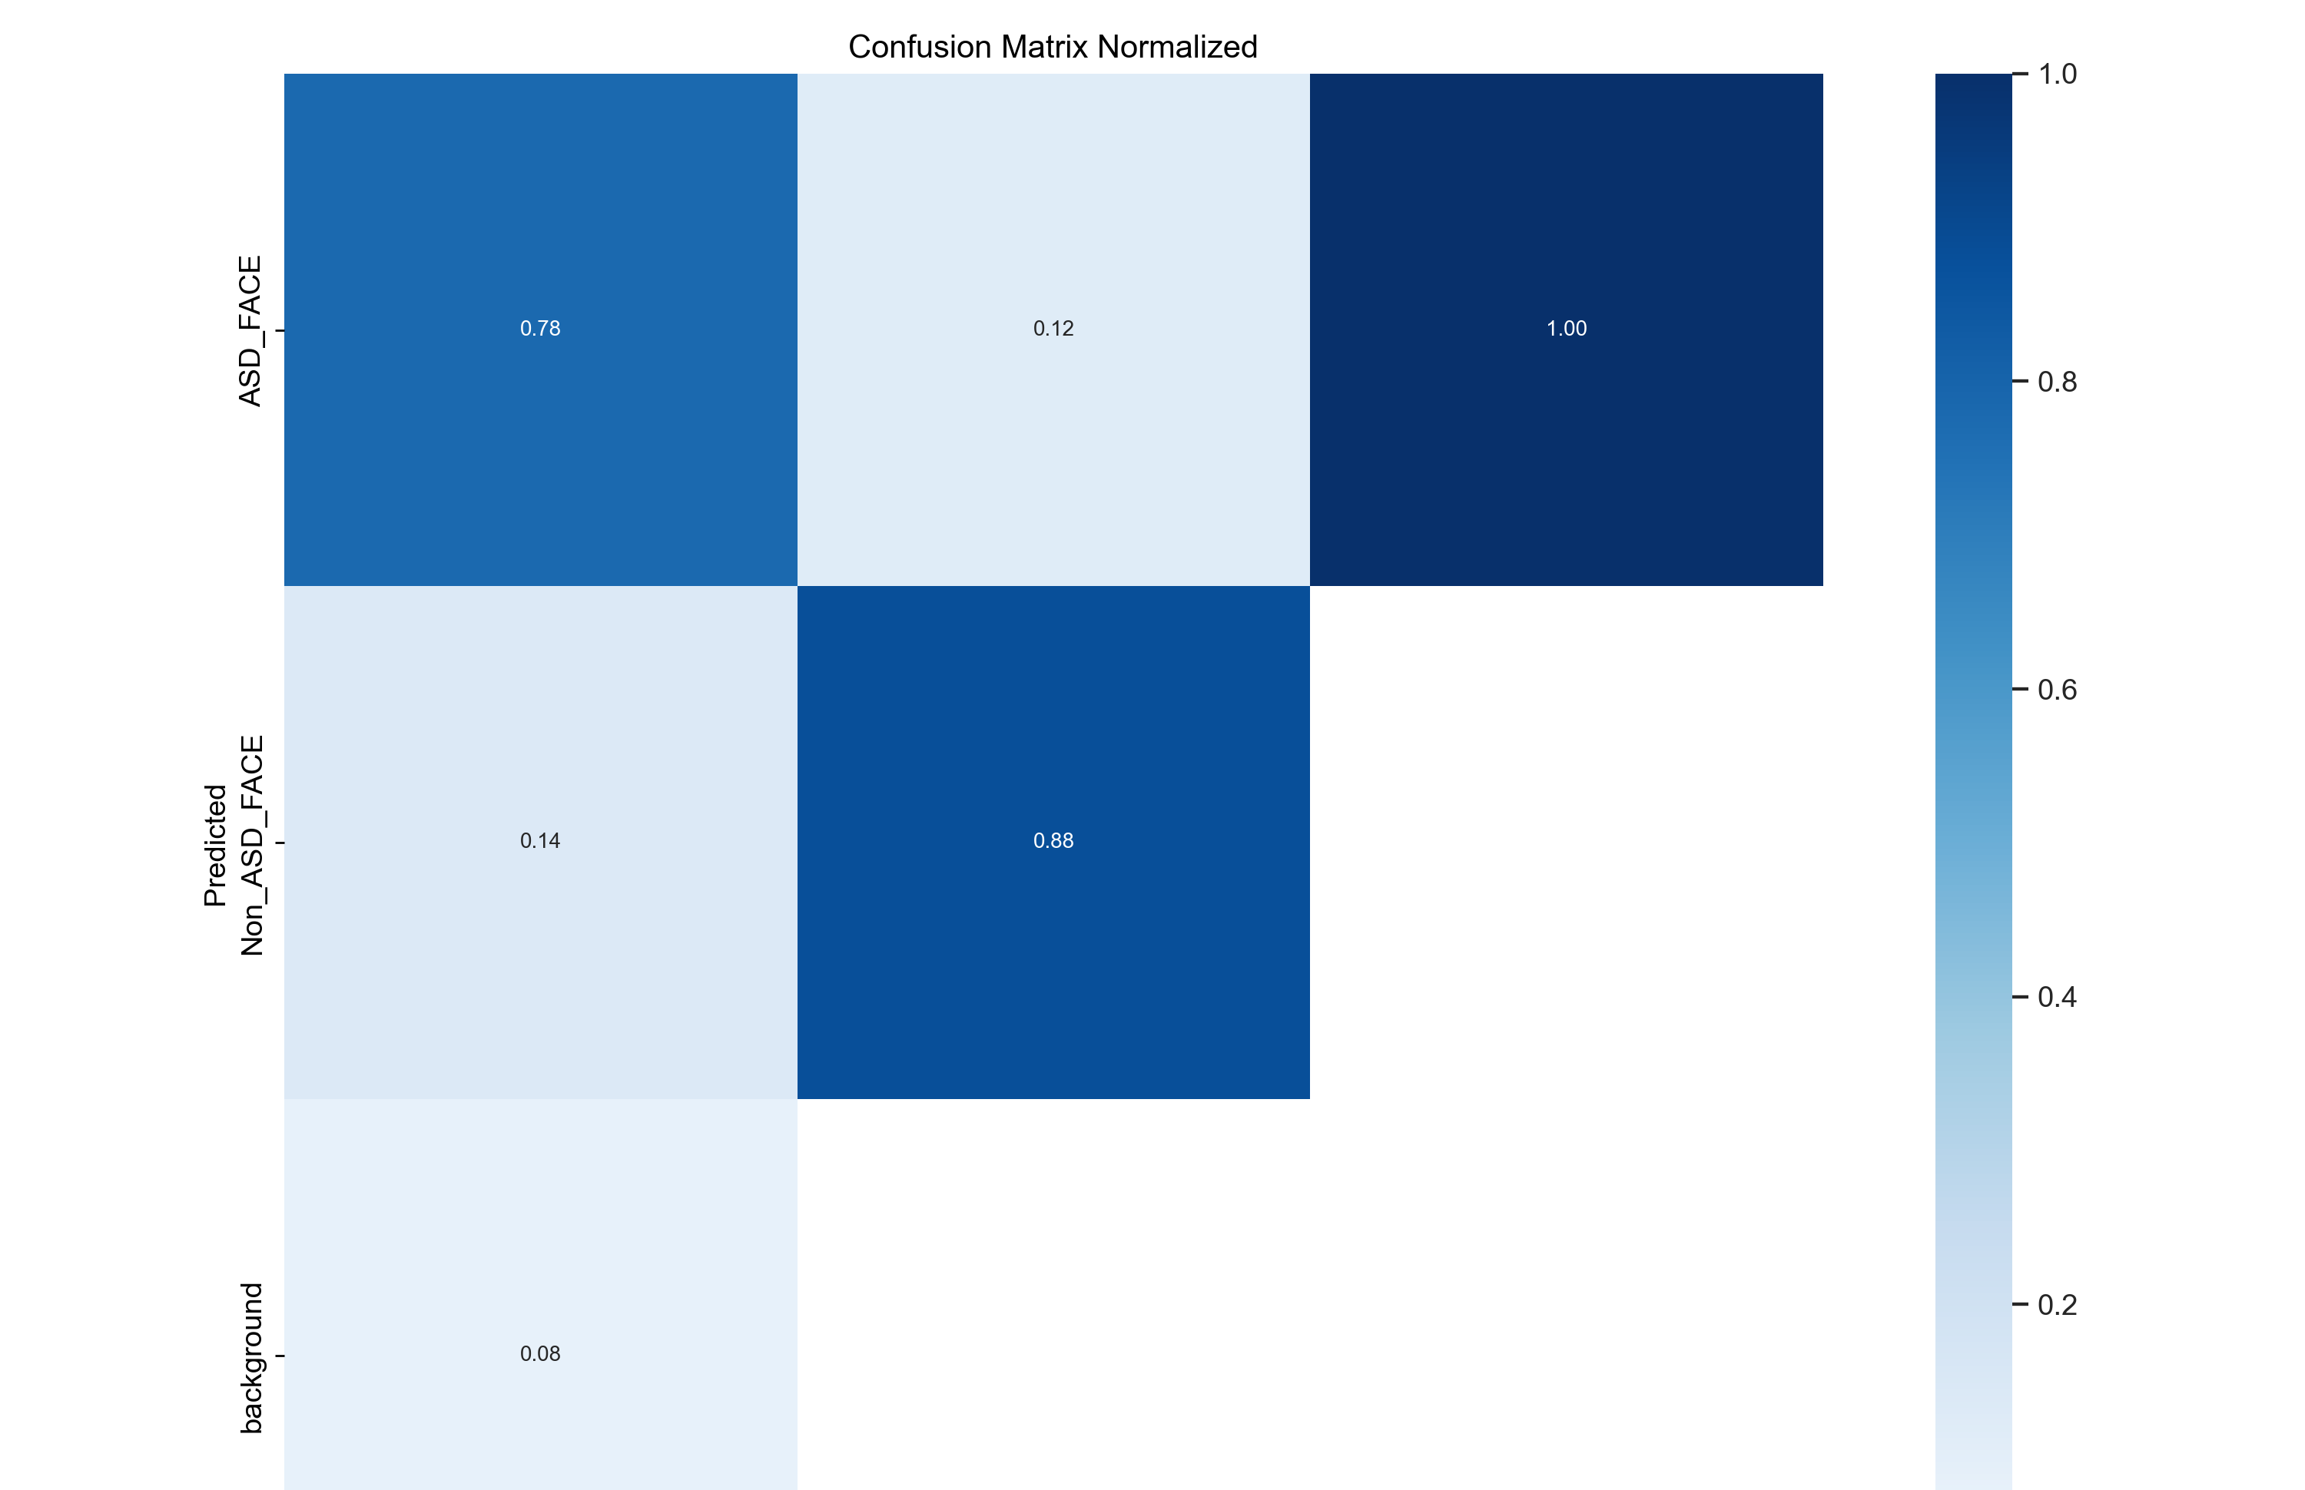
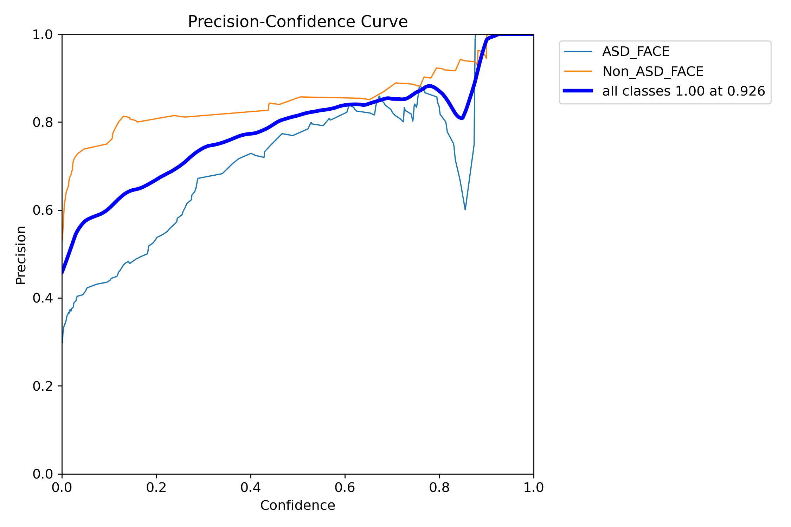
Result
Precision Confidence rate around 92.6%

Slide 8
Video classification
Transformers
Pre-Training model – VideoMAE
Trained 22 videos

Slide 9
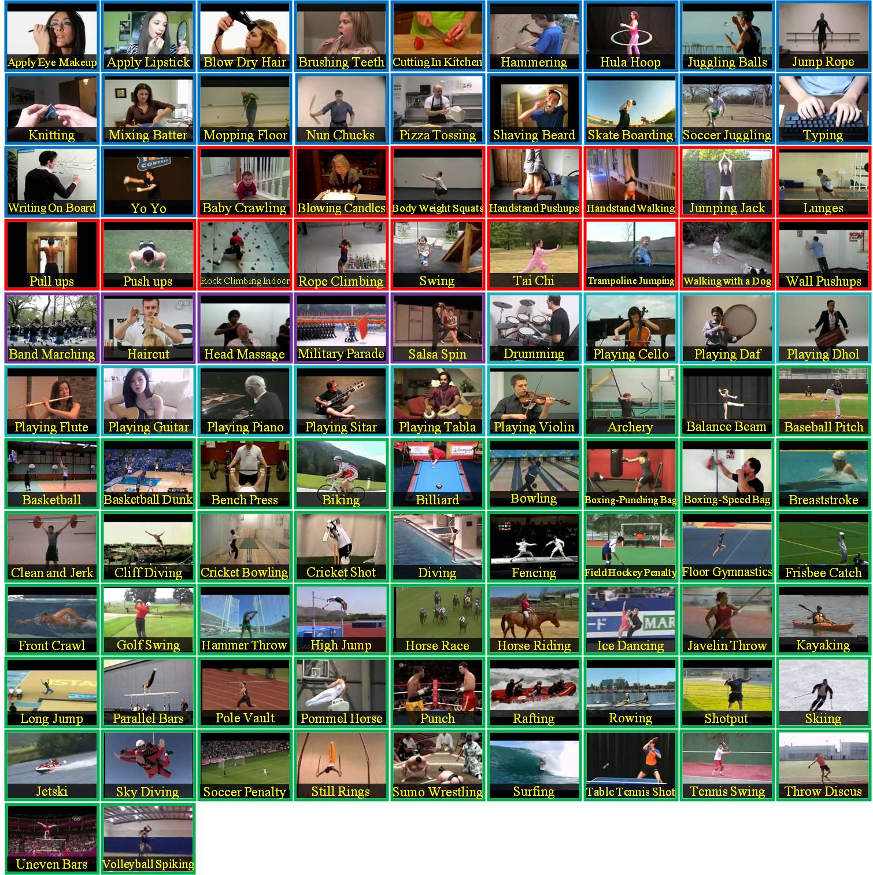
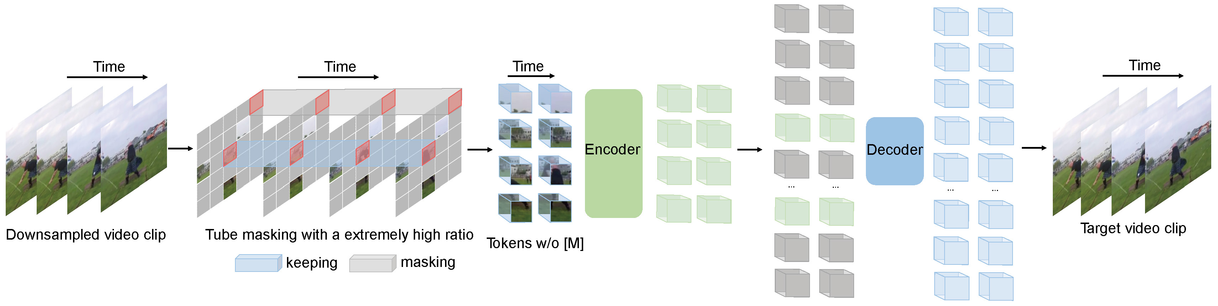
Advantage of Transformer combine to VideoMAE
Good result of small dataset (3k-4k videos)
On the famous dataset UCF101 archive the 90.8% acracy

Slide 10
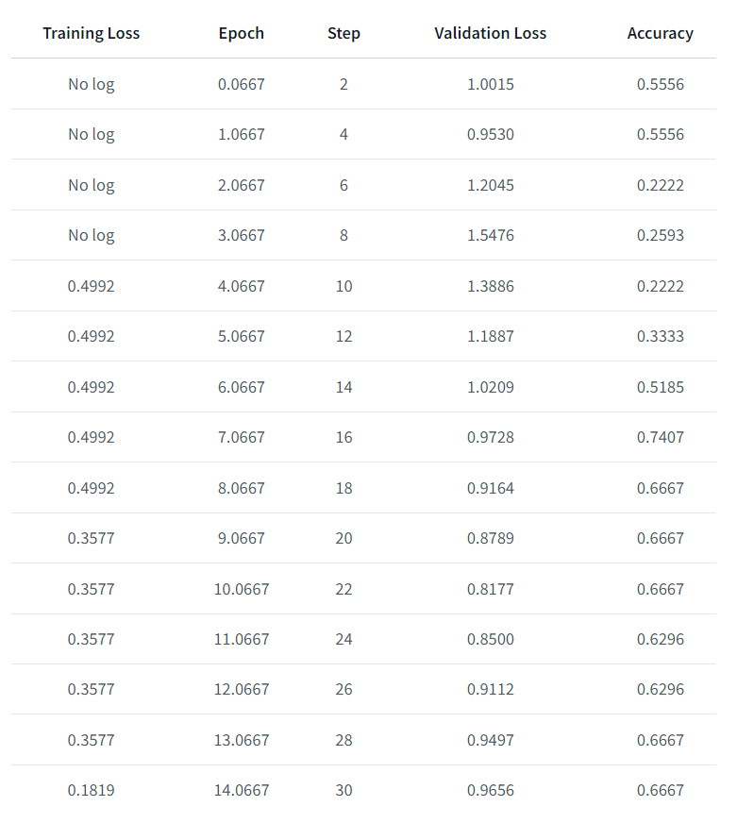
Result
Loss: 0.9525
Accuracy: 36.36%
NOT good
Lack of dataset
Not have enough GPU for training many times

Slide 11
AI chatbot
Large Language Model
LLMAM2(Develop by Facebook)
Transformer
Use the Wisper ai model for speech to text

Slide 12
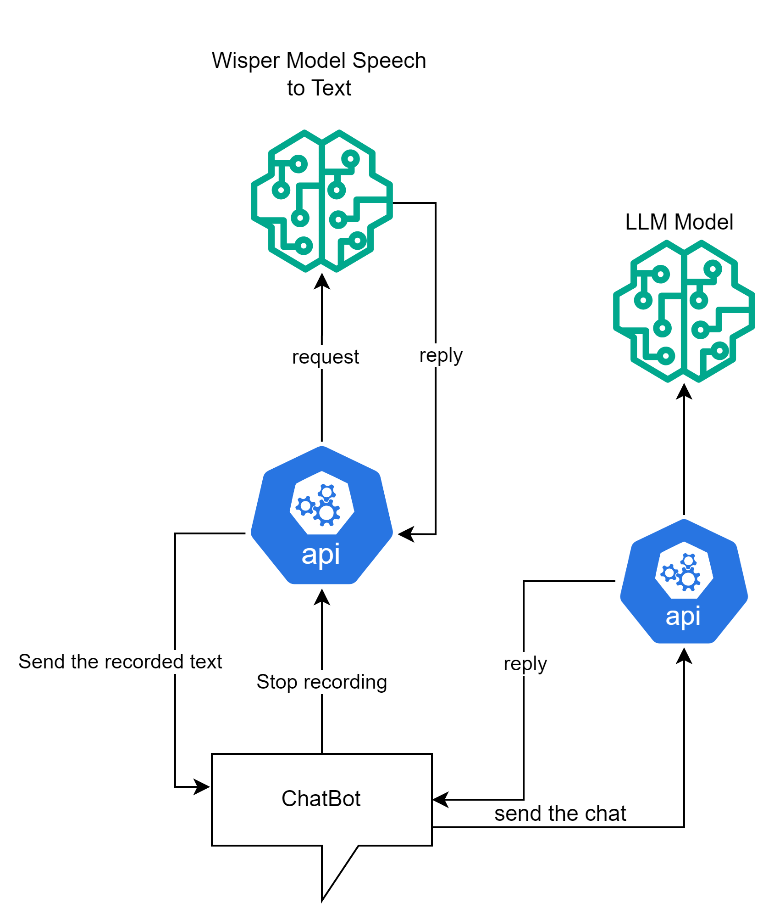
Architecture of chatbot

Slide 13
Advantage of LLAMA2
Trainable
Open sources

Slide 14
Prompt
你扮演一個自閉症治療師，現在和自閉症5歲小朋友進行廣東話對話，一句一個問題，第一句問咩名，只要中文，不要英文，no English， no English translation，之後的對話只用中文

Slide 15
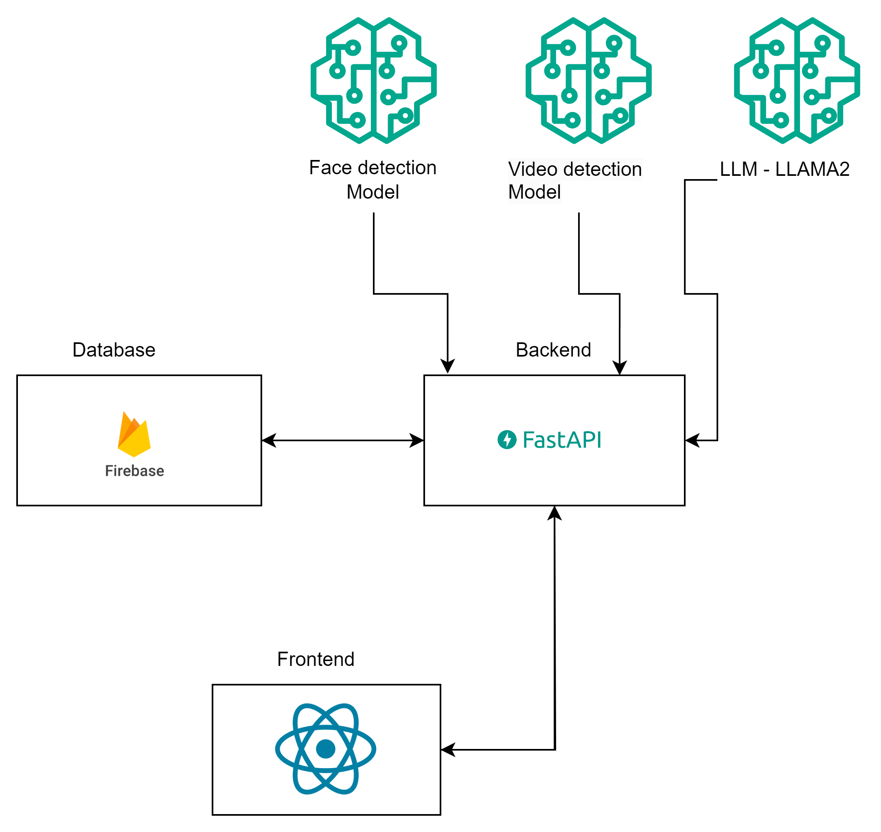
Software Architecture

Slide 16



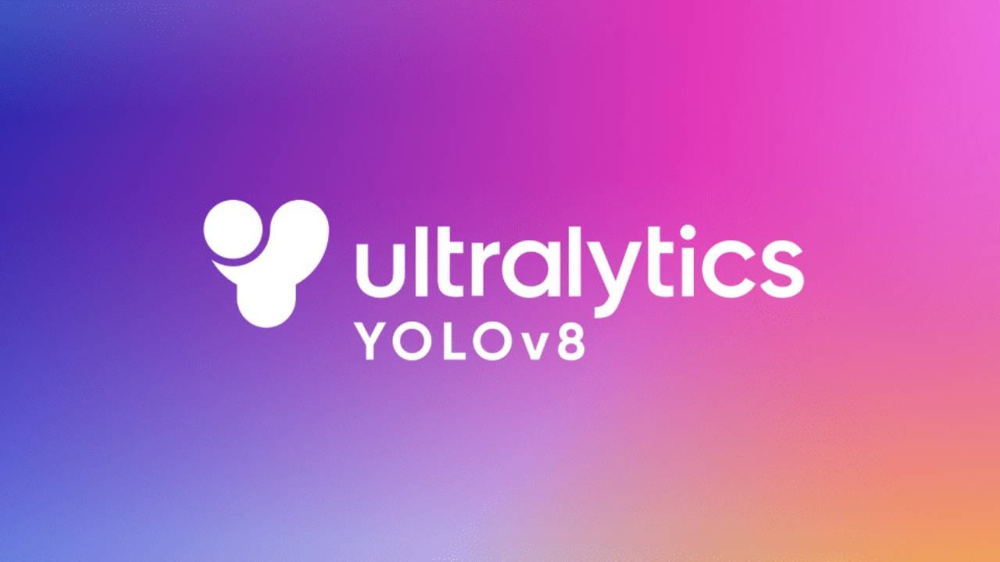

Tech Stack
Fast API (Backend)
React (Frontend)
Firebase (Database)
Model
YOLOv8
VideoMAE
LLAMA

Slide 17
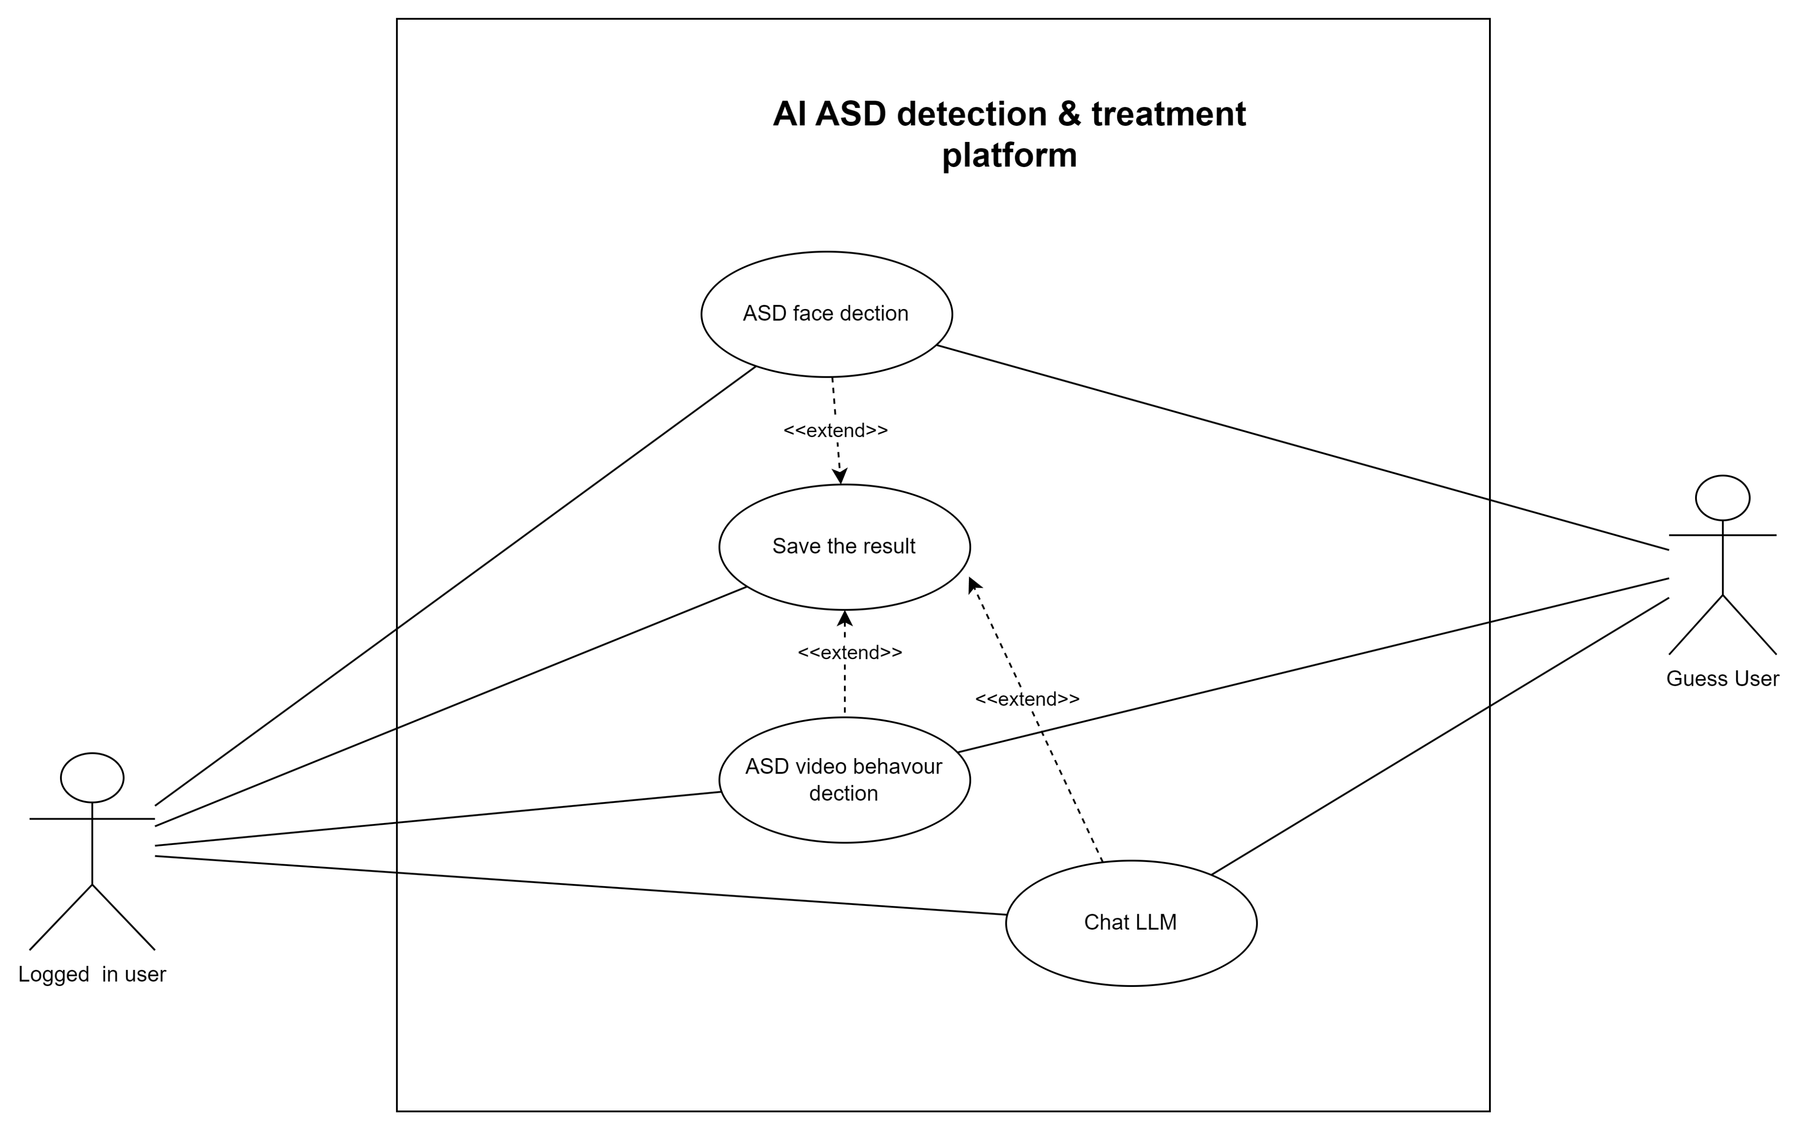
Use case Diagram

Slide 18

Demo

Slide 19

Q&A

