Slide 1
ApexPlanet Data Analytics Internship
Task 5 - Final Reporting, Deployment & Presentation
Project: Superstore Sales and Profit Analysis
Prepared by Kanmani S
Internship period: 11 July 2026 - 24 August 2026

Slide 2
Problem Statement & Objectives
Understand sales and profitability by category, sub-category and region.
Identify loss-making and low-margin areas.
Create an executive-ready report and Power BI dashboard evidence.
Prepare an automated analytics pipeline and submission documentation.

Slide 3
Data Overview
10 records, 8 columns, 10 unique orders.
Total Sales: {money(total_sales)} | Total Profit: {money(total_profit)} | Quantity: {int(total_qty)}.
0 missing cells and 0 duplicate rows.
Short sample: insights are descriptive, not predictive.

Slide 4
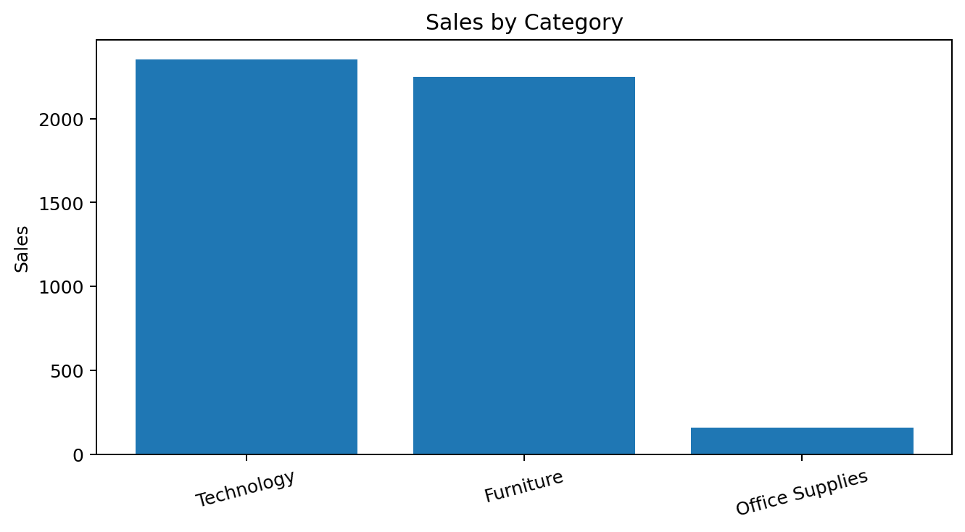
EDA Insights
Technology leads sales at 2,350.
Furniture follows at 2,250.
Office Supplies records 160 sales.

Slide 5
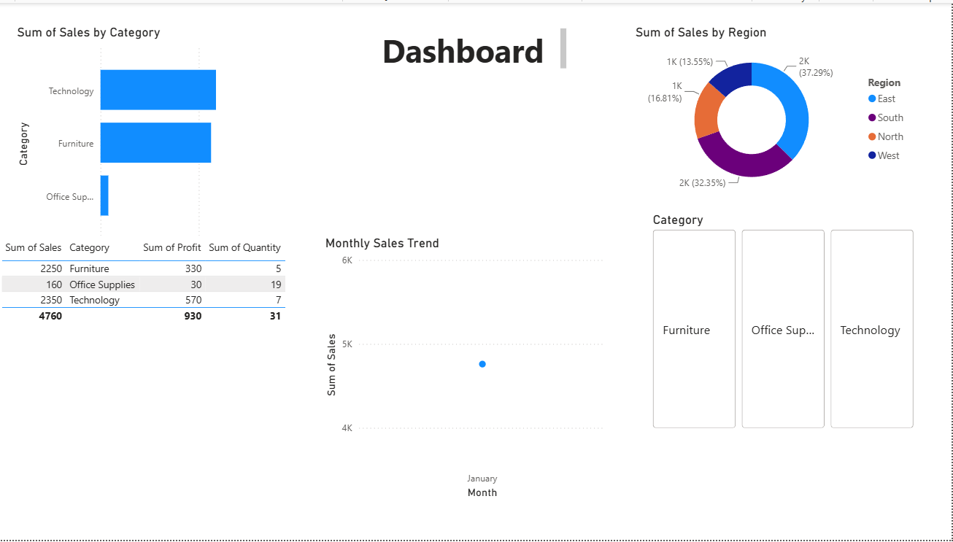
Power BI Dashboard

Slide 6
Statistical Analysis
Sales-profit correlation: 0.919.
Quantity-sales correlation: -0.587.
Overall profit margin: 19.54%.
Table is the only loss-making sub-category in the supplied records.
Because n=10, results should be treated as descriptive.

Slide 7
Business Recommendations
Prioritize Technology products.
Review Furniture margin and cost structure.
Investigate North region's weak margin.
Review Table pricing/cost/fulfillment economics.
Increase Office Supplies basket value through bundling/cross-selling.
Use the dashboard for recurring monitoring.

Slide 8
Challenges & Learnings
Small dataset limits statistical confidence.
No forecasting/segmentation/churn outputs were supplied for Task 5 evidence, so unsupported claims are excluded.
Learned to connect data cleaning, analytics, visualization, dashboarding and reporting.
Prepared a repeatable Python automation workflow and documentation.

Slide 9
Automation, GitHub & Future Scope
Automation script validates data and exports KPI/category/region/sub-category summaries.
README and requirements.txt are prepared.
Schedule with Windows Task Scheduler / GitHub Actions / Airflow.
Future: forecasting, customer segmentation, churn, anomaly alerts and cloud deployment.
GitHub push and public links remain manual final steps.

Slide 10
Conclusion & Thank You
Verified results: 4,760 sales | 930 profit | 31 units.
Strongest areas: Technology and East.
Priority areas: North margin and loss-making Table.
Final manual steps: GitHub push, demo recording/upload, LinkedIn/dashboard links if required.
Thank You

