Slide 1
EMPLOYEE DATA ANALYSIS USING EXCEL
STUDENT NAME: R.KANMANI
REG. NO.: 312209484
DEPARTMENT: B.COM BANK MANAGEMENT
COLLEGE: ANNA ADARSH COLLEGE FOR WOMEN

Slide 2
PROJECT TITLE
EMPLOYEE PERFORMANCE ANALYSIS USING EXCEL

Slide 3
AGENDA
Problem Statement
Project Overview
End User
Our Solution and Proposition
Dataset Description
Modelling Approach
Results and Discussion
Conclusion

Slide 4
PROBLEM STATEMENT
Analyzing and evaluating the performance of employees over the past years to identify strengths, areas for improvement, and overall trends that can inform strategic HR decisions.

Slide 5
PROJECT OVERVIEW
It aims to develop a comprehensive framework for evaluating employee performance. The scope includes analyzing job responsibilities, goals, and key performance indicators. A combination of quantitative and qualitative approaches will be used to assess performance. The expected outcome is accurate performance assessments and targeted development plans. This will enable data-driven decision-making to enhance organizational efficiency.

Slide 6
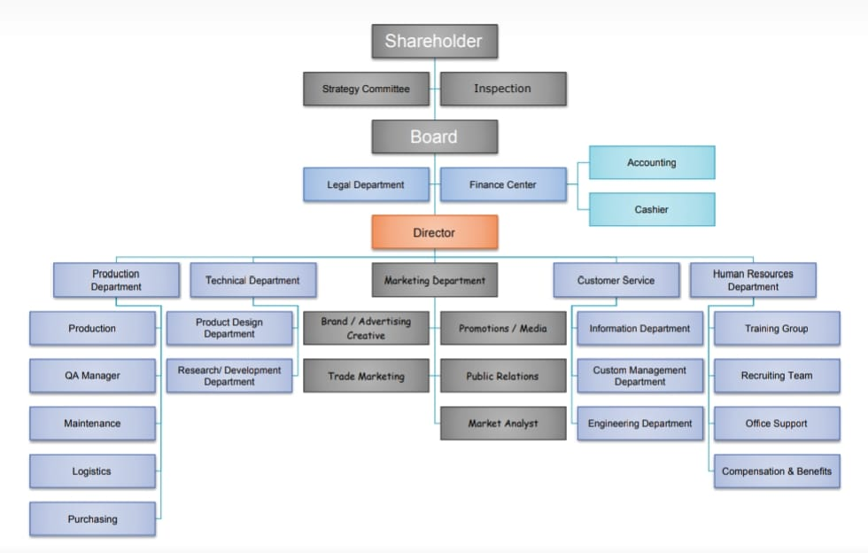
WHO ARE THE END USERS ?

Slide 7
Our solution and its value proposition
Conditional formatting-missing
Filter-remove
Formula-performance
Pivot-summary
Graph-data visualization

Slide 8
DATASET DESCRIPTION
Employee dataset from Kaggle
26-features
We selected 9-features
Employee ID number
Employee name
Employee type
Performance level
Gender
Employee rating number

Slide 9
THE “WOW” IN OUR SOLUTION
Using this formula we have measured the
performance level of employees working in an
organization
Performance level = IF(Z2>=5,"VERY HIGH",Z2>=
4,"HIGH",Z2>=3,"MED","TRUE","LOW“)

Slide 10
MODELLING
Data collection
Download the employee dataset from Kaggle
After the download, an Excel sheet will open
In that sheet, we have employee data details which have 26 features
Features collection
We are selecting 9-features for our project
In that feature, we have employee ID, employee name, employee type, gender,
performance level, and employee rating.
Data cleaning
In this method, we clear the empty rows or columns in the sheet
By selecting the empty rows and clearing them using a conditional formatting tool

Slide 11
Performance level
Here, we calculate the performance of the employees
By using a formula we can calculate the performance
Using IF formula: =IF(Z2>=5, "VERY HIGH", Z2>=4, "HIGH", Z2>=3, "MED", "TRUE", "LOW“)
Pivot table
After creating the performance level, click on the pivot table icon
In that, an application will appear as a row, column, fields
Select the required items and click ok
Then using the details create a graph
Summary
Using this method, we can know the performance level of the employees through
the graph

Slide 12
RESULTS Employee Performance Analysis

Slide 13
Performance Level

Slide 14
CONCLUSION
Effective employee performance analysis has far-reaching benefits, including
better resource allocation, enhanced accountability, improved succession
planning, increased employee retention, data-driven promotions, skills gap
identification, enhanced employee experience, strategic alignment,
competitive benchmarking, and continuous improvement. Accurate
performance assessments enable targeted development initiatives, improved
employee engagement, and a culture of constructive feedback, ultimately
leading to a high-performing culture that supports the organization's overall
mission and objectives.

