Slide 1












Team Details
Team Name:
NEXUS
SR. NO
ROLE
NAME
ACADE MIC YE AR
Annie Darling Kanmani A
1
Team Leader 3rd Year
2 Member 1 Mridulaa Kishore 3rd Year
COL L E GE NAME
SRM Madurai College for Engineering and Technology
TE AM LE ADER CONTACT NUMBER
TE AM LE ADER EMAIL ADDRESS
+91 7845242804
anniedarling60@gmail.com
GitHub Repos itory
https://github.com/kanmaniannie1 80-hub/edge-ai-wafer-defect-classification/tree/main
Prototype / Simulation Video
https://drive.google.com/file/d/1pWAH54snOZnXsOuz2sV-4Bh3qW7buV9A/view?usp=sharing

Slide 2

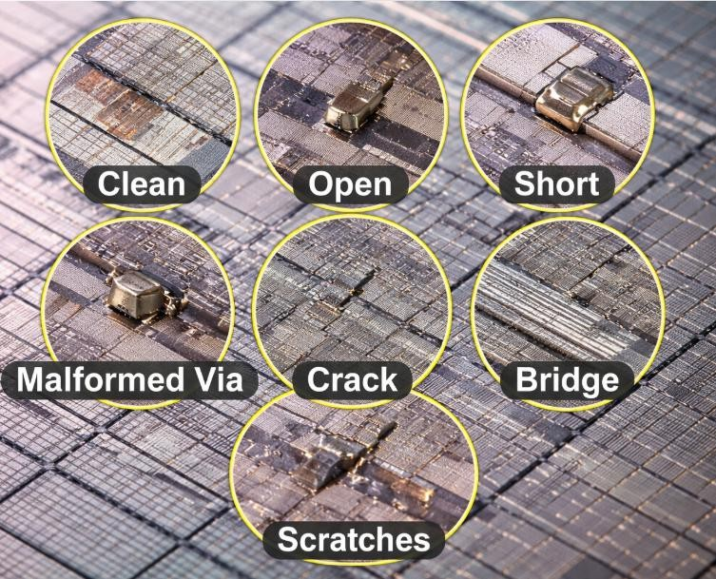

Problem Statement Addressed
DESCRIPTION / DETAILS
Semiconductor wafer and die defects reduce manufacturing yield and reliability
Manual inspection is time-consuming and prone to human error
Cloud-based AI solutions introduce latency and power overhead
Real-time defect detection requires low-power, compact AI models
Edge AI enables fast and efficient on-device inspection
Example of wafer surface defects during inspection

Slide 3


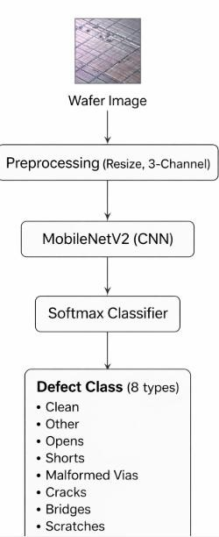
Idea Description - Edge-AI Based Semiconductor Wafer Defect Classification
KEY CONCEPT & APPROACH
Develop an AI-based image classification system to automatically identify semiconductor wafer defects
Use a lightweight convolutional neural network optimized for edge deployment
Apply transfer learning to achieve reliable performance with limited labeled data
Focus on model portability and compact size to enable real-time, low-power inference
SOLUTION OVERVIEW
Automates wafer defect detection, reducing reliance on manual and error-prone inspection
processes
Uses a compact deep learning model to meet low-power and real-time edge constraints
Enables on-device inference, eliminating latency and dependency on cloud connectivity , internet connectivity.
Provides scalable and consistent defect classification across multiple defect types

Slide 4

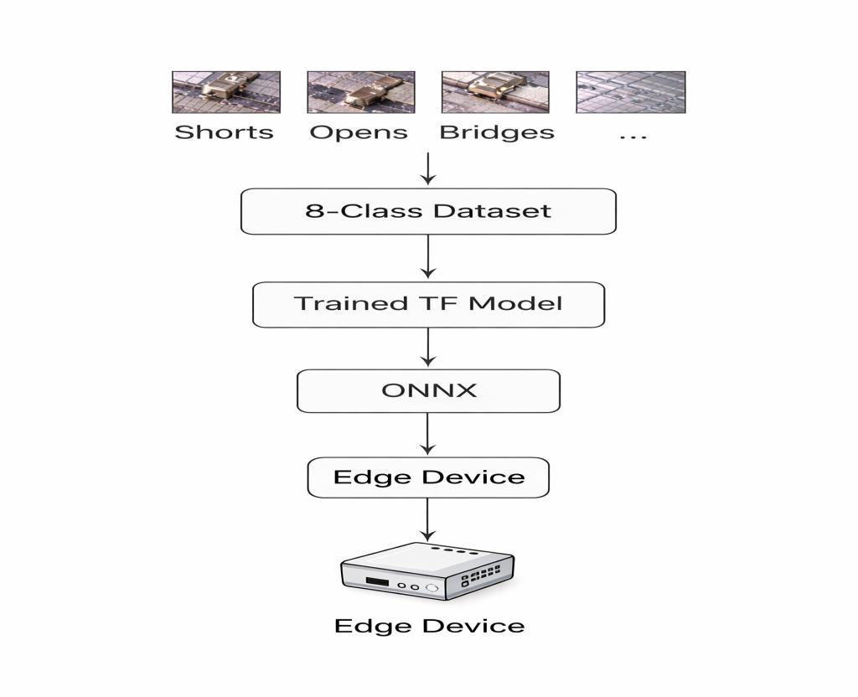
Proposed Solution - Edge-AI Based Semiconductor Wafer Defect Classification
SOLUTION DETAILS
The proposed solution uses a convolutional neural network to classify semiconductor wafer defects from inspection images
A lightweight MobileNetV2 architecture is employed to meet
edge deployment constraints
Transfer learning with ImageNet pretraining enables stable training on limited defect data
Images are resized to 224×224 and converted to 3-channel input for model compatibility
The trained model is exported to ONNX format to ensure portability across edge platforms
The solution is designed for real-time, low-power inference on
embedded devices.

Slide 5

Innovation and Uniquenes s
KEY INNOVATION
The innovation is a novel application of lightweight edge AI for real-time semiconductor wafer defect classification
The solution enables fully offline, on-device inference without internet connectivity, eliminating cloud dependency
An edge-first, portable workflow using ONNX allows deployment on low-power embedded platforms
COMPE TITIVE ADVANTAGE
Enables real-time, offline defect detection, removing cloud
latency and recurring costs
Uses a lightweight, compact model that lowers power and hardware requirements for edge deployment
Provides automated, consistent classification, improving efficiency over manual or rule-based inspection
Impact and Benefits
Enables real-time, offline wafer defect detection, improving
inspection speed and manufacturing yield
Reduces inspection cost and power consumption by eliminating cloud dependency and heavy hardware
Provides consistent and reliable defect classification, minimizing human error in quality control
2× faster inspection
Reduced inspection latency
Lower operational cost
Improved inspection consistency
Compact model size (< XX MB)

Slide 6





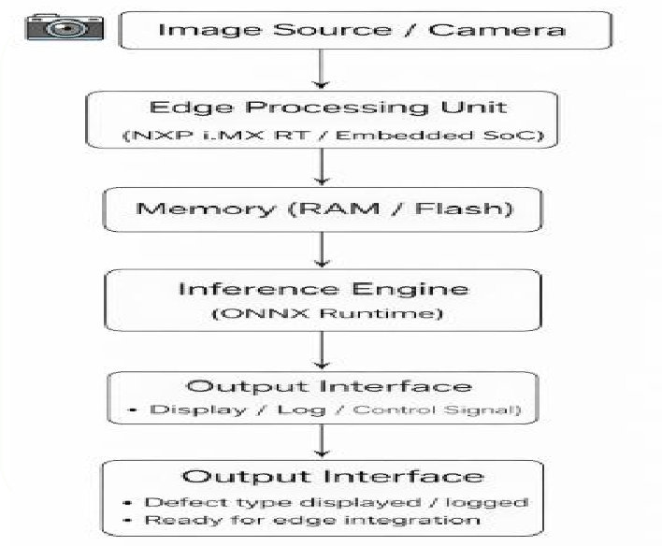
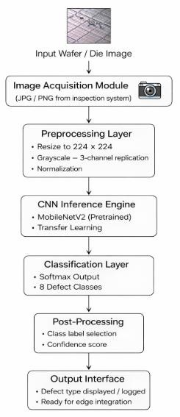
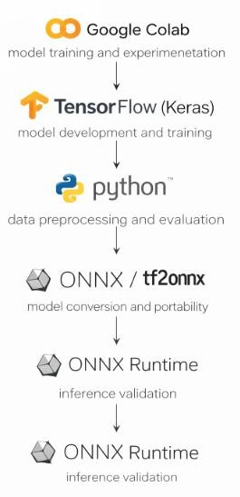
Technology & Feas ibility/Methodology Used
IMPLE ME NTATION STR ATE GY
Technical Stack & Feasibility
Software: TensorFlow (Keras), Python, ONNX, ONNX Runtime
Architecture: MobileNetV2-based CNN with transfer learning and 224×224 inputs
Deployment: ONNX export for offline, edge-ready inference
Feasibility: Lightweight model ensures low power, small memory footprint, and easy edge deployment
Software Architecture
Hardware Components
Development Tools

Slide 7


Research and References
Research Background & Methodology
Briefly describe the research foundation or scientific principles supporting your idea.
Transfer Learning Baseline: Used a pretrained MobileNetV2 (ImageNet) with a frozen backbone to establish a stable and reproducible Phase-1 baseline suitable for edge deployment.
Dataset Strategy: Eight defect classes organized using folder-based labeling with fixed train/validation/test splits to ensure consistent and unbiased evaluation.
Training Discipline: Trained for a maximum of 25 epochs using Adam (LR = 1e-4) with early stopping; data augmentation applied only to the training set.
Evaluation Approach: Performance assessed using overall accuracy, per-class precision and recall, and a confusion matrix to analyze defect-wise behavior.
Key Insight: Strong performance on well-defined classes (e.g., clean, cracks), while lower recall on rare or ambiguous defects highlights data limitations rather than
model failure, guiding Phase-2 improvements.
References & Citations
List key papers, articles, or data sources.
Wafer Map Failure Pattern Recognition Using Deep Learning
Source: IEEE
URL: https://ieeexplore.ieee.org/document/8113459
Deep Learning for Semiconductor Defect Classification: A Review Source: Springer
URL: https://link.springer.com/article/10.1007/s10489-020-01744-0
WM-811K Wafer Map Dataset Source: Kaggle
URL: https://www.kaggle.com/datasets/qingyi/wm811k-wafer-map

