Slide 1
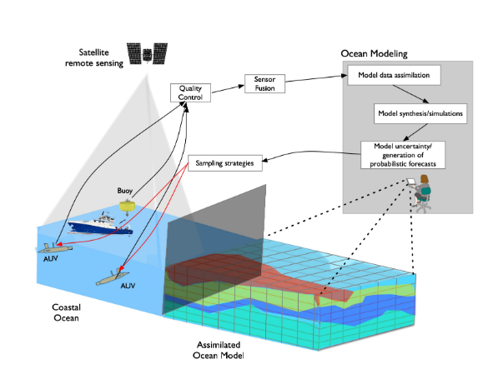
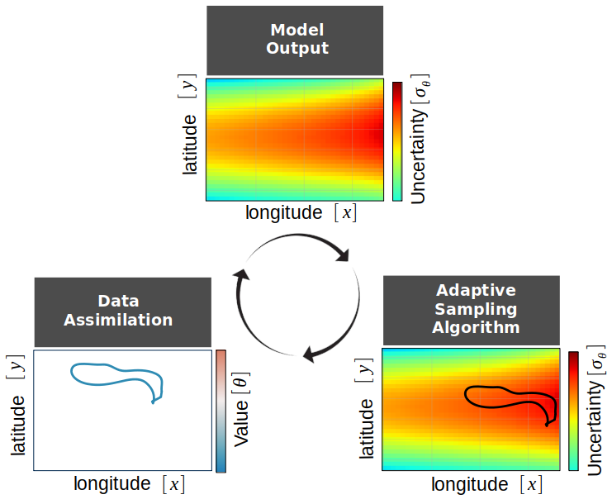
Fresnel
Full data loop in a coastal ocean setting
→ model prediction → uncertainty estimation → target sampling → data assimilation
Demonstrates how model-based uncertainty guides robotic sampling to improve ocean forecasts
Validates a model-driven adaptive exploration approach
Highlights benefits and challenges of real-world ocean operations

Slide 2
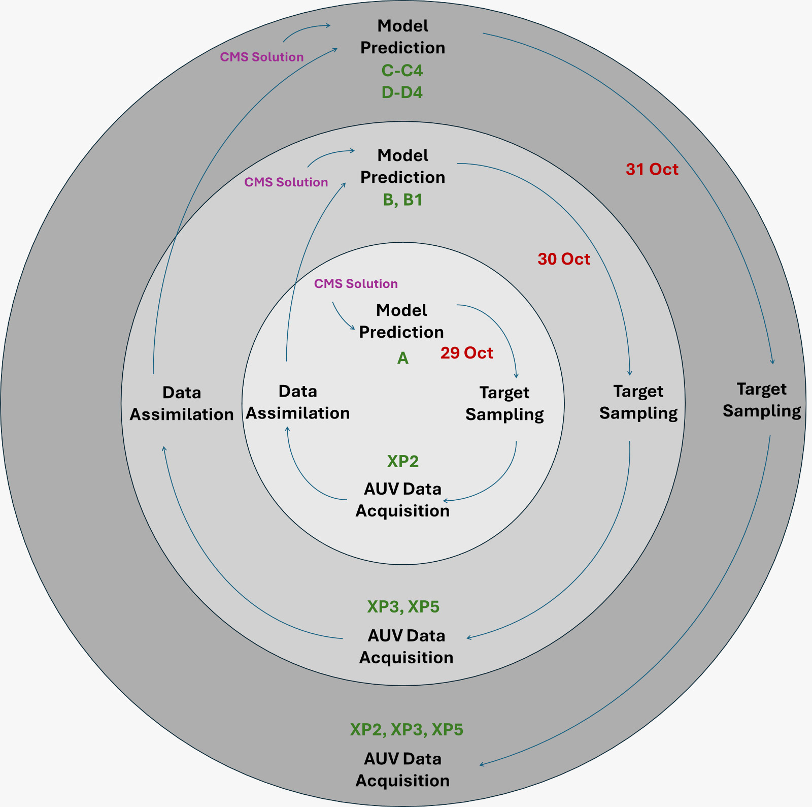
Fresnel
Challenging meteorological and ocean conditions constrained the team from multiple iterations of the sample-assimilate-predict-direct loop to a three-day sequence of consecutive experiments (29-–31 October, 2025).
The analysis in this work aims to quantify the impact of assimilating AUV-acquired temperature data on the predictive performance of the statistical model and to assess the operational feasibility of the data cycle approach in a real-world coastal setting.
Each experimental day followed a structured cycle involving:
the generation of a statistical model forecast and its associated uncertainty field based on the Copernicus Marine Service (CMS) data available up to the previous day;
the execution of the target sampling algorithm to plan the next-day missions; and
in situ data collection by AUVs following the algorithmically determined transects.
The data collected within the previous day were subsequently assimilated into the statistical model to produce updated forecasts, enabling comparisons between forecasts with and without data assimilation.

Slide 3
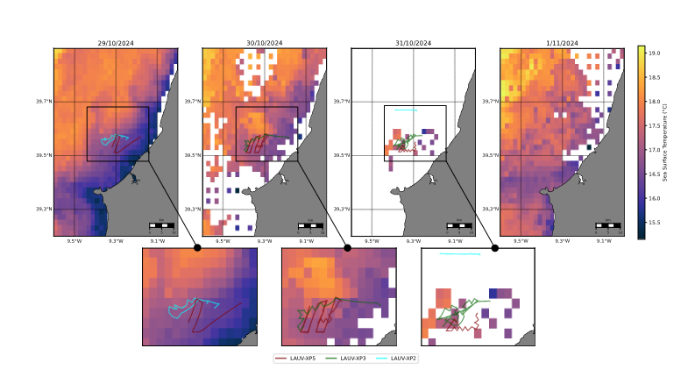
Fresnel
Figure provides an overview of the environmental conditions observed during the three-day experimental window considered in this study (29–31 October). The background fields correspond to the Level-3Sea Surface Temperature (SST) product from Copernicus Marine Service. The operational area was relatively compact, covering approximately 100 km² south of the Nazaré Canyon, where the AUVs executed the planned target sampling missions.

Slide 4
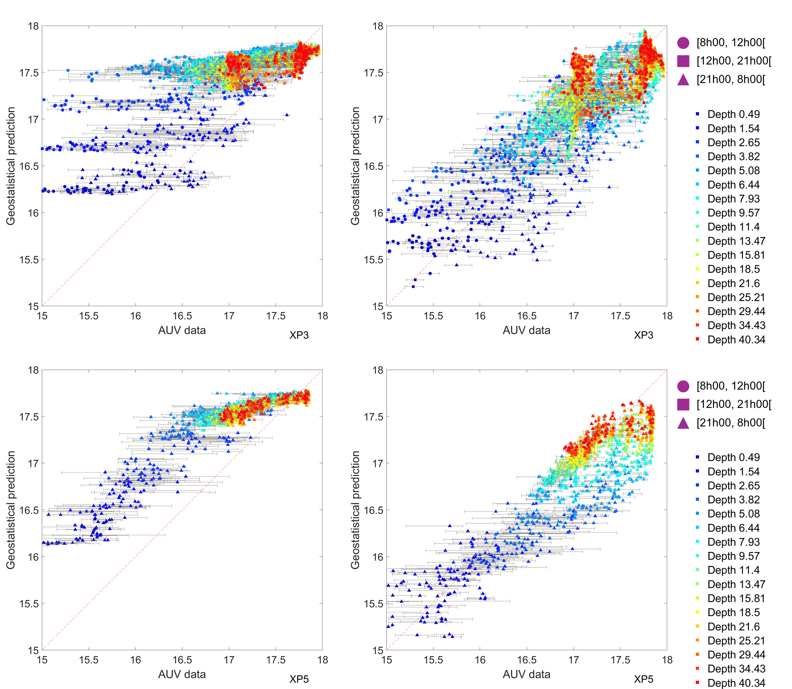
Fresnel
31 October
Statistical prediction vs LAUV in situ data
In the baseline scenarios without assimilation (C and D), the scatterplots exhibit a wide spread of points around the reference line, indicating substantial discrepancies between the model predictions and the observed AUV temperatures. These deviations are particularly evident in the Figure, where surface temperatures tend to be overestimated. This dispersion reflects the model’s limited ability to accurately reproduce the vertical thermal structure when it relies solely on CMS data without incorporating recent in situ information.
In contrast, the fully assimilated scenarios (C4 and D4) show a much tighter clustering of points around reference, especially within the upper layers, where the previous AUV missions had provided dense and temporally relevant observations. This reduction in spread suggests a clear improvement in predictive accuracy, indicating that the assimilation of targeted measurements effectively constrains the thermal structure and captures ongoing physical transitions in the water column.
with Assimilation
C
C4
with Assimilation
D
D4

Slide 5
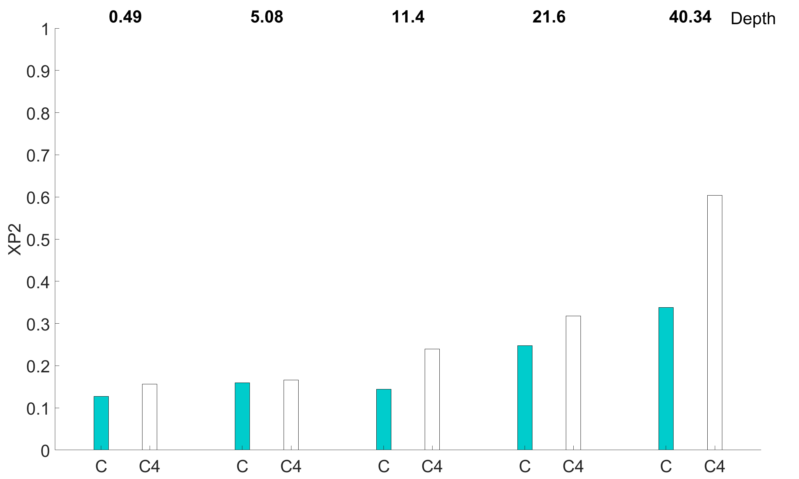
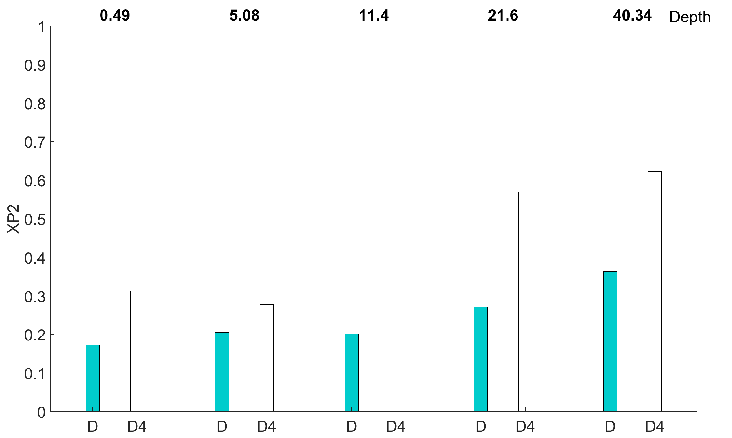
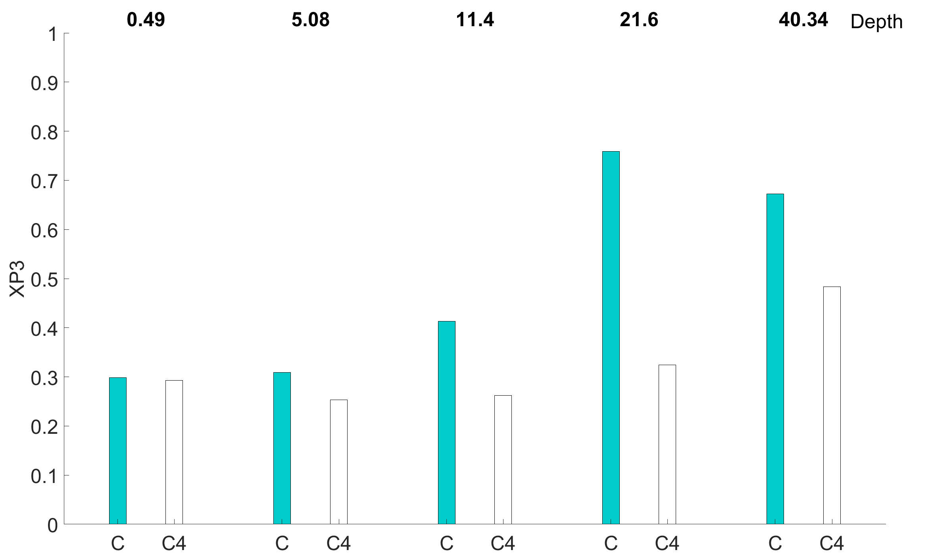
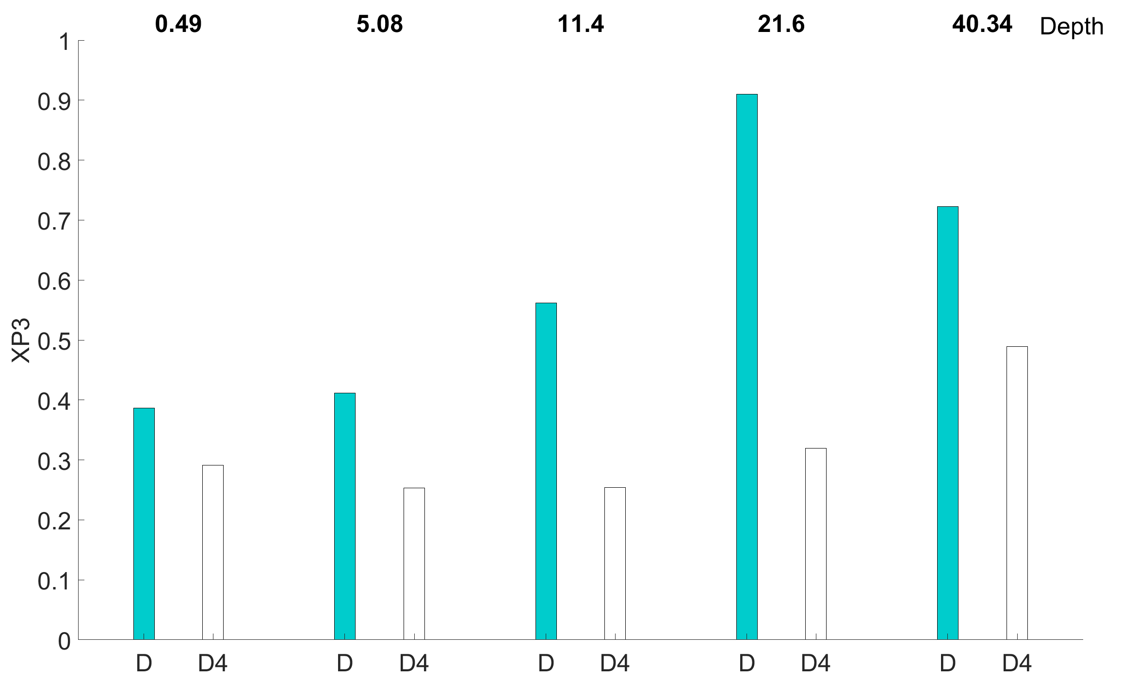
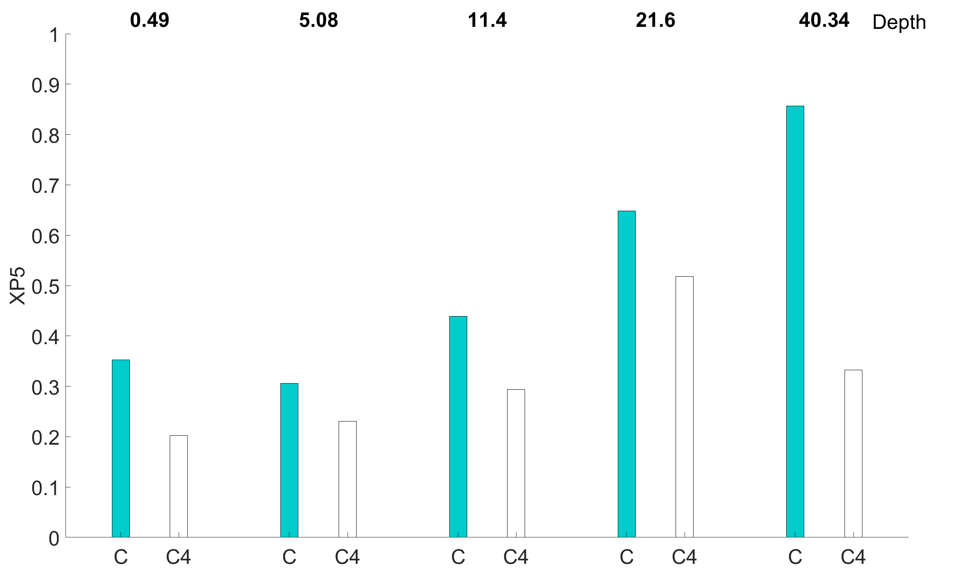
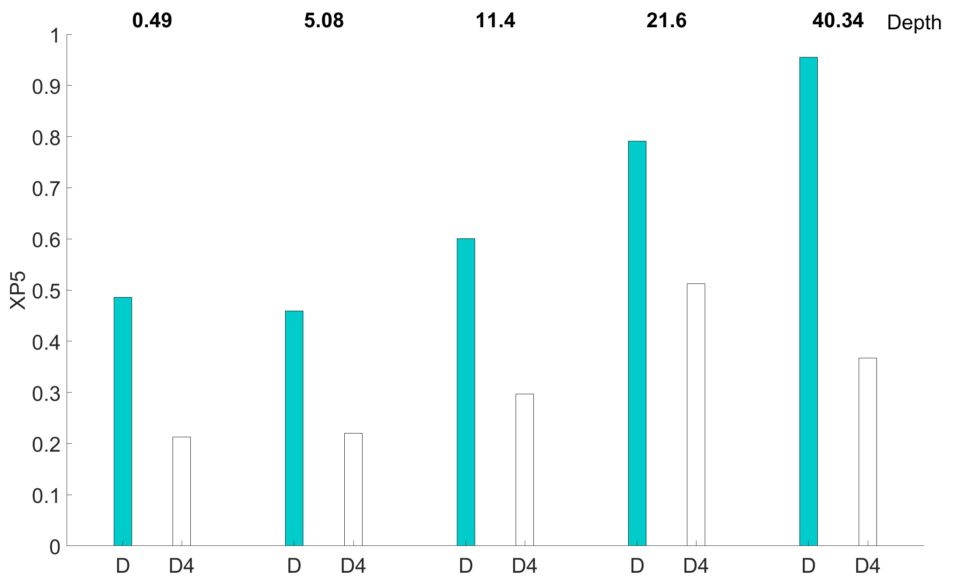
Fresnel
For LAUVs XP3 and XP5, a clear and consistent trend is observed: the assimilation scenarios (C4 and D4) improve the model prediction skill. The RMSE error decreases across all depths and vehicles, indicating that the assimilation procedure effectively constrains the local dynamics represented in the geostatistical model. Although small differences are present between C4 and D4, they are not statistically significant, confirming that the assimilation results are robust with respect to initial configuration differences.
The situation for LAUV XP2 is radically different. In this case, the assimilation scenarios (C4 and D4) lead to higher prediction errors compared with the non-assimilation runs (C and D). This counterintuitive result stems from an important spatial mismatch: on 31 October, XP2 operated north of the Nazaré Canyon, whereas the assimilated data from the previous days (29 and 30 October) were collected in its southern sector.
The Nazaré Canyon marks a transition zone between distinct oceanographic regimes, where circulation patterns are strongly influenced by the canyon’s complex topography and the interaction between shelf and slope processes. Inside the Nazaré Canyon, residual currents are generally aligned along the canyon axis as a result of strong topographical control and this alignment extends well above the canyon edges (~150 m depth), implying a substantial disturbance of the predominant north–south circulation parallel to the general trend of the shelf and slope
Xp2 – higher error with Assimilation
Why?
Xp2 – higher error with Assimilation
Why?

Slide 6
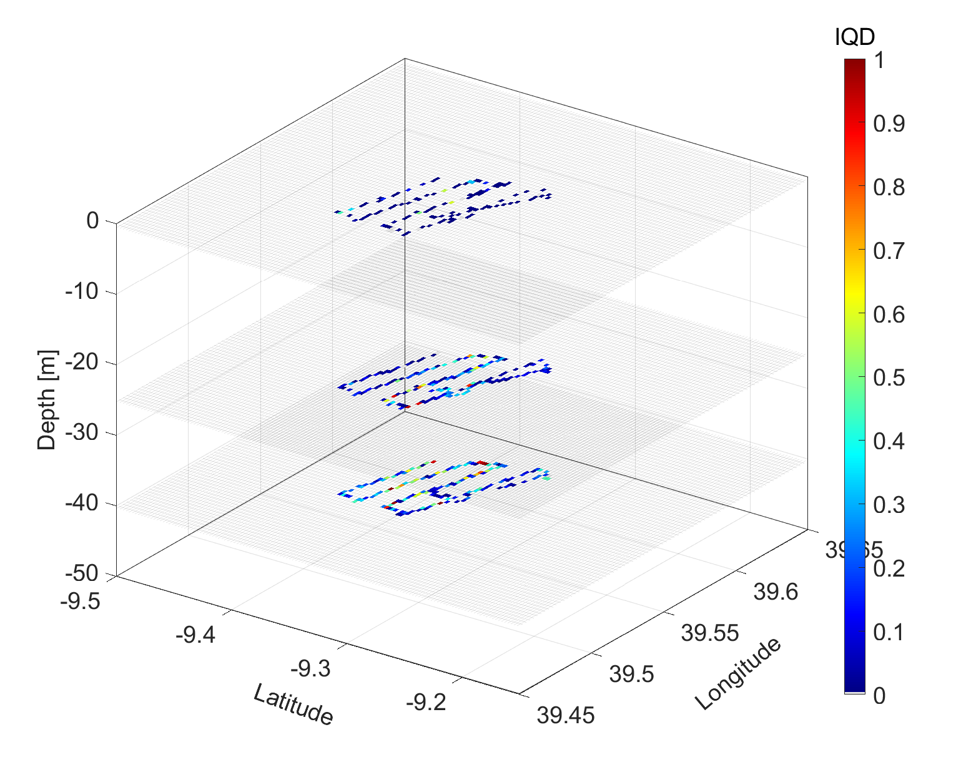
Fresnel
Subgrid variability of AUV temperature observations within the model grid.
The grid represents the maximum spatial resolution of the statistical model, while the interquartile range (IQR) quantifies variability within each grid cell. The results reveal the subgrid-scale variability: the range of physical fluctuations captured by the AUVs at scales finer than those resolved by the model.
Although the model provides a smoothed, grid-based estimate of ocean properties, AUV data expose significant variations within individual 3D cells, suggesting that dynamically relevant features may exist below the model’s effective resolution.
This variability, particularly strong around the thermocline, offers valuable insight into local uncertainty and underscores the importance of agile AUV sampling for resolving small-scale dynamics often missed by traditional ship-based CTD casts. Incorporating this information into data assimilation can improve the model’s representation of real ocean processes. While AUV sensors may have higher measurement uncertainty, they can provide a detailed view of sub-pixel variability, essential for understanding unresolved dynamics and evaluating model performance at the subgrid level.
In this specific case, higher IQR values are concentrated near the thermocline, reflecting enhanced variability where vertical gradients are strongest. Elevated variability could also appear near the surface, potentially indicating small-scale frontal zones with sharp horizontal temperature and salinity gradients.

