Slide 1
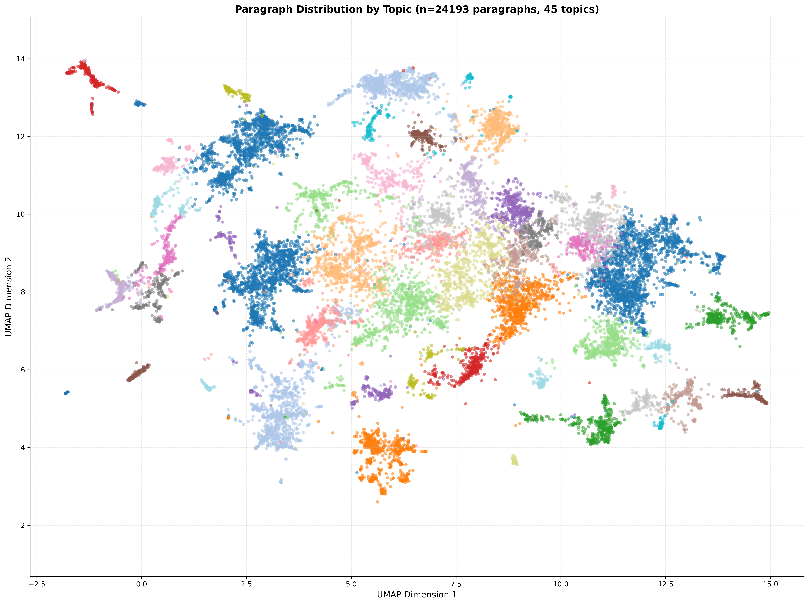
T35: Multi-Domain Operations
T21: Aviation & Unmanned Systems
T28: Mission Command
T6: Reserve and Readiness
T38, T39: Regionally Aligned Forces, Logistics and Sustainment

Slide 2
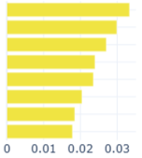
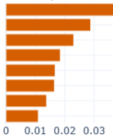
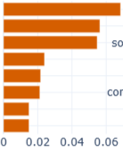
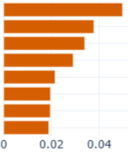
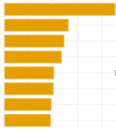
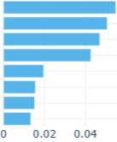
T6: Reserve and Readiness
T21: Aviation & Unmanned Sys.
T28: Mission Command
reserve
uas
mission command
train
aircraft
command
unit
aviation
mission
army
air
leader
readiness
unman
commander
force
drone
army
guard
capability
trust
mobilization
force
philosophy
T35: Multi-Domain Operations
T38: Regionally Aligned Forces
T39: Logistics and Sustainment
domain
raf
logistics
multi-domain
force
supply
multi
jtf
supply chain
joint
joint
chain
concept
command
maintenance
force
regionally
support
army
align
sustainment
mdo
headquarter
army

Slide 4
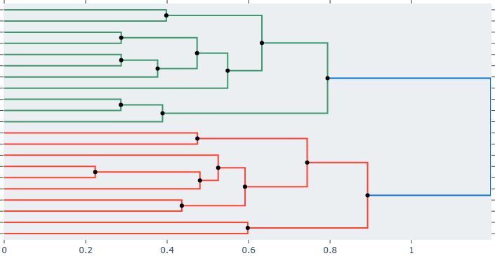
WT20: Equip. Maintenance & Deployment Support
WT19: Sustainment & Modernization Efforts
WT3: National Guard & Reserve Components
WT18: Reserve Support & Mobilization Duties
WT14: Operational Reserve Training & Mobilization
Operational Readiness and Reserve Mobilization
WT10: Army Reserve & Active Comp. Integration
WT6: Unit Training & Readiness Cycle
WT9: Mobilization Processes for Reserves
WT16: Annual Training Requirements for Reserves
WT12: Leadership Dev. & Combat Planning
WT13: Brigade Combat Team Readiness
WT17: Security Force Assistance Brigades
WT4: Regional Alignment & Funding Support
WT0: Command Philosophy & Leadership Doctrine
WT7: Multi-Domain Operations Concepts
Strategic Command,
Technology, &
Multi-Domain Warfare
WT11: Domain Warfare & Artillery Operations
WT1: Unmanned Aerial Systems & Aviation Tech.
WT2: Headquarters Operations & Integration
WT15:Artillery & Missile Capability Integration
WT5: Defense Logistics & Enterprise Management
WT8: Additive Manufacturing Technologies

Slide 5
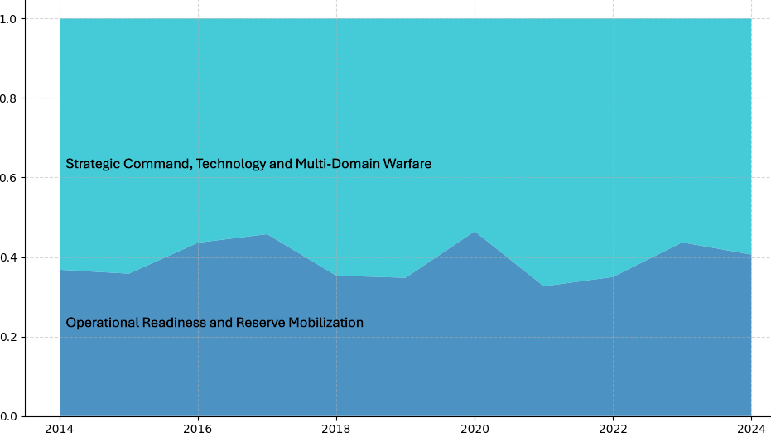
Proportion
Year

Slide 6
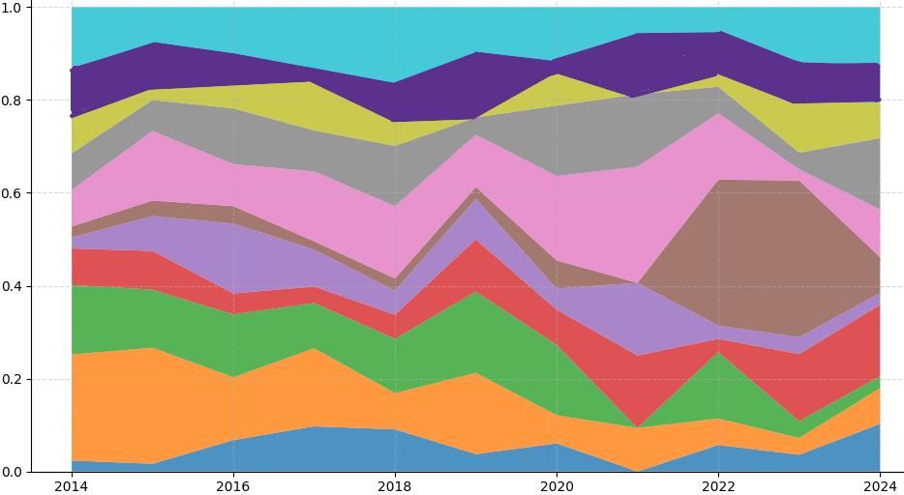
WT6: Unit Training & Readiness Cycle
WT19: Sustainment & Modernization Efforts
WT18: Reserve Support & Mobilization Duties
WT14: Operational Reserve Training & Mobilization
Proportion
WT3: National Guard & Reserve Components
WT9: Mobilization Processes for Reserves
WT12: Leadership Dev. & Combat Planning
WT20: Equip. Maintenance & Deployment Support
WT13: Brigade Combat Team Readiness
WT10: Army Reserve & Active Comp. Integration
WT16: Annual Training Requirements for Reserves
Year

Slide 7
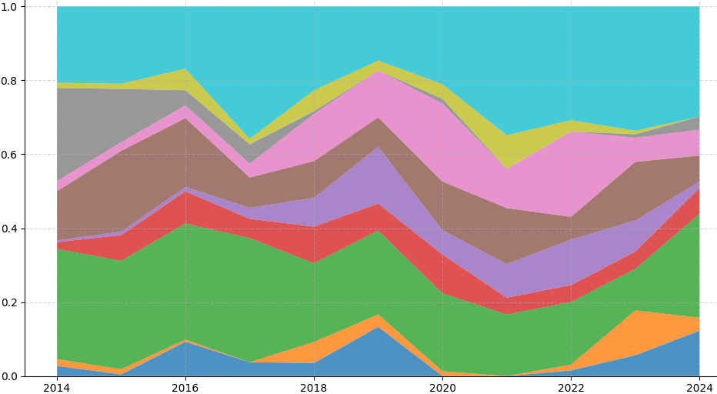
WT1: Unmanned Aerial Systems & Aviation Tech.
WT17: Security Force Assistance Brigades
WT4: Regional Alignment & Funding Support
WT7: Multi-Domain Operations Concepts
WT2: Headquarters Operations & Integration
Proportion
WT11: Domain Warfare & Artillery Operations
WT5: Defense Logistics & Enterprise Management
WT0: Command Philosophy & Leadership Doctrine
WT15:Artillery & Missile Capability Integration
WT8: Additive Manufacturing Technologies
Year

