Slide 1
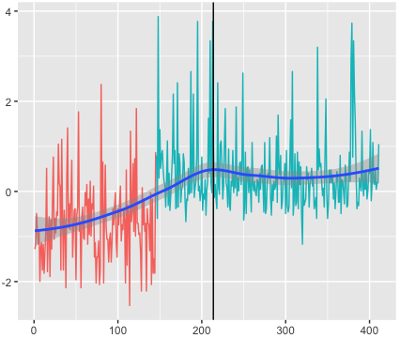
Red – Cluster 1 (L_{r} + G_{r})/2 values
Cyan – Gibbs cluster (L_{r} + G_{r})/2 values
Blue – MIM(r)
index (increasing survival time)

