Slide 1


Introduction to Database
Dr Simon Jones – simon.jones@nyumc.org
Thanks to Mariam Mohaideen

Slide 2
Today – database theory
  Key learning outcome - is to understand data normalization
Thursday, 19 November
  Introduction to SQL & MySQL practical
  Key learning outcome - write SQL queries
Tuesday, 24 November
  R and MySQL
  Key learning outcome – call SQL from R. Use SQLDF in R to manage large datasets

Slide 3
ACID Semantics
ACID is a set of requirement of database systems intended to guarantee validity even in the event of:
power failures,
Errors
etc..
Atomicity: All or nothing.
Consistency: Consistent state of data and transactions.
Isolation: Transactions are isolated from each other.
Durability: When the transaction is committed, state will be durable.
By giving up ACID properties, one can achieve higher performance and scalability.

Slide 4

Analysis and Modeling

Slide 5
Learning Objectives
Explain the role of conceptual data modeling in the overall analysis and design of an information system.

Slide 6
Conceptual Data Modeling
Conceptual data modeling: a detailed model that captures the overall structure of data in an organization
  Independent of any database management system (DBMS) or other implementation considerations
Notes:
Note the distinction between the conceptual data model and the actual implementation of the database (or even the database design). The conceptual model makes no assumptions about underlying technology. It’s only about the entities, attributes, and relationships that are to be captured.
A similar distinction can be made between the DFD diagrams from the previous chapter and final software design and implementation.

Slide 7
Deliverables and Outcome
Entity-relationship (E-R) diagram or UML class diagram
  Entities (or classes) – categories of data, represented as rectangles
  Relationships (or associations) – lines between the entities
Set of entries about data objects to be stored in repository project dictionary, or data modeling software
  Repository links data, process, and logic models of an information system.
  Data elements included in the data flow diagram (DFD) must appear in the data model and vice versa.
  Each data store in a process model must relate to business objects represented in the data model.

Slide 8
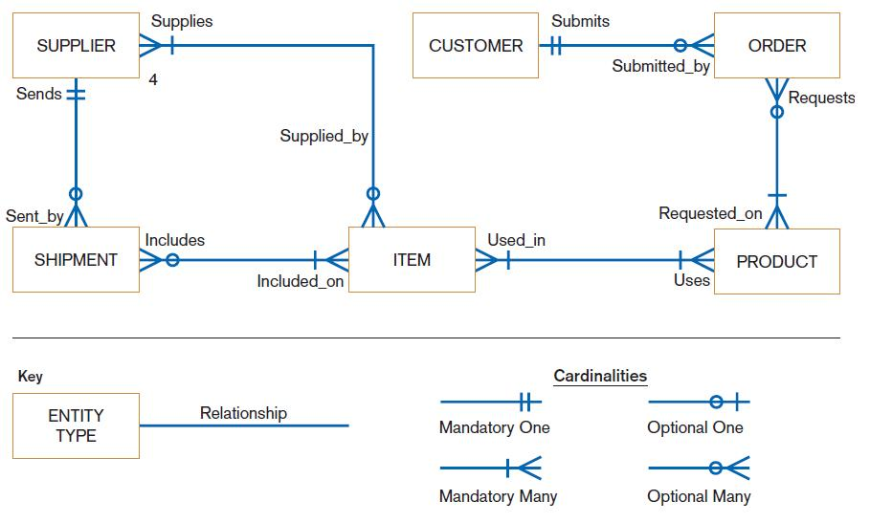
FIGURE 8-3
Sample conceptual data model
Notes:
This is an E-R diagram. The boxes represent entity types and the lines between boxes represent relationships between these entity types. Relationships can be one-to-one, one-to-many, or many-to-many.
For example, in this figure we see a one-to-many relationship between customers and orders. This means that a customer can have any number of orders, but that each order belongs to exactly one customer. On the other hand, there is a many-to-many relationship between orders and products. Each product may be included in many orders, and each order can have many products. These are called relationship cardinalities.
To add nuance to the relationship cardinalities, they can be either mandatory or optional. For example, in the relationship between products and orders, you see that a product may not be involved in any orders at all, but that an order must have at least one product.
We’ll go through several other diagrams and examples in this chapter, and define our terms in detail.

Slide 9
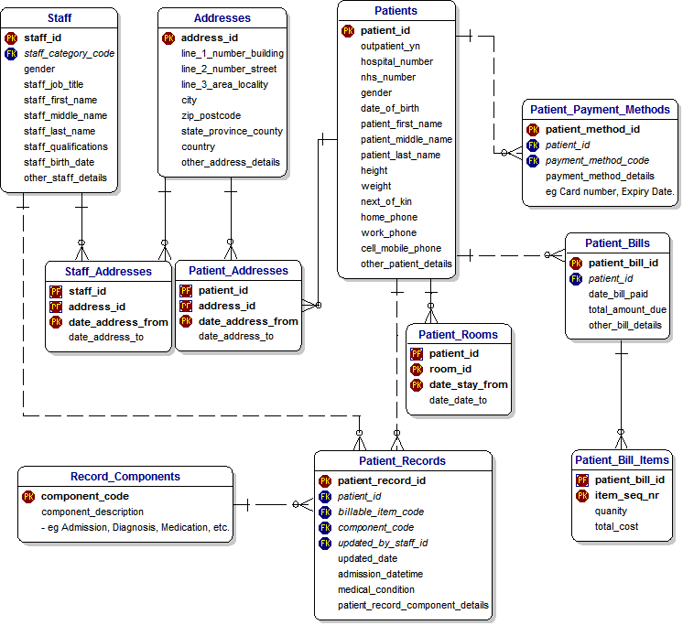
1-<number>

Slide 10
Introduction to Entity-Relationship (E-R) Modeling (cont’d)
Entity: a person, place, object, event or concept in the user environment about which data is to be maintained
Entity type: collection of entities that share common properties or characteristics
Entity instance: single occurrence of an entity type
Notes:
Note the distinction between an entity type and an entity instance. For example, if Employee is an entity type, then John Smith (a particular employee) would be an entity instance. When you see the word “entity” alone, it’s important to discern whether you are talking about an entity type or an entity instance. In the E-R diagrams we see, the boxes represent entity types.

Slide 11
Introduction to Entity-Relationship (E-R) Modeling
Entity-Relationship data model (E-R model): a detailed, logical representation of the entities, associations and data elements for an organization or business area
Entity-relationship diagram (E-R diagram): a graphical representation of an E-R model

Slide 12
Gathering Information for
Conceptual Data Modeling (Cont.)
Requirements Determination Questions for Data Modeling:
  What are subjects/objects of the business?
    Data entities and descriptions
  What unique characteristics distinguish between subjects/objects of the same type?
    Primary keys

Slide 13
Gathering Information for
Conceptual Data Modeling (Cont.)
  What characteristics describe each subject/object?
    Attributes and secondary keys
  How do you use the data?
    Security controls and user access privileges
    Who knows the meaning of the data?
  Over what period of time are you interested in the data?
    Cardinality and time dimensions

Slide 14
Gathering Information for
Conceptual Data Modeling (Cont.)
  Are all instances of each object the same?
    Supertypes, subtypes, and aggregations
  What events occur that imply associations between objects?
    Relationships and cardinalities
  Are there special circumstances that affect the way events are handled?
    Integrity rules, minimum and maximum cardinalities, time dimensions

Slide 15
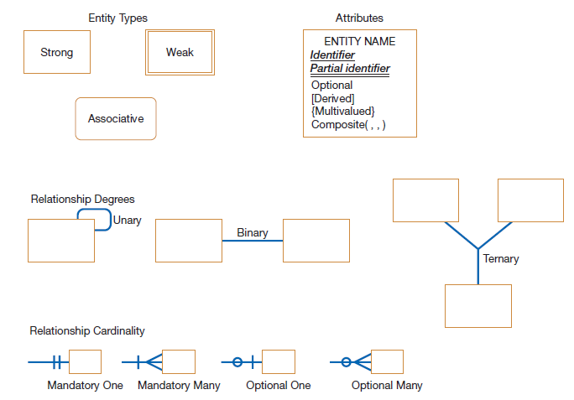
FIGURE 8-5 Basic E-R notation
Notes:
As you can see, there are different kinds of entity types. Entities can be strong, weak, or associative.
Also, in addition to cardinalities, relationships also have degrees, which indicate how many entities are involved in the relationship.
In this E-R notation, attributes are shown within the entity type rectangle. There are various types of attributes, including identifiers, derived, multivalued, and composite. An identifier uniquely identifies an entity instance; only one instance of the entity type can have a particular identifier value. Composite attributes can be decomposed; for example an address may include street number, street name, city, state, and zip code. Multivalued attributes are those that can contain many values. For example, maybe a person has more than one email address. Derived attributes are calculated, not stored in the database. For example, a person’s age is calculated based on birthdate and current date.
There are different notations for E-R diagrams, but this is a common one.
All of this will be explained more later.

Slide 16
Naming and Defining Entity Types
An entity type name should be:
  A singular noun.
  Descriptive and specific to the organization.
  Concise.
Event entity type should be named for the result of the event, not the activity or process of the event.
Notes:
An entity is a person, a place, an object, an event, or a concept in the user environment about which the organization wishes to maintain data.
Note: an entity should be about something that is being represented by the system.
An entity is NOT a user of the system, and an entity is not an output from the system. In other words, entities are not sources and sinks, nor are they reports or forms. simple rule to avoid such confusion is that a true data entity will have
many possible instances, each with a distinguishing characteristic, as well as one or more other descriptive pieces of data.

Slide 17
Naming and Defining Entity Types (Cont.)
An entity type definition:
  Includes a statement of what the unique characteristic(s) is (are) for each instance.
  Makes clear what entity instances are included and not included in the entity type.
  Often includes a description of when an instance of the entity type is created or deleted.

Slide 18
Attributes
Attribute: a named property or characteristic of an entity that is of interest to the organization
  Naming an attribute: i.e. Vehicle_ID
  Place its name inside the rectangle for the associated entity in the E-R diagram.
Notes:
Entities have attributes. For example, if the entity is a person, then attributes might include the person’s name, gender, age, etc. Additional attributes may include address, phone number, email address, etc.

Slide 19
Naming and Defining Attributes
An attribute name is a noun and should be unique.
To make an attribute name unique and for clarity, each attribute name should follow a standard format.
Similar attributes of different entity types should use similar but distinguishing names.

Slide 20
Naming and Defining Attributes (Cont.)
An attribute definition:
  States what the attribute is and possibly why it is important.
  Should make it clear what is included and what is not included.
  Contains any aliases or alternative names.
  States the source of values for the attribute.

Slide 21
Naming and Defining Attributes (Cont.)
An attribute definition should indicate:
  If a value for the attribute is required or optional.
  If a value for the attribute may change.
  Any relationships that attribute has with other attributes.
Notes:
Some attributes may be optional. For example, a person may or may not have a phone number.

Slide 22
Candidate Keys and Identifiers.
Candidate key: an attribute (or combination of attributes) that uniquely identifies each instance of an entity type
Identifier: a candidate key that has been selected as the unique, identifying characteristic for an entity type
Notes:
An identifier (or a candidate key) must is unique. So, for a person, his or her name doesn’t work as an identifier. But social security number, employee ID, credit card number are all candidate keys, and any one of these would work as an identifier.

Slide 23
Candidate Keys and Identifiers (Cont.)
Selection rules for an identifier
  Choose a candidate key that will not change its value.
  Choose a candidate key that will never be null.
  Avoid using intelligent keys.
  Consider substituting single value surrogate keys for large composite keys.
  Question: Is the vehicle number plate a good identifier for a car?
  Question: Is the New York State License Number a good identifier for a nurse?
Notes:
An example of an “intelligent identifier” is the first two digits of a key for a PART entity may indicate the warehouse location. Such codes are often modified as conditions change, which renders the primary key values invalid.

Slide 24
Relationships
Relationship: an association between the instances of one or more entity types that is of interest to the organization
Degree: the number of entity types that participate in a relationship
Notes:
One of the real strengths of the E-R model is that it depicts the relationships that exist between entities of various types.

Slide 25
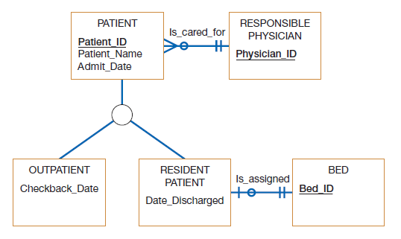
Figure 8-18
Supertype/subtype relationships in a hospital
Notes:
Here we see a supertype called Patient, with two subtypes called Outpatient and Resident Patient. All patients (including outpatients and resident patients) have a patient id, a patient name and an admit date. The subtypes inherit these attributes from the supertype. Also, All patients (including outpatients and residents) inherit the Is_cared_for relationship.
Outpatients include an additional attribute, the checkback date. No other types of patients have this. Similarly, resident patients have their own specialized discharge date and their own assigned beds; outpatients do not have these.

Slide 26
Representing Supertypes and Subtypes (Cont.)
Business Rules for Supertype/subtype Relationships:
  Total specialization specifies that each entity instance of the supertype must be a member of some subtype in the relationship.
  Partial specialization specifies that an entity instance of the supertype does not have to belong to any subtype, and may or may not be an instance of one of the subtypes.

Slide 27
Representing Supertypes and Subtypes (Cont.)
  Disjoint rule specifies that if an entity instance of the supertype is a member of one subtype, it cannot simultaneously be a member of any other subtype.
  Overlap rule specifies that an entity instance can simultaneously be a member of two (or more) subtypes.

Slide 28
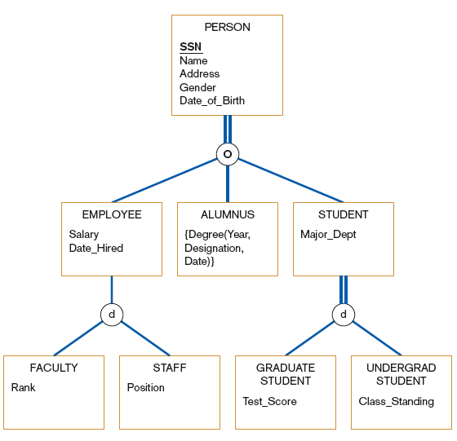
FIGURE 8-19
Example of supertype/subtype hierarchy
Notes:
Total specialization is represented by double lines. Single lines mean partial specialization.
Overlap is represented with “o” and disjoint is represented with “d”.
Question: can there be another type of person who is not an employee, alumnus, or student?
Answer: no, because of the total specialization.
Question: can a person be both an employee and a student?
Answer: yes, because of the overlap rule.
Question: can an employee be both faculty and staff?
Answer: no, only one of these, because of the disjoint rule.
Question: can an employee be something other than faculty or staff?
Answer: yes, because of partial specialization.
Question: what can you say about students?
Discussion here…

Slide 29
Associative Entities
Associative Entity: an entity type that associates the instances of one or more entity types and contains attributes that are peculiar to the relationship between those entity instances
  Sometimes called a gerund
The data modeler chooses to model the relationship as an entity type.
Notes:
An associative entity is kind of a combination of entity and relationship. Remember the “Supplies” relationship from figure 8-11? This could have been represented as an associative entity.

Slide 30
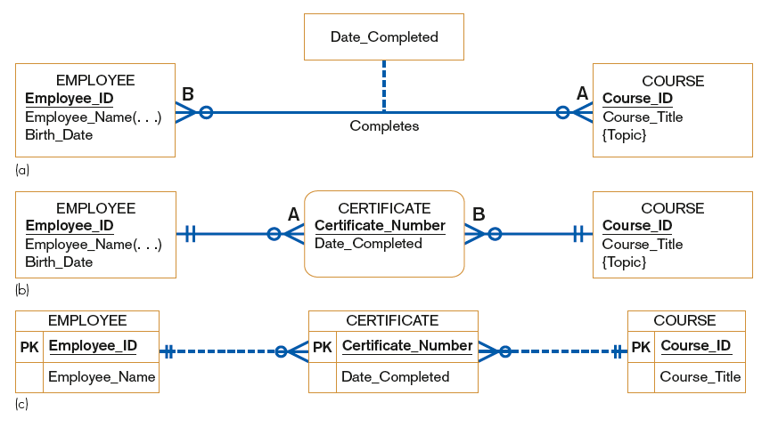
FIGURE 8-15 An associative entity
Attribute on a relationship
An associative entity (CERTIFICATE)
An associative entity using Microsoft Visio®
Notes:
In this figure, (a) shows a many-to-many relationship between employees and courses. This relationship has an attributes, the date completed.
By contrast, (b) shows an associative entity (note the curved corners) that links employees with courses. In (c) you see a Microsoft Visio version of this. As I said earlier, there are various notations for E-R diagrams, just like there are various notations for DFDs.

Slide 31
Summary of Conceptual Data Modeling with E-R Diagrams
The purpose of E-R diagramming is to capture the richest possible understanding of the meaning of the data necessary for an information system or organization.

Slide 32
Representing Supertypes and Subtypes
Subtype: a subgrouping of the entities in an entity type
  Is meaningful to the organization
  Shares common attributes or relationships distinct from other subgroupings
Supertype: a generic entity type that has a relationship with one or more subtypes
Notes:
After the original E-R model was created, it was enhanced into something often called EER (enhancer ER, or extended ER).
This allows for supertype/subtype representations, and we’ll look at some examples in the next few slides.

Slide 33
Fields
Field – the smallest unit of meaningful data to be stored in a database
  the physical implementation of a data attribute
Notes:
Chapter 14 – Database Design
No additional notes.

Slide 34
Fields (continued)
Primary key – a field that uniquely identifies a record.
Secondary key – a field that identifies a single record or a subset of related records.
Foreign key – a field that points to records in a different file.
Descriptive field – any nonkey field.
Notes:
Chapter 14 – Database Design
No additional notes.

Slide 35
Records
Record – a collection of fields arranged in a predetermined format.
  Fixed-length record structures
  Variable-length record structures
Blocking factor – the number of logical records included in a single read or write operation (from the computer’s perspective).
Notes:
Chapter 14 – Database Design
No additional notes

Slide 36
Files and Tables
File – the set of all occurrences of a given record structure.
Table – the relational database equivalent of a file.
Notes:
Chapter 14 – Database Design
No additional notes

Slide 37
Types of conventional files & tables
Master files – Records relatively permanent though values may change
Transaction files – Records describe business events
Document files – Historical data for review without overhead of regenerating document
Archival files – Master and transaction records that have been deleted
Table lookup files – Relatively static data that can be shared to maintain consistency
Audit files – Special records of updates to other files
Notes:
Chapter 14 – Database Design
No additional notes.

Slide 38
Data Architecture
Data architecture – a definition of how:
  Files and databases are to be developed and used to store data
  The file and/or database technology to be used
  The administrative structure set up to manage the data resource
Notes:
Chapter 14 – Database Design
No additional notes

Slide 39
Data Architecture (continued)
Data is stored in some combination of:
  Conventional files
  Operational databases – databases that support day-to-day operations and transactions for an information system. Also called transactional databases.
  Data warehouses – databases that store data extracted from operational databases.
    To support data mining
  Personal databases
  Work group databases
Notes:
Chapter 14 – Database Design
No additional notes

Slide 40
From Logical Data Model …
Notes:
Chapter 14 – Database Design
No additional notes

Slide 41
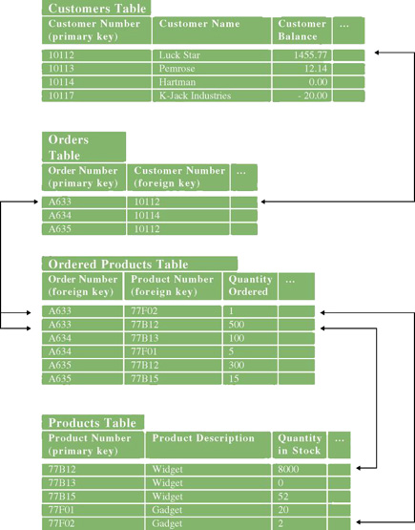
… To Physical Data Model (Relational Schema)
Notes:
Chapter 14 – Database Design
Teaching Notes
This is the physical relational database schema for the previous slide.

Slide 42
What is a Good Data Model?
A good data model is simple
  The data attributes that describe an entity should describe only that entity
A good data model is essentially nonredundant
  Each data attribute exists in at most one entity (except for foreign keys)
A good data model should be flexible and adaptable to future needs
These goals are achieved through database normalization.
Notes:
Chapter 14 – Database Design
No additional notes

Slide 43
Goals of Database Design
A database should provide for efficient storage, update, and retrieval of data.
A database should be reliable—the stored data should have high integrity and promote user trust in that data.
A database should be adaptable and scalable to new and unforeseen requirements and applications.
A database should support the business requirements of the information system.
Notes:
Chapter 14 – Database Design
No additional notes

Slide 44
Database Schema
Database schema – a model or blueprint representing the technical implementation of the database.
  Also called a physical data model
Notes:
Chapter 14 – Database Design
No additional notes

Slide 45
Primary Key Attribute (PK)
Can be a single attribute or composite attribute.
Can be called identifier.
Weak entity may have no key.
Has the following criteria:
    Should not change its value
    Not null
    Avoid intelligent keys.
    Substitute large composite keys with surrogate keys (system generated keys for unique numbers).

Slide 46
Why Database Normalization?
Eliminate redundancy
Organize data efficiently
Reduce the potential for data anomalies.

Slide 47
Data Anomalies
inconsistencies in the data stored in a database as a result of an operation such as
  update,
  insertion
  deletion.
Inconsistencies may arise when a record is stored in multiple locations and not all of the copies are updated.
Normalization help reduce Data Anomalies

Slide 48

1st Normal Form
The values in each column of a table are atomic (No multi-value attributes allowed).
There are no repeating groups: two columns do not store similar information in the same table.
(Each table has a primary key: minimal set of attributes which can uniquely identify a record)

Slide 49
1st Normal Form Example
Un-normalized Students table:
1st Normal From Students table :
Student# | TutorID | TutorName | TutorRoom | ClassList
123 | 123A | James | 555 | 102-8, 104-9
124 | 123B | Smith | 467 | 209-0, 102-8
Student# | TutorID | TutorName | TutorRoom | Class
123 | 123A | James | 555 | 102-8
123 | 123A | James | 555 | 104-9
124 | 123B | Smith | 467 | 209-0
124 | 123B | Smith | 467 | 102-8

Slide 50
Functional Dependence
Student# | TutorID | TutorName | TutorRoom | ClassList
123 | 123A | James | 555 | 102-8, 104-9
124 | 123B | Smith | 467 | 209-0, 102-8

Slide 51
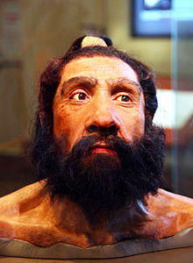
2nd Normal Form (Simplified)
All requirements for 1st NF must be met.
Redundant data across multiple rows of a table must be moved to a separate table.
  The resulting tables must be related to each other by use of foreign key.
  In 1NF AND every non-prime attribute of the relation is dependent on the whole of every candidate key.

Slide 52
2nd Normal Form Example
Students table
Registration table
StudentID | TutorID | TutorName | TutorRoom
123 | 123A | James | 555
124 | 123B | Smith | 467
StudentID | ClassID
123 | 102-8
123 | 104-9
124 | 209-0
124 | 102-8

Slide 53

3rd Normal From (Simplified)
All requirements for 2nd NF must be met.
Eliminate fields that do not depend on the primary key;
  i.e. any field that is dependent not only on the primary key but also on another field must be moved to another table.

Slide 54
3rd Normal Form Example
Students table:
Registration table: Tutor table:
StudentID | TutorID
123 | 123A
124 | 123B
StudentID | ClassID
123 | 102-8
123 | 104-9
124 | 209-0
124 | 102-8
TutorID | TutorName | TutorRoom
123A | James | 555
123B | Smith | 467

Slide 55
What’s Missing?
Tutor
TutorID
TutorName
TutorRoom
Student
StudentID
TutorID
Registration
StudentID
ClassID

Slide 56
Exercise – Put this table in 3rd Normal Form
Student
StudentID
AddressLine1
AddressLine2
City
State
Zip Code
MobilePhone
SponsorName
SponsorContact
SponsorPhoneNumber
US / Non-US Student

Slide 57
Exercise – Put this table in 3rd Normal Form
Patient ID
Patient First Name
Patient Last Name
Patient Address
Admission Date
Discharge Date
Attending Physician
Attending Physician Office Number
Attending Physician Phone
Drug Prescribed
Drug Prescribed By
Date Drug Prescribed
Drug Dosage

Slide 58
Exercise – Put this table in 3rd Normal Form
Customer ID (primary key)
Customer Name
Customer Type
Contact Name 1
Contact Name Role 1
Contact Name 2
Contact Name Role 2
Order Date
Order Item 1
Order Item 2
Delivery Date
Person Who Singed for Delivery
Person Who Singed for Delivery Role
Address 1
Address 2
City
State
Zip Code
Country

Slide 59
Database Distribution and Replication
Data distribution analysis establishes which business locations need access to which logical data entities and attributes.
14-<number>
Notes:
Chapter 14 – Database Design
No additional notes

Slide 60
Database Distribution and Replication (continued)
Centralization
  Entire database on a single server in one physical location
Horizontal distribution (also called partitioning)
  Tables or row assigned to different database servers/locations.
  Efficient access and security
  Cannot always be easily recombined for management analysis
Vertical distribution (also called partitioning)
  Specific table columns assigned to specific databases/servers
  Similar advantages and disadvantages of Horizontal
Replication
  Data duplicated in multiple locations
  DBMS coordinates updates and synchronization
  Performance and accessibility advantages
  Increases complexity
14-<number>
Notes:
Chapter 14 – Database Design
No additional notes.

Slide 61
Database Capacity Planning
For each table sum the field sizes. This is the record size.
For each table, multiply the record size times the number of entity instances to be included in the table (planning for growth). This is the table size.
Sum the table sizes. This is the database size.
Optionally, add a slack capacity buffer (e.g. 10 percent) to account for unanticipated factors. This is the anticipated database capacity.
Notes:
Chapter 14 – Database Design
No additional notes.

Slide 62
Further Reading
Hoffer JA, George JF, Valacich JS (2014) Modern Systems Analysis and Design, 7th Edition, Pearson
1-<number>

