Slide 1


Spatial Image Analysis & Modeling of Multiplexed Immunofluorescence Images
Kasthuri Kannan, PhD
Associate Professor
Translational Molecular Pathology
UT MD Anderson Cancer Center

Slide 2
Contents
Thoughts on existing infrastructure. Why spatial image analysis? (1)
Introduction to spatial image analysis (2)
Exploratory data analysis and dependency estimation (7)
K/L, pair-correlation, G-, F-, J- functions
Dependency estimation using multi-type functions
Interactions between phenotypes/model fitting (2)
Relative risk estimation between phenotypes (2)
Automated report generation for projects
Sample report - TNBC project
Consulting and research opportunities (1)
Insights from TNBC mIF spatial analysis

Slide 3
Automated Report Generation
Overall spatial statistics
Phenotype specific statistics
Dependencies between phenotypes
Interaction between phenotypes
Relative risk estimation

Slide 4
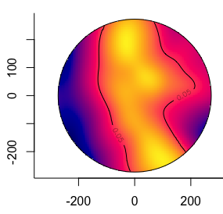
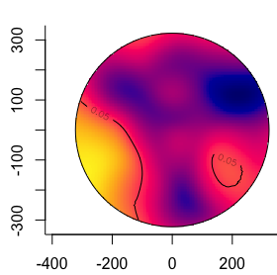


Slide 5
