Slide 1
Server Log Data Extraction

Slide 2
Project Objectives
Read the log file and extract the email addresses, date associated with each email address.
Transform the extracted data into a desired format as given below,
Suitable format for database insertion.
Format the date into a standard format (e.g., YYYY-MM-DD HH:MM:SS).
Load the transformed data into a MongoDB collection named user_history.
Fetch the data from MongoDB collection and insert it into relational database.
Table name – user_history.
Include primary key constraints and any other relevant constraints
Technology Used – Python, MongoDB, MySQL
Tools Used – VS Code, Git

Slide 3
Source Code Review

Slide 4
Queries to analyse the data
List all unique email addresses.
Count the number of emails received per day.
Find the first and last email date for each email address.
Count the total number of emails from each domain (e.g., gmail.com, yahoo.com).

Slide 5
10 SQL Questions
Types of SQL commands (or SQL subsets)
DDL: CREATE, ALTER TABLE, DROP, TRUNCATE, and ADD COLUMN
DML: UPDATE, DELETE, and INSERT
DCL: GRANT and REVOKE
TCL: COMMIT, SET TRANSACTION, ROLLBACK, and SAVEPOINT
DQL: – SELECT
SQL constraints
DEFAULT – provides a default value for a column.
UNIQUE – allows only unique values.
NOT NULL – allows only non-null values.
PRIMARY KEY – allows only unique and strictly non-null values (NOT NULL and UNIQUE).
FOREIGN KEY – provides shared keys between two or more tables.

Slide 6
What is a primary key?
The PRIMARY KEY constraint uniquely identifies each record in a table.
Primary keys must contain UNIQUE values, and cannot contain NULL values.
A table can have only ONE primary key; and in the table, this primary key can consist of single or multiple columns (fields).
What is UNIQUE Constraint?
The SQL UNIQUE constraint ensures that all values in a column or a set of columns are different from one another
It can be applied to one or more columns in a table
The UNIQUE constraint allows NULL values
Types of joins?
(INNER) JOIN – returns only those records that satisfy a defined join condition in both (or all) tables. It's a default SQL join.
LEFT (OUTER) JOIN – returns all records from the left table and those records from the right table that satisfy a defined join condition.
RIGHT (OUTER) JOIN – returns all records from the right table and those records from the left table that satisfy a defined join condition.
FULL (OUTER) JOIN – returns all records from both (or all) tables. It can be considered as a combination of left and right joins.

Slide 7
Types of SQL operators
Arithmetic (+, -, *, /, etc.)
Comparison (>, <, =, >=, etc.)
Compound (+=, -=, *=, /=, etc.)
Logical (AND, OR, NOT, BETWEEN, etc.)
String (%, _, +, ^, etc.)
Set (UNION, UNION ALL, INTERSECT, and MINUS (or EXCEPT))
How to sort records in a table?
Using the ORDER BY statement
Types of SQL functions
Aggregate functions - Work on multiple, usually grouped records for the provided columns of a table, and return a single value (usually by group), Example: AVG(), SUM(), MIN(), MAX(), COUNT() etc..
Scalar functions - Work on each individual value and return a single value, Example: LEN(), UCASE(), LCASE() etc..

Slide 8
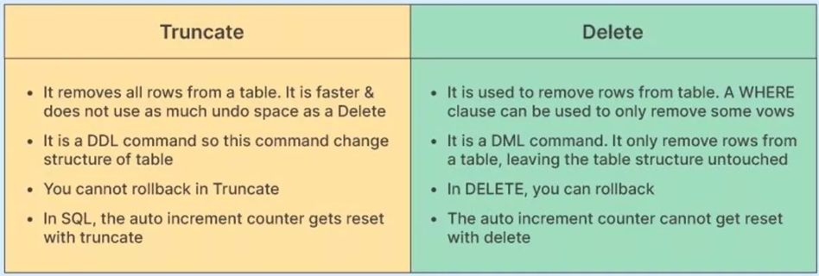
What is a stored procedure, and how is it different from a function?
A stored procedure is a precompiled set of SQL statements that can be executed as a single unit to perform a specific task. Unlike functions, stored procedures can return multiple result sets and modify database objects, while functions typically return a single value and cannot modify data.
Difference between the DELETE and TRUNCATE statements

Slide 9
Any Queries?

Slide 10
Thank you ☺

