Slide 1
PS-1 Seminar
UST Global - Machine Learning
Akash S Revankar (2019A7PS0294P)
Aman Gupta (2019A7PS0052G)
Taresh Batra (2019A3PS0388G)
Abhijith M B (2019B5A70688P)
Faculty Incharge - Tanmay Tulsidas Verlekar
PS Station Mentor - Hanish Sargiya

Slide 2

AUTOMATIC MINUTES-OF-MEET GENERATOR
ASR + Summarization
We created a pipeline, where the audio recording is fed to the application, a transcript is generated and then using it, a summary is returned as the output.

Slide 3
Web Application Video Demo

Slide 4
Speech Recognition in Minutes-of-Meet
Automatic Speech Recognition
DeepSpeech
Fine-tuning to the Indian accent

Slide 5
Automatic Speech Recognition
ASR (Automatic Speech Recognition) takes any continuous audio speech and output the equivalent text .
Models in speech recognition can conceptually be divided into:
Acoustic model: Turn sound signals into some kind of phonetic representation.
Language model: houses domain knowledge of words, grammar, and sentence structure for the language.

Slide 6
Automatic Speech Recognition
Traditional ASR - MFCC, HMM’s, Language Model
State-of-the-Art ASR - Deeper Neural Networks involving RNN’s and Connectionist Temporal Classification (CTC) layers.

Slide 7
Feature Extraction with MFCC
Reducing an audio signal to essential speech component features using Mel Frequency Analysis and Cepstral Analysis.
Mel Frequency Analysis
Filtering out sound that we can’t hear.
Cepstral Analysis
Separating the elements of sound that are speaker-independent.
Human voice production model as a combination of source and filter.

Slide 8
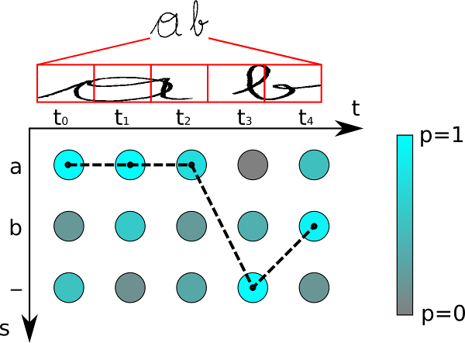
CTC (Connectionist Temporal Classification)
Variation in the length of Phonemes.
A special type of encoding is used to handle the problem of repeating characters. Eg.
“to” → “---ttttttooo”, or “-t-o-”, or “to”
“too” → “---ttttto-o”, or “-t-o-o-”, or “to-o”, but not “too”
Best Path : aaa-b
Encoding : a-b
Ground Truth : ab

Slide 9
DeepSpeech
An open-source Speech-To-Text engine, based on Baidu's Deep Speech research paper.
Uses Google's TensorFlow to make the implementation easier.
Why DeepSpeech?
Extensive documentation.
Trained on the extensive large scale multilingual corpus Common Voice (CoVoST) dataset.
Uses MFCC features and CTC loss function.

Slide 10
Fine-tuning to the Indian Accent
Biased nature of open-source pre-trained models.
CoVoST - US : 24%, UK : 8%, India & South Asia : 5%
Variation in accents across various states within India.
Acquiring the dataset
Generic conversation datasets.
IIT M Speech Lab.
Achieved a word accuracy of approximately 80% on the Indian Accent Speech Data (Test Set) compared to the 56.2% word accuracy of the DeepSpeech pre-trained Model.

Slide 11
Text Summarization in Minutes-of-Meet
Abstractive Text Summarization
Models (PEGASUS & BART)
Training the Model

Slide 12
Build an intermediate semantic representation of the document
2
1
3
4
ABSTRACTIVE TEXT SUMMARIZATION
summary is synthesized from the intermediate semantic representation
summary may not be having original content
summary may use paraphrasing techniques
Challenging problem to generate grammatically and semantically correct summaries.

Slide 13

TRANSFORMERS
Parallelization
Reduce training time and improve efficiency
ATTENTION
Uses ‘attention’ to boost speed of model training
Semi-supervised learning
Unsupervised pre-training and supervised fine-tuning

Slide 14

PEGASUS AND BART
PEGASUS
Masking sentences instead of words
Gap Sentence Generation
568M trainable parameters.
ROUGE-1 (unigram overlap) - 26.7; ROUGE-2 (bigram overlap) - 8.9
Bi-directional encoder and Autoregressive Decoder
Multiple text corruption techniques used in pre-training.
340M trainable parameters.
BART
ROUGE-1 (unigram overlap) - 42.6; ROUGE-2 (bigram overlap) - 22.9

Slide 15

PEGASUS: Pre-training with Extracted Gap-sentences for Abstractive Summarization
Masking sentences instead of words
Gap Sentence Generation
568M trainable parameters.
ROUGE-1 (unigram overlap) - 26.7; ROUGE-2 (bigram overlap) - 8.9

Slide 16
BART: Bidirectional Auto-Regressive Transformer
Bi-directional encoder and Autoregressive Decoder
Multiple text corruption techniques used in pre-training.
340M trainable parameters.
ROUGE-1 (unigram overlap) - 42.6; ROUGE-2 (bigram overlap) - 22.9

Slide 17

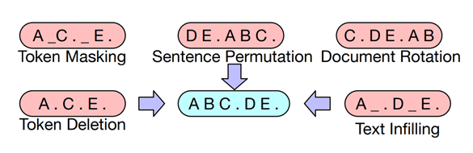

Slide 18
TRAINING THE MODEL
OVERVIEW
CNN/SAMSum
FINE-TUNING
BART Large model pre-trained on CNN and fine-tuned on SAMSum
Sequence Generation Tasks
CNN: news articles and highlight sentences
SAMSum: about 16k messenger-like conversations with summaries

Slide 19
Pipeline Google Colab
Getting input & Audio Preprocessing
Generating & Storing Transcript
Generating Text Summary from Transcript

Slide 20
Thank You

