Slide 1
Jenkins
Continuous Integration with Jenkins

Slide 2
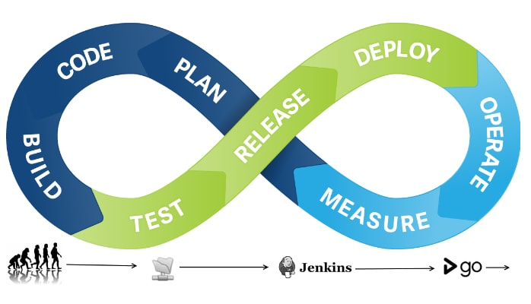
What is CI?
According to Martin Fowler,
Continuous Integration is a software development practice where members of a team integrate their work frequently, usually each person integrates at least daily - leading to multiple integrations per day. Each integration is verified by an automated build (including test) to detect integration errors as quickly as possible.
Source: https://martinfowler.com/articles/continuousIntegration.html
Continuous Delivery (CD) and Continuous Integration (CI) terms have gained momentum with growth of Agile movement. Regardless of the platform we are working on Jenkins, an open source server application, handles build or continuous integration.

Slide 3
What does Jenkins do?

