Slide 1
Angular
Version13 @2021

Slide 2
Main Objective
Learn how to build the Angular app with
Routing,
Observables.

Slide 3
Module Introduction
The Angular Router enables navigation from one view to the next as users perform application tasks.

Slide 4
Why we need a Router?
Enter a URL in the address bar and the browser navigates to a corresponding page.
Click links on the page and the browser navigates to a new page.
Click the browser's back and forward buttons and the browser navigates backward and forward through the history of pages you've seen.

Slide 5
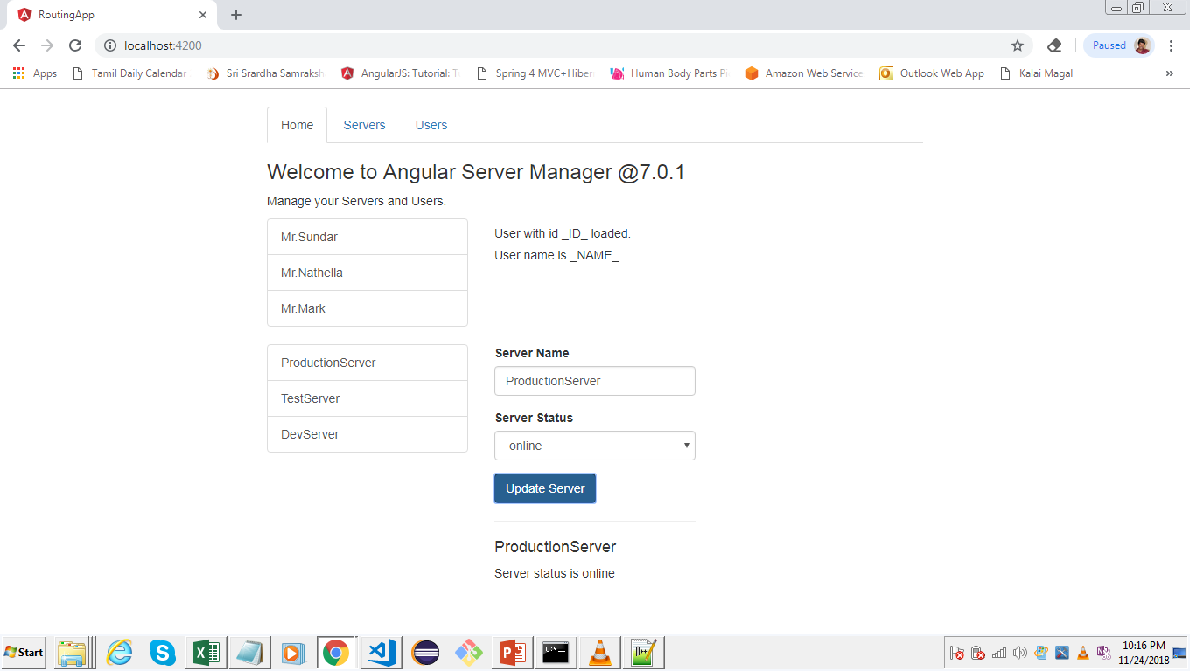

Slide 6
Understanding the Example Project
localhost:4200
localhost:4200/home
localhost:4200/server
localhost:4200/user
localhost:4200/user/user-details

Slide 7
Setting Up and Loading Routes
import { Routes, RouterModule } from '@angular/router’;
const routes: Routes = [];
@NgModule({
imports: [RouterModule.forRoot(routes)],
exports: [RouterModule]
})
export class AppRoutingModule { }

Slide 8
Navigating with RouterLinks
<router-outlet></router-outlet>
<!-- Routed components go here -->
<a routerLink="/">Home</a>
<a routerLink="/users">Home</a>
<a routerLink="/">Home</a>

Slide 9
Understanding the Navigation Paths
The RouterLink directives on the anchor tags give the router control over those elements.
The navigation paths are fixed, so you can assign a string to the routerLink (a "one-time" binding).
Had the navigation path been more dynamic, you could have bound to a template expression that returned an array of route link parameters (the link parameters array).
The router resolves that array into a complete URL.

Slide 10
Styling Active RouterLinks
<li role="presentation"
routerLinkActive="active"
[routerLinkActiveOptions]="{exact: true}“>

Slide 11
Navigating Programmatically
import { Router } from '@angular/router’;
…
constructor(private router: Router) { }
…
onLoadServers() {
this.router.navigate(['/servers']);
}
…

Slide 12
Using Relative Paths in Programmatic Navigation
<button class="btn btn-primary" (click)="onReload()">Reload Page</button>
…..
import { Router, ActivatedRoute } from '@angular/router’;
…..
constructor(private service: ServersService,
private router: Router,
private route: ActivatedRoute) { }
…..
onReload() {
this.router.navigate(['/users'], {relativeTo: this.route});
}

Slide 13
Passing Parameters to Routes
const routes: Routes = [
{path: '', component: HomeComponent}, // localhost:4200
{path: 'users', component: UsersComponent}, // localhost:4200/users
{path: 'users/:id', component: UserComponent}, // users/1
{path: 'servers', component: ServersComponent}
];

Slide 14
Fetching Route Parameters
import { ActivatedRoute } from '@angular/router';
user: {id: number, name: string};
constructor(private route: ActivatedRoute) { }
ngOnInit() {
this.user = {
id: this.route.snapshot.params['id’],
name: this.route.snapshot.params['name’]
};
}

Slide 15
Fetching Route Parameters Reactively
…...
……
this.route.params.subscribe(
(params: Params) => {
this.user.id = params['id’];
this.user.name = params['name’];
}
);

Slide 16
An Important Note about Route Observables
import { Subscription } from 'rxjs’;
paramSubscription: Subscription;
…
this.paramSubscription = this.route.params.subscribe(
(params: Params) => {
this.user.id = params['id’];
this.user.name = params['name'];
});
…
ngOnDestroy() {
this.paramSubscription.unsubscribe();
}

Slide 17
Passing Query Parameters and Fragments
{path: 'servers/:id/edit', component: EditServerComponent}
<a href="#“
[routerLink]="['/servers',5,'edit’]”
[queryParams]="{allowEdit: '1’}”
fragment="loading"
class="list-group-item"
*ngFor="let server of servers">
{{server.name}}
</a>
onLoadServers(id: number) {
this.router.navigate(['/servers', id, 'edit'], {queryParams: {allowEdit: '1'}, fragment: 'loading'});
}

Slide 18
Retrieving Query Parameters and Fragments

Slide 19
Practicing and some Common Gotchas

Slide 20
Setting up Child (Nested) Routes
const routes: Routes = [
{path: '', component: HomeComponent}, // localhost:4200
{path: 'users', component: UsersComponent, children: [
{path: ':id/:name', component: UserComponent},
]},
{path: 'servers', component: ServersComponent, children: [
{path: ':id', component: ServerComponent},
{path: ':id/edit', component: EditServerComponent}
]}
];

Slide 21
Using Query Parameters - Practice

Slide 22
Configuring the Handling of Query Parameters

Slide 23
Redirecting and Wildcard Routes

Slide 24
Important: Redirection Path Matching

Slide 25
Outsourcing the Route Configuration

Slide 26
An Introduction to Guards

Slide 27
Protecting Routes with canActivate

Slide 28
Protecting Child (Nested) Routes with canActivateChild

Slide 29
Using a Fake Auth Service

Slide 30
Controlling Navigation with canDeactivate

Slide 31
Passing Static Data to a Route

Slide 32
Resolving Dynamic Data with the resolve Guard

Slide 33
Understanding Location Strategies

Slide 34
Break

Slide 35
Observables

Slide 36
Observables
Angular makes use of observables as an interface to handle a variety of common asynchronous operations.
Can define custom events that send observable output data from a child to a parent component.
The HTTP module uses observables to handle AJAX requests and response.
The Router and Forms modules use Observables to listen for and respond to user-input events.

Slide 37
Module Introduction
What is Observable ?
Observable – rxjs library
Various Data Sources
(User Input) Events, Http Requests, Triggered in Code, …
Data
Data
stream
Data
You write the Code which gets executed!
Handle Data
Handle Error
Handle Completion
Observer

Slide 38
Observables-start-up

Slide 39
Angular 6 & RxJS 6
Observable
Subscription
Subjects

Slide 40
Analyzing a Built-in Angular Observable
Observables provide support for passing messages between publishers and subscribers in your application.
Observables offer significant benefits over other techniques for event handling, asynchronous programming, and handling multiple values.

Slide 41
Building & Using a First Simple Observable
import { Observer, Observable, Subscription, interval } from 'rxjs’;
const myNumbers = interval(1000)
.pipe(map(
(data: number) => {
return data * 2;
}
));
this.numbersObsSubscription = myNumbers.subscribe(
(num: number) => {
console.log(num);
}
);

Slide 42
Building & Using a Custom Observable from Scratch
const myObservable = Observable.create(
(observer: Observer<string>) => {
observer.next(1);
observer.next(2);
observer.next(3);
setTimeout(() => {
observer.next(4);
observer.complete();
}, 1000);
});
this.customObsSubscription = myObservable.subscribe(
(data: string) => { console.log(data); },
(error: string) => { console.log(error); },
() => { console.log('completed'); },
);

Slide 43
Unsubscribe!
import { Subscription } from 'rxjs';
numbersObsSubscription: Subscription;
customObsSubscription: Subscription;
…..
…..
ngOnDestroy() {
this.numbersObsSubscription.unsubscribe();
this.customObsSubscription.unsubscribe();
}

Slide 44
Operator
What is Subscription using operator
Observable
Various Data Sources
(User Input) Events, Http Requests, Triggered in Code, …
Data
Data
stream
Data
Operators
Subscription
Observer

Slide 45
Where to learn more
http://reactivex.io/rxjs

Slide 46
Using Subjects to Pass AND Listen to Data

Slide 47
Understanding Observable Operators

Slide 48
RxJS 6 without rxjs-compat

Slide 49
observables-final-without-rxjs-compat

Slide 50
Wrap Up

Slide 51
Thank you

