Slide 1
JAVA @11
Introduction to OOPs

Slide 2
Objective
After completing this session you will be able to understand,
Introduction to OOPs
OOPs concept – Encapsulation
OOPs concept – Inheritance
OOPs concept - Polymorphism

Slide 3
What is a Procedural Language
Procedural programming language helps the programmers to develop applications as series of instructions to achieve the desired functionality.
Disadvantages:
Not easy to maintain for larger applications.
Not Flexible for changes.
Complex to reuse a common programming logic.
Programmers find it complex to understand the program and fix bugs.

Slide 4
What is OOPs?
The disadvantages of procedural language gave birth to Object Oriented Programming Language (OOPs)
Programmers develop application by breaking them into small objects.
Advantages:
The code is easy to maintain as the objects are self contained, cohesive units developed for specific functionalities.
The objects can be reused to perform similar logics.
The system is flexible to change.

Slide 5




What is Noun?
Definition: As a simple definition, a noun is any word that describes a person, place, or thing.
Example: The Man read a Book.
Noun

Slide 6
What is a Adjective?
Definition: Adjectives are describing words.
Example: The Man read a Java Book.
Shape
Color
Adjective
Size
characteristics

Slide 7
What is a verb
Definition: A verb is a word used primarily to indicate a type of action.
Example: The Man read a Java Book.
Talk
Sat
Verb
Run
Drink

Slide 8
Analog to Software world
Nouns in real world translates into objects in software paradigm.
Translates
Objects
Noun

Slide 9
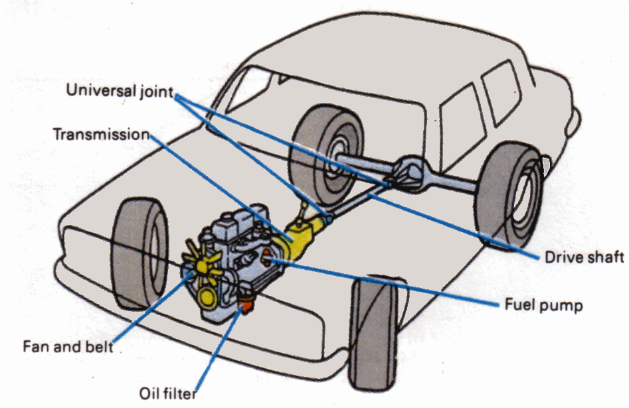
Real world Object System
In real world all the entities are made of smaller objects, for example, a car is manufactured by assembling smaller objects like
Engine
Tyres
Fan
Steering Wheel

Slide 10
Characteristics of Object
Objects has two characteristics,
State – State of the object.
Behavior – Behavior of the object, it changes the state of the object.
Translate into
Adjective
State
Translate into
Verb
Method

Slide 11
Characteristics of Objects Explained with an example
Taking the car example,
State – The speed of the car, fuel indicator which represents the state of the car.
Behavior - Operations such as accelerate the speed, start/stop the car and apply brake are behaviors of the car.
The behavior “accelerate the speed” changes the car’s state “speed”.

Slide 12
Software System
Software system are collection software objects which interoperate to achieve a desired functionality.
What is a Software Object?
Software objects are conceptually similar to real-world objects, they too consist of state and related behavior.

Slide 13
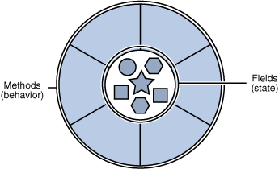
Software Object
Software objects have the same characteristics,
State - Stored in fields.
Behavior – Exposed through methods. Methods changes the state of the objects.

Slide 14
A software example
Lets take a net banking application where user can,
Check account status.
Check account balance.
Transfer amount.
The system will be represented with a “Account” object.
Account Objects Characteristics:
Methods (Behaviors) | Fields (States)
Check Account Status | Account Status
Transfer Amount Check Account Balance | Account Balance

Slide 15


What is Class?
What Is a Class?
A class is the blueprint from which individual objects are created.
Class defines the states and behavior of an object.
The mold here refers to the “Class”, the bottles created out of the mold are “Objects”
Bottles created
From Mould
Bottle Mould
Bottles

Slide 16


Time To Reflect
Trainees to reflect the following topics before proceeding.
What is OOPs?
What are Classes?
What are Objects?
What are the characteristics of objects? Explain with the Car example?

Slide 17
OOPS Concepts
The following are the OOPS concepts,
Encapsulation
Inheritance
Polymorphism
We will learn about each in the next slides.!!

Slide 18
Encapsulation
What is Encapsulation?
Encapsulation is a process that allows selective hiding of properties and methods in a class.
Example #1:
The speed of the car is controlled by the method “accelerateSpeed”
The state “speed” is hidden from direct access and can be only controlled using the accelerateSpeed().
Example #2:
In the net banking application the “accountBalance” is hidden and can be accessed only through the “accountTransfer” method.

Slide 19
Inheritance
What is a Inheritance?
Object Oriented Programming allows classes to inherit the state and behavior from the classes.
Father
State
Assets
Car
Behavior
exciseDaily()
doWork()
Father is a parent class
Example:
The father is called the “super” class and the son is called the “sub” class
Son inherits the assets, car and the behavior exciseDaily(), doWork() from his father.
extends
Son

Slide 20
More of Inheritance
The inheriting class contains all the attributes and behaviours of its parent class.
Ideally the methods which needs to be reused are placed in the parent class.
The inheriting class can override the definition of existing methods by providing its own implementation.
Overriding Example:
In the previous example if the son needs to work differently he can override the doWork() and provide a different implementation.

Slide 21
Overriding Example
class Car
State:
speed;
odometer;
Methods:
applyBrake()
startCar()
stopCar()
Assume that the Benz car the start and stop method is different and BMW the apply Brake is different
class BMW
Methods:
applyBrake()
class BENZ
Methods:
startCar()
stopCar()
applyBrake() is overridden
Start/stop method is overridden

Slide 22
Polymorphism
What is Polymorphism?
The dictionary definition of polymorphism refers to a principle in biology in which an organism or species can have many different forms or states.
Polymorphism is the ability to take more than one form. It is extensively used in implementing inheritance.

Slide 23
Polymorphism Types
Polymorphism Types:
Method Overloading - Two versions of the same method available in the same class.
Method Overriding - Methods of a subclass override the methods of a super class.
Dynamic Method Binding - At run time the interpreter will find out which objects methods needs to be executed.

Slide 24

Method Overloading
Method Overloading - Two versions of the same method available in the same class.
This is done by either changing the input parameter or return type.
Lets assume there is a object "Dog" with method "makeSound". Assume that the dog can make more than one sound based on whether it is normal or injured or other external factor. Now same method will have two implementations.
Implementation #1
makeSound(){
//default parameter
Bark woof woof
}
Implementation #2
makeSound(injured){
//Added input parameter
Make a whining sound
}

Slide 25
Method Overriding
Method Overriding - Methods of a subclass override the methods of a super class.
This is done by redefining the super class method in sub class.
Lets assume there are objects "Truck" & "Car" which extends "Vehicle"
Vehicle:
applyBrake(){
oil brake;
}
extends
Car:
//Does not override as car uses oil brake
Truck:
//method overridden as truck needs air brake
applyBrake(){ air brake }

Slide 26
Dynamic Method Binding
Dynamic Method or Late Binding - At run time the interpreter will find out which objects method needs to be executed.
The method being invoked is based on the type of the object and not based on the reference.
Taking the same truck example, based on what objects is created in run time either the oil/air brake is applied.
You will learn more about overriding and dynamic binding during the inheritance and polymorphism sessions.

Slide 27
Time To Reflect
Trainees to reflect the following topics before proceeding.
What are the OOPs concepts?
What is Encapsulation? Explain with a example
What is Inheritance? Explain with a example
What is overriding? Explain with a example
What are the types of overriding?

Slide 28
Thank you
You have successfully completed Introduction to OOPs

