Slide 1
JAVA @11
Abstract Classes

Slide 2
Objective
After completing this session you will be able to understand,
Introduction to Abstract Classes
When to use abstract classes

Slide 3
The word - Abstract
Dictionary Meaning of Abstract:
Conceptual
Theoretical
Existing in thought or as an idea but not having a physical or concrete existence.

Slide 4
Abstract Class
Abstract Class in Java
An abstract class is a class that contains one or more abstract methods.
Example:
abstract class Calculator{
public void display() {
}
public abstract void calculateVolume();
}
Abstract class should use the keyword “abstract”
An abstract class can contain non abstract methods also.
If a class has at least one abstract method, then that class should be declared abstract.

Slide 5
Abstract Method
Abstract Method in Java:
Methods that do not have any implementation(body) are called abstract methods
Example:
Abstract Method:
Public abstract void add();
Concrete Method:
public void add(){
int x = a + b;
}
To create an abstract method, just write the method declaration without the body and use the keyword “abstract”
DO NOT USE CURLY BRACES.

Slide 6
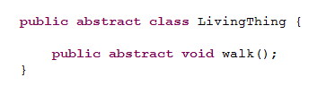
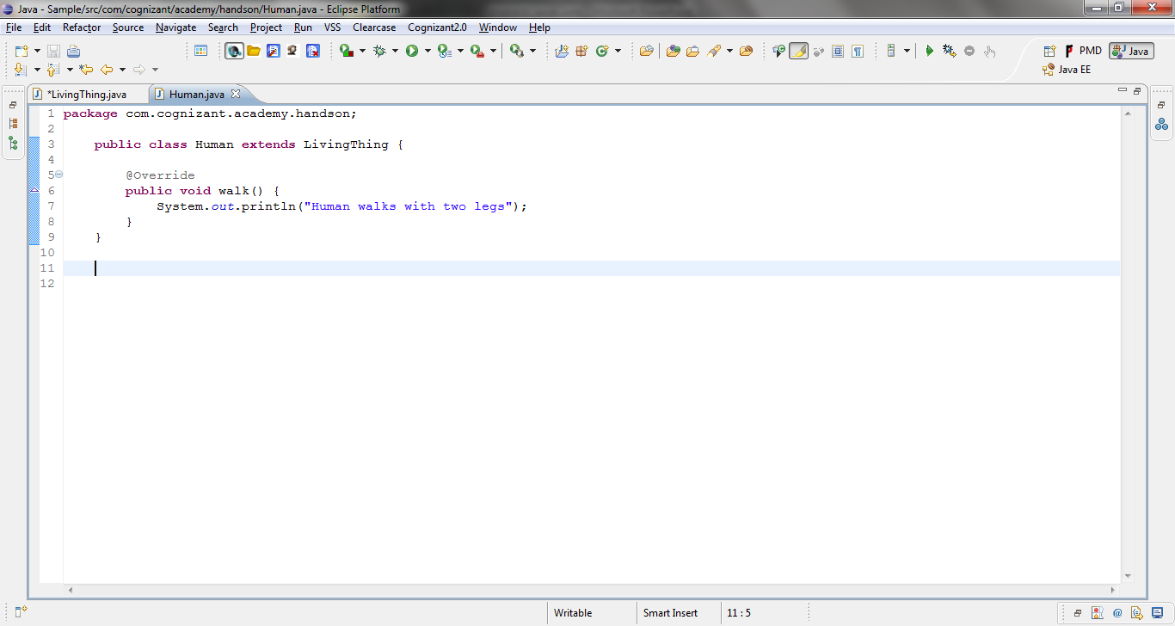
Extending an Abstract class
Assume a parent class as LivingThing
Abstract method - walk() in parent class
Human subclass of LivingThing
Implementation of abstract method - walk() in subclass

Slide 7
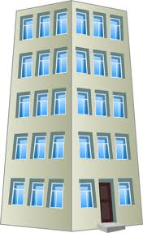

Abstract in real world
Scenario: Lets take a passport issuance process, assume that the passport head office is located in Delhi and corresponding local offices are in Chennai/Bangaluru. The passport issuance is a two step process, verification of photo identity and final approval. In Chennai and Bangalore the verification document for photo identity are different. Say in Bangalore they verify using ration card and in Chennai they use drivers license. So the head office at Delhi decides to define a protocol and delegate the photo identity verification process but the final approval will be done by the head office.
Delhi Office,
Defines a protocol, that all local passport office should verify the photo identity.
HO verifies and approves the final document.
Bangaluru,
Adheres to the protocol and performs photo identification using ration card.
Sends the document to HO for approval.
Chennai,
Adheres to the protocol and performs photo identification using driver license.
Sends the document to HO for approval.
Passport Head Office,
Delhi
Passport Office,
Bangaluru
Passport Office,
Chennai

Slide 8
Abstract class & Passport office
Passport Head Office
Abstract Class
Local passport Offices
Sub Class
Photo Identity Verification
Protocol: Abstract Methods
Common concrete method in abstract class reused by sub classes.
Final Approval
NOTE: No people can directly reach Delhi head office for passport application rather they should always go via the local offices in appropriate cities.
Similarly abstract Class cannot be instantiated only the subclasses can be instantiated and methods in abstract class invoked.

Slide 9
When to use Abstract classes?
When do we use abstract classes and Methods?
Abstract class (Passport Head Office) is one way of dictating a strict protocol for the subclasses (Local passport offices) to follow, that is implement the abstract methods (verify photo identity) declared in parent class.
NOTE: Defining methods to be implemented (protocol) cannot be done in case of normal class being extended.
Abstract methods are usually declared where two or more subclasses are expected to fulfill a similar role (abstract methods) in different ways
These subclasses extend the same abstract class and provide different implementations for the abstract methods.
You can use abstract classes to implement common methods (passport final approval) and use the subclasses to implement the abstract methods specific to the sub class.

Slide 10
When to use Abstract classes?
When do we use abstract classes and Methods? – Software Example
Assume Shape is the parent class, Circle and Square are subclasses that extends Shape. All the Shapes should have red color and they should expose a method to calculate area based on their appropriate shape.
Shape
Abstract class Shape
Implements the common method setColor.
Declares a abstract method (protocol) calculateArea for sub class to implement.
Circle
Square
Classes Square & Circle extend Shape and
Inherit setColor method.
Implement abstract method calculateArea (adhere the protocol).

Slide 11
Example – Abstract classes
Let us understand more about abstract classes with the below program
Create a parent class Shape.java with a instance variable color and methods below,
Abstract method calculateArea() which returns double value;
Concrete method setColor which accepts a String color as the parameter and sets the instance variable ‘color’. It should also print the color in the console.
Create a sub class Circle.java which extends Shape.java and
Implements the calculateArea() method. It should calculate the area as 3.14*r*r and print the area in the console. Consider radius = 5.0.
Create another sub class Square.java which extends Shape and
Implements the calculateArea() method. It should calculate the area as length*breadth and print the area in the console. Consider Length/Breadth = 4.0.
Create AbstractDemo.java class with Main method which invokes the setColor method and the calculateArea() method on Circle and Square Object

Slide 12
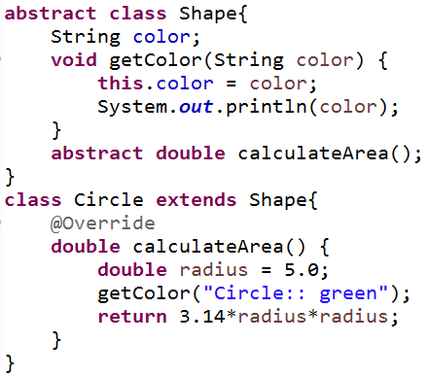
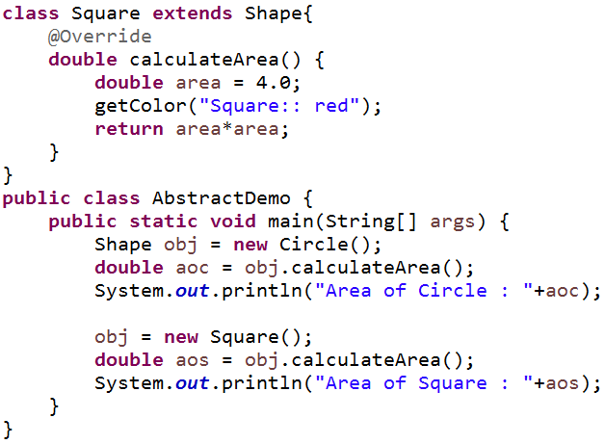
Example - Solution

Slide 13
Thank you
You have successfully completed Abstract Class
APIs

