Slide 1
JAVA @11
Collection Framework

Slide 2
Objective
After completing this session you will be able to understand,
Define collection
Describe usage of collections
Describe the benefits of collections
Understand the core collection interfaces
Understand the implemented classes.

Slide 3

Collections
A “Collection” is a container that groups multiple elements into single unit.
Collections in java is a framework that provides an architecture to store and manipulate the group of objects.

Slide 4
Collections Framework
A collections framework is a unified architecture for representing and manipulating varieties of collections.
Some collections allow duplicate elements and others do not.
Can be used only to hold object type data (non – primitive type).
Some are ordered and others are unordered.
The collection framework is available in the java.util package.
Collection framework contains,
A set of Interfaces.
Concrete class implementations for the interfaces.
The classes in turn has standard API’s for processing collections.

Slide 5
Benefits of Collection framework
Reduce programming Effort
Example: This provides methods for sorting which need not be developed, from scratch thus reducing the development effort.
Collection Framework Benefits
Easy to maintain
High performance APIs
The API’s are easy to use and maintain.
Example: The API’s provided are proven tested ones with high performance.
Easy to use
Resizable and grows
Example: The collection sizes dynamically changes that is it gets shrunk or increased based on the elements stored.

Slide 6
Collection Framework Components
Iterable
interface
extends
class
Collection
implements
List
Queue
Set
ArrayList
PriorityQueue
HashSet
LinkedList
Deque
LinkedHashSet
Vector
SortedSet
ArrayDeque
Stack
TreeSet

Slide 7
Difference between List & Set
List :
Cat | Dog | Rat | Rat | Lion | Cat | Lion | Bird
null | null
It allows duplicates
It permits multiple null values.
Set:
Cat | Dog | Rat | Lion | Bird | null
It does not allow duplicates
Only one null value is permitted

Slide 8
Ordered vs Sorted Collection
Consider you have a collection fruits names.
Grapes
Orange
Banana
Apple
Pineapple
Problem 1 : You need to insert the above list of fruits in the same order given above . What type of collection can be used ?
Solution : Any ordered collection can be used. Example: List.
Problem 2: Suppose you want to automatically sort the fruit names and store it in a collection ? What type of collection can be used ?
Solution : A sorted collection like SortedSet can be used which automatically sorts and rearranges the value each time a new fruit is added to the list.
A SortedMap is a Map that maintains its entries in ascending order, sorted based on the key.

Slide 9
Collection Interface
The root interface in the collection hierarchy.
JDK does not provide any direct implementations of this interface, it provides implementations of more specific sub-interfaces like Set and List etc.
Contains methods which needs to implemented directly or indirectly by the sub classes.

Slide 10
Collection Methods
Methods | Description
public boolean add(Object element) | is used to insert an element in this collection.
public boolean addAll(Collection c) | is used to insert the specified collection elements in the invoking collection.
public boolean remove(Object element) | is used to delete an element from this collection.
public boolean removeAll(Collection c) | is used to delete all the elements of specified collection from the invoking collection.
public boolean retainAll(Collection c) | is used to delete all the elements of invoking collection except the specified collection.
public int size() | return the total number of elements in the collection.
public void clear() | removes the total no of element from the collection.

Slide 11
Collection Methods
Methods | Description
public boolean contains(Object element) | is used to search an element.
public boolean containsAll(Collection c) | is used to search the specified collection in this collection.
public Iterator iterator() | returns an iterator.
public Object[] toArray() | converts collection into array.
public boolean isEmpty() | checks if collection is empty.
public boolean equals(Object element) | matches two collection.
public int hashCode() | returns the hashcode number for collection.

Slide 12
List Interface
Used for storing the elements in a ordered way.
Supports duplicate entries.
Supports index based additions and retrieval of items.
List implementations:
Vector
ArrayList
LinkedList
public interface List<E> extends Collection<E>

Slide 13
List Methods
Methods | Description
void add(int index,Object element) | It is used to insert element into the invoking list at the index passed in the index.
boolean addAll(int index,Collection c) | It is used to insert all elements of c into the invoking list at the index passed in the index.
object get(int index) | It is used to return the object stored at the specified index within the invoking collection.
object set(int index,Object element) | It is used to assign element to the location specified by index within the invoking list.
object remove(int index) | It is used to remove the element at position index from the invoking list and return the deleted element.

Slide 14
ArrayList
Implements List interface
ArrayList can grow and shrink in size dynamically based on the elements stored hence can be considered as a variable array.
Values are stored internally as an array hence random insert and retrieval of elements are allowed.
Can be traversed using a foreach loop, iterators, or indexes.
Initially gets created with an initial capacity , when this get’s filled the list automatically grows.
Can hold only object type data – Cannot hold primitive type values.
Supports duplicate entries.
public class ArrayList<E> extends AbstractList<E> implements List<E>, RandomAccess, Cloneable, Serializable

Slide 15
How to create an ArrayList ?
Constructors of Java ArrayList
Non-generic:
ArrayList list = new ArrayList();
Generic:
ArrayList<String> list = new ArrayList<String>();
Constructor | Description
ArrayList() | It is used to build an empty array list.
ArrayList(Collection c) | It is used to build an array list that is initialized with the elements of the collection c.
ArrayList(int capacity) | It is used to build an array list that has the specified initial capacity.

Slide 16
How to add elements in a List?
Values can be added to an ArrayList using any of the add methods.
Syntax :
listName.add(element);
Example :
Create an arraylist
0
1
2
3
4
5
6
List myList=new ArrayList()
Apple | Orange
Apple | Lemon | Orange
Banana | Lemon | Orange
myList.add(“Apple”);
myList.add(“Orange”);
Adds the element lemon at position 1 moving orange to position 2.
Adds elements one by one to the list.
myList.add(1,”Lemon”);
When set is used the item in the particular index will be replaced by the new item.
myList.set(0,”Banana”);

Slide 17
Example – using ArrayList
Objective: In this lend a hand we are going to learn about creating and adding elements into the array list.
Problem Statement 1: Create a method that accepts the names of five fruits and loads them to an array list and returns the list.
Problem Statement 2: Create an method which can return an array list holding values 1-10.
Problem Statement 3: Create a method needs to return an array list holding value 1-15. The method should make use of the already created array list containing values up to 10 and then add values from 11-15 using a for loop.

Slide 18
Set Interface
The Set interface is a collection that cannot contain duplicate elements.
It permits a single element to be null.
Set interface contains methods inherited from collection interface.
SortedSet interface is a set that maintains its elements in ascending order.
Set Implementations:
HashSet
LinkedHashSet
TreeSet

Slide 19
HashSet
Java HashSet class is used to create a collection that uses a hash table for storage.
It inherits the AbstractSet class and implements Set interface.
The important points about Java HashSet class are:
HashSet stores the elements by using a mechanism called hashing.
HashSet contains unique elements only.
Cannot predict the order in which the items get stored in the Set
Not thread safe.
Permits null value(only one).
syntax:
public class HashSet<E> extends AbstractSet<E> implements Set<E>, Cloneable, Serializable

Slide 20
HashSet - Methods
Method | Description
void clear() | It is used to remove all of the elements from this set.
boolean contains(Object o) | It is used to return true if this set contains the specified element.
boolean add(Object o) | It is used to adds the specified element to this set if it is not already present.
boolean isEmpty() | It is used to return true if this set contains no elements.
boolean remove(Object o) | It is used to remove the specified element from this set if it is present.
Object clone() | It is used to return a shallow copy of this HashSet instance: the elements themselves are not cloned.
Iterator iterator() | It is used to return an iterator over the elements in this set.
int size() | It is used to return the number of elements in this set.

Slide 21

How to add elements to HashSet?
Elements can be added one by one using a add() method or an entire collection can be added using the addAll() method.
Example:
mySet.add(“Grapes”);
mySet.add(“Banana”);
mySet.add(“Grapes”)
mySet.addAll(mySet1);
Adds two elements into the set.
Returns false since India already exists in the set.
Adds all the items of Set mySet1 to mySet
Note : If an entire set is added to another set , the duplicate elements will not get added.

Slide 22
Objective: Let us learn how to create a HashSet and add elements into it.
Problem Statement 1: Create a method that accepts the names of five books details and loads them to an HashSet and returns the Set.
Problem Statement 2 : Create an method which can return a set holding values 1-10.
Problem Statement 3 : Create a method needs to return a set holding value 1-15. The method should make use of the already created set containing values up to 10 and then add values from 11-15 using a for loop.

Slide 23


Time To Reflect
Trainees to reflect the following topics before proceeding.
What method can be used to merge to two array lists ?
What happens when a duplicate entry is tried to be added to a set ?
What is the difference between add and set method in array list?
How to add an element to a particular position in an array list?

Slide 24



Generics
Let us take a real time example
The buyer does not know what these red shape boxes contain. Hence the buyer needs to open these boxes every time to find what is inside it
Roses
Jewels
Chocolate
Here, the buyer is aware of what is inside the boxes ,since the box is labeled. This makes his job easier since he knows what he can put in and what he can take out from the box

Slide 25
What is Generics?
Generics is a feature allows the programmer to specify the data type to be stored in a collection or a class when developing the program.
Compile throws error if the data stored is different from the data type specified in the generic.

Slide 26
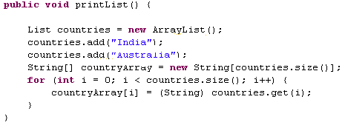
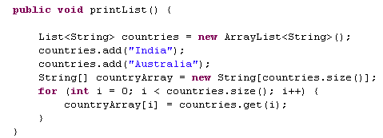
Advantage of using Generics using Collection
Avoid unnecessary type casting : Using generics avoid the need of typecasting while retrieving the elements from the collection.
Consider an ArrayList named countries ,elements can be retrieved from the List as shown below
Without Generics
With Generics
Type Casted to String
No need of type casting

Slide 27
Advantage of using Generics using Collection
Minimize CastException during run time: For example assume a method returns a List of integers. The client is unaware about the type of data held by the collection and he may type cast it to some incompatible type and end up in CastException during runtime. In case of any invalid casting compiler will throw an error..
Easy Maintenance & Readability : Looking at the code the developer can easily know the data type stored in the collection and thus helps him to process the collection easily.

Slide 28
How to Iterate through collection elements?
Let us now see how to iterate through the collection and read elements one by one.
The following are the ways to iterate through a collection
For loop
Reads elements by specifying the index using the get() method
Can be used only with List.
For-each loop
Iterate over a list and gets the elements one by one until the complete list is covered
Can be applied with both List and Set.
Iterator
Iterator provides methods to iterate through a collection.
Can be applied with both List and Set.
ListIterator
An iterator which support both forward and back ward iteration.
Can be applied only with List.

Slide 29
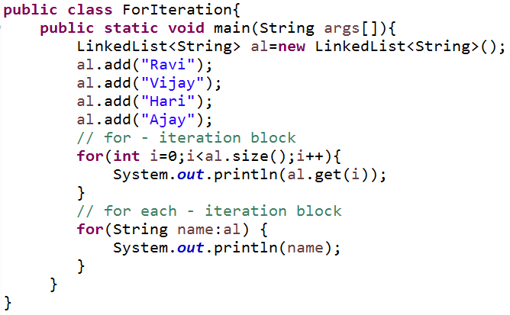
Iteration using “for” and “for each” loop
Using for block to iterate the list elements
Using for each block to iterate the list elements

Slide 30
Iterator
What is an Iterator interface?
This interface contains methods which is used for iterating & accessing all the elements of a collection in sequence.
The List and Set collections can be iterated using iterators.
Iterator interface methods:
Method | Description
boolean hasNext() | true if there are more elements for the iterator.
Object next() | Returns the next object or elements.
void remove() | Removes the element that was returned by next from the collection. This method can be invoked only once per call to next .

Slide 31
How to create an Iterator?
An Iterator is created for a particular collection object by calling the iterator() method on the collection object.
Syntax :
Iterator<type> iteratorName=collection.iterator();
Where type is the generic type of the Iterator
Example : Creates an iterator to iterate the elements of the myList containing Integer objects.
Iterator<Integer> myListIterator = myList.iterator();

Slide 32
Iterator - Illustration
Working of Iterator
it.hasNext()
it.hasNext()
it.hasNext()
it.hasNext()
Iterator<Integer> it=myList.iterator();
It.next()
It.next()
It.next()
No element, hence loop terminated
Iterator Object created
The next element is retrieved everytime ‘it.next()’ is executed.
The hasnext() method is used for verifying the existence of
element in the collection before firing the next().

Slide 33
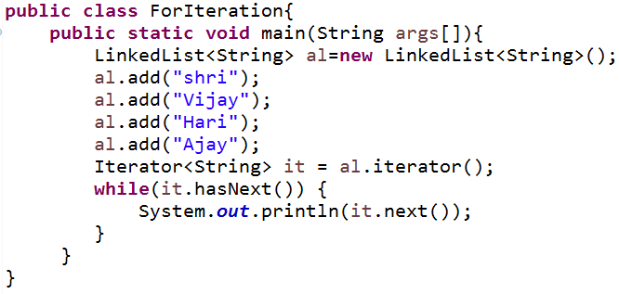
Example – an Iterator
Create an iterator to work on the Linked List
Invoke the hasNext() method to check whether the iterator contains elements to be read.
Invoke the next() method to read each country from the Set.
Note :The Iterator is also declared with generics to avoid type casting.

Slide 34
ListIterator
An list iterator can be used by programmer to traverse the list in either direction, modify the list during iteration, and obtain the iterator's current position in the list.
A ListIterator has no current element; its cursor position always lies between the element that would be returned by a call to previous() and the element that would be returned by a call to next().

Slide 35
Time To Reflect
Trainees to reflect the following topics before proceeding.
How to make a collection accept only Integer objects?
What are all the methods available to iterate through a Set?
Can a ListIterator be used with a Set?
Which iterator can be used to add elements to a list in between the iteration process?
What may be the reason that for loop is not used to iterate through set?

Slide 36
Maps
Map stores Elements as key – value pairs.
Each key maps to one value stored in the map.
The values can be accessed by passing the key.
The key should be unique used to identify the value.
The key and value can only be objects.
Key | Value
1 | Grapes
2 | Pineapple
3 | Banana
4 | Apple
5 | Orange

Slide 37
Map Interfaces
A Map is an object that maps keys to values
Map
SortedMap
HashMap
HashTable
TreeMap
Can contain null values.
Not Thread Safe
Cannot contain null values.
This is Thread Safe
Stores in sorted order according to the key
Not Thread safe.
Key | Value
C | Cat
D | Dog
B | Null
A | Null
E | Bird
Key | Value
C | Cat
D | Dog
B | pigeon
A | cow
E | Bird
Key | Value
A | Null
B | Null
C | Cat
D | Dog
E | Bird

Slide 38
Difference between Collection Interfaces and Map
Collection
Map
Cat | Dog | Bat | Lion | Bird
Key | Value
C | Cat
D | Dog
B | Bat
L | Lion
Bi | Bird
How Lion look up happens?
In the case of collection we can see that the search traverses across the entire collection to get the required object. But in the case of map it is directly accessed using the key.

Slide 39
Methods in Map
Method | Description
void clear() | Removes all mappings from this map (optional operation).
boolean containsKey(Object key) | Returns true if this map contains a mapping for the specified key.
boolean containsValue(Object ob) | Returns true if this map maps one or more keys to the specified value.
Set<Map.Entry<K, V>> entrySet() | Returns a set view of the mappings contained in this map.
Object get(Objectkey) | Returns the value to which this map maps the specified key.
boolean isEmpty() | Returns true if this map contains no key-value mappings.
Set keySet() | Returns a set with all the keys contained in this map.
Object put(Object key, Object value) | Associates the specified value with the specified key in this map.
void putAll(Map t) | Copies all of the mappings from the specified map to this map

Slide 40
Map.Entry
Entry is the sub interface of Map.
It provides methods to get key and value.
Methods in Map.Entry
Methods | Description
Object getKey() | It is used to obtain key.
Object getValue() | It is used to obtain value.

Slide 41
HashMap
A HashMap contains values based on the key.
It contains only unique elements.
It may have one null key and multiple null values.
It maintains no order.
HashMap class declaration
HashMap class Parameters
K: It is the type of keys maintained by this map.
V: It is the type of mapped values.
public class HashMap<K,V> extends AbstractMap<K,V> implements Map<K,V>, Cloneable, Serializable

Slide 42
How to create a HashMap Object ?
Syntax:
Map<Type1,Type2> mapName = new HashMap<Type1,Type2>();
Creates a map with generics defined key of the type Type1 and value of the type Type2.
Example: Creates map object supporting Integer key and String value.
Map<Integer,String> myMap = new HashMap<Integer,String>();

Slide 43
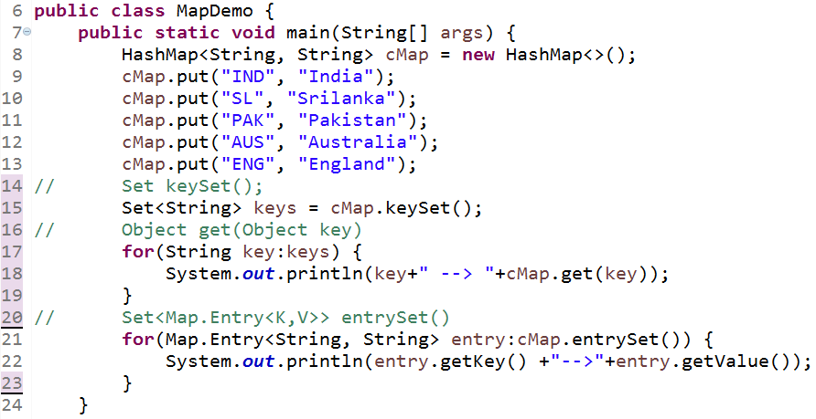
Example – HashMap

Slide 44
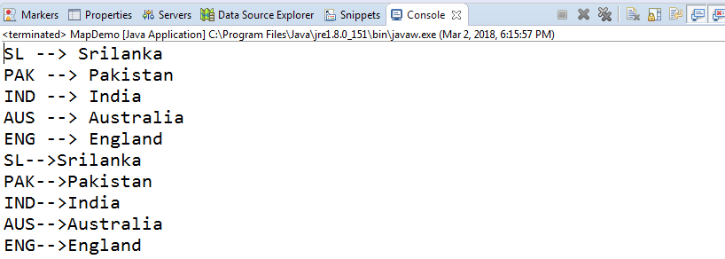
Output - HashMap
What can be done to automatically sort the map according to the country code?
The solution is TreeMap, since Tree implements the SortedMap interface, it automatically stores the elements in a sorted order based on the key.

Slide 45
Example - TreeMap
In this example we will see how TreeMap can be used to store elements sorted by the key. We will tweak the previous program to use TreeMap rather than HashMap implementation.
Solution: Change the HashMap to TreeMap in the MapDemo class.
Map<String,String> studentMap=new HashMap<String, String>();
Map<String,String> studentMap=new TreeMap<String, String>();
Note : See how easily we changed the implementation from HashMap to TreeMap by making just one change. This is the advantage of declaring collections with the interface Map.

Slide 46
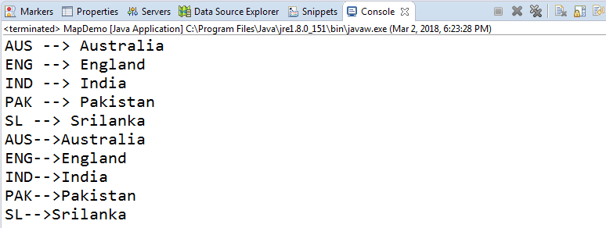
Output - TreeMap
Notice the output the this MapDemo class are displayed based on the country code order.

Slide 47
Time To Reflect
Trainees to reflect the following topics before proceeding.
What types of map can be used to if want to allow null values?
Suppose you are asked to create a telephone directory with person's name in a sorted order which map implementation do you prefer to use ?

Slide 48
How to store user defined Objects in Collections
User defined classes can be stored in any of the collections like list, set, map etc.
In the next lend a hand we will see how user defined objects can be added and retrieved from an ArrayList. Same procedure applies for all other collections.
NOTE: To add a user defined object to a sorted collection developers should either
Make the User Defined object to implement Comparable interface (or)
Create a custom comparator class and pass it as constructor parameter when creating the collection object.

Slide 49
Example – Add user defined object in collection
Consider a scenario in which you want to send the details of products to a method. The product details includes product id , product name , quantity, price and supplier name. Suppose there are 50 products what can be done to pass the details of all the 50 products together ?
Let us see how to solve it?
Step 1: Create a Product class with the prodId, prodName, quantity, price, supplierName as it’s fields.
Step 2: Create an object of Product class for each product and load the details.
Step 3: Create an ArrayList and add each of the Product objects to the list.
Step 4: Pass the list as argument to the method.

Slide 50
Example – Add user defined object in collection
Let us create a ProductManager class with method printProductDetails() accepts the product details as a list of product objects.
Components to be developed:
Product Class : For holding the product details.
ProductManager class : Contains method for printing the product details.
MainClass class : Creates 5 product objects , adds them to a list and pass it to the printProductDetails() method of the ProductManager class.

Slide 51
Example – Create a Product class
The Product class should have the following fields to hold the product details
prodId
prodName
quantity
price
supplierName
All the fields should be created as private and accessed using public methods.

Slide 52
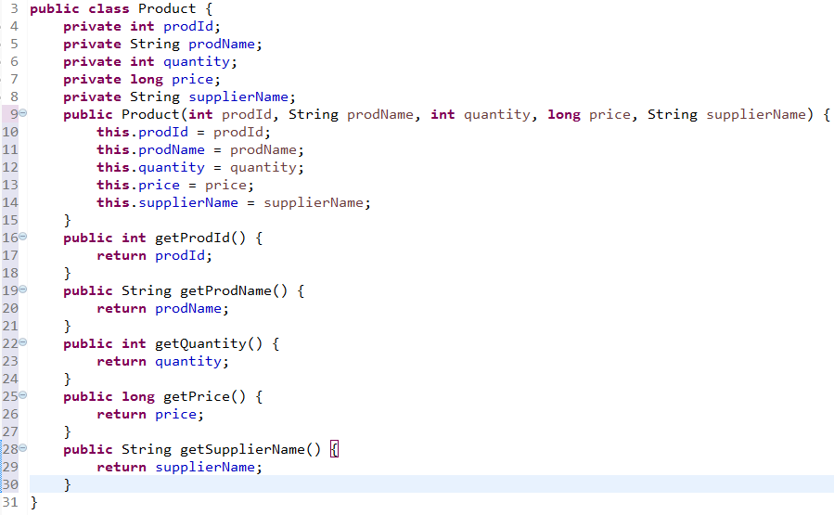
Product.java
All the methods starting with the word “get” are used to read the associated field value.
Example : getName() returns the name.
The values to the member variables can be initialized using the overloaded constructor.

Slide 53
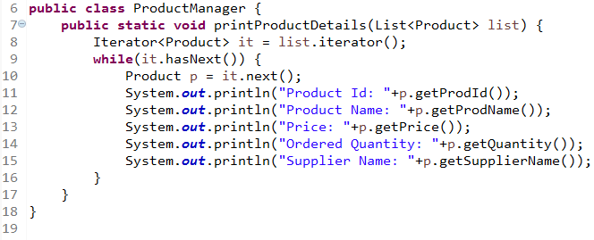
ProductManager.java
The printProductDetails() method accepts list of students as argument.

Slide 54
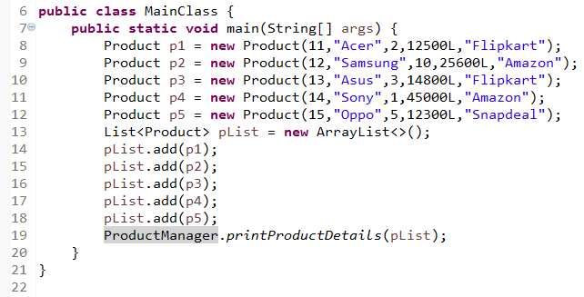
MainClass.java
Creates five Product objects
Creates ArrayList objects and adds the product objects to the list.
Passes the list as input to printProductDetails method

Slide 55
Time To Reflect
Trainees to reflect the following topics before proceeding.
What types of map can be used to if want to allow null values?
Suppose you are asked to create a telephone directory with person's name in a sorted order which map implementation do you prefer to use ?

Slide 56
Thank you
You have successfully completed Collection Framework

