Slide 1
CORE JAVA 8
Java Thread – Part I

Slide 2
About the Author

Slide 3
Objective
After completing this session you will be able to understand,
What is Multithreading?
Life cycle of a Thread
Creating Thread
Thread Scheduler
Thread Interruption techniques
Thread Priority

Slide 4

Process vs Thread
Before we learnt about threads lets first understand the difference between a thread and a process.
Process are executables which run in separate memory space.
Threads are small process which run in shared memory space within a process.
So in a nutshell Process is a container for Threads, all thread runs inside the process.
Still confused lets look at a example to understand it better.

Slide 5
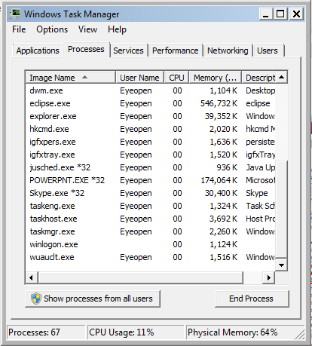
Process
Lets consider Eclipse IDE application to understand it better, what happens when you start an eclipse application.
A process for eclipse ide application will be started.
Now lets see what happens when the user starts using word application.

Slide 6
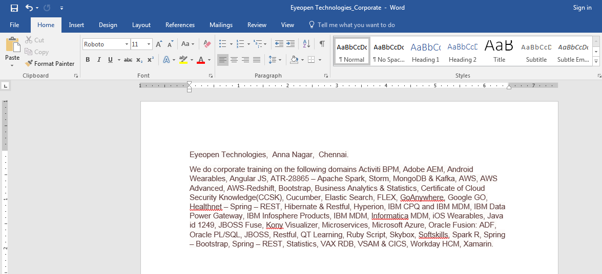
Thread
The spell check has been implemented as a thread within the worde.exe process which runs continuously and verifies what you type.
Word.exe is the process and spell check is a thread running inside the process.
Now as you type you will see the spelling and grammar being verified by the word process.

Slide 7

Real time scenario
Ram was developing an application where he has a requirement where user can register his profile in the application, assume registration has three steps
Validate user details – Takes 3 seconds for execution for each user.
Validate user Citizenship - Takes 4 seconds for execution for each user.
Now customer wants to complete the registration process is less than 5 seconds.
Guess how Mr. Ram would have achieved it?
He used Multi Threading.
Lets see what it is and how it can be implemented in this session.

Slide 8
Multitasking
What is Multitasking?
Refers to a computer's ability to perform multiple jobs concurrently
More than one program are running concurrently,
Example: In windows you can run Word, power point , media player at the same time. Yu will working on word and in parallel media player might play some music.

Slide 9
Multithreading
What is Multithreading?
A thread is a single sequence of execution within a program/process.
This refers to multiple threads of control within a single program.
Each program can run multiple threads of control within it.
Example: Microsoft word process having multiple threads like spell check, auto save etc.

Slide 10
System Illustration
CPU
Process1
Process 2
Word Process
Thread 1
Auto Save
Thread 2
Spell Check
Thread 3
The CPU is running three processes. Process 2 in turn has three threads running inside it.

Slide 11
Benefits of Multithreading
To reduce response (execution) time of a process.
Support Parallel Operation of Functions.
Increase System Efficiency.
Requires less overheads compared to Multitasking.

Slide 12
How Ram Solved the Problem?
Ram implemented two threads for processing the Validate user details and Validate user Citizenship.
Single Threaded
Validate User Citizenship
4
Seconds
The thread takes 7 seconds for completing the registration process.
Let look how Ram implemented it.
Validate User Details
3
Seconds

Slide 13
How Ram Solved the Problem?
Ram implemented two threads one thread for each method Validate user details and Validate user Citizenship.
Multi Threaded
Validate User Citizenship
Validate User Details
4
Seconds
3
Seconds
The process will be completed in 4 seconds.
Since both the threads works in parallel.

Slide 14
What is an Application Thread?
When we execute an application,
The JVM creates a thread (T1) object which invokes the main() method and starts the application.
The thread executes the statements of the program one by one (or) starts other threads.
After executing all the statements, the method returns and the thread dies.
The thread T1 which is responsible for starting the application by invoking the main method is called “Application Thread”.

Slide 15
Ways of Implementing Threads
Method 1 : Extend Thread Class
Method 2 : Implement Runnable Interface

Slide 16
Using Thread in Java
How To Use Threads in Java
Using Thread
class
java.lang.Thread class is used to construct and access individuals thread in a multi threaded application.

Slide 17
Using Thread in Java
public class Thread extends Object implements Runnable {
public Thread();
public Thread(String name); // Thread name
public Thread(Runnable r); // Thread ⇒ r.run()
public Thread(Runnable r, String name);
public void run();
public void start(); // begin thread execution
}

Slide 18
Thread class methods
Method | Description
void run() | The thread logic should be implemented in this method. This method should be overridden in all the Thread class.
void start() | Creates a new thread and invokes run method of the thread.
getName() | Returns the thread's name.
int getPriority() | Returns the thread's priority
boolean isAlive() | Tests if the thread is alive.

Slide 19
Method | Description
Thread currentThread() | Return a reference to the currently executing thread object
setName(String name) | Sets a name for the thread to be equal to the argument name.
setPriority (int newPriority) | Changes the priority of the thread
static void sleep(long millis) | Causes the currently executing thread to sleep (temporarily cease execution) for the specified number of milliseconds.
void yield() | Causes the currently executing thread object to temporarily pause and allow other threads of same priority to execute

Slide 20
Lifecycle of Thread
New Thread created
Suspended
start()
notify()
calls
wait()
run()
Sleeping
sleep()
Running
Terminated
stop()
timeout
return

Slide 21
Java thread states
State Diagram
new
start
new
runnable
notify, notifyAll,
IO complete, sleep expired,
join complete
scheduler
yield,
time slice
running
blocked
IO, sleep,
wait, join
terminate
dead

Slide 22
Example – How to develop a thread?
In this demo we will learn how to
Create a Thread by extending the Thread class
Override the run method
Create a thread object and start the thread using the start method
How the following methods operates
getName()
setName()
setPriority()
getPriority()
sleep()
Components to be developed,
1. ThreadEX – The Thread class should loop and print values 0…4.
2. ThreadExMain – The main class to execute the Threads

Slide 23
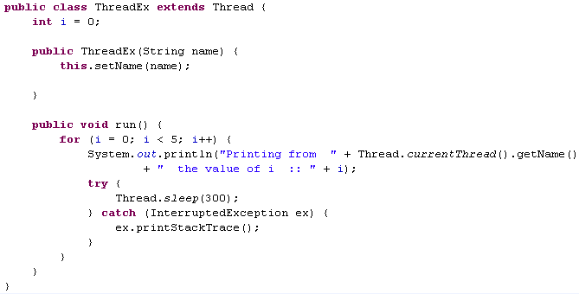
Solution - Thread
Class ThreadEx extends Thread class and becomes a Thread class
Sets the name of the Thread using setName method()
Overrides the run() method
Prints the name of the current Thread using the getName() method
Makes the Thread sleep for 300 milliseconds. Invoking the sleep may cause an InterruptedException to be thrown which should be handlers.

Slide 24
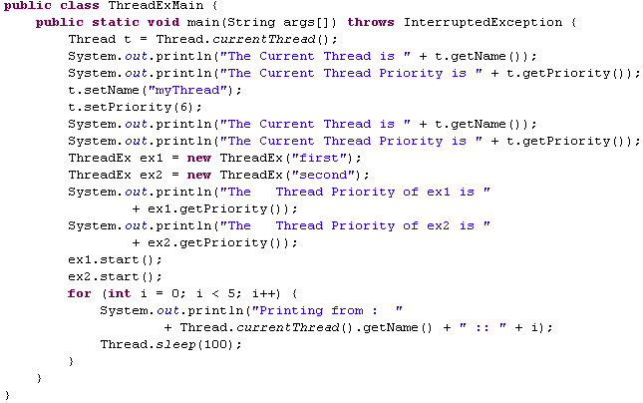
Solution - Thread
Gets the priority and name of the main thread
Sets the priority and name of the main thread
Creates two new Thread objects with name “first “and “second”
Starts the Thread by invoking the start () which will invoke the run() method of the Thread class

Slide 25
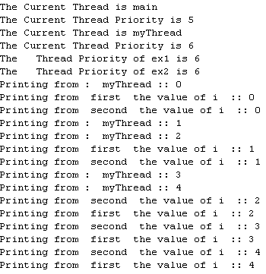
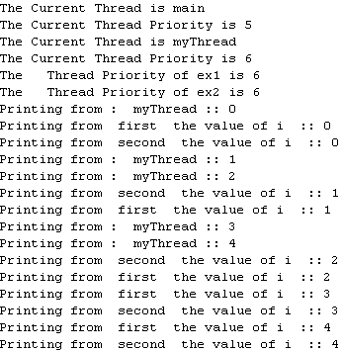
Solution - Thread
Execute the main class – ThreadExMain
The output will be something as shown below – Output may vary for each execution since Thread execution is based on the underlying operating system.
Different output displayed during different run

Slide 26


Time To Reflect
Trainees to reflect the following topics before proceeding.
What is Multithreading?
How can we implement threading in Java API?
Explain about Thread Lifecyle methods in Java API?

Slide 27
Thank you
You have successfully completed Thread-I

