Slide 1
CORE JAVA 8
Java Thread – Part II

Slide 2
About the Author

Slide 3
Objective
After completing this session you will be able to understand,
How to create thread by implementing runnable interface?
Comparison between the two method of thread creation
Learn about thread join method

Slide 4
Runnable Interface
Threads can be created by implementing the Runnable interface and overriding the run method.
Runnable interface contains only one method – the run() method which should be overridden to start a new Thread.

Slide 5
Implementing Runnable Interface
Step 1: Create a class ThreadRunnableEx by implementing the Runnable interface
Step 2: Override the run() method , the logic each thread should execute.
Step 3: Create an main method which can start the thread.
Step 4: Inside the main method create an object of the ThreadRunnableEx class.
Step 5: Inside the main method create a Thread object using the ThreadRunnableEx. This is done by passing the ThreadRunnableEx object to the constructor of the Thread class.
Step 6: Invoke the start method on the Thread object which in turn calls the run() method of the ThreadRunnableEx class and starts a thread.

Slide 6
Example – Runnable Interface
In this demo we will learn how to
Create a Thread by using Runnable interface.
Implement the run method.
Create a thread object using the Runnable interface,
Components to be developed,
ThreadRunnableEx – Thread implemented using Runnable interface. Each Thread should loop and print values 0…9
RunnableExMain – The main class to start the Threads

Slide 7
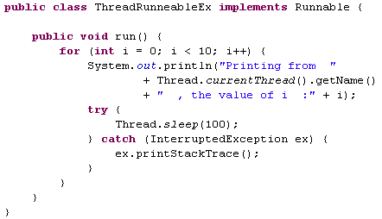
Solution – Runnable Interface
Create a class named ThreadRunnableEx implementing the Runnable interface
Class ThreadRunnableEx implements Runnable interface override the run method to print values between 0..9.

Slide 8
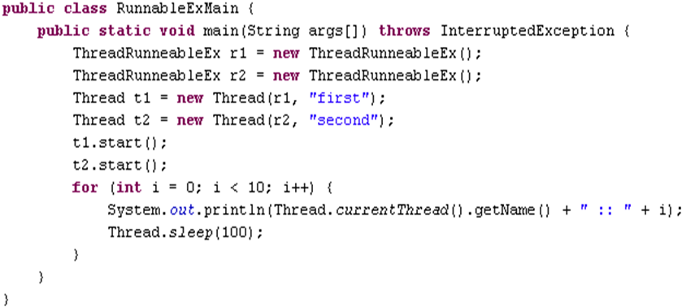
Solution – Runnable Interface
Create class RunnableExMain with a main method which will start the threads.
This creates two thread to be run
Create the Thread objects using the Runnable objects
Start the two Threads

Slide 9
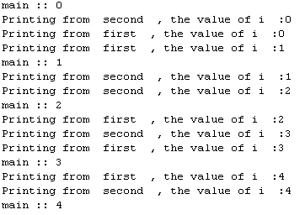
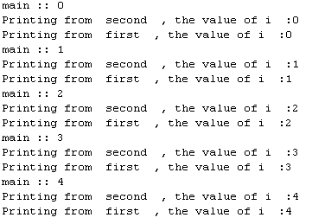
Execute the Runnable
Run the main class – ThreadExMain
The output will be something as shown below.
Output may vary for each execution since Thread execution depends upon the operating system.
Different output displayed during different run

Slide 10

Runnable vs Thread
Why Runnable is better?
If we inherit the Thread class for creating threads we cannot extend any other class. Since Java does not support multiple inheritance
By implementing the Runnable interface we can make the thread class extend other classes.
Which Method is better? Why?
Implementing Runnable interface is recommended.

Slide 11
Ram faces another problem
In the previous examples we can see that the main Thread (Application Thread) exits before the other child Threads which was originated by it completes execution. This may not be desirable in some situations.
Example: Assume tax needs to be calculated for 10 employees using calculateTax() method, Tim the programmer decides to speedup the process by spawning 10 thread one thread per employee. Also Tim needs to ensure that the program should exit only after all the ten threads complete the tax calculation.
How can this be solved?
Tim used Thread Join Method.

Slide 12
What is join method?
join method in Thread class,
join() is used to ensure that the application main thread will complete only after all the thread spawned by it inside the process completes execution.
In other words, one thread can wait for another to complete using the join() method.
Invoking join() guarantees that the method will not return until the threads started from it returns and join.

Slide 13
Example – join()
In this demo we will see how a method works with and without join .
Step 1: We will create a Runnable class JoinEx and a main class JoinExMain
Step 2: First we will create the main method without join() and look at the output
Step 3: Then will inject join() to the main method and see how join changes the output.

Slide 14
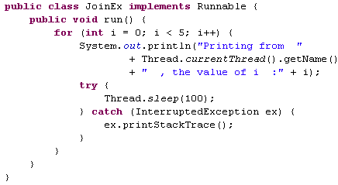
Solution – join()

Slide 15
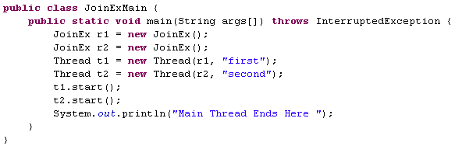
Main method without join, create two threads and start it.

Slide 16
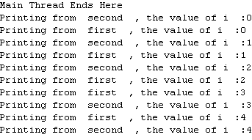
Output – without join()
The main method ends before the completion of the other threads

Slide 17
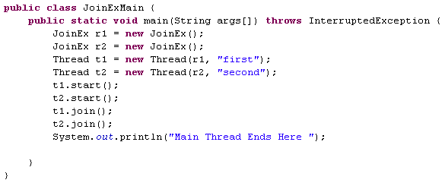
Add the join()
The threads join method is triggered.

Slide 18
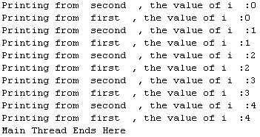
Output – with join()
The main method ends after the completion of the other threads

Slide 19


Time To Reflect
Trainees to reflect the following topics before proceeding.
What is Runnable interface?
Which method is better either Thread or Runnable? Why?
What is Thread join() method?

Slide 20
Thank you
You have successfully completed Thread-II

