Slide 1
CORE JAVA 8
Java IO – Part II

Slide 2
About the Author

Slide 3
Objective
After completing this session you will be able to understand,
What is a character stream?
Types of character stream
How to read and write files using character streams?

Slide 4
CharacterStream
Character streams are used to read write data as character type(16 bit Unicode) data .
All character stream classes are the sub classes of the following two abstract classes,
Reader :The base class which contains the common methods for reading characters.
Writer : The base class which contains the common methods for writing characters.

Slide 5
Reader
A Reader class is used by a Java programs to read character data from a source.
Reader class is an abstract class available in java.io package.
Reader class is the super class of all classes representing an input stream of characters.
Java IO package provides various implementations of Reader class.

Slide 6
Methods of Reader class
Method | Description
int read() | Reads a single character.
Int read(char[] cbuf) | Reads characters into an array
int read (char[] cbuf, int offset, int length) | Reads characters into a portion of an array
boolean ready() | Tells whether this stream is ready to be read.
void close() | Closes the stream and releases any system resources associated with it.
void mark(int position) | Marks the present position in the stream.
int skip(long char) | Skips characters

Slide 7
Reader class Illustration
Listed below are the different Reader objects, In this session we will focus on BufferedReader and FileReader.
BufferedReader
CharArrayReader
Reader
InputStreamReader
FileReader
StringReader

Slide 8
FileReader
The FileReader class is used for reading data as characters from a file.
Example:
FileReader reader=new FileReader(“info.txt”);
Note: An exception named FileNotFoundException is thrown if the file is not present in the specified location.

Slide 9
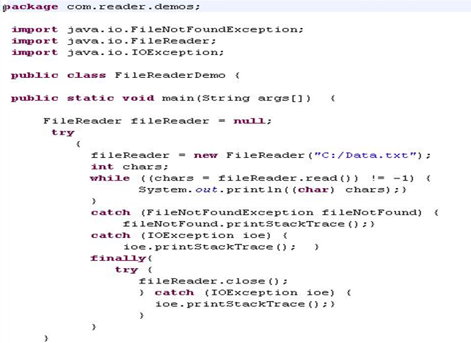
Example - FileReader
Creating a new file reader and open the file.
Reads the file character by character.

Slide 10
BufferedReader
BufferedReader reads the character from a character input stream.
BufferedReader is more efficient than the FileReader in reading data from file.
Example:
BufferedReader reader = new BufferedReader(new FileReader(“C:\Data.txt"),100);
The above example creates a buffering character-input stream that uses an input buffer of size 100 bytes.

Slide 11
Methods of BufferedReader
Method | Description
int read() | Reads a byte of data from this input stream.
int read(char[] ch) | Reads up to b.length bytes of data from this input stream into an array of bytes.
int read(char[] ch, int off, int len) | Reads up to len bytes of data from this input stream into an array of bytes. ‘off’ - the start offset in array b at which the data is written.
void close() | Closes this file input stream and releases any system resources associated with the stream.

Slide 12
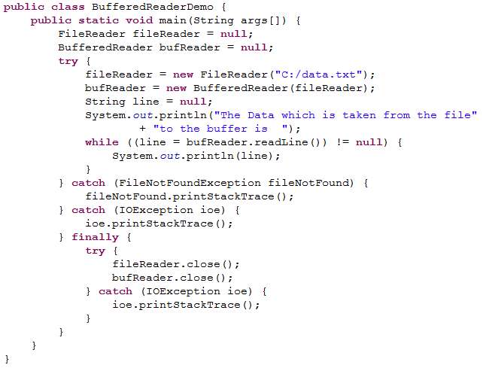
Example - BufferedReader
Creating a buffered reader for the file reader object.
Reads the file line by line

Slide 13
Example - BufferedReader
Objective: Learn how to use BufferedReader for reading files.
Prerequisite: Create a file named data.txt and type some data into it.
Exercise: Print the file content in the reverse order.
Create a class named FileReverseReading.java with a main method. The main method should reverse the contents of a file and print the reversed String to the console. The file should be read using a BufferedReader.
Expected Output:
“The Reversed File Content is” <reversed content>.

Slide 14
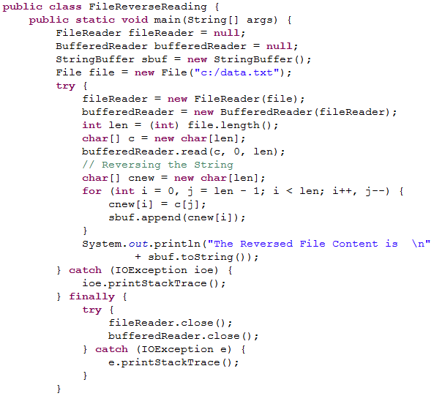

Code - BufferedReader

Slide 15
Writer
An Writer class is used by a Java Program to write character data to a destination.
Writer class is an abstract class available in java.io package.
Java.io package holds the implementation classes of Writer class.
Implementation of the writer class are used to write data to a file,a character array, a network socket ,etc.

Slide 16
Methods in Writer
Method | Description
int write() | Reads a byte of data from this input stream.
int write(char[] ch) | Reads up to b.length bytes of data from this input stream into an array of bytes.
int write(char[] ch, int off, int len) | Reads up to length bytes of data from this input stream into an array of bytes. ‘off’ - the start offset in array b at which the data is written.
void close() | Closes this file input stream and releases any system resources associated with the stream.

Slide 17
Writer class Illustration
Listed below are the different Writer objects, In this session we will focus on BufferedWriter and FileWriter.
BufferedWriter
FileWriter
CharArrayWriter
Writer
OutStreamWriter
StringWriter

Slide 18
FileWriter
The FileWriter class is used to write the contents to a file.
Example:
FileWriter writer=new FileWriter (“info.txt”);
The above example writes content to info.txt file.

Slide 19
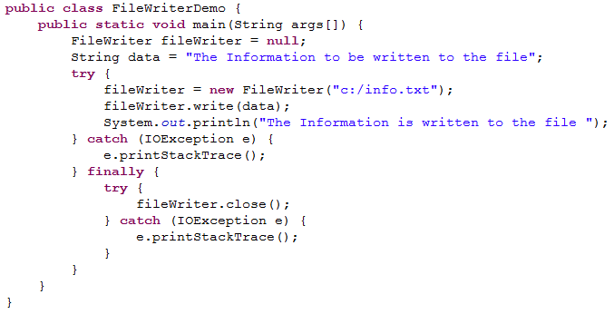
FileWriter - Example
Creating a File Writer Object.

Slide 20
BufferedWriter
BufferedWriter writes the character to character output stream.
As name indicates BufferedWriter uses buffer for writing content to files. So this is efficient than the other character output streams.
The argument for BufferedWriter is any other character stream
Example:
BufferedWriter writer= new BufferedWriter (new FileWriter(“C:\Data.txt”,100);
The above example creates a new buffered character-output stream that uses an output buffer of the given size specified size of 100 bytes.

Slide 21
Methods of BufferedReader
Method | Description
write(int c) | Writes a single character.
write(char[] cbuf, int off, int len) | Writes a portion of an array of characters.
write (String str, int off, int len) | Writes a portion of a String.
Void flush() | Flushes the stream.
void close() | Closes the stream, flushing it first.

Slide 22
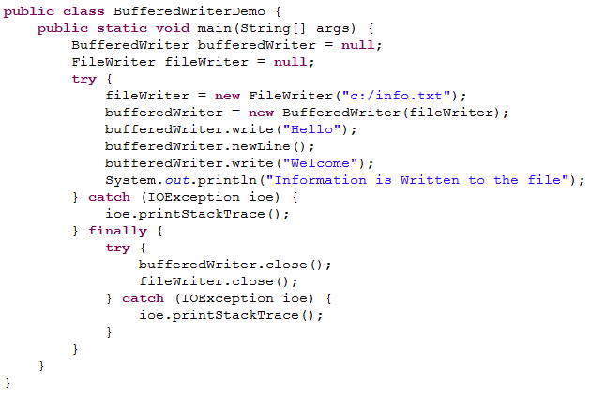
Example – BufferedWriter
Creating a Buffered Writer Object.

Slide 23
Example - BufferedWriter
Objective: Learn how to use Buffered Writer for writing files.
Exercise: Create a class named BufferedWriterEmailReg.java with a main method which will take the data from console and write to a file .The name of the file should be newFile.txt.
Main method logic:
Create the object of FileWriter class and pass the path and name of the file as argument.
Create the object of BufferedWriter and pass the reference of FileWriter to it.
Create an object of scanner class and get the name and email id from the console. Append the inputs in the below format
"Welcome " <name> ", Thank you for registering your email id, <email>

Slide 24
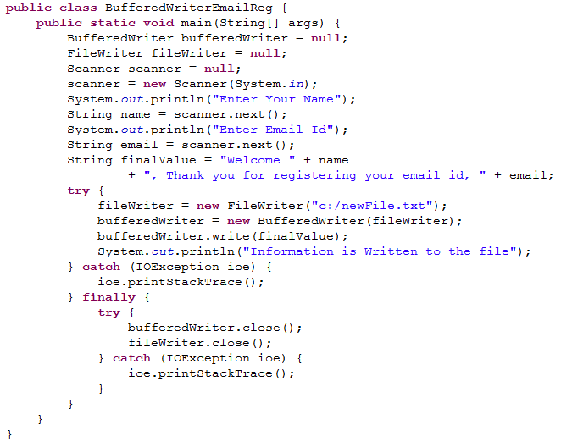
Code - BufferedWriter

Slide 25

Other CharacterStream classes
InputStreamReader - class used for converting byte streams to character streams.
StringReader - class is used for reading characters from a String.
CharArrayReader - class is used for reading characters from a character array.
OutputStreamWriter - class used for converting character streams to byte streams.
CharArrayWriter - class is used for writing characters to a character array.
Associates based on their needs can use the appropriate readers and writers to develop applications in their projects.

Slide 26
Thank you
You have successfully completed Java IO part - II

