Slide 1
CORE JAVA 8
Java IO – Part II

Slide 2
About the Author

Slide 3
Objective
After completing this session you will be able to understand,
What is a serialization in java?
Significance of Transient keyword
A demo on Serialization & De-Serialization

Slide 4
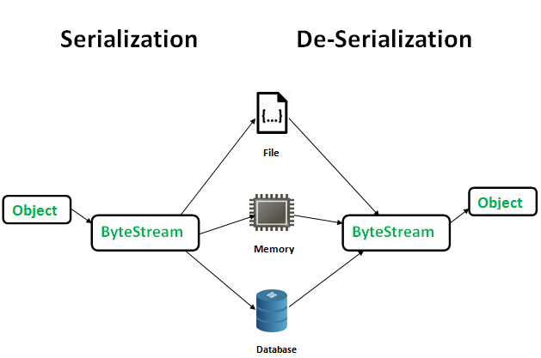
Serialization

Slide 5
Serialization in Java
Serialization is the process of converting an object’s state to a sequence of bytes, as well as the process of rebuilding those bytes into a live object.
Some facts about serialization:
The objects stored can be restored by using the process of de-serialization.
Only an object that implements the Serializable interface can be persisted and restored by the serialization.
The Serializable interface defines no members. It is simply used to indicate that a class may be serialized.
If a class is serializable, all of its subclasses are also serializable.
A interface with no methods is known as an abstract/marker interface.

Slide 6
How to Serialize and de-serialize objects?
The following classes can be used for serializing and de-serializing an object.
ObjectOutputStream: Used for writing objects into the hard disk.
This has the method writeObject(targetobject) which used for persisting the serialized object to an output stream.
ObjectInputStream: This is used for reading the serialized object.
This has the method readObject() which can de-serialize a serialized object and load it back to memory.

Slide 7
How can one prevent variables being de-serialized?
Transient keyword can be used to avoid serialization of instance variables.
Example: If productName is a instance variable in ProductInfo which should not be serialized it will be declared as,
Syntax: transient String productName;
The transient modifier applies only to instance variables.
Instance variables declared transient cannot be serialized.
If an instance variable is transient, java will not serialize the variable when the attempting to serialize the object.

Slide 8
Steps for Object Serialization
Step 1: The class should implement Serializable interface make the object serializable.
Step 2: Create an file (F) using the object FileOutStream class to store the serialized object.
Step 3: Create an object of the ObjectOutStream class to serialize the object and write into the file (F) created as part of step 2.
Step 4: Use the writeObject() method of the object stream class to save the object as a serialized object in the file (F).

Slide 9
Steps for De-Serialization
Step 1: Create an object of the FileInputStream class for reading the file (F).
Step 2: Create an object of the ObjectInputStream class to read the object from the file (F).
Step 3: Use readObject() method on the ObjectInputStream to read the object back into memory.

Slide 10
Example – Object Serialization
Objective: Learn how to serialize objects.
Prerequisite: Create a Employee Object with employee Id, name, salary as instance variable.
Exercise: Develop methods to serialize in a file “data.txt” and de-serialize the employee objects. The salary should not be stored in the serialized file.
Create a class named SerializationDemo , develop a main method which should create a Employee object and serialize it.

Slide 11
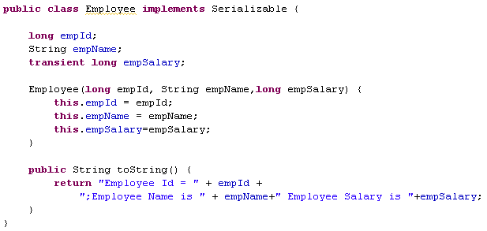
Solution – Serialization
Implement serializable interface
Overriding the toString method to print the employee id , name and employee salary

Slide 12
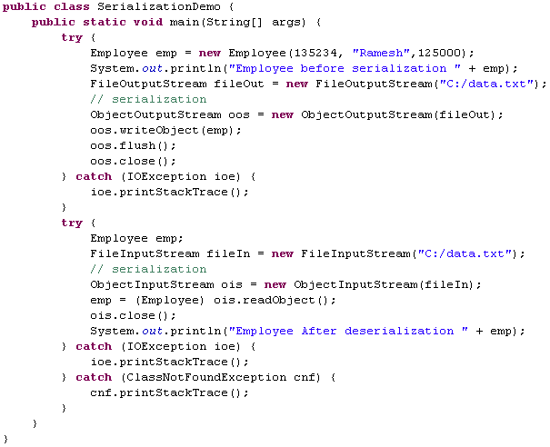
Solution - Serialization
Serializing the Employee Object
De-Serializing the Employee Object

Slide 13
Thank you
You have successfully completed Java IO part - III

