Slide 1


  Core Java
  Introduction to OOPS
LEVEL – PRACTITIONER

Slide 2
Session Objective
  Objective: End of the session you will be able to understand
  About OOPS Concepts.
  What are Objects?
  What are the characteristics of Objects?
  What are classes?

Slide 3
What is a Procedural Language
Procedural programming language helps the programmers to develop applications as series of instructions to achieve the desired functionality.
Disadvantages:
Not easy to maintain for larger applications.
Not Flexible for changes.
Complex to reuse a common programming logic.
Programmers find it complex to understand the program and fix bugs.

Slide 4
What is OOPS?
The disadvantages of procedural language gave birth to Object Oriented Programming Language (OOPs)
Programmers develop application by breaking them into small objects.
Advantages:
The code is easy to maintain as the objects are self contained, cohesive units developed for specific functionalities.
The objects can be reused to perform similar logics.
The system is flexible to change.

Slide 5




What is a Noun
Definition: As a simple definition, a noun is any word that describes a person, place, or thing.
Example: The Man rode a Bike.
Noun

Slide 6
What is a Adjective
Definition: Adjectives are describing words.
Example: The Man rode a Red Bike.
Shape
Color
Adjective
Size
characteristics

Slide 7
What is a verb
Definition: A verb is a word used primarily to indicate a type of action.
Example: The Man rode a Red Bike.
Talk
Sat
Verb
Run
Drink

Slide 8
Analogy to Software World
Translates
Objects
Noun
Nouns in real world translates into objects in software paradigm.

Slide 9
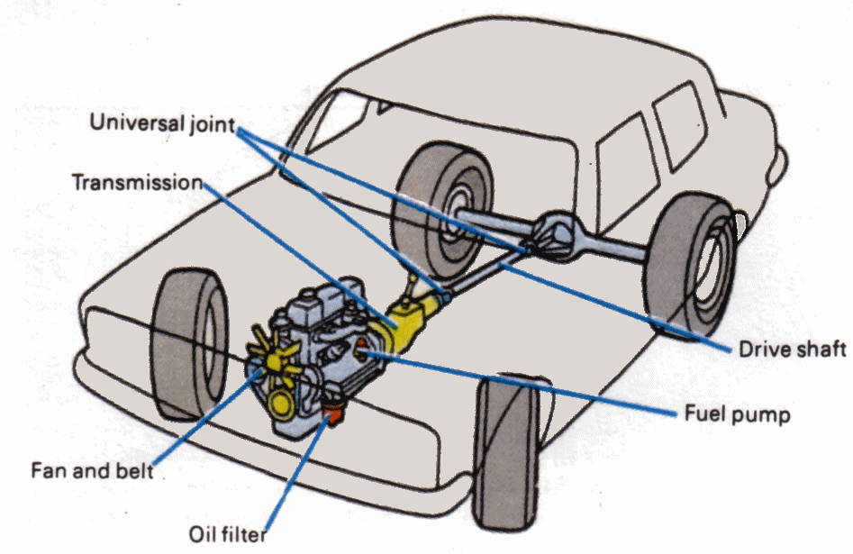
Real World Object System
In real world all the entities are made of smaller objects, for example, a car is manufactured by assembling smaller objects like
Engine
Tyres
Fan
Steering Wheel

Slide 10
Characteristics of Objects.
Objects has two characteristics,
  State – State of the object.
  Behavior – Behavior of the object, it changes the state of the object.
Adjective
Translate into
State
Verb
Translate into
Method

Slide 11
Characteristics of Objects Explained with an example
Taking the car example,
State – The speed of the car, fuel indicator which represents the state of the car.
Behaviour - Operations such as accelerate the speed, start/stop the car and apply brake are behaviours of the car.
The behaviour “accelerate the speed” changes the car’s state “speed”.

Slide 12
Software System
Software system are collection software objects which interoperate to achieve a desired functionality.
What is a Software Object?
Software objects are conceptually similar to real-world objects, they too consist of state and related behavior.

Slide 13
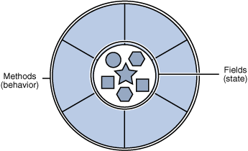
Software Object
Software objects have the same characteristics,
  State - Stored in fields.
  Behavior – Exposed through methods. Methods changes the state of the objects.

Slide 14
A Software Example
Lets take a net banking application where user can,
Check account status.
Check account balance.
Transfer amount.
The system will be represented with a “Account” object.
Account Objects Characteristics:
Methods (Behaviours) | Fields (States)
Check Account Status | Account Status
Transfer Amount Check Account Balance | Account Balance

Slide 15


What is a Class?
What Is a Class?
A class is the blueprint from which individual objects are created.
Class defines the states and behaviour of an object.
The mould here refers to the “Class”, the bottles created out of the mould are “Objects”
Bottles created
From Mould
Bottle Mould
Bottles

Slide 16

Time To Reflect
Associates to reflect the following topics before proceeding.
What is OOPS?
What are Classes?
What are Objects?
What are the characteristics of Objects? Explain with the car example?

Slide 17
OOPS Concepts
The following are the OOPS concepts
Inheritance
Encapsulation
Polymorphism
We will learn about each in the next slides.

Slide 18
Encapsulation
What Is Encapsulation?
  Hiding internal state and requiring all interaction to be performed through an object's methods is known as data encapsulation.

Slide 19
Encapsulation
  Example # 1: The speed of the car is controlled by the method “accelerate speed”
  The state “speed” is hidden from direct access and can be only controlled using the “accelerate speed” method.
Example # 2: In the net banking application the “account balance” is hidden and can be accessed only through the “account transfer “method.

Slide 20
Inheritance
What Is a Inheritance?
Object-oriented programming allows classes to inherit the state and behavior from other classes.
Example:
The father is called the “Super” class and the
son is called the
“Sub”class.
Father
State:
Assets
Car
Behaviour:
exerciseDaily
doWork
Father is the parent class.
Son
Son inherits the assets, car and the behaviour exerciseDaily, doWork from his father

Slide 21
More of Inheritance
The inheriting class contains all the attributes and behaviours of its parent class.
Ideally all the methods which needs to be reused are placed in the parent class
The inheriting class can override the definition of existing methods by providing its own implementation.
Overriding Example:
In the previous example if the son needs to work differently he can override the “doWork” method and provide a different implementation.

Slide 22
Overriding example
Car
  State:
    Speed
    Odometer
  Methods:
    applyBrake()
    startCar()
    Stop(Car()
Assume that the Nissan car the start and stop method is different and BMW the applyBrake is different.
BMW
  Methods:
    applyBrake()
Nissan
  Methods:
    startCar()
    stopCar()
Applybreak method overridden
Start/ stop car method overridden

Slide 23
Polymorphism
What Is a Polymorphism?
The dictionary definition of polymorphism refers to a principle in biology in which an organism or species can have many different forms or stages.

Slide 24
Polymorphism Types
Polymorphism Types:
Method Overloading – Two versions of the same method available in the same class.
Method overriding – Methods of a subclass override the methods of a super class.
Dynamic Method Binding – At run time the intepreter will find out which objects method needs to be executed.

Slide 25

Method Overloading
Method Overloading – Two versions of the same method available in the same class.
This is done by either changing the input parameter or return type.
Lets assume there is a object “Dog” with method “makeSound”. Assume that the dog can make more than one sound based on whether it is normal or injured or other external factor. Now same method will have two implementations
Implementation 1:
makeSound()
{
  Bark woof woof
}
Implementation 2:
makeSound(injured) // Added input parameter, overloaded method.
{
  Make a whining sound.
}

Slide 26
Method Overriding
Method overriding – Methods of a subclass override the methods of a super class.
This is done by redefining the super class method in sub class.
Lets assume there are objects “Truck” & “Car” which extends “Vehicle”.
Vehicle:
applyBreak() { Oil brake }
Car:
// Does not override as car uses oil brake,
Truck: // method overridden as truck needs air brake
applyBreak() { apply air brake }

Slide 27
Dynamic Method Binding
Dynamic Method (or) Late Binding – At run time the interpreter will find out which objects method needs to be executed.
The method being invoked is based on the type of the object and not based on the reference.
Taking the same truck example, based on what objects is created in run time either the oil (or) air brake is applied.
You will learn more about overriding and dynamic binding during the inheritance and interface sessions.

Slide 28
Time To Reflect
Associates to brainstorm and reflect the following topics.
What are the OOPS concepts?
What is Encapsulation? Explain with a example
What is Inheritance? Explain with a example
What is overriding? Explain with a example
What are the types of overriding?

Slide 29

  Core Java
  You have successfully completed -
  Introduction to OOPS

