Slide 1


  Core Java
  Garbage Collection
LEVEL – PRACTITIONER

Slide 2
Objectives
After completing this chapter you will be able to understand:
  JVM runtime memory architecture
  What happens when a object is created?
  What is garbage collection?
  What is memory leaks?
  System.gc() and finalize() methods.

Slide 3
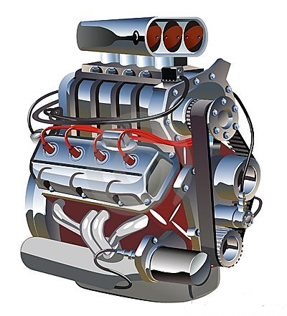
Heart of Java Technology
Java is generally referred to as a “Java Programming Language” for developing applications.
The components which makes Java program run are,
  Java API’s
  Java Class File
  Java Virtual Machine (JVM) – Heart of Java technology.

Slide 4
What are Java API’s?
Java API’s are application interface which the program we develop uses to access system resources.
Example: I/O operations.
System.out.println(“Hello World”);
These access the I/O API to print the hello world message in console.

Slide 5
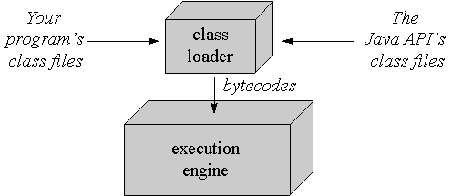
What is Java Virtual Machine ?
Java Virtual Machines is the heart of the java platform. It is a abstract computer which,
Loads class files using class loader
Executes the class file using the execution engine.
HelloWorld.java
System.out.println()
String()
Integer()

Slide 6
How is Java portable?
Java Platform = Java virtual Machine + Java API.
Example: Linux Platform = JVM for Linux + Java API for Linux.
HelloWorld.class
HelloWorld.class
HelloWorld.class
Linux
Windows
Unix
Class Loader
Class Loader
Class Loader
Execution Engine
Execution Engine
Execution Engine
Here the same helloworld.class is developed once and run in three different operating systems. This is possible because of the Java platform which transforms the class file to OS dependent machine code.
So Java is Portable, that is it can be developed once and run anywhere.

Slide 7
How java program runs?
Myclass.java
JAVAC
Myclass.class
Java compiled to Byte Code format.
J
ava
Java command executes the class.
JVM
Class loader
Class loader searches the class from class path and loads the byte code in JVM.
Byte Codes
Execution Engine
The byte code would be interpreted by the engine and transformed into native calls for invocation.
Native method invocation calls
Host Operating System

Slide 8
JVM Runtime memory Areas
Heap:
Shared across threads.
There is only one heap in JVOM.
All the java objects instantiated are stored in this memory area.
Example: String name = new String ();
PC register:
Would be created for each thread.
This holds the next instruction set in the method to be executed.
JAVA RUNTIME ENVIRONMENT
Native Stack:
Stores the state of native method invocations
CLASS LOADER
JVM RUNTIME MEMORY AREAS
Method Area
Heap
PC register
Stack
Native Stack
Method Area:
There is only one method area in a JVM.
Shared across threads.
This holds the class template data such as how many methods, member variables, method description.
The static objects are created inside this memory area.
Stack:
This is created for each method invocation of a thread.
Stores the state of method execution including the local variable values.
Execution Engine

Slide 9
What happens when an object is created ?
Heap Memory
As each class is instantiated a object is created in the heap memory.
circleObj
circleObj1
What happens on execution of the below statement?
Circle circleObj=new Circle();
Circle circleObj1=new Circle();
Square squareObj=new Square();
Box box Obj=new Box();
boxObj
squareObj
NOTE: Since two circle object are instantiated two objects are created in the heap memory.

Slide 10
What happens when values are set to instance variables?
Class Student
{
int a; int b;
}
Student s1 = new Student();
Student s2 = new Student();
s1.setData(1,2);
s2.setData(3,4);
Lets see what happens when this code execution happens?
HEAP
S2
a=0b=0
a=3b=4
a=0
b=0
a=1
b=2
Two student objects are created in heap.
The variables will be defaulted to zero when the objects are created.
When the value are set the appropriate values will be set in the relevant objects.
S1

Slide 11
What happens when two objects are assigned ?
S1
Student s3;
s3=s2;
HEAP
S2
Both the objects S2 and S3 are points to the same object instance (address)
a=3b=4
a=1
b=2
S3

Slide 12

Remove Reference of an Object
What happens when one nullify an object?
s1 = null;
HEAP
S2
What happens to S1?
a=3b=4
a=1
b=2
S3
S1 will be garbage collected.
S1

Slide 13
Garbage Collector Illustration
Open the below attachment to see what is a Garbage Collector
Refer to the “Resources” section of this Session for the attachment “How_Garbage_Collector_Works.swf”

Slide 14
What is Garbage Collection ?
Garbage collection is the process which reclaims the memory allocated by objects which are unreferenced .
Since objects are stored in the heap memory it can be considered as a mechanism to reclaim the heap memory
Garbage collector is a JVM daemon thread which perform the task of garbage collection
An object is a candidate for garbage collection if and only if there is no reference to it.
Any object becoming unreferenced does not mean that it will be immediately garbage collected , it only means that the object is candidate for getting collected in the next garbage collector cycle.
JVM runs the garbage collector based on several predefined algorithms mostly when it is in need of memory

Slide 15
When does an object become a Garbage collected?
An Object becomes eligible for Garbage collection if its not reachable from any live threads or its references is null.
Generally an object becomes eligible for garbage collection in Java on following cases:
1) Reference of that object is explicitly set to null. Example: object = null
2) Object is created inside a block (anything put inside curly braces) and reference becomes null once control exit that block.
Example: if(condition){ String str = new String()}// Once the block is executed the object str will be marked for GC.
3) Parent object set to null, if an object holds reference of another object and when you set container object's reference to null, child or contained object automatically becomes eligible for garbage collection.

Slide 16
System.gc() Method
System.gc or Runtime.getRuntime.gc() methods are used to forcefully run the garbage collector to reclaim memory.
Calling these methods does not guarantee that garbage collector will be immediately run but interrupts the JVM to run the GC.

Slide 17
finalize() method
Before an object is garbage collected, the runtime system invokes the objects finalize() method.
The finalize() can be used to perform clean up activities such as release system file resources (or) close sockets (or) close database connections etc.
The finalize() method is declared in the java.lang.Object class,
Example
protected void finalize(){
//close resource }
Note :It is important to understand that finalize() is only invoked prior to garbage collection. It is not invoked immediately when an object goes out-of-scope. So programmers should provide other means of releasing system resources used by the object. It must not rely on finalize() for normal program operation.

Slide 18
What is Out of memory Error?
Open the below attachment to see Why we get Out of Memory Error
Refer to the “Resources” section of this Session for the attachment “GC_Out_Of_Memory_Error.swf”

Slide 19

What are Memory Leaks?
If an applications continues to eat up heap memory without freeing the unused memory it holds. This leads to Memory Leaks.
Memory Leaks lead to Memory Shortage results in
“Out Of Memory Error”

Slide 20

Time To Reflect
Associates to quickly summarize the following before ending the session
When can we say that any object is eligible for garbage collection?
What happens when there is no memory available in heap?
In which memory area the object gets created?
Which loads the classes in memory?
Which memory holds the methods local variables values?
How can you forcefully run GC?

Slide 21

  Core Java
  You have successfully completed –
  Garbage Collection

