Slide 1
Angular
Modern Web Development

Slide 2
1.Introduction
Need of Angular
2.Components
Components
Templates
3.Directives
Structural directives
What is Angular?
Modules
Attribute directives
4.Data binding
One-way databinding
5.Pipes
Built-in Pipes
Features of Angular
Two-way databinding
Custom Pipes
6.Nested Components
8.Services
Custom Services
9.Routing
Route
Routing Guards
10.Capstone Project
Flight Booking
We Care Application
Data sharing between components
Component Life cycle
7.Forms
Template driven forms
Reactive forms
Custom Validators
Observables
HttpClient
Async Routing

Slide 3
About Angular
Angular is one of the most powerful and performance-efficient JavaScript frameworks to build single-page applications for both web and mobile. The powerful features of Angular allow us to create complex, customizable, modern, responsive, and user-friendly web applications.
Angular follows a component-oriented application design pattern to develop completely reusable and modularized web applications. Popular web platforms like Google Ads, Google Fiber, AdSense have built their user interfaces using Angular.
In this course, you will learn about components, modules, directives, data binding, pipes, HttpClient, Routing, and much more. You will be using Angular CLI to speed up the development process of Angular applications. Angular CLI is a command-line interface tool to scaffold and build Angular applications. Angular CLI offers all best practices right from development till the deployment stage.
Target Audience: Developers

Slide 4
Getting started
Angular

Slide 5
Why Angular?
Angular 1 is a JavaScript framework from Google which was used for the development of web applications.
Following are the reasons to migrate from Angular 1 to the latest version of Angular:
​​​​​​​Cross-Browser Compliant
Internet has evolved significantly from the time Angular 1.x was designed. Creating a web application that is cross-browser compliant was difficult with Angular 1.x framework. Developers had to come up with various workarounds to overcome the issues. Angular helps to create cross-browser compliant applications easily.
Typescript Support
Angular is written in Typescript and allows the user to build applications using Typescript. Typescript is a superset of JavaScript and more powerful language. The use of Typescript in application development improves productivity significantly.

Slide 6
Why Angular?
Web Components Support
Component-based development is pretty much the future of web development. Angular is focused on component-based development. The use of components helps in creating loosely coupled units of application that can be developed, maintained, and tested easily.
Better support for Mobile App Development
Desktop and mobile applications have separate concerns and addressing these concerns using a single framework becomes a challenge. Angular 1 had to address the concerns of a mobile application using additional plugins. However, the Angular framework, addresses the concerns of both mobile as well as desktop applications.
Better performance
The Angular framework is better in its performance in terms of browser rendering, animation, and accessibility across all the components. This is due to the modern approach of handling issues compared to earlier Angular version 1.x.

Slide 7
Single Page Application
A Single Page Application (SPA) is a web application that interacts with the user by dynamically redrawing any part of the UI without requesting an entire new page from the server.
For example, have a look at the Amazon web application. When you click on the various links present in the navbar present in any of the web pages of this application, the whole page gets refreshed. This is because visibly, a new request is sent for the new page for almost each user click. You may hence observe that it is not a SPA.
But, if you look at the Gmail web application, you will observe that all user interactions are being handled without completely refreshing the page.
Modern web applications are generally SPAs. SPAs provide a good user experience by communicating asynchronously (a preferable way of communication) with a remote web server (generally using HTTP protocol) to dynamically check the user inputs or interactions and give constant feedback to the user in case of any errors, or wrongful/invalid user interaction. They are built block-by-block making all the functionalities independent of each other. All desktop apps are SPAs in the sense that only the required area gets changed based on user requests.
Angular helps to create SPAs that will dynamically load contents in a single HTML file, giving the user an illusion that the application is just a single page.

Slide 8
What is Angular?
Angular is an open-source framework written in typescript , to build single page client side applications using HTML and Typescript.
The very first version of angular i.e. AngularJS was built in 2010 and it was known as the "Golden Child" among such Javascript frameworks. It was later completely re written and was introduced as Angular 2, which has been improvised ever since then. In this course, we will follow the latest angular version, i.e. Angular 13.
Developers prefer TypeScript to write Angular code. But other than TypeScript, you can also write code using JavaScript (ES6 or ECMAScript 6)
Why most developers prefer TypeScript for Angular?
TypeScript is Microsoft’s extension for JavaScript which supports object-oriented features and has a strong typing system which enhances the productivity
TypeScript supports many features like annotations, decorators, generics, etc. A very good number of IDE’s like Sublime Text, Visual Studio Code, NodeEclipse, etc., are available with TypeScript support
TypeScript code is compiled to JavaScript code using build tools like npm, bower, gulp, Webpack, etc. to make browser understand the code

Slide 9
Angular JS vs Angular
Now that we know why we should use angular and what is angular? let us see a few differences between the different versions of Angular i.e. AngularJS and Angular 2+, also known as Angular.
Angular JS | Angular
It was the first version of Angular and is popular a name for Angular 1.0 | All the versions released Angular 2 onwards are known as Angular
It is a Javascript based open source front-end web framework. | It is a Typescript based open source full-stack web application framework.
It has a simple syntax and is used on HTML pages along with the source location. | It uses different expression syntax such as '[]' for property binding, and '()' for event binding.
It does not support dynamic loading of pages. | It supports dynamic loading of the page.
Developing complex web apps used to get troublesome using Angular JS | We can create web apps with complex logic with eash using Angular.
Developing mobile compatible applications, required help from other frameworks in Angular JS | It supports development of desktop as well as mobile web applications.

Slide 10
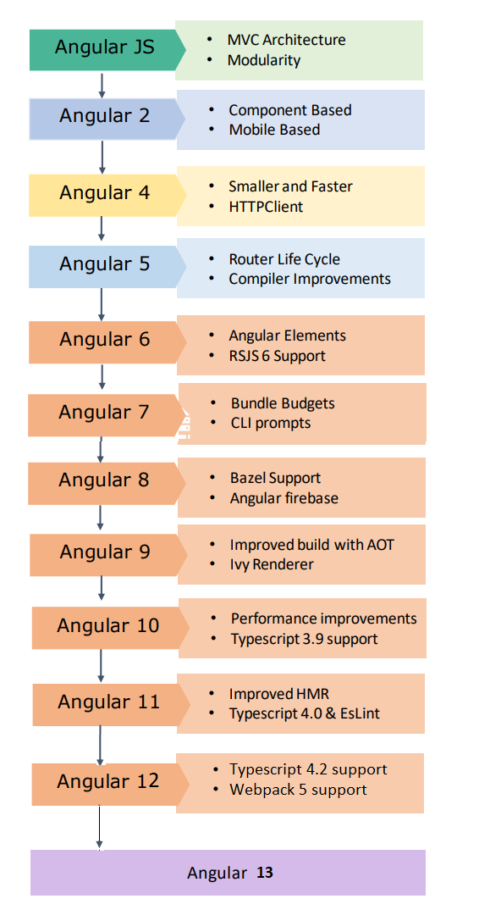
Evolution of Angular Framework
Let us now understand what is Angular and what kind of applications can be built using Angular:
Angular is exclusively used to build Single Page Applications (SPA).
Angular is completely rewritten and is not an upgrade to Angular 1.

Slide 11
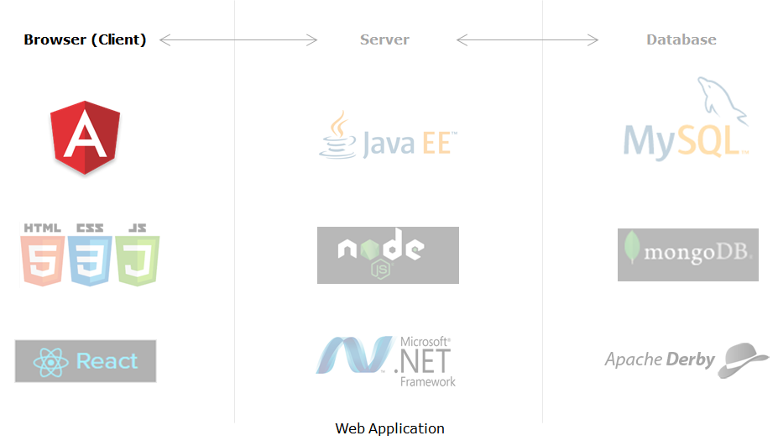
Angular in Web Application Stack
Angular places itself on the client-side in the complete application stack and provides a completely client-side solution for quick application development. Angular has absolutely no dependencies and also jells perfectly with any possible server-side technology like Java, NodeJS, PHP, etc., and any database like MongoDB, MySql.

Slide 12
Case Study
mCart Application

Slide 13
Environment Setup
Angular

Slide 14
Angular Environment Setup
Steps to install Node.js
To check whether the Node is installed or not in your machine, go to the Node command prompt and check the Node version by typing the following command.
node -v
Steps to install the Angular CLI
D:\> npm install -g @angular/cli
D:\> ng v

Slide 15
Angular CLI Important Commands
Angular CLI is a command-line interface tool to build Angular applications. It makes application development faster and easier to maintain.
Using CLI, you can create projects, add files to them, and perform development tasks such as testing, bundling, and deployment of applications.
Command | Purpose
npm install -g @angular/cli | Installs Angular CLI globally
ng new <project name> | Creates a new Angular application
ng serve --open | Builds and runs the application on lite-server and launches a browser
ng generate <name> | Creates a class, component, directive, interface, module, pipe, and service
ng build | Builds the application
ng update @angular/cli @angular/core | Updates Angular to latest version

Slide 16
Creating an Angular Application
Creating an Angular application using Angular CLI
Step 1: Create an application with the name ‘my-dream-app' using the following CLI command
D:\>ng new my-dream-app
Step 2: The above command will display two questions. The first question is as shown below. Typing 'y' will create a routing module file (app-routing.module.ts).
Step 3: The next question is to select the stylesheet to use in the application. Select CSS and press Enter as shown below:
This will create the following folder structure with the dependencies installed inside the node_modules folder.

Slide 17
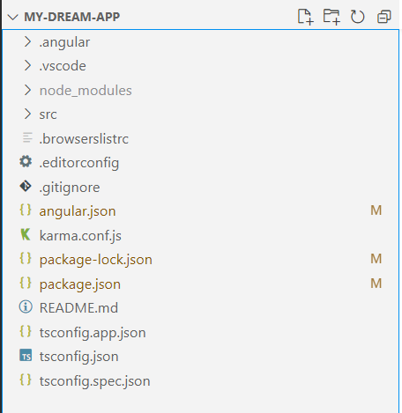
Exploring the Angular folder structure
File / Folder | Purpose
node_modules/ | Node.js creates this folder and puts all npm modules installed as listed in package.json
src/ | All application-related files will be stored inside it
angular.json | Configuration file for Angular CLI where we set several defaults and also configure what files to be included during project build
package.json | This is a node configuration file that contains all dependencies required for Angular
tsconfig.json | This is the Typescript configuration file where we can configure compiler options
.angular | From Angular version 13.0.0, .angular folder is generated in the root. This folder caches the builds and is ignored by git.
Note: If the above command gives errors while installing dependencies, navigate to the project folder in the Node command prompt and run "npm install" to install the dependencies manually.

Slide 18
Creating Components & Modules
Angular

Slide 19
Components
Angular@13

Slide 20
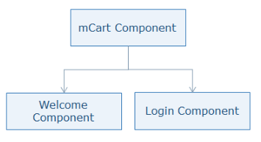
Why Components?
We already know that angular is a component based framework, now there must be a question here that why components ?
Let's take an example the example of our very own shopping app i.e. mCart. If you observe the entire application. you can find a welcome page, Login Page, mobiles page, tablets page, cart page and checkout page.
As we said using Angular, we are going to build a SPA, so does it mean the entire template code has been written in a single file and its entire logic in a single typescript file?
No, definitely not!! That would be a really poor design!! Hence Angular uses Components.
In Angular, Components will help us break the entire application into smaller chunks, keep all the pages and their corresponding business logic separately and load each one of them as and when requested by the user.

Slide 21
What are components?
A component controls a patch of the screen called a view.
You define a component's application logic— i.e. what it does to support the view—inside a class (having a decorator). Components are represented by defining a TypeScript class with properties and methods and using a special decorator that makes them a component. The class interacts with the view through an API of properties and methods.
Components are the basic building blocks of an Angular application. An Angular app is built component-by-component.
A Component is a custom tag (custom HTML tag) with some functionality attached to it.
Components emphasize the separation of concerns and each part of an Angular application can be written independent of one another.
Angular creates, updates, and destroys these components as the user moves through the application. Your app can take action at each moment in this component life-cycle through optional life-cycle hooks.
Angular Components are based on MVVM architecture. Next, we will learn more about MVVM architecture.

Slide 22
MVVM Architecture
MVVM stands for Model, View and ViewModel. It is a software design pattern that increases the readability and maintainability of the code by dividing the code into three sections namely Model, view and ViewModel.
Model:
A Model can be used to define the structure of an entity. If a model for login is to be defined, it should be as follows:
class Login {
userName: string;
password: string;
}
In Angular, Typescript classes or interfaces are used to define the model.
View:
A View is the visual representation of an application. In Angular, View is written in HTML templates. Templates are a part of the component in Angular.
ViewModel:
A ViewModel contains the business logic of the page. View and ViewModel are connected through data binding. That means any change in the ViewModel property will be reflected on View by default. In Angular, ViewModel is written as a Typescript class.
Now that we have understood the MVVM architecture, we will be implementing this architecture while creating an Angular application. Next, let's explore the structure of an angular component.

Slide 23
Component Structure
Open VS Code IDE. Go to the File menu and select the Open Folder option. Select the MyApp folder you have created earlier.
Go to the folder app inside src folder of MyApp, the following files would be present as a part of the root component i.e. AppComponent
app.component.ts - contains the business logic of app component
app.component.html - contains the view of app component that gets rendered when the component loads in browser
app.component.css - contains all the custom styling used for various HTML elements in app component
app.component.spec.ts - test cases for the app component should be written in this file

Slide 24
Modules
Angular@13

Slide 25
Why Modules?
We saw how we break the angular application into small chunks using components. This helps us keep a single feature per component and load that feature as and when needed.
But even though we have divided the app into components, still all of them are grouped together under the same module i.e. the root module, known as AppModule.
For example, Consider mCart application, where the products related components, cart and checkout components are supposed to be rendered only after the user is logged in. In such case, even though we do not need those components during the initial load of the application, still those components will be bundled and loaded during the initial load of the application. Hence, it will consume more time and affect the performance of the application.
This leads us to different issues while we use the angular app such as:
As all the components are present together as a part of App Module, it usually gets difficult to maintain and debug the application.
Even though some of the components are not required immediately, it still compiles and loads all the components during the initial load of the application
Modules can help us solve such issues. Using Modules in angular we can group the related components together and load each one of them whenever we want

Slide 26
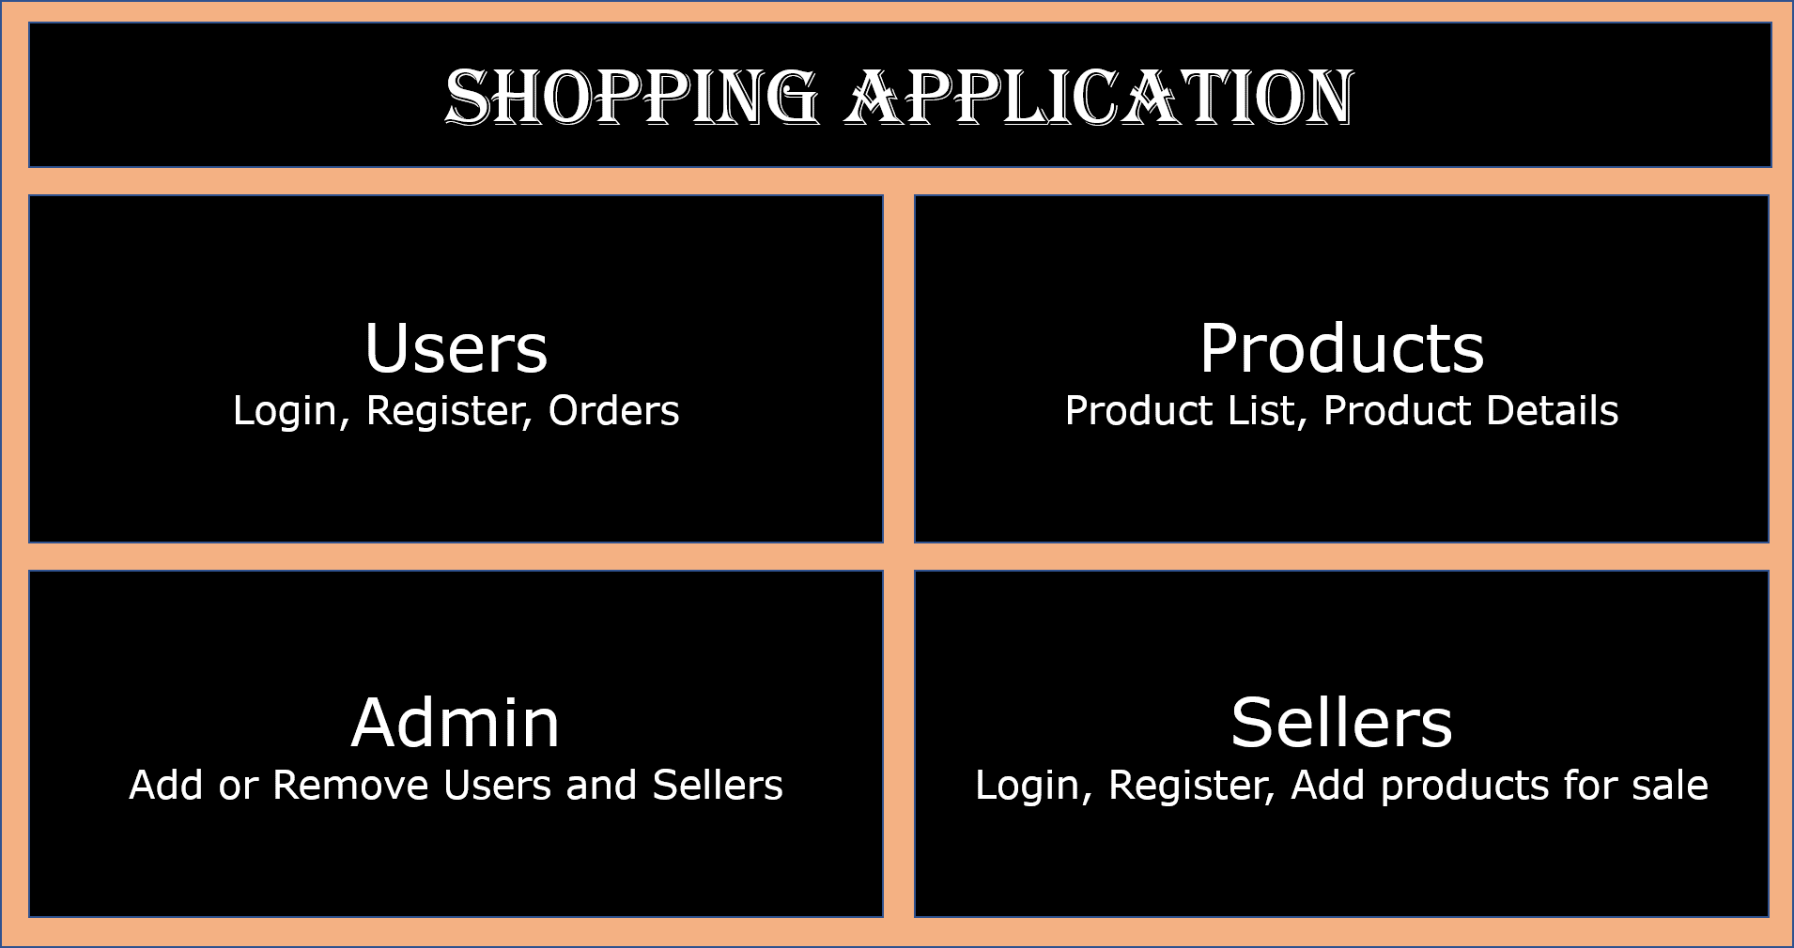
What are Modules?
Modules are used as a mechanism to group a set of components, directives, pipes and services that are related to a particular domain of our angular application.
For Example, In an Online Shopping Application, We might have different domains within the applications as shown below:
Now, under each domain, you might create different components, directives, pipes and services to achieve the set of requirements.
For example, In Users Domain, you may have components, directives, pipes and services for User Registration, User Login, User Profile, and User Orders.
The group of all these components, directives, pipes and services for Users domain and every other domain is called as a Module.
Irrespective of all these Modules for different domains of the application, every angular application will have at least one module known as AppModule
A module in angular is just another class with @NgModule decorator.
Now that We have understood what are modules. Let us go ahead and explore more about modules.

Slide 27
Module Configuration
To Understand further about modules and it's configurations in an angular application. Let us analyze the code of the root module i.e. AppModule
Root Module
In app.module.ts file placed under app folder, we have the following code:
import { NgModule } from '@angular/core';
import { BrowserModule } from '@angular/platform-browser';
import { AppRoutingModule } from './app-routing.module';
import { AppComponent } from './app.component';
@NgModule({
declarations: [
AppComponent
],
imports: [
BrowserModule,
AppRoutingModule
],
providers: [],
bootstrap: [AppComponent]
})
export class AppModule { }

Slide 28
Templates
Angular

Slide 29
Introduction to Templates
Templates separate the view layer from the rest of the framework.
You can change the view layer without breaking the application.
Templates in Angular represents a view and its role is to display data and change the data whenever an event occurs
The default language for templates is HTML
Creating a template
Template can be defined in two ways:
Inline Template
External Template

Slide 30

Inline Template
You can create an inline template in a component class itself using the template property of the @Component decorator.
app.component.ts
Line 4-7: You can even write HTML code inside the component using the template property. Use backtick character (`) for multi-line strings.
import { Component } from '@angular/core’;
@Component({
selector: 'app-root',
template: `
<h1> Welcome to {{title | uppercase}} </h1>
<h2> Course Name: {{courseName}} </h2>
`,
styleUrls: ['./app.component.css']
})
export class AppComponent {
courseName = 'Angular';
title = 'my-dream-app';
}

Slide 31
External Template
By default, Angular CLI uses the external template.
It binds the external template with a component using templateUrl option.
Example
app.component.html
<h1> Welcome to {{title | uppercase}} </h1>
<h2> Course Name: {{ courseName }}</h2>
app.component.ts
import { Component } from '@angular/core';
@Component({
selector: 'app-root',
templateUrl: './app.component.html',
styleUrls: ['./app.component.css']
})
export class AppComponent {
courseName = 'Angular';
title = 'my-dream-app';
}
Line 4: templateUrl property is used to bind an external template file with the component
Output

Slide 32
Elements of Template
The basic elements of template syntax:
HTML
Interpolation
Template Expressions
Template Statements
HTML
Angular uses HTML as a template language. In the below example, the template contains pure HTML code.
Interpolation
Interpolation is one of the forms of data binding where component’s data can be accessed in a template. For interpolation, double curly braces {{ }} is used.

Slide 33
Expressions & Statement
Template Expressions
The text inside {{ }} is called as template expression.
{{ courseName }}
Angular first evaluates the expression and returns the result as a string. The scope of a template expression is a component instance.
That means, if you write {{ courseName }}, courseName should be the property of the component to which this template is bound.
Template Statement
Template Statements are the statements that respond to a user event.
(event) = statement
For example (click) = "changeName()"
This is called event binding. In Angular, all events should be placed in ( ).

Slide 34


Hands-on Elements of Template
app.component.ts
export class AppComponent {
courseName = 'Angular';
title = 'my-dream-app';
changeName() {
this.courseName = "TypeScript";
}
}
Line 4-6: changeName is a method of AppComponent class where you are changing courseName property value to "TypeScript"
app.component.html
<h1> Welcome to {{title | uppercase}} </h1>
<h2> Course Name: {{ courseName }}</h2>
<p (click)="changeName()">Click Here to Change</p>
Line 3: changeName() method is bound to click event which will be invoked on click of a paragraph at run time. This is called event binding.

Slide 35
Change Detection
How does Angular detect the changes and update the application at the respective places?
Angular uses its change detection mechanism to detect the changes and update the application at the respective places. Angular applications run faster than Angular 1.x applications due to the improved change detection mechanism.
What is the change detection mechanism, and how it helps to run Angular applications so fast?
Change Detection is a process in Angular that keeps views in sync with the models.
In Angular, the flow is unidirectional from top to bottom in a component tree. A change in a web application can be caused by events, Ajax calls, and timers which are all asynchronous.
Who informs Angular about the changes?
Zones inform Angular about the changes in the application. It automatically detects all asynchronous actions at run time in the application.

Slide 36
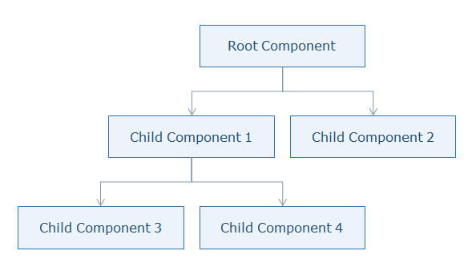
What happens when a change is detected?
What does Angular do when a change is detected?
Angular runs a change detector algorithm on each component from top to bottom in the component tree. This change detector algorithm is automatically generated at run time which will check and update the changes at appropriate places in the component tree.
Angular is very fast though it goes through all components from top to bottom for every single event as it generates VM-friendly code. Due to this, Angular can perform hundreds of thousands of checks in a few milliseconds.

Slide 37
Directives
Angular

Slide 38
Directives
Now that you are familiar with the concept of templates, let us now understand directives in Angular.
Directives are used to change the behavior of components or elements. It can be used in the form of HTML attributes.
You can create directives using classes attached with @Directive decorator which adds metadata to the class.
Why Directives?
It modify the DOM elements
It creates reusable and independent code
It is used to create custom elements to implement the required functionality

Slide 39
Types of Directives
There are three types of directives available in Angular
Components
Components are directives with a template or view.
@Component decorator is actually @Directive with templates
Types of Directives
Components
Structural Directives
Attribute Directives

Slide 40
Structural Directives
A Structural directive changes the DOM layout by adding and removing DOM elements.
*directive-name = "expression"
Angular has few built-in structural directives such as:
ngIf
ngFor
ngSwitch
ngIf directive renders components or elements conditionally based on whether or not an expression is true or false.
Syntax:
*ngIf = "expression"
ngIf directive removes the element from the DOM tree.

Slide 41
Definite assertion (!) for variables
Angular CLI creates all new workspaces and projects with strict mode enabled. This leads to an improved compile time check for properties. If any property is not initialized either by providing a default value or by initializing within the constructor or if a parameter is not mapped to a property, the below error gets generated:
property <<property>> has no initializer and is not definitely assigned in the constructor.
username!: string;
This is known as a definite assignment error because there is no definite assignment for that property. The correct fix to this is to assign the property with a value in the constructor. An alternate is to permit the property with no definite assignment by using the definite assignment assertion. You can do that by adding ! to the property name.
the above code doesn't have a value initialized and hence the use of !.

Slide 42
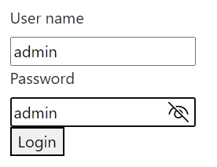
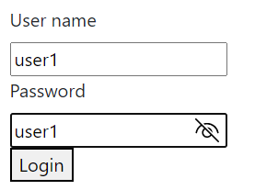


Hands-on ngIf
app.component.ts
app.component.html
import { Component } from '@angular/core';
@Component({
selector: 'app-root',
templateUrl: './app.component.html',
styleUrls: ['./app.component.css']
})
export class AppComponent {
isAuthenticated!: boolean;
submitted: boolean = false;
username!: string;
onsubmit(name: string, pwd: string) {
this.submitted = true;
this.username = name;
if(this.username === 'admin' && pwd === 'admin') {
this.isAuthenticated = true;
} else {
this.isAuthenticated = false;
}
}
}
<div class="login" *ngIf="!submitted">
<form>
<label for="uname">User name</label><br>
<input type="text" #username> <br>
<label for="pwd">Password</label> <br>
<input type="password" #password> <br>
</form>
<button (click)="onsubmit(username.value, password.value)">Login</button>
</div>
<div class="resp" *ngIf="submitted">
<div class="" *ngIf="isAuthenticated; else failure">
<h4>Welcome back to, {{username}} </h4>
</div>
<ng-template #failure>
<h3 style="color: red;">Invalid Login! Try again.</h3>
</ng-template>
<button (click)="submitted=false">Back</button>
</div>

Slide 43
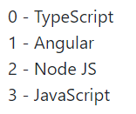
ngFor Directive
ngFor directive is used to iterate over-collection of data i.e., arrays
Syntax:
*ngFor = "expression"
app.component.ts - Line 2-7: Creating an array of objects
app.component.html - Line 3: ngFor iterates over courses array and displays the value of name property of each course. It also stores the index of each item in a variable called i
Line 4: {{ i }} displays the index of each course and course.name displays the name property value of each course
app.component.ts
app.component.html
export class AppComponent {
courses: any[] = [
{ id: 1, name: "TypeScript" },
{ id: 2, name: "Angular" },
{ id: 3, name: "Node JS" },
{ id: 4, name: "JavaScript" }
];
}
<div class="list">
<ul style="list-style-type: none;">
<li *ngFor="let course of courses; let i=index">
{{i}} - {{course.name}}
</li>
</ul>
</div>

Slide 44
ngSwitch directive
ngSwitch adds or removes DOM trees when their expressions match the switch expression. Its syntax is comprised of two directives, an attribute directive, and a structural directive.
It is very similar to a switch statement in JavaScript and other programming languages.
app.component.ts
export class AppComponent {
choice = 0;
nextChoice() {
this.choice++;
}
}
Line 2: Creates a choice property and initializes it to zero
Line 3-5: nextChoice() increments the choice when invoked
app.component.html
<div [ngSwitch]="choice">
<p *ngSwitchCase="1">First Choice</p>
<p *ngSwitchCase="2">Second Choice</p>
<p *ngSwitchCase="3">Third Choice</p>
<p *ngSwitchCase="2">Second Choice Again</p>
<p *ngSwitchDefault>Default Choice</p>
</div>
Line 1: ngSwitch takes the value and based upon the value inside the choice property, it executes *ngSwitchCase. Paragraph elements will be added/removed from the DOM based on the value passed to the switch case.

Slide 45
Hands-on ngSwitch directive
app.component.html
<h4>
Current choice is {{ choice }}
</h4>
<div [ngSwitch]="choice">
<p *ngSwitchCase="1">First Choice</p>
<p *ngSwitchCase="2">Second Choice</p>
<p *ngSwitchCase="3">Third Choice</p>
<p *ngSwitchCase="2">Second Choice Again</p>
<p *ngSwitchDefault>Default Choice</p>
</div>
<div>
<button (click)="nextChoice()">Next Choice</button>
</div>

Slide 46
Custom Structural Directive
You can create custom structural directives when there is no built-in directive available for the required functionality. For example, when you want to manipulate the DOM in a particular way which is different from how the built-in structural directives manipulate.
Generate a directive called 'repeat' using the following command
ng generate directive repeat
create repeat.directive.ts file and add the following code
import { Directive, Input, TemplateRef, ViewContainerRef } from '@angular/core’;
..
@Directive({
selector: '[appRepeat]'
})
export class RepeatDirective {
constructor(private tempRef: TemplateRef<any>, private vcRef: ViewContainerRef) {
}
@Input() set appRepeat(count: number) {
for(let i=0; i < count; i++) {
this.vcRef.createEmbeddedView(this.tempRef);
}
}
}

Slide 47
Custom structural directive
Line 3: Annotate the class with @Directive which represents the class as a directive and specify the selector name inside brackets
Line 7: Create a constructor and inject two classes called TemplateRef which acquires <ng-template> content and another class called ViewcontainerRef which access the HTML container to add or remove elements from it
Line 9: Create a setter method for an appRepeat directive by attaching @Input() decorator which specifies that this directive will receive value from the component. This method takes the number passed to the appRepeat directive as an argument.
Line 11: As we need to render the elements based on the number passed to the appRepeat directive, run a for loop in which pass the template reference to a createEmbeddedView method which renders the elements into the DOM. This structural directive creates an embedded view from the Angular generated <ng-template> and inserts that view in a view container.

Slide 48
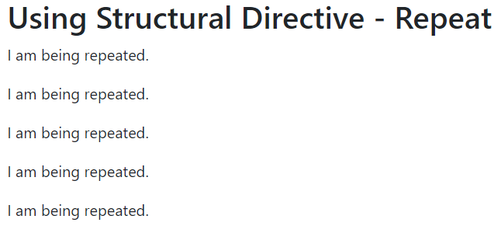
Explore the custom directive
app.component.html
<h2>Using Structural Directive - Repeat</h2>
<p *appRepeat="5">
I am being repeated.
</p>
Line 2: appRepeat directive is applied to the paragraph element. It will render five paragraph elements into the DOM.
Output:

Slide 49
Custom structural directive – exportAs property
exportAs property is used to define a name for a directive using which you can access directive class properties and methods in a component template.
exportAs property can be applied to components and directives

Slide 50
Attribute Directives
Attribute directives change the appearance/behavior of a component/element.
Following are built-in attribute directives:
ngStyle
ngClass

Slide 51

style binding
This directive is used to modify a component/element’s style. You can use the following syntax to set a single CSS style to the element which is also known as style binding
[style.<cssproperty>] = "value"
Example:
app.component.ts
...
export class AppComponent {
colorName = 'yellow';
color = 'red’;
}
Line 3-4: colorName and color properties are initialized to default values
app.component.html
<div [style.background-color]="colorName" [style.color]="color">
Uses fixed yellow background
</div>
Line 1: style.background-color will set the background-color of the text to yellow and style.color directive will set the color of the text to red.

Slide 52

ngStyle
If there are more than one CSS styles to apply, you can use ngStyle attribute.
app.component.ts
...
export class AppComponent {
colorName = 'red';
fontWeight = 'bold';
borderStyle = '1px solid black';
}
Line3-5: Create three properties called colorName, fontWeight and borderStyle and initialize them with some default values
app.component.html
<p [ngStyle]="{
color:colorName,
'font-weight':fontWeight,
borderBottom: borderStyle
}">
Demo for attribute directive ngStyle
</p>
Line 1-5: ngStyle directive is used here to set multiple CSS styles for the given text

Slide 53
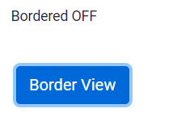
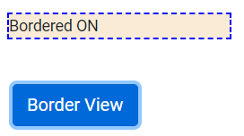
class binding
It allows you to dynamically set and change the CSS classes for a given DOM element. Use the following syntax to set a single CSS class to the element which is also known as class binding.
[class.<css_class_name>] = "property/value"
app.component.ts
...
export class AppComponent {
isBordered = true;
}
Line 3: Create a Boolean property called isBordered and initialize it to true
app.component.html
<div [class.bordered]="isBordered">
Bordered {{isBordered ? "ON" : "OFF"}}
</div>
<button class="btn btn-primary" (click)="isBordered=!isBordered">
Border View
</button>
Line 1: Bind the isBordered property with the CSS class bordered. Bordered CSS class will be applied only if isBordered property evaluates to true.
In app.component.css, add the following CSS class
.bordered {
border: 2px dashed blue;
background-color: antiquewhite;
}

Slide 54
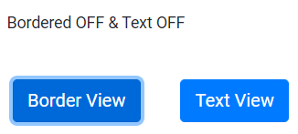
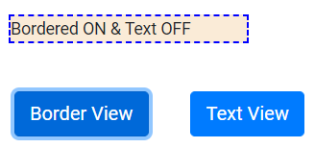
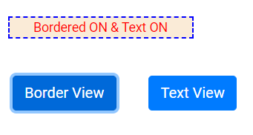
ngClass
If you have more than one CSS classes to apply, then you can go for ngClass syntax.
[ngClass] = "{css_class_name1 : Boolean expression, css_class_name2: Boolean expression, ……}"
app.component.ts
...
export class AppComponent {
isBordered = true;
isColor = true;
}
Line 3-4: Two Boolean properties called isBordered and isColor are initialized to true
app.component.html
<div [ngClass]="{bordered: isBordered, txt: isText}">
Bordered {{isBordered ? " ON" : " OFF"}} & Text {{isText ? " ON":" OFF"}}
</div>
<button class="btn btn-primary" (click)="isBordered=!isBordered">
Border View
</button>
<button class="btn btn-primary" (click)="isText=!isText">
Text View
</button>
Line 1: Two CSS classes called bordered and color are applied to a div tag. Both the classes are binded with isBordered and isColor properties where the CSS classes will be applied to div tag only if the properties return true
Add the following CSS classes in app.component.css
.bordered {
border: 2px dashed blue;
background-color: antiquewhite;
}
.txt {
color: red;
text-align: center;
}

Slide 55
Custom Attribute Directive

Slide 56
Data binding
Angular

Slide 57
Why Data Binding?
While developing any web application, we will always need to display data dynamically because there must be some properties in the Component class for which the values will change probably due to any of the following reasons:
invoking a function that alter the value
some data coming from the server which gets assigned to the property
based on some calculations performed in the business logic
Now, as we can only display the template to the user, hence there must be some way to communicate the property values to the Template i.e. HTML page. This is where Data Binding comes into play as it is responsible for this communication.
As we know that angular is based on MVVM architecture, one must ensure that data is synchronized between models and views. This is done using Data Binding in angular. Data binding has been a part of Angular since AngularJS to the latest Angular version i.e. Angular 10.

Slide 58
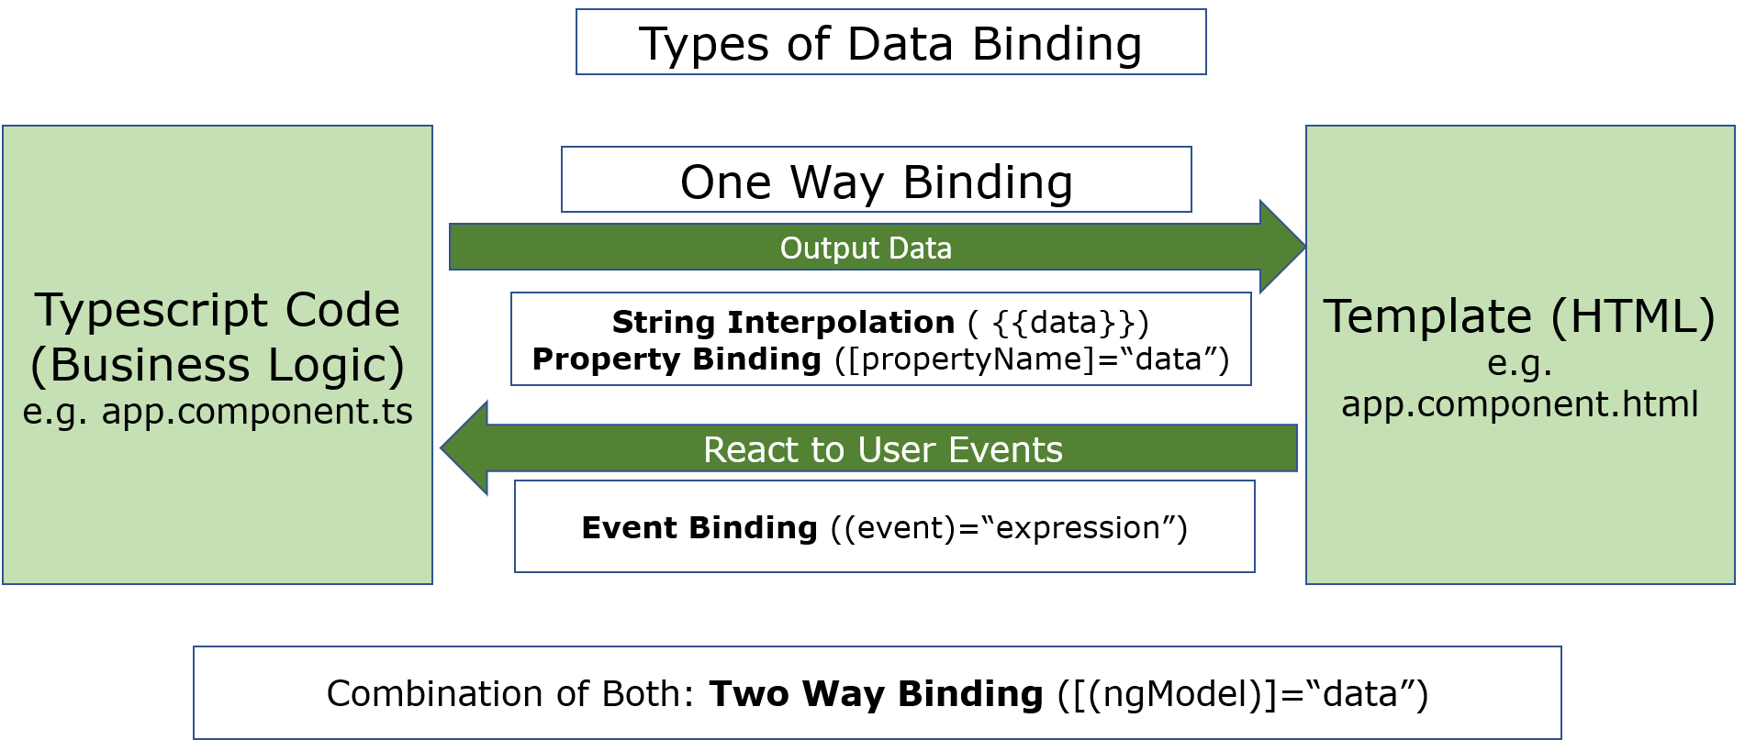
Understanding Data Binding
In simple words, we can understand data binding as a communication. A communication that happens between the Typescript Code of the component i.e. Business Logic and the template i.e what the user sees in the screen.
As a developer, we need to declare bindings between binding sources and HTML target elements. Using Data Binding, users can manipulate the elements present on the website using the Browser.
Types of Data Binding:
Angular provides us different ways for the communication between the Component Class and its Template. The following diagram demonstrates the different types of data binding in angular

Slide 59
Types of Data Binding
One Way Data Binding allows either updating the view using the model or updating the model through view whereas Two Way Data Binding allows us to synchronize the data both ways.
Binding types other than interpolation have a target name to the left side of equal sign surrounded by [ ] or ( ) or preceded by a prefix (bind-, on-, bindon-)
The target of data binding can be an (element or component or directive) property, an (element or component or directive) event, or rarely an attribute name.
Data Direction | Syntax | Data Binding Type
One-way (class → view) | {{ expression }} [target] = “expression” bind-target = “expression” | Interpolation Property Attribute Class Style
One-way (view → class) | (target) = “statement” on-target = “statement” | Event
Two-way | [(target)] = “expression” Bindon-target = “expression” | Two way

Slide 60
Property Binding

Slide 61
Attribute Binding

Slide 62
Class Binding

Slide 63
Style Binding

Slide 64
Event Binding

Slide 65
Two-way Binding

Slide 66
Pipes
Angular

Slide 67
Introduction to Pipes
Pipes are used to format the data before displaying it to the user. A pipe takes data as input and transforms it into the desired output.
Syntax:
{{ expression | pipe }}
Example:
{{ "Technology" | uppercase }}
This will display TECHNOLOGY
Following table displays the built-in pipes available:
Built-in Pipes
uppercase | lowercase | titlecase
currency | date | percent
slice | decimal | json
I18nplural | i18nselect

Slide 68
Custom Pipes
We have explored built-in pipes so far. But if we want to implement functionalities such as sorting, filtering, etc., we should go for custom pipes as there are no corresponding built-in pipes available
We can create our own custom pipe by inheriting PipeTransform interface
PipeTransform interface has a transform() method where we need to write custom pipe functionality
Syntax:
@Pipe({
name: 'pipename'
})
export class classname implements PipeTransform {
transform(value: any, ...args:any[]): any {
}
}
transform() method has two arguments, first one is the value of the expression passed to the pipe and the second is a variable "arguments". We can have multiple arguments based on the number of parameters passed to the pipe. The transform method should return the final value.

Slide 69
Nested Components
Angular

Slide 70
Nesting of Component
Nested component is a component that is loaded into another component
The component where another component is loaded onto is called a container component/parent component.
The root component is loaded in the index.html page using its selector name. Similarly, to load one component into a parent component, use the selector name of the component in the template i.e., the HTML page of the container component

Slide 71
Services
Angular

Slide 72
Dependency Injection
Dependency Injection (DI) is a mechanism where the required resources will be injected into the code automatically.
Angular comes with an in-built dependency injection subsystem.
Why Dependency Injection?
It is because DI:
allows developers to reuse the code across applications.
makes the code loosely coupled.
makes application development and testing much easier.
allows the developer to ask for the dependencies from Angular. There is no need for the developer to explicitly create/instantiate them.

Slide 73
Services
A service in Angular is a class that contains some functionality that can be reused across the application. A service is a singleton object. Angular services are a mechanism of abstracting shared code and functionality throughout the application.
Angular Services come as objects which are wired together using dependency injection.
Angular provides a few inbuilt services also can create custom services.
Why Services?
Services can be used to:
share the code across components of an application.
make HTTP requests.
Creating a Service
To create a service class, use the following command:
ng generate service book
The above command will create a service class as shown below:
@Injectable({
providedIn:'root'
})
export class BookService
{
}
@Injectable() decorator makes the class injectable into application components.

Slide 74
RxJS – Observable and Operators
Angular

Slide 75
What is RxJS?
Reactive Extensions for JavaScript (RxJS) is a third-party library used by the Angular team.
RxJS is a reactive streams library used to work with asynchronous streams of data.
Observables, in RxJS, are used to represent asynchronous streams of data. Observables are a more advanced version of Promises in JavaScript

Slide 76
Forms
Angular

Slide 77
Introduction to Forms in Angular
Forms are crucial part of web applications. Forms enable users to provide data input into the application in contexts like performing user registration, user sign-in, updating profile, entering sensitive information like payment information and for performing other data-entry based tasks.
Forms in Angular:
Angular has two different approaches in dealing with forms: reactive forms and template-driven forms.
Both reactive forms and template-driven forms:
can capture user-provided data,
can capture user input events,
can validate the user input, etc.
have their own approaches of processing and managing the form data:
In template-driven forms, you will create the form completely in the template and need to rely on directives to create and manipulate the underlying form object model. Since the template-driven forms do not scale that well, they are more suitable only when you want to add a simple small form to the application. For example: a signup form.
In reactive forms, you can control the form completely from the component class and hence you will get direct, explicit access to the underlying forms object model. Hence, reactive forms are also known as 'model-driven forms'. As reactive forms are more robust and scalable, they are more suitable for creating all kind of forms in an application, irrespective of the size of form.

Slide 78
State of forms and form controls in Angular
Angular automatically tracks the changes happening to the form and form controls as and when user provides input and thereby controls the state and the validity of the form/form controls. Angular does this by associating respective keywords automatically for the forms/form controls depending on the context. The below table describes the details:
State detected for the form control | Context | Keyword associated by Angular
valid | Element value is valid | valid. The keyword becomes true if element is valid.
invalid | Element value is invalid | invalid. The keyword becomes true if element is invalid
dirty | Element value is changed | dirty. The keyword becomes true if element is dirty
pristine | Element value is unchanged | pristine. The keyword becomes true if element is pristine
touched | Element gets focus | touched. The keyword becomes true if element is touched
untouched | Element doesn't have a focus in it | untouched. The keyword becomes true if element is untouched

Slide 79
State of forms and form controls in Angular
Angular also has the following built-in CSS classes which get auto-applied depending on the state. Code can be written inside these CSS classes which can change the appearance of the control suitably as per context.
CSS Class | Purpose
ng-valid | Applied if control's value is valid
ng-invalid | Applied if control's value is invalid
ng-dirty | Applied if control's value is changed
ng-pristine | Applied if control's value is not changed
ng-touched | Applied if control is touched/gets focus
ng-untouched | Applied if control is not touched/doesn't get focus

Slide 80
Advantages of Reactive Forms
Following are the advantages of Reactive Forms/Model Driven Forms:
Unit testing(using the Jasmine framework) on the validation logic can be performed, as it is written inside the component class.
Form changes or events can be heard easily using reactive forms. Each FormGroup or FormControl has few events like valueChanges, statusChanges, etc., which can be subscribed to.
Reactive forms are used in creating medium to large scale applications
Due to the advantages of Reactive forms, in most Angular applications, Reactive Forms Approach is chosen when creating forms.

Slide 81
Creating Reactive Forms in Angular
Step 1: To create a reactive form in Angular, FormBuilder class must be used. To make the FormBuilder class available, ReactiveFormsModule has to be imported in the root module.
Register the ReactiveFormsModule during bootstrapping, in the app.module.ts
import { ReactiveFormsModule } from '@angular/forms’;
import { AppComponent } from './app.component';
import { RegFormComponent } from './reg-form/reg-form.component’;
@NgModule({
declarations: [ AppComponent, RegFormComponent ],
imports: [
BrowserModule,
ReactiveFormsModule,
BrowserAnimationsModule
],
Line 1: Import ReactiveFormsModule from @angular/forms module
Line 8: Add ReactiveFormsModule in the imports declaration to create reactive forms
Step 2: Create a component called RegistrationForm using the following CLI command
ng generate component reg-form - -skipTests=true
Step 3: Add the below to app.component.html
<app-registration-form></app-registration-form>

Slide 82
Building Reactive Forms (Angular v13)
Add the following code in the reg-form.component.ts file

Slide 83
Routing
Angular

Slide 84
Introduction to Routing
Routing means navigation between multiple views on a single page.
Routing allows to express some aspects of the application's state in the URL. The full application can be built without changing the URL.
Why Routing?
Routing allows to:
Navigate between the views
Create modular applications

Slide 85
Configuring Router
Angular uses Component Router to implement routing
A <base> tag must be added to the head tag in the HTML page to tell the router where to start with.
<base href="/">
Angular component router belongs to @angular/router module. To make use of routing, you should import Routes, RouterModule classes.
RouterModule.forRoot() method should be used when the routes are being configured in the root module of the app.
The use of these methods creates a singleton instance of the Router class, which is responsible for managing the routes.
You need to configure the routes and the router will look for a corresponding route when a browser URL changes. Routes is an array which contains all the route configurations. Then you need to pass this array to the RouterModule.forRoot() function in the application bootstrapping function.

Slide 86
Configure app-routing.module.ts
You can move the routes declaration into a separate new module called app-routing.module.ts file.
import { NgModule } from '@angular/core';
import { RouterModule, Routes } from '@angular/router';
const routes: Routes = [
{path: 'dashboard', component: DashboardComponent},
{path: '', redirectTo: '/dashboard', pathMatch: 'full'},
{path: 'books', component: BookComponent},
{path: 'detail/:id', component: BookDetailComponent},
{path: '**', component: PageNotFoundComponent}
];
@NgModule({
imports: [RouterModule.forRoot(routes)],
exports: [RouterModule]
})
export class AppRoutingModule { }

Slide 87
app-routing.module.ts
Line 2: Imports Routes and RouterModule classes
Line 4-8: Configure the routes where each route should contain the path to navigate and the component class has to be invoked for a specific path.
Line 4: A route configuration must be provided for the default path i.e., path:'' and redirect it to the specific route using redirectTo option. pathMatch is required if redirectTo option is used which specifies how the given path should match. Here pathMatch: 'full' tells Router to match the given path completely. pathMatch has another value called 'prefix' where it checks if the path begins with the given prefix.
Line 7: The path 'detail/:id' has the route parameter id which will receive different values for the paramter 'id' based on the book selected, as part of the route itself.
Line 8: A route configuration must be provided for the wildcard route '**'. When users attempt to navigate to a route which may not be existing in your application, the application should be in a position to handle this gravefully. This can be done by configuring a wildcard route. The Angular router will automatically select this route when the requested URL doesn't match any of the other router paths.
Line 11: Pass the appRoutes array to forRoot method of RouterModule class to configure with the Router and add it to the imports property

Slide 88
Configure app.module.ts
Now configure the Router module with NgModule that imports in app.module.ts to make it available to the entire application
import { AppRoutingModule } from './app-routing.module';
@NgModule({
declarations: [AppComponent, DashboardComponent, BookComponent, BookDetailComponent,
PageNotFoundComponent ],
imports: [ BrowserModule, AppRoutingModule ],
providers: [],
bootstrap: [AppComponent]
})
export class AppModule { }
Line 1: Imports AppRoutingModule from routing module file
Line 5: Add AppRoutingModule class to the imports property

Slide 89
Navigate using Angular Router
After configuring the routes, the next step is to decide how to navigate. Navigation will happen based on user actions like clicking a hyperlink, clicking on a button, etc. Hence, there is hyperlink based navigation and programmatical navigation.

Slide 90
Hyperlink based navigation
RouterLink directive can be used with the anchor tag for using hyperlink based navigation in Angular. Have a look at code shown below:
app.component.ts

Slide 91
Testing using Jasmine
Angular

